Slide 1
Kobe Bryant Shot Selection
By: Connor Gibb

Slide 2

Problem Background
Kobe Bryant, a basketball legend, played 20 NBA seasons and took over 30,000 shots. Can we predict whether each shot was made or missed based on the shot's context and characteristics?

Slide 3
Feature Engineering
Distance ~ using x and y coordinates
Home or Away ~ Seeing if the matchup contained “vs” or “at”
Angle of Shot
First two and last two seasons
Period into factor
Clutch Time

Slide 4
Logistic Regression
Naive Bayes
Random Forest
Pros: Easy to interpret, faster to train, works well when data is linearly separable.
Cons: Assumes linearity, struggles with non-linear relationships and interactions unless manually specified.
Pros: Fast, requires little memory, easy to interpret.
Cons: Struggles with correlations between features, may underperform in complex relationships.
Pros: Handles non-linear relationships, robust to overfitting (if tuned properly), handles missing data well, performs well with complex datasets.
Cons: Less interpretable, requires more computational resources, slower to train compared to Naive Bayes or Logistic Regression.

Slide 5
Random Forest
Decision Trees: Reducing RMSE
Random Forests: Multiple Decision Trees using Bootstrap Sampling.
Bootstrap sampling reduces variance and overfitting
Final Prediction: Majority voting among all trees

Slide 6
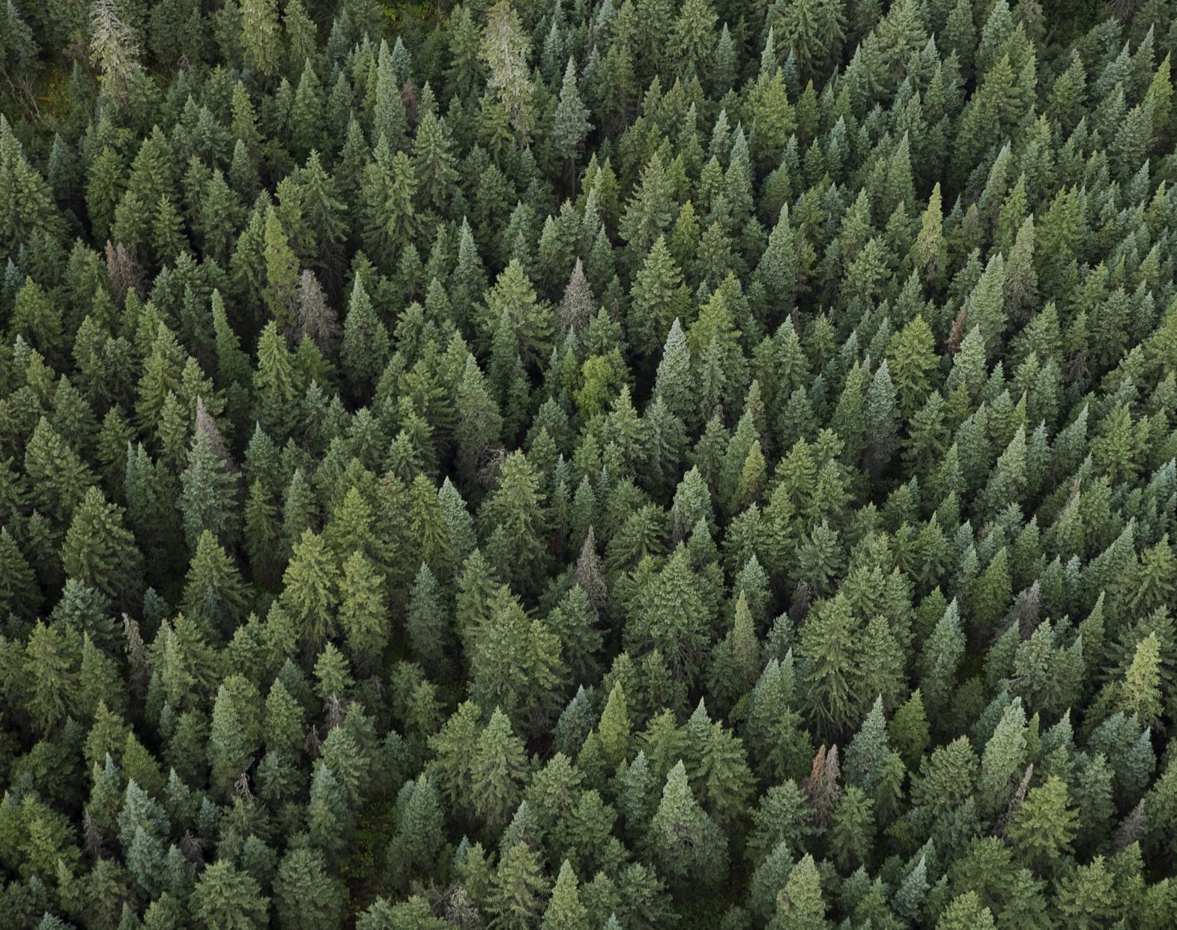
Best Model: Random Forest
Random Forest was the best model producing a score of .59981

