Slide 1
Country in Crisis: Relationship Between Legal Opioid Sales and Opioid Deaths by U.S. Region
Blue Team: Aren Durham, Chris Gilbert, Ileri Onabanjo, Rodney Mosquito, Suzanne Polk

Slide 2
Introduction
Our team is interested in gaining a better understanding of the current epidemic of opioid related deaths in the US
We WILL visualize current trends regarding overdose deaths by region and the UNITED STATES as a whole
We INTEND TO see if there is a relationship between prescription rates and opioid deaths

Slide 3
Questions
Does there exist a relationship between opioid deaths and opioid prescription rates in the U.S.?
Which regions claim the most deaths?
Which region prescribes the most opioids?
What are the odds of dying from an opioid-related event?

Slide 4
Statistical Data Summary
- Prescription Rates are per 100 people
- Population and Deaths are actual

Slide 5
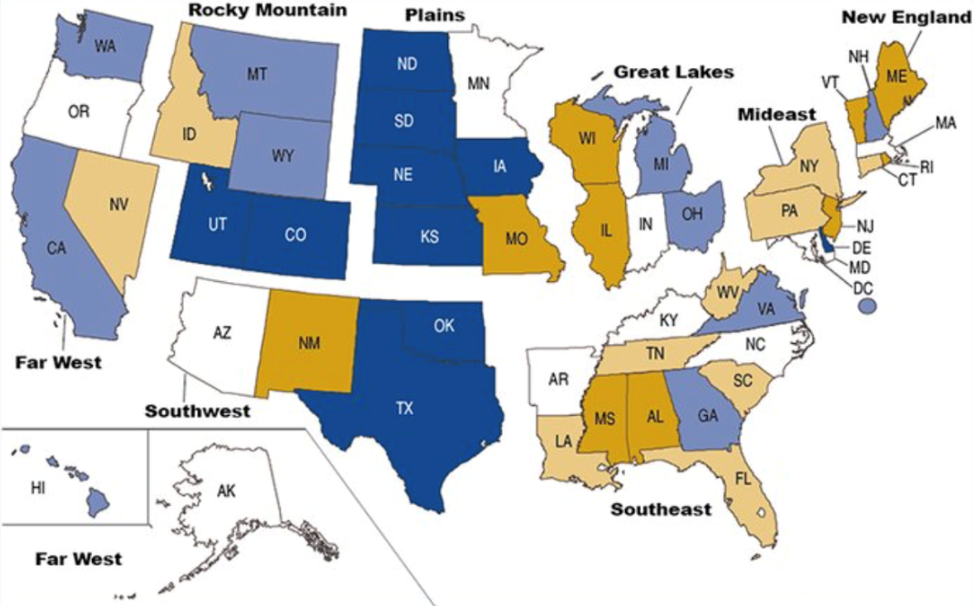
Region Map
Source: U.S. Bureau of Economic Analysis

Slide 6
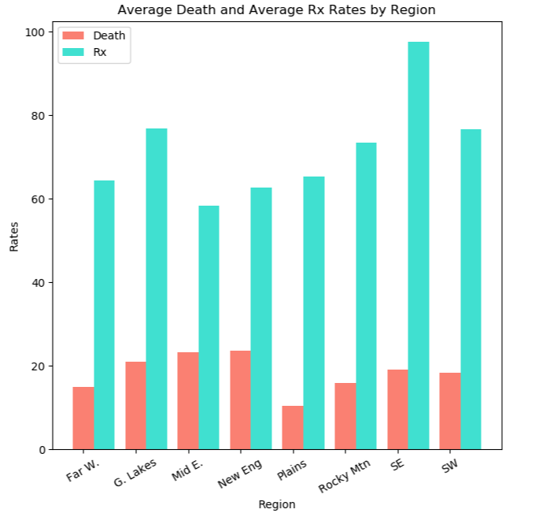
Average Rx and Deaths by Region
Prescription data is based on the average number of opioid prescriptions written between 2013 and 2017 per 100 people in the region
Deaths is based on the average number of deaths between 2013 and 2017 per 100,000 people in the region

Slide 7
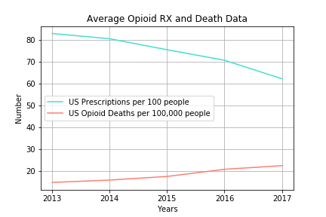
Opioid Deaths vs Prescriptions – U.S.
Top 5 Rx – 2017
Alabama - 107.2
Arkansas - 105.4
Tennessee - 94.4
Mississippi - 92.9
Louisiana - 89.5
Top 5 Deaths – 2017
(Total Deaths)
Pennsylvania - 5,388
Ohio - 5,111
Florida - 5,088
California - 4,868
New York - 3,921
Top 5 Deaths – 2017
(Deaths per 100,000)
West Virginia - 53.64
Wash DC - 44.67
Ohio - 43.84
Pensylvania - 42.08
Maryland - 37.13

Slide 8
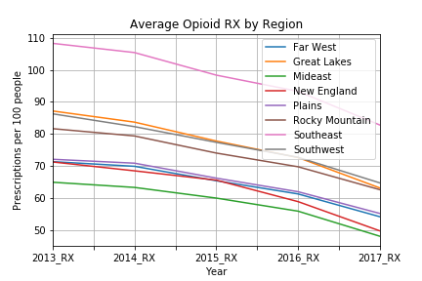
Regional Prescriptions - 2013 to 2017

Slide 9
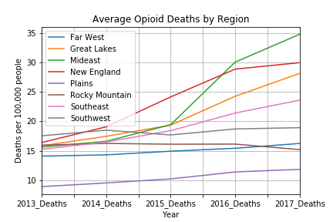
Regional Opioid Deaths - 2013 to 2017

Slide 10
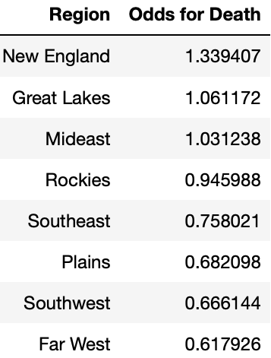
Odds Ratios Total Opioid Deaths in the U.S. from 2013 to 2017

Slide 11

Questions Answered
Does there exist a relationship between opioid deaths and opioid prescription rates in the U.S.?
Based on the data that we have, we could not complete an accurate inferential analysis. However, we were able to run descriptive analysis showing trends both regionally and nationally.
Which regions claim the most deaths?
Mideast, New England, Great Lakes
Which region prescribes the most opioids?
Southeast
What are the odds of dying from an opioid-related event?
Highest – New England (1.34), Great Lakes (1.06)
Lowest – Far West (.62)

Slide 12

Questions for the team?

Slide 13
Thank you!

Slide 14
Data sources
U.S Bureau of Economic Analysis: Regional breakdown
CDC: data related to opioid prescriptions and opioid deaths
US Census Bureau: US population data by state

Slide 15
Implications and Limitations
Normalized deaths rates to per 100,000 people in the population as some regions contained larger or more states than others. Prescription rates were already normalized to per 100 persons from data sources.
Believed categorizing by region would better explain the relationship between death rates and prescription rates.
The statistics (variance) of this data set are extremely high
The data set only covered a 5-year period

Slide 16
Additional questions we could ask
We would need to look for additional data sets in order to perform inferential analysis
Does mental health affect opioid deaths
Do economic conditions affect opioid deaths
Does a state’s laws regarding medicinal/recreational marijuana affect the number of opioid prescriptions and/or opioid related deaths

Slide 17
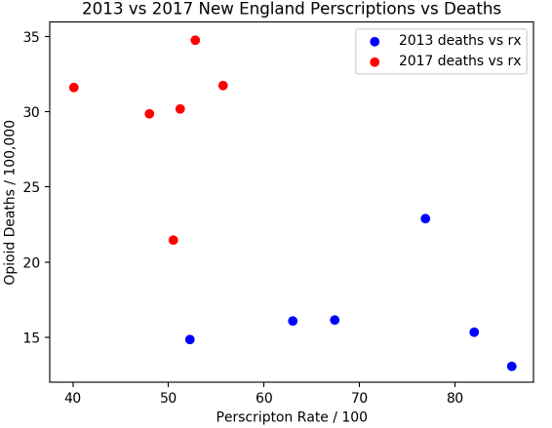
New England Scatterplot

Slide 18
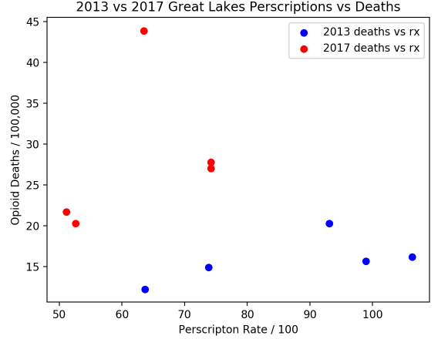
Great Lakes Scatterplot

Slide 19
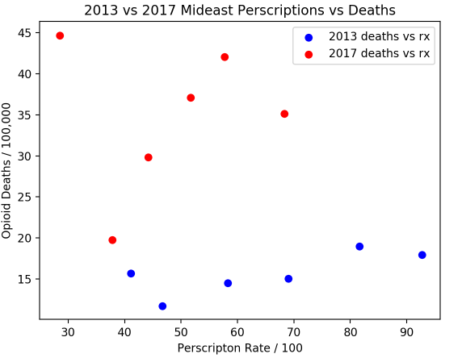
Mideast Scatterplot

Slide 20
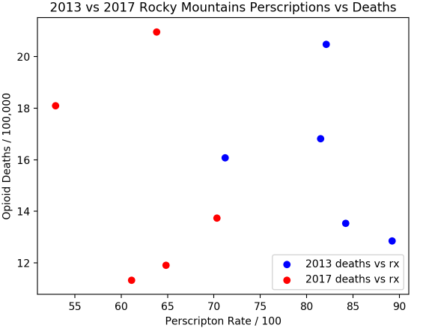
Rocky Mountains Scatterplot

Slide 21
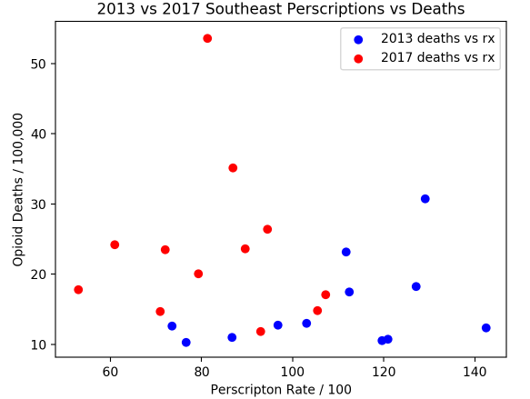
Southeast Scatterplot

Slide 22
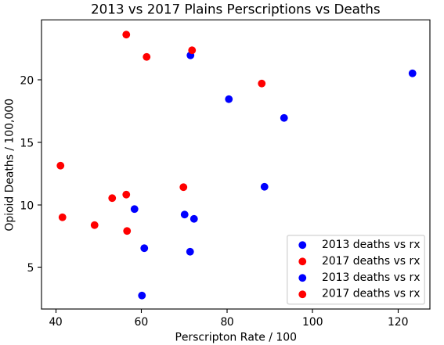
Plains Scatterplot

Slide 23
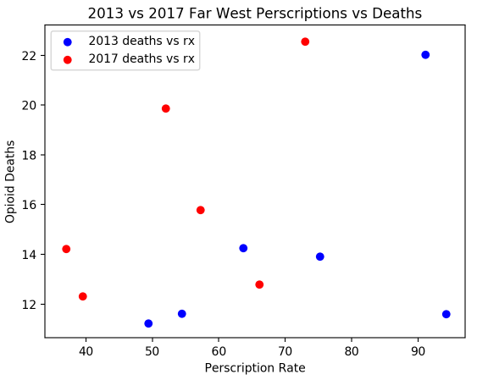
Far West Scatterplot

