Slide 1
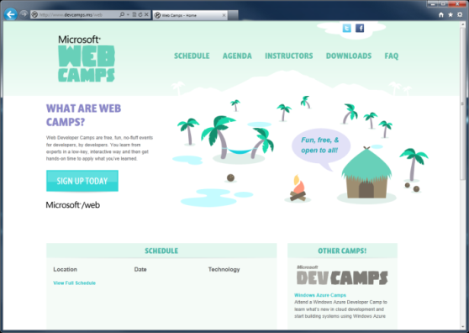

WebCamps Online
Twitter: Follow @webcamps Hashtag #devcamps
[Speaker] / [Twitter]
Website: http://www.devcamps.ms/web
What are web camps?
Web Developer Camps are free, fun, no-fluff events for developers, by developers. You learn from experts in a low-key, interactive way and then get hands-on time to apply what you’ve learned.

Slide 2
Housekeeping notes
Wireless information:

Slide 3
Web Camps Keynote
[Speaker]
[Company]

Slide 4
Agenda
What’s new in ASP.NET 4.5
Building and deploying websites with ASP.NET MVC 4
Creating HTML5 Applications with jQuery
Building a service layer with ASP.NET Web API
Leveraging ASP.NET dev skills to build apps for Office
Building for the mobile web
Real-time communications with SignalR
Using Cloud Application Services

Slide 5
Welcome | 8:30am | 9:00am
What's new in ASP.NET 4.5 | 9:00am | 9:30am
Building and deploying websites with ASP.NET MVC 4 | 9:30am | 10:30am
Break | 10:30am | 10:45am
Creating HTML5 Applications with jQuery | 10:45am | 11:45am
Lunch | 11:45am | 12:45pm
Building a service layer with ASP.NET Web API | 12:45pm | 1:15pm
Leveraging your ASP.NET development skills to build Office Apps | 1:15pm | 1:45pm
Building and leveraging social services in ASP.NET | 1:45pm | 2:15pm
Break | 2:15pm | 2:30pm
Building for the mobile web | 2:30pm | 3:00pm
Realtime communications with SignalR | 3:00pm | 3:30pm
Break | 3:30pm | 3:45pm
Using Cloud Application Services | 3:45pm | 4:45pm
Wrap Up | 4:45pm | 5:00pm

Slide 6
The foundation: tools & frameworks
Visual Studio
Windows Azure
NuGet
ASP.NET

Slide 7


Visual Studio 2012: The editor for serious web dev
HTML5 / CSS3 standards and smarts
JavaScript language features
Page Inspector
One code editor for client and server
Web Essentials extension

Slide 8

NuGet: The smart, easy way to manage dependencies
Find the latest release
Install and configure in your project
Handle dependencies and versions
Updates with dependency checking
Common list of installed packages
Simplified uninstalls
Streamlined deployment with Package Restore

Slide 9
ASP.NET: A Framework For All
HTML
XML
JSON
Web Forms
Razor View Engine
Code
Web Pages
MVC
MVC 4
Web API
ASP.NET Core
Self Host
Modules
Handlers
Membership
Intrinsics
Caching
Etc.

Slide 10
ASP.NET and Web Tools 2012.2 RC
Just adds new project templates
No changes to .NET or ASP.NET runtime
Lightweight install (5 minutes, no reboot)
Download and information: http://asp.net/vnext

Slide 11

Deploying ASP.NET Apps to the Cloud
Windows Azure Web Sites (10 free!)
Fast site creation and deployment
Nothing new to learn
Easy to scale

Slide 12
Windows Azure signup
demo…
http://aka.ms/webcamps-azure

Slide 13
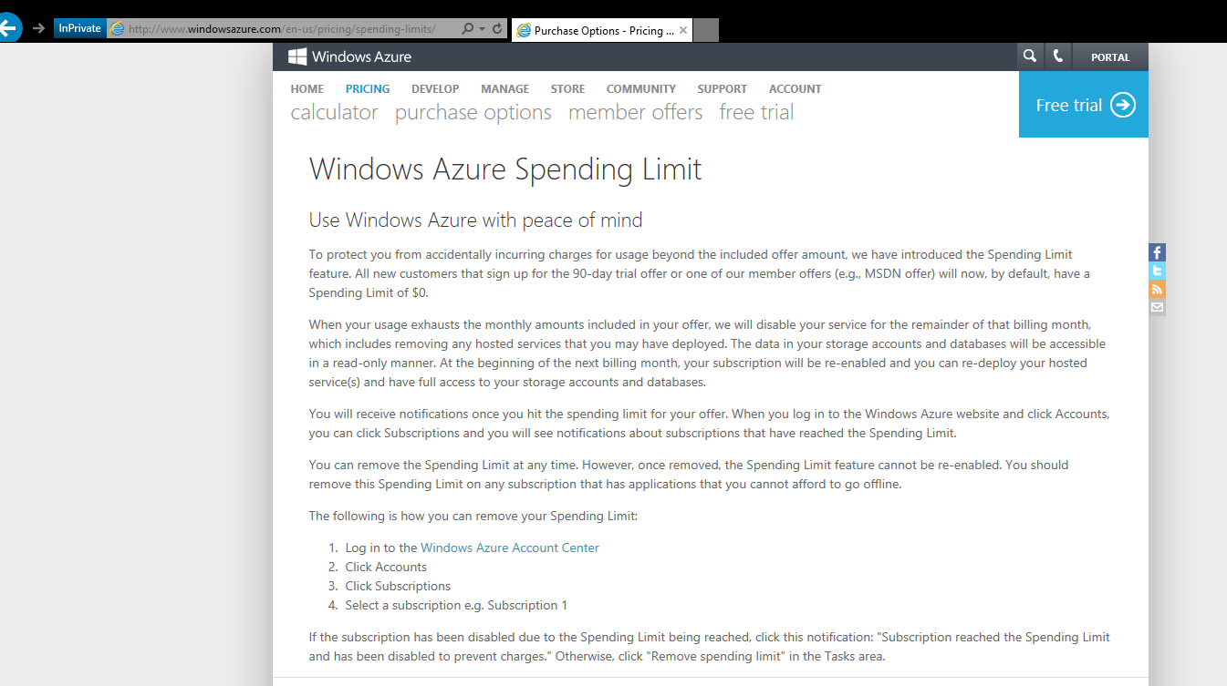

Slide 14
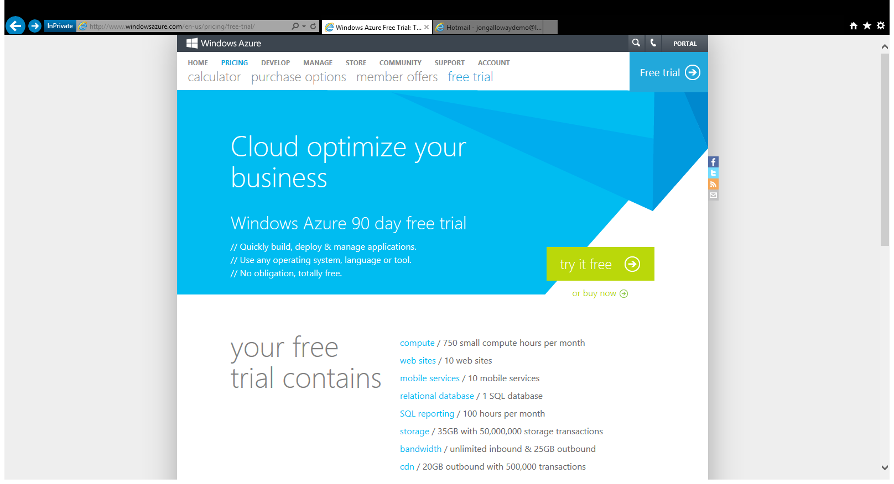

Slide 15
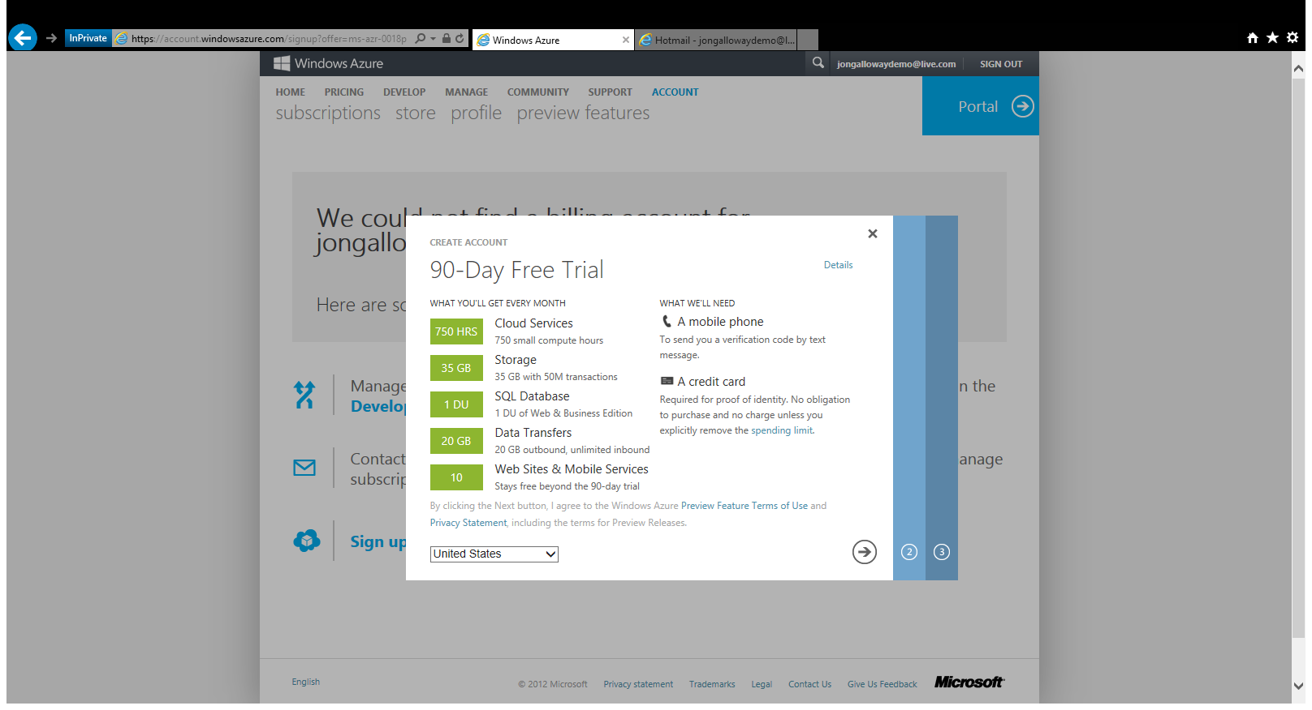

Slide 16
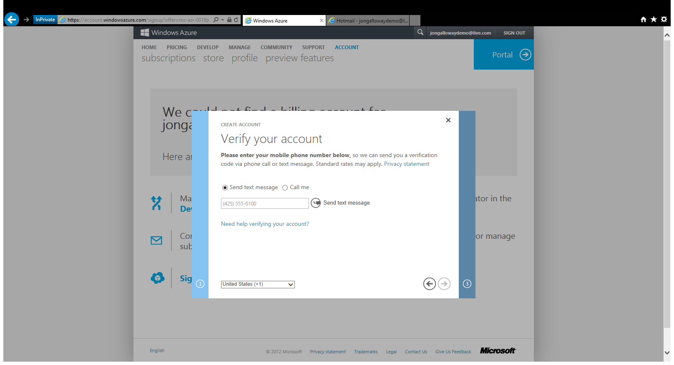

Slide 17
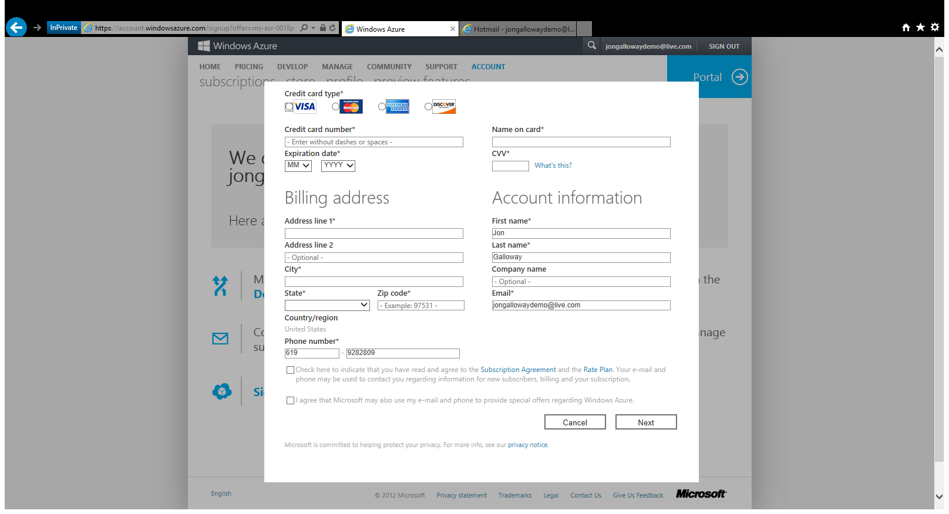

Slide 18
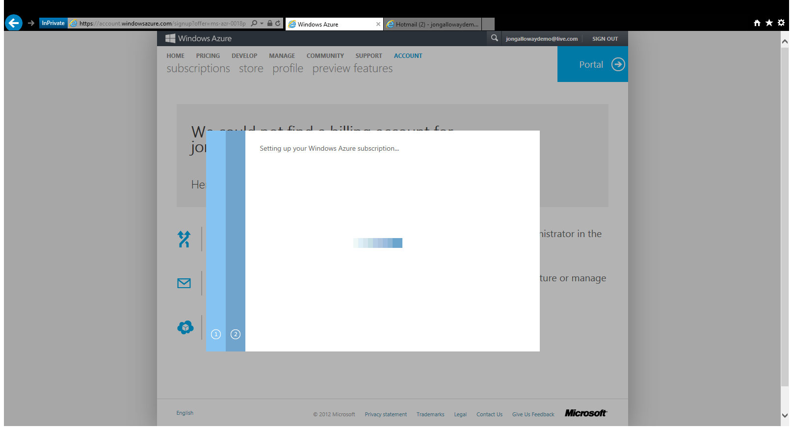

Slide 19
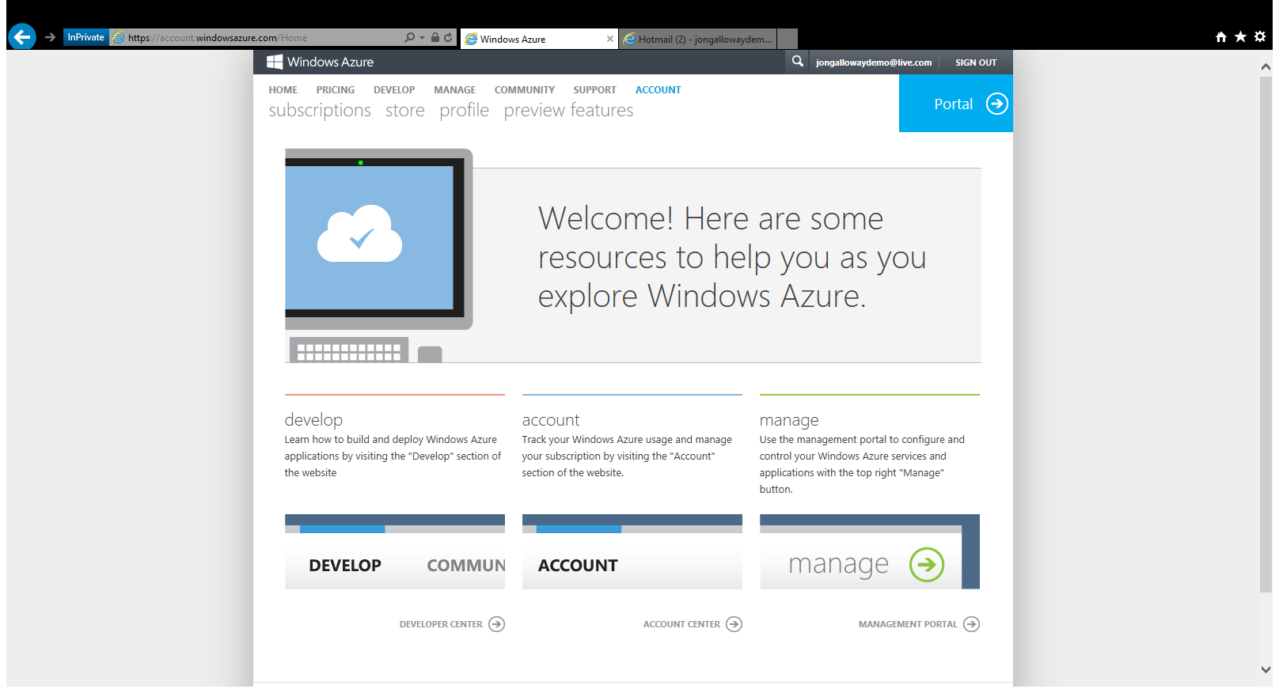

Slide 20
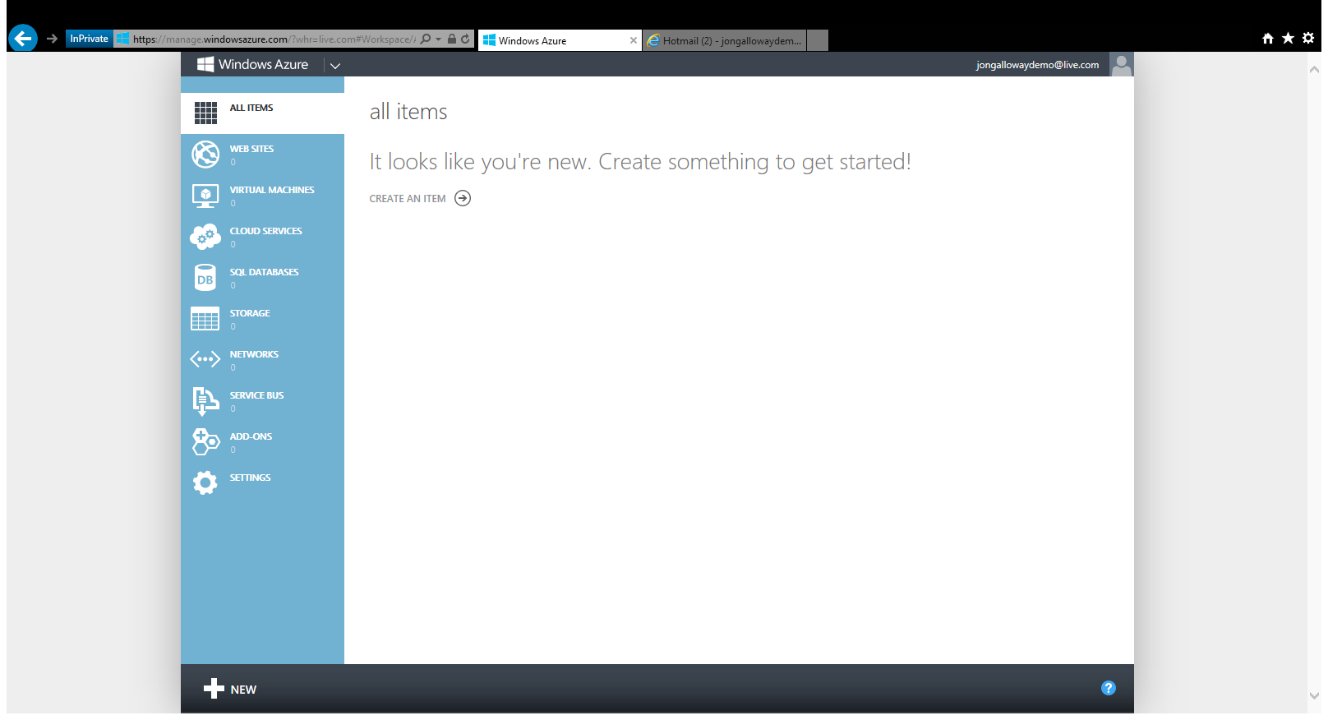

Slide 21
The foundation: tools & frameworks
Visual Studio
Windows Azure
NuGet
ASP.NET

Slide 22
Taking it further: key scenarios
HTML5
HTTP Services
Apps for Office
Realtime
Mobile
Social Apps
Visual Studio
Windows Azure
NuGet
ASP.NET

Slide 23
Resources
Feedback and questions http://asp.net
http://asp.net/vnext
http://www.devcamps.ms/web
http://windowsazure.com
http://aka.ms/webcamps-training-kit
http://aka.ms/webcamps-azure (free trial)

