Slide 1
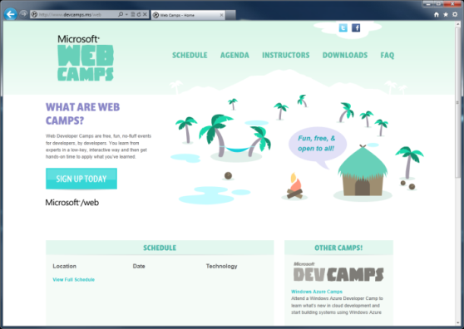

WebCamps Online
Twitter: Follow @webcamps Hashtag #devamps
[Speaker] / [Twitter]
Website: http://www.devcamps.ms/web
What are web camps?
Web Developer Camps are free, fun, no-fluff events for developers, by developers. You learn from experts in a low-key, interactive way and then get hands-on time to apply what you’ve learned.

Slide 2
Building and Deploying Websites with ASP.NET MVC 4
[Speaker]
[Company]

Slide 3
Agenda
Introduction to ASP.NET MVC
Creating a new ASP.NET MVC site
Adding a model / controller / view
Entity Framework Code First
Deploying to Windows Azure Web Sites
Entity Framework Migrations

Slide 4
MVC is Another Alternative in the Stack
XML
HTML
JSON
Web Forms
Razor View Engine
Code
Web Pages
MVC
MVC 4
Web API
ASP.NET Core
Self Host
Modules
Handlers
Membership
Intrinsics
Caching
Etc.

Slide 5
How MVC Works
What does MVC look like?
Request
Controller
Controller
Retrieves Model
“Does Stuff”
Response
View
View
Visually represents
the model

Slide 6
Creating a new ASP.NET MVC 4 Application
demo…

Slide 7
Adding a model, controller, view
demo…

Slide 8
Entity Framework Code First
demo…

Slide 9
Deploying to Windows Azure Web Sites
demo…

Slide 10
Entity Framework Migrations
demo…

