Slide 1
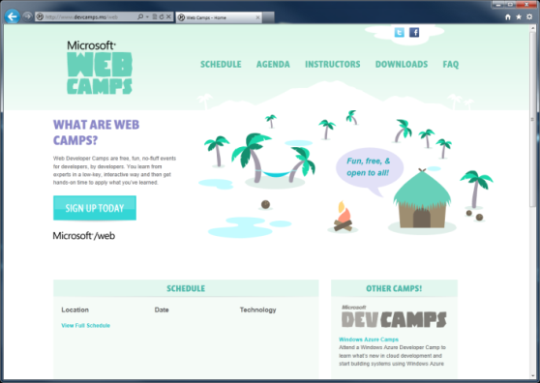

WebCamps Online
Twitter: Follow @webcamps Hashtag #devcamps
[Speaker] / [Twitter]
Website: http://www.devcamps.ms/web
What are web camps?
Web Developer Camps are free, fun, no-fluff events for developers, by developers. You learn from experts in a low-key, interactive way and then get hands-on time to apply what you’ve learned.

Slide 2



Windows Azure & apps for Office and SharePoint
[Speaker]
[Company]

Slide 3
Agenda
Introduction to the new Cloud App Model
HTML5 + jQuery = New app for Office
Adding in ASP.NET Web API
Developer resources

Slide 4
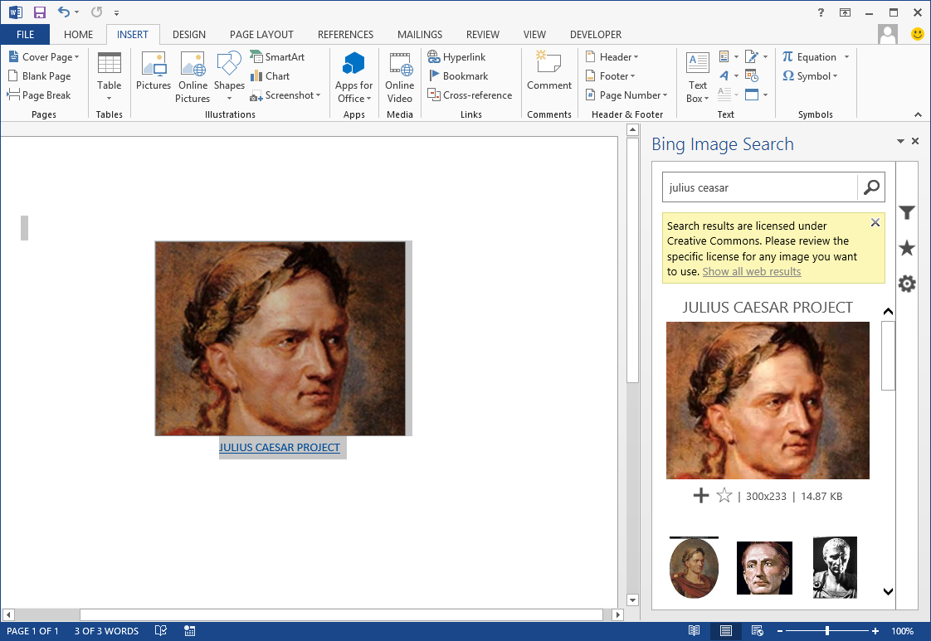
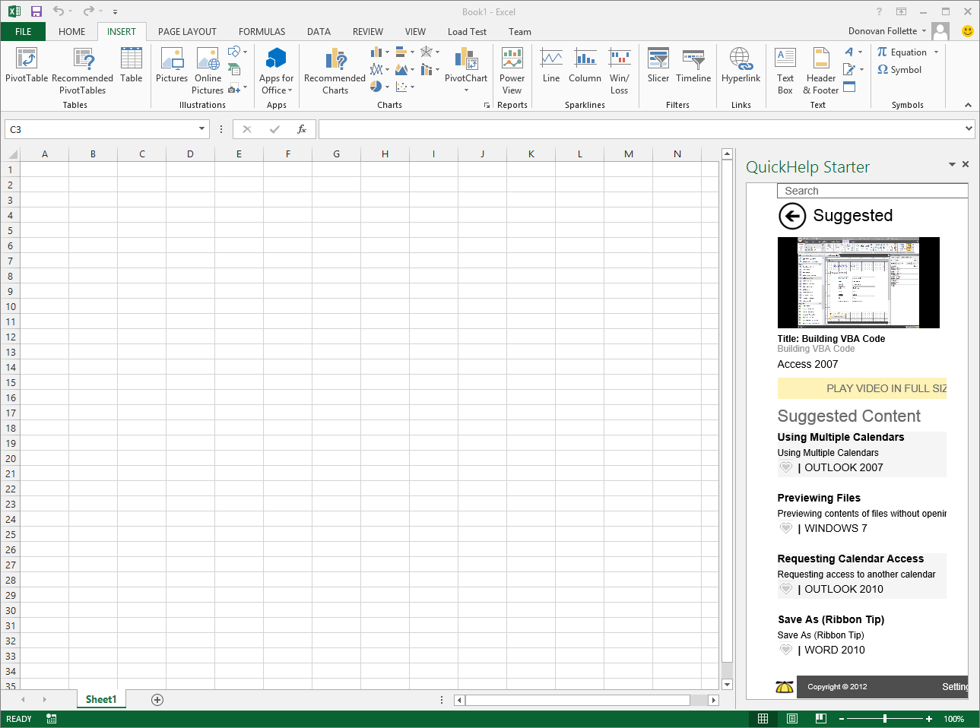
Demo
Some apps for Office & SharePoint currently in the store

Slide 5
What is an App for Office?
A Web page loaded inside an Office Application
Embedded inline or as task pane within documents, mails or appointments.
Works in both Office Applications and Office Web Applications
Allows Office applications to leverage Web technologies
HTML 5 and CSS for rendering user interface
JavaScript and jQuery to add behavior
Calls to REST APIs to retrieve and update data from across network

Slide 6
Manifest + Windows Azure Web Site = app for Office
MVC 4 as an app for Office
Demo

Slide 7
Introducing the Cloud App Model for SharePoint
SharePoint applications no longer live in SharePoint
Custom code executes in the client, cloud or on-premises
Apps are granted permissions to SharePoint via OAuth
Apps communicate with SharePoint via REST/CSOM

Slide 8
Hosting: Choice of two cloud-based Architectures
Provider-Hosted App
“Bring your own server hosting infrastructure”
SharePoint Web
Your Hosted Site
(Windows Azure an Option)
Cloud-based Apps
Get remote events from SharePoint Use CSOM/REST + OAuth to work with SP
Autohosted App
Windows Azure + SQL Azure provisioned automatically as apps are installed
SharePoint Web
Windows Azure
Web Sites

Slide 9
Summary
apps for Office and SharePoint can be:
Built using standard Web technologies
Written in any language
Hosted on Windows Azure or any platform
apps for Office and SharePoint have the worldwide reach of the Office Store on office.com
apps can be monetized now in the Office Store
dev.office.com – to get started now
www.devcamps.ms/office – training locations worldwide

