Slide 1
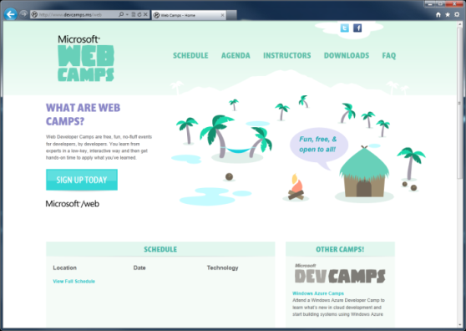

WebCamps Online
Twitter: Follow @webcamps Hashtag #devcamps
[Speaker] / [Twitter]
Website: http://www.devcamps.ms/web
What are web camps?
Web Developer Camps are free, fun, no-fluff events for developers, by developers. You learn from experts in a low-key, interactive way and then get hands-on time to apply what you’ve learned.

Slide 2
Real-time Communications With SignalR
[Speaker]
[Company]

Slide 3
Agenda
Build a Real-time Hit Counter
What is SignalR?
Build a Chat Application
Build a Multi-player Game
Load Balancing SignalR

Slide 4
Demo
Hit Counter

Slide 5
SignalR Components
Clients
JQuery
Native .NET
WP7
iOS
Silverlight
WinRT
Android
(via Mono)
ASP.NET
OWIN
SQL
Redis
Service Bus
Hosts
Backplanes

Slide 6

What is SignalR?
An open-source series of libraries that provide an abstraction around persistent HTTP connections
[In English, please]
SignalR makes real-time HTTP so easy
it seems like magic that it works

Slide 7
Arthur C. Clarke
Any sufficiently advanced technology is indistinguishable from magic.

Slide 8
Demo
Chat

Slide 9
SignalR on Old Servers or Clients
Got Data?
Got Data?
Got Data?
Got Data?
Client Browser
Web Server
Here’s some data!
Got Data?
Got Data?
Got Data?
Got Data?

Slide 10
SignalR on New Servers and Clients
I do real time, do you?
Client Browser
Web Server
Absolutely!
Let’s Party in Real-time!

Slide 11
Basically…
Client Browser
SignalR!!!
Web Server

Slide 12
Online Gaming
Examples of how SignalR provides online games real-time already exist
ShootR – http://shootr.signalr.net
Fireworks – http://firework.cloudapp.net

Slide 13
Demo
Online Gaming

Slide 14

SignalR Backplanes
Load balancing via a common transport mechanism
Backplane
Load Balancer

