Slide 1
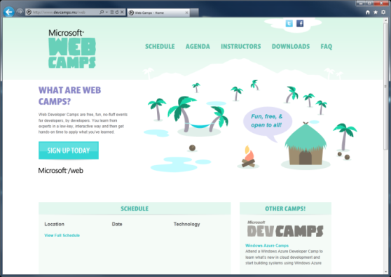

WebCamps Online
Twitter: Follow @webcamps Hashtag #webcamps
[Speaker] / [Twitter]
Website: http://www.devcamps.ms/web
What are web camps?
Web Developer Camps are free, fun, no-fluff events for developers, by developers. You learn from experts in a low-key, interactive way and then get hands-on time to apply what you’ve learned.

Slide 2
What’s New In ASP.NET 4.5 and Visual Studio 2012 for Web
[Speaker]
[Company]

Slide 3
Agenda
Web Forms: Strongly Typed Data Controls
Web Forms: Model Binding
Friendly URLs
Page Inspector
Visual Studio web editor features
Web Essentials
Bundling & Optimization

Slide 4
Model Binding with ASP.NET Web Forms: Strongly Typed Data Controls
Step 1:
Set the ItemType
<ul>
<asp:Repeater ID="customersRepeater" runat="server"
ItemType="WebFormsLab.Model.Customer">
</asp:Repeater>
</ul>
Step 2:
Reference the properties as needed using the Item keyword
<ul>
<asp:Repeater ID="customersRepeater" runat="server“ ItemType="WebFormsLab.Model.Customer">
<ItemTemplate>
<li>
<a href="CustomerDetails.aspx?id=<%#: Item.Id %>">
<%#: Item.FirstName %> <%#: Item.LastName %>
</a>
</li>
</ItemTemplate>
</asp:Repeater>
</ul>

Slide 5
Web Forms: Model Binding Getting Data
Step 1:
Set Select Method
<ul>
<asp:Repeater ID="customersRepeater" runat="server"
ItemType="WebFormsLab.Model.Customer" SelectMethod="GetCustomers">
</asp:Repeater>
</ul>
Step 2:
Get method returns IEnumerable or IQueryable
public IQueryable<Customer> GetCustomers([Control]DateTime? createdSince)
{
IQueryable<Customer> query = _db.Customers;
if (createdSince.HasValue)
{
query = query.Where(
i => i.CreatedOn >= createdSince.Value);
}
return query;
}

Slide 6
Web Forms: Model Binding Inserting Data
Step 1:
Set Insert Method
<asp:FormView runat="server" ID="customerForm"
InsertMethod="InsertCustomer" UpdateMethod="UpdateCustomer"
<EditItemTemplate>
<asp:Label runat="server" Text="Name:" AssociatedControlID="Name" />
<asp:TextBox runat="server" ID="Name" Text="<%# BindItem.Name %>" />
<!-- etc. -->
Step 2:
Use TryUpdateModel to validate, then save
public void InsertCustomer()
{
var customer = new Customer();
TryUpdateModel(customer);
if (ModelState.IsValid)
{
_db.Customers.Add(customer);
SaveChanges(customer);
}
}

Slide 7
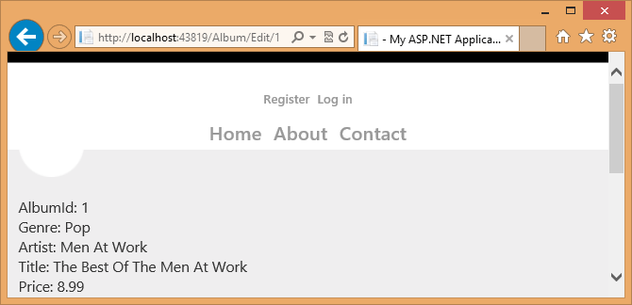
Web Forms: Friendly URLs
/Album/Edit/1
\Album\Edit.aspx
ID passed to controls
Segments can be bound or accessed programmatically
public Album EditAlbum_GetItem([FriendlyUrlSegments] int? id)
{
return _db.Albums.Find(id);
}

Slide 8
Web Forms Model Binding & Friendly URLs, Mobile Support
demo…

Slide 9
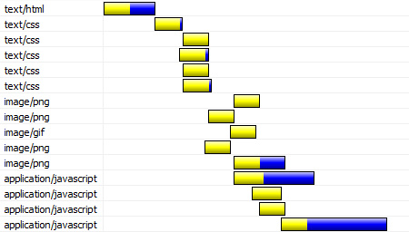
Bundling and Optimization
Web pages have many external references:
CSS, Images, JavaScript

Slide 10
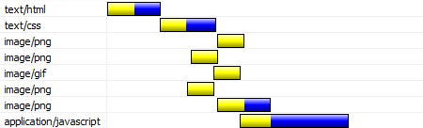
Bundling and Optimization
Bundling combines CSS and JavaScript requests

Slide 11
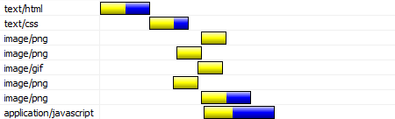
Bundling and Optimization
Minification compresses the files before sending

Slide 12
Visual Studio 2012 web dev features
Page Inspector
CSS and HTML editor
JavaScript editor
Web Essentials

Slide 13
Visual Studio 2012 and Web Essentials
demo

