Slide 1

A PROPOSAL FOR FIRST BAPTIST CHURCH ALMA
Kids Day Out
Thursdays, 9:00 to 2:00 | Ages 6 months to Pre-K
Presented by Kim Vaught, Director
Notes:
Thank you for making time for this. I want to walk you through Kids Day Out: who it is for, how it runs, what it costs, and what we need from the church.

Slide 2

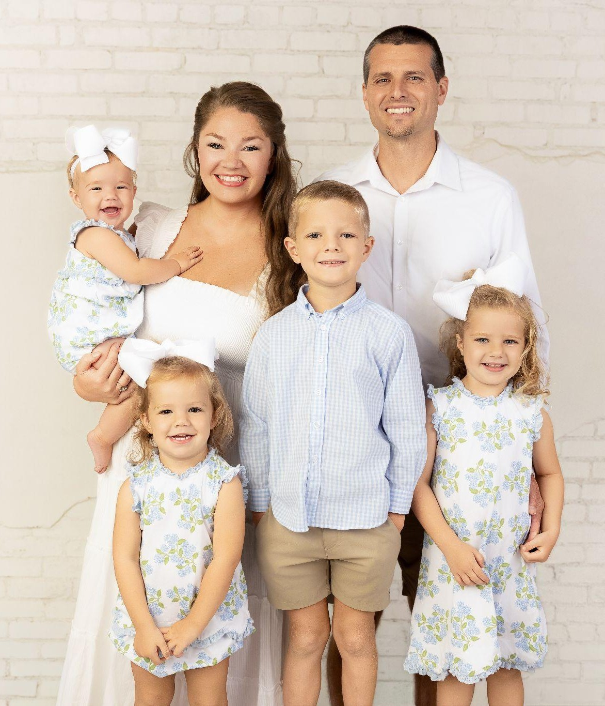
INTRODUCTION
Kids Day Out at a glance
Kim Vaught
Thursdays
DIRECTOR
9:00 to 2:00
LCSW and LCSW supervisor
6 months to Pre-K
Master's in Social Work
ages
18 Thursdays
Clinical supervisor, Arisa Health
January 7 to May 20, 2027
3 years in Kids Day Out
1 day a week
to start
KIDS DAY OUT | FIRST BAPTIST ALMA
02
Notes:
I am a licensed clinical social worker and LCSW supervisor, and I worked three years in Cross Church's Kids Day Out before we moved to Alma. I serve in the three year old room on Wednesday nights and lead Story Time. KDO is one day a week to start: Thursdays, nine to two, for kids six months to Pre-K.

Slide 3
THE NEED
Why Alma needs KDO
0
530
$200+
Mother's Day Out or Kids Day Out programs in Alma
kids under 5 living in Alma
a month for the nearest programs, which require 2 days
Open to every family in Alma, members or not.
KIDS DAY OUT | FIRST BAPTIST ALMA
03
Notes:
There is no Mother's Day Out or Kids Day Out in Alma today. Families drive to Van Buren, Fort Smith, or Greenwood, and those programs require two days and cost two hundred dollars or more a month. For some kids, KDO will be their first time hearing about Jesus.

Slide 4
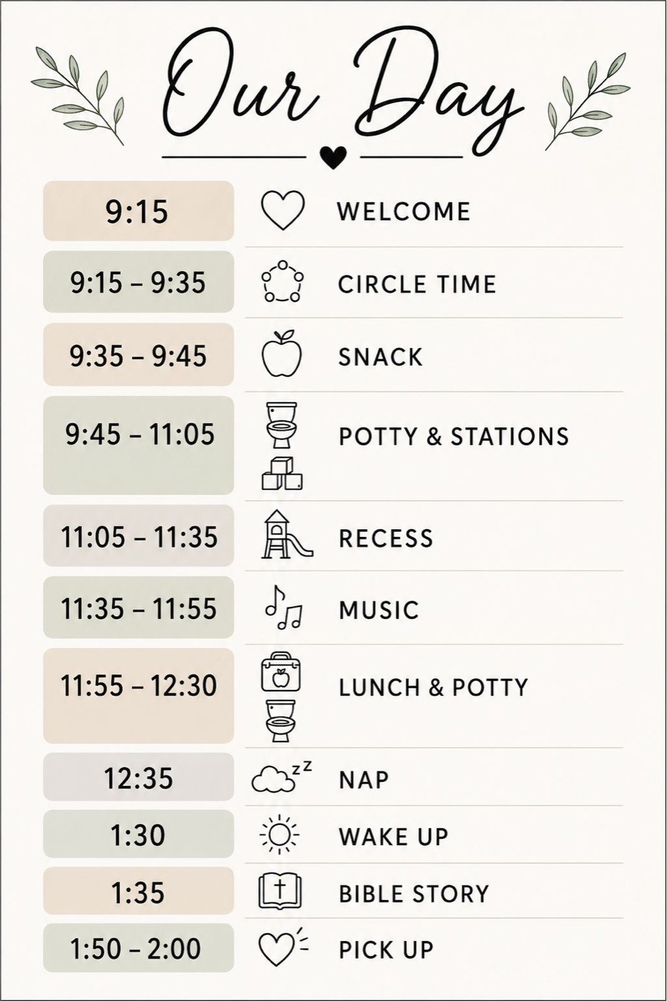
A THURSDAY AT KDO
Drop off 9:00. Pick up 2:00.
Circle time
Stations
Recess
Music
Lunch
Nap
Bible story
Memory verse
A Bible story every week and a memory verse every month.
KIDS DAY OUT | FIRST BAPTIST ALMA
04
Notes:
The same schedule every week, so kids know what to expect. Each month the kids learn one memory verse, and each Thursday has a Bible story that builds on it.

Slide 5

SAFETY
Safety and supervision
2 adults in every room
Locked doors, tagged pickup
Background checks
CPR and first aid
Mandated reporter training
Parent updates in Homeroom
ROOMS BY AGE | UNDER 3 AND 3 AND UP ARE ALWAYS SEPARATE
Babies, 6 to 17 months
Toddlers, 18 months to 3
Preschool, 3 and up
1 to 3 state 1 to 5
1 to 6 state 1 to 8
1 to 6 state 1 to 12
KIDS DAY OUT | FIRST BAPTIST ALMA
05
Notes:
Every room has two adults at all times, and no adult is ever alone with a child. Our ratios are better than the state requires for licensed centers.

Slide 6
STATE RULES AND BUILDING
No license required
✓
Ground floor rooms
5 hours
✓
I called the fire marshal
a week. Arkansas exempts part-time programs open 5 hours a day or less and 10 hours a week or less.
written approval to follow
✓
Monthly fire and tornado drills
logged every time
✓
Written state confirmation
Minimum Licensing Requirements for Child Care Centers, Appendix A
before we advertise
KIDS DAY OUT | FIRST BAPTIST ALMA
06
Notes:
Because we are open five hours a week, KDO does not need a state license. First Baptist Greenwood runs this same model unlicensed. We will still follow the licensed standards, have called the fire marshal and will keep his approval in writing, and confirm with the state before we advertise.

Slide 7
TEACHERS
Teachers and staffing
Apply
Screening
State training
CPR
1
2
3
4
3 minutes
background check
free, online
one morning
2 teachers
4 teachers
6 teachers
1 room
2 rooms
3 rooms
Today: 2 teachers and 2 subs committed. Goal: 6 teachers hired by December 1.
Training led by my sister, Melissa: 8 years as Cross Church's associate preschool director, and the SBC's first Caring Well coordinator.
KIDS DAY OUT | FIRST BAPTIST ALMA
07
Notes:
Every teacher is background checked, trained, and CPR certified before the first day. Teachers make thirteen dollars an hour and we pray together before the kids arrive. A room only opens when two trained teachers are ready, so we never enroll more kids than we can staff. As director I float between rooms. My sister Melissa will lead training. She spent 8 years as associate preschool director and women's minister at Cross Church, was the first Caring Well coordinator in the Southern Baptist Convention, and served as Caring Well coordinator and women's minister at Immanuel. That training can be open to every preschool volunteer at FBA.

Slide 8
TUITION
Founding Family rates
TODDLERS AND PRESCHOOL
BABIES
SNACKS AND SUPPLIES
$20
$25
$13
per Thursday, 18 months to Pre-K
per Thursday, 6 to 18 months
a month, per child
$93 a month, snacks included
$113 a month, snacks included
Snacks, wipes, craft materials
Pay by the 7th of each month. 10% off for siblings or paying in full.
KIDS DAY OUT | FIRST BAPTIST ALMA
08
Notes:
Tuition is the daily rate times 18 Thursdays. Toddlers and preschoolers are twenty dollars a Thursday and babies are twenty five, since babies need more teachers per child. Families pay monthly, by the seventh. Each payment covers four Thursdays plus thirteen dollars for snacks, wipes, and craft materials, so a toddler is ninety three dollars a month and a baby is a hundred thirteen. May has only two Thursdays, so it is about half. Or they can pay in full and save ten percent. These Founding Family rates stay the same while a child is enrolled; families who join next semester pay twenty five a day, thirty for babies.

Slide 9
BUDGET
No risk to the church
Low
Income $4,992
$0
Donor
12 kids, 2 rooms
Expenses $8,150
Donor covers the $3,158 gap
Medium
Income $7,488
$0
18 kids, 2 full rooms
Expenses $8,330
Donor covers the $842 gap
High
Income $12,156
+$444
30 kids, 3 full rooms
Expenses $11,712
Pays for itself
Our donor covers any gap, so the church is never out a dollar. Per semester, after a 10% discount allowance. Low has 4 babies; medium and high have 6.
KIDS DAY OUT | FIRST BAPTIST ALMA
09
Notes:
The bottom line: there is no risk to the church. Green is what comes in, red is what goes out. At twenty dollars a day, twenty five for babies, a full first semester of thirty kids pays for itself. If enrollment comes in low, our donor covers the difference, so the church is not out anything: about thirty two hundred with twelve kids, and about eight hundred with eighteen. We are capping this first semester at 30. New families who join later pay a little more, and that is how KDO grows.

Slide 10
BUDGET
No risk to the church
Semester P&L
Per semester (18 Thursdays) | Low: 12 kids | Medium: 18 kids | High: 30 kids
Tuition (x 18: $20 a day, $25 for babies) | $4,680 | $7,020 | $11,340
Discounts (siblings, pay in full): 10% | -$468 | -$702 | -$1,134
Snacks and supplies fee ($65 per child) | $780 | $1,170 | $1,950
Donor support | $3,158 | $842 | $0
Total income | $8,150 | $8,330 | $12,156
Teachers ($13/hr x 6 hrs x 18 = $1,404 each) | 4 = $5,616 | 4 = $5,616 | 6 = $8,424
Director ($15/hr x 6 hrs x 18) | $1,620 | $1,620 | $1,620
Payroll taxes (7.65%) | $554 | $554 | $768
Supplies ($30 per child) | $360 | $540 | $900
Total expenses | $8,150 | $8,330 | $11,712
Net | $0 | $0 | +$444
KIDS DAY OUT | FIRST BAPTIST ALMA
10
Notes:
There is no risk to the church in any column: the net line never goes below zero, because our donor covers any gap. Tuition is twenty dollars a Thursday, twenty five for babies, times 18 Thursdays. Low assumes 4 babies; medium and high assume 6, one full baby room. We set aside 10 percent for sibling and pay-in-full discounts. Teachers and the director are paid for 6 hours each Thursday so we can set up and pray together before the kids arrive. With thirty kids, KDO pays for itself. With fewer, our donor covers the gap, so the church is not out anything. Thirty kids is our cap this semester. Insurance is not included; adding KDO to the church's policy is one of our questions for the church.

Slide 11
LONG-TERM PLAN
Start low, then grow
Per semester | Spring 2027 | Fall 2027 | Spring 2028
New families pay a day | $20, babies $25 | $25, babies $30 | $25, babies $30
Kids | 30 founding | +12 new = 42 | +12 new = 54
Teachers | 6 | 8 | 10
Income | $12,156 | $17,796 | $23,436
Expenses | $11,712 | $15,095 | $18,478
Profit | +$444 | +$2,701 | +$4,958
Running total | +$444 | +$3,145 | +$8,103
Founding families keep $20 a day ($25 for babies) while their child is enrolled.
Prices top out at $25 a day ($30 for babies). If enrollment is low, our donor covers the gap.
KIDS DAY OUT | FIRST BAPTIST ALMA
11
Notes:
This is the long-term plan. We start low on purpose. This first semester is not about making money; at thirty kids it just covers its costs, and if things go slowly our donor covers the gap, so the church is never out anything. Then each semester we add one room, and new families pay twenty five a day, thirty for babies. That is as high as our prices go. The original families keep their founding price the whole time their child is enrolled. With modest growth, KDO is about eight thousand dollars ahead after three semesters.

Slide 12
CHURCH SUPPORT
What we need from the church
1
The church owns KDO
4
Use of the check-in system
2
Background checks
5
The kdo@firstalma.com email
3
Payroll, tuition, and insurance
6
Classroom space, left clean
KIDS DAY OUT | FIRST BAPTIST ALMA
12
Notes:
KDO would belong to First Baptist Alma, with written policies and a handbook the church adopts, so it continues through any staff change. We would love the church's help with background checks, payroll and tuition, insurance, the check-in system, and setting up kdo@firstalma.com, the address already on the website and handbooks. We will leave every room as clean and organized as we found it.

Slide 13
NEXT STEPS
From here to January 7
Nov
Nov
Dec 1
Dec
Jan 7
State letter, fire marshal, insurance quote
Hiring starts: teachers and subs
Teachers and subs hired; registration opens
Training and CPR
First KDO Thursday
READY NOW
✓ Parent Handbook
✓ Staff Policies Manual
✓ Registration site
✓ Budget
✓ Logo
KIDS DAY OUT | FIRST BAPTIST ALMA
13
Notes:
The handbooks, registration site, budget, and logo are ready now. If you approve, here is what happens between now and our first Thursday on January 7.

Slide 14
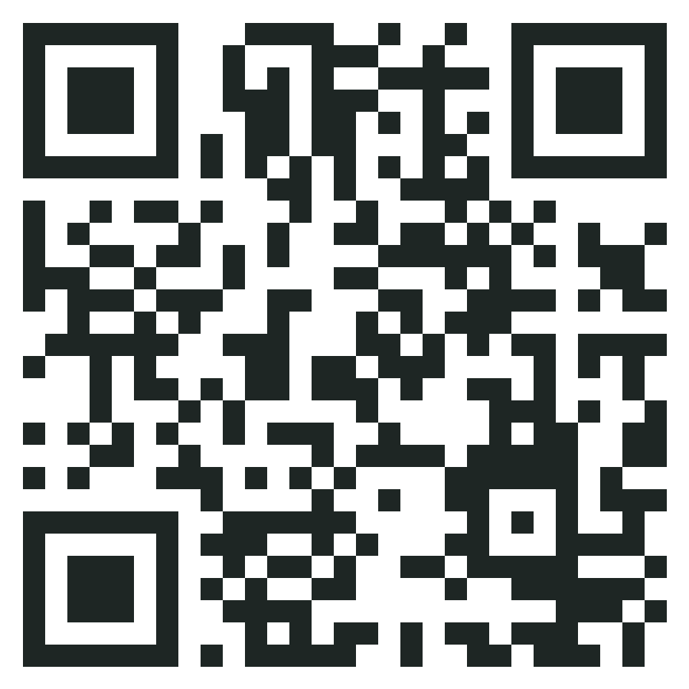
TRY IT NOW
Scan, register, and watch it arrive
Scan the code with your phone and send a test registration. I'll pull up our sign-up sheet so you can see it come in.
firstalma-kdo.vercel.app
Thank you
References: Lisa Hill, previous KDO Director, 479-236-8555 | Ellie Sherburne, previous KDO Assistant Director, (870) 405-7338 | Kristin Lehner, previous Director at OGC (Arisa Health), 913-426-0525
Notes:
Go ahead and scan this with your phone. Pick any made-up child and send a registration. [Open the KDO Sign-ups Google Sheet on the screen.] Here it is in the Kids tab, and the Summary tab already shows the room, the waitlist, and the budget. Thank you, I would love to answer any questions.

