Slide 1
Mockiato Web based Platform for API Virtualization Open Source Project

Slide 2
What is Service Virtualization?
Service virtualization is a method to imitate the behavior of specific components in heterogeneous component-based applications such as API-driven applications, cloud-based applications and service-oriented architectures.
Service virtualization remove dependency constraints on development and testing teams. Such constraints occur in complex, interdependent environments when a component connected to the application under test is:
Not yet completed
Still evolving
Controlled by a third-party or partner
Available for testing only in limited capacity or at inconvenient times
Difficult to provision or configure in a test environment
Needed for simultaneous access by different teams with varied test data setup and other requirements
Restricted or costly to use for load and performance testing

Slide 3
Various Service Virtualization Tool
CA Devtest
IBM Rational Test Virtualization
Tricentis TOSCA
Parasoft Virtualize
Traffic Parrot
Mocking Bird
Open Source Tools
HoverFly
Wiremock
Cirtus Framework

Slide 4
Why Mockiato?
Open Source : While most of the Service Virtualization tool are licensed tool which cost a lot and also in case of any support there is no free reference. Mockiato is built on open source technologies like Node.js and Mongodb.
Easily Maintainable : As Mockiato is an in-house product it is easily maintainable avoiding any third part involvement hence saves the maintenance cost also.
User Friendly : Mockiato is easy to use and consumers does not require any special training to use it. Thus it could be easily accessed by both Developers and QA. While other tools require special expertise and training.

Slide 5
Why Open Source ?
Started with Inner source and moved to open source due to
Speed of delivery.
Collaboration
Flexibility and Scalability
High Quality and less security issues
PRE LUANCH CHECKLIST
Documentation
Project has a LICENSE file with an open source license
Project has basic documentation (README, CONTRIBUTING, CODE_OF_CONDUCT)
The name is easy to remember, gives some idea of what the project does, and does not conflict with an existing project or infringe on trademarks
The issue queue is up-to-date, with issues clearly organized and labeled
Code
Project uses consistent code conventions and clear function/method/variable names
The code is clearly commented, documenting intentions and edge cases
There are no sensitive materials in the revision history, issues, or pull requests (for example, passwords or other non-public information)
People
Worked with legal department and/or understand the IP and open source policies of your company
You have a marketing plan for announcing and promoting the project
Someone is committed to managing community interactions (responding to issues, reviewing and merging pull requests)
Team should have administrative access to the project

Slide 6
Mockiato
Mockiato is a web-based platform for API virtualization. Mockiato was developed at Optum to enable test automation, and can simulate REST APIs, SOAP services, and message-oriented middleware.
Mockiato can generate realistic data for testing, and export it to JSON, XML, or CSV. Mockiato creates virtual endpoints that simulate your production APIs. These virtual services are ideal for testing, sandboxing, knowledge transfer, and driving rapid development.
For getting started we need to raise access request to the secure group :mockiato_users . Once that is approved we can start creating virtual service using Mockiato.

Slide 7
Various Sources For creating Virtual
Service In Mockiato
Request/Response Pairs
Bulk Upload
Open API
WSDL
Recording
Import

Slide 8
Groups & Admin
Groups in Mockiato help different teams segregate their Virtual Services
Members of a group are only allowed to modify services under their group.
Groups can be categorized as:
General Groups – Group used for virtual service calls that are executed using the Mockiato URL as the endpoint.
Domain Groups – Group used by EEPS/EAIP domains for virtual service calls that are executed using a proxy or frontend aggregate service that redirects via API Engine Console config setting to Mockiato virtual backend services.
We have Admin tab for Creating a New Group, Deleting an existing Group and Adding/Removing Members to a Group.

Slide 9
Match Templates
Matching templates allow the user to select which fields Mockiato should attempt to match on, and/or provide specific conditions for whether a field is considered to have matched.
When & Why do we need Match Template?
In case we want to ignore some headers or security details which are not relevant in case of virtual services.
If we want to ignore any dynamic values like date, Auth tokens etc. , as Virtual services contain only hard coded values.
In case we want to apply certain conditions to any field values in the request payload.

Slide 10
Live Invocation
Live Invocation feature gives user an option to direct the request that will be hitting the virtual service endpoint to be sent to the live system or virtual service first.
Live Invocation can be used :
When we do not have all flows virtualized due to test data constraint.
We want to send a request to Live system in case of some security validations.
Does not want to send a Error/Failure response in case Live system ceases to responds.
In edge case scenarios which have to be tested but are not part live system, we can use Live invocation which will redirect the flow to virtual services when the conditions for that scenarios are met.
.

Slide 11
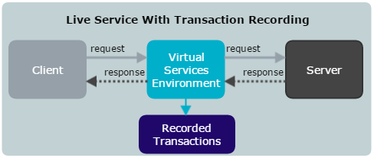
Recording
Mockiato lets user create a virtual service by recording the traffic between a client and a server.
Mockiato acts as the pass through medium between client and server . While the Mockiato passes the requests and responses along, it records the transactions and creates a Virtual service from it.

Slide 12
Use cases
Many teams have already started using Mockiato for Virtualization. Some of them are listed as below:
Optum RX
Contact Center Services - IVR team is using it for Regression testing.
EAIP Benefits team is using it for Unit testing.
EAIP Clinical and Financial team is using it for Unit testing.
CDB EEMS Eligibility team is using it for regression testing.
Layer7 for performance testing
Deployed in secure government OFE West Virginia project.

Slide 13
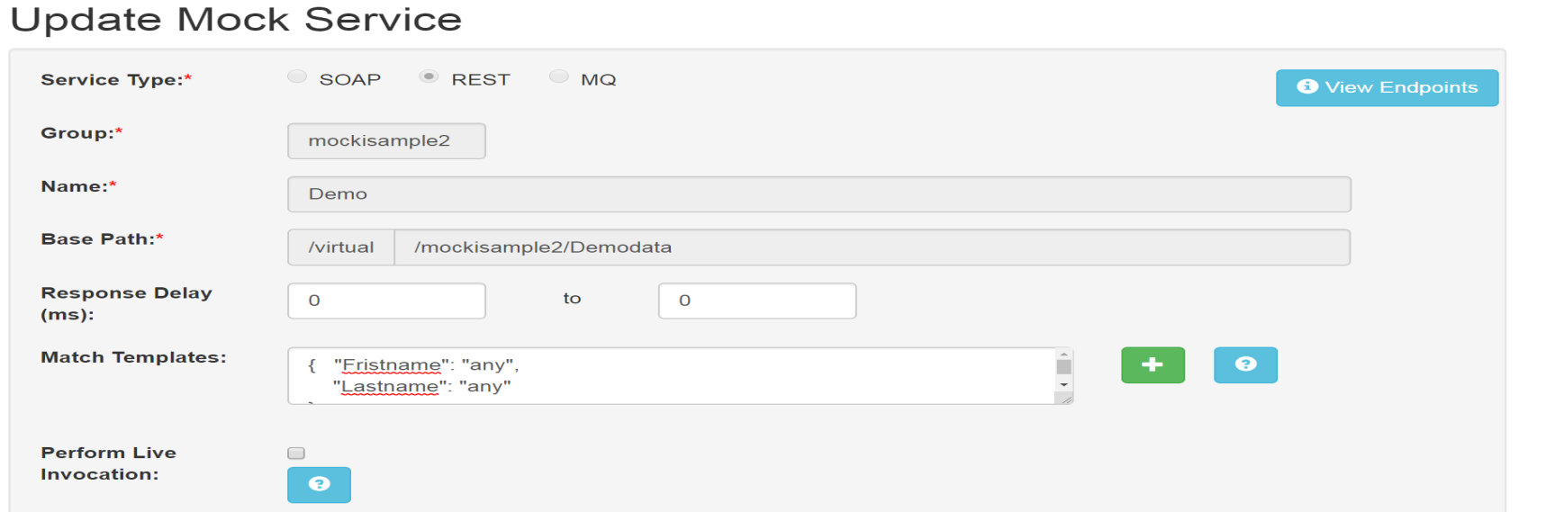
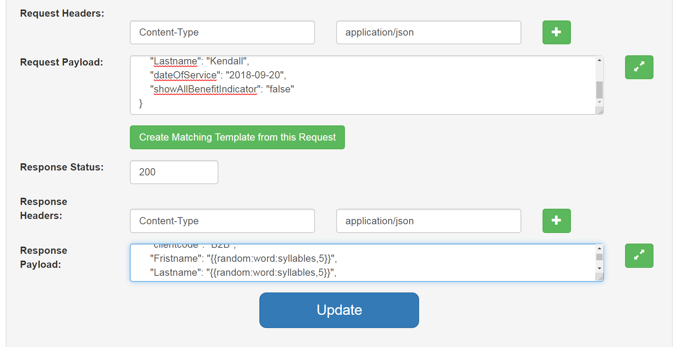

Slide 14
Questions??

Slide 15
Thank You.

