Slide 1
A GUIDE TO PRONUNCIATION
The Sound of the Letters of the English Alphabet

Slide 2

Learning Objectives
At the beginning of the session, you are expected to:
Identify the different English sounds; Distinguish the English sounds from Filipino sounds; Know the proper use of the articulators; Differentiate the sounds of the English alphabet; Recognize vowels and consonant sounds.
Notes:
For the facilitator:
Ensure they meet their goals on each of the slides

Slide 3

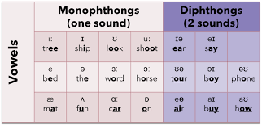
Vowels & Consonants
FACTS! | Focused sounds:
There are 26 letters in the English alphabet, and 44 sounds! 20 vowel sounds (12 vowels & 8 diphthongs) 24 consonant sounds | Source: IELTS Speaking: How to learn vowel phonetics - Paramount IELTS
Notes:
FOR THE FACILITATOR: Utilize the white board & the chat box
Give more examples of a monophthong – check understanding before proceeding to the next slide.

Slide 4

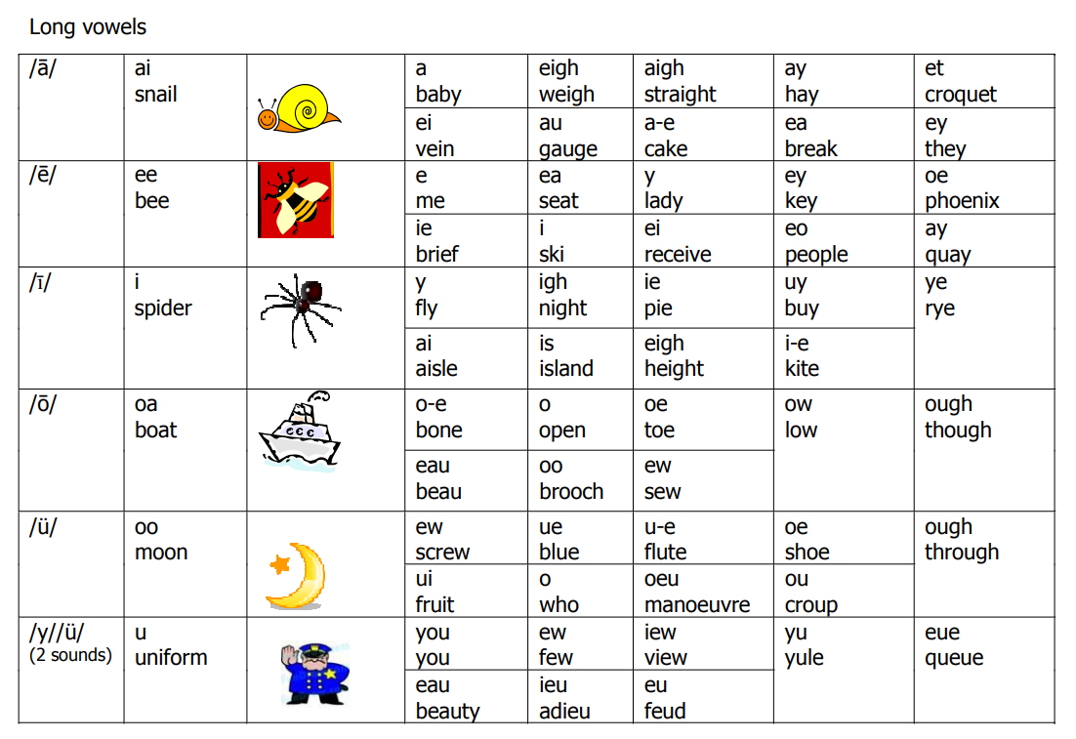
The Long Vowels
Source: Reading Rockets | Launching Young Readers
Notes:
For the facilitator: Utilize the whiteboard:
Long A Vowel Teams: ai, ay, ea, eigh, ey
Long E Vowel Teams: ee, ea, ey, ei, ie
Long I Vowel Teams: ie, igh
Long O Vowel Teams: oa, oe
Long U Vowel Teams: ew, ue, eu
Diphthong Vowel Teams: oi, oy, ou, ow, au, aw, oo

Slide 5
The Long Vowels
Source: Reading Rockets | Launching Young Readers
Notes:
For the facilitator: Utilize the whiteboard:
Long A Vowel Teams: ai, ay, ea, eigh, ey
Long E Vowel Teams: ee, ea, ey, ei, ie
Long I Vowel Teams: ie, igh
Long O Vowel Teams: oa, oe
Long U Vowel Teams: ew, ue, eu
Diphthong Vowel Teams: oi, oy, ou, ow, au, aw, oo

Slide 6
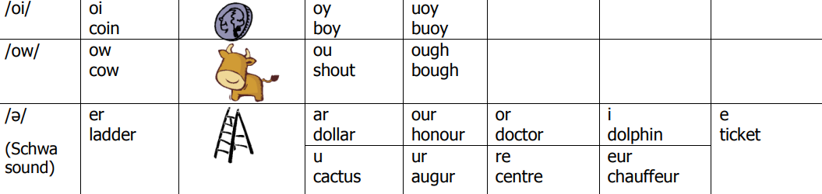
The Long Vowels
Source: Reading Rockets | Launching Young Readers
Notes:
For the facilitator: Utilize the whiteboard:
Long A Vowel Teams: ai, ay, ea, eigh, ey
Long E Vowel Teams: ee, ea, ey, ei, ie
Long I Vowel Teams: ie, igh
Long O Vowel Teams: oa, oe
Long U Vowel Teams: ew, ue, eu
Diphthong Vowel Teams: oi, oy, ou, ow, au, aw, oo

Slide 7
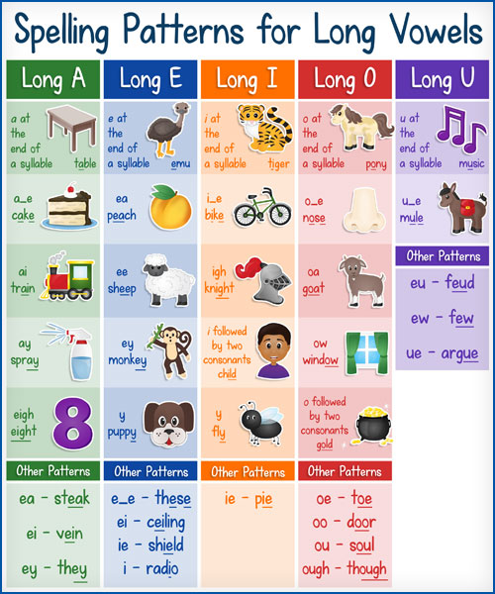
The Long Vowels
Four Ways to Form Long Vowel Sounds | SHORT VOWELS
A vowel at the end of a syllable can be long. Silent E can make the previous vowel long. Vowel teams can make long vowel sounds. I or O can be long when they come before two consonants.
Source: A Handy Guide to Long Vowel Sounds (+ 5 FREE Downloads) (allaboutlearningpress.com)
Notes:
For the facilitator: Utilize the whiteboard: check understanding before proceeding to the next slide
In the word ”we,” as in ”We love emus,” the vowel E is at the end of the syllable and says long E. In these words, the vowel at the end of a syllable is long: hero, hi, music.
In the word ”cute,” as in ”Emus are cute,” the long U sound is formed by adding Silent E at the end of the word. Here are more words in which Silent E makes the previous vowel long: tape, shine, code.
Vowel teams are two vowels that work together to make one sound. For example, in the word eat, as in Emus eat seeds, vowel team EA says long E. These words have vowel teams that make a long vowel sound: mail, sheep, soap.
In the word ”stroll,” as in The emu went for a stroll, the letter O comes before two consonants and says its long vowel sound. In these words, I or O are long before two consonants: kind, gold, child.

Slide 8
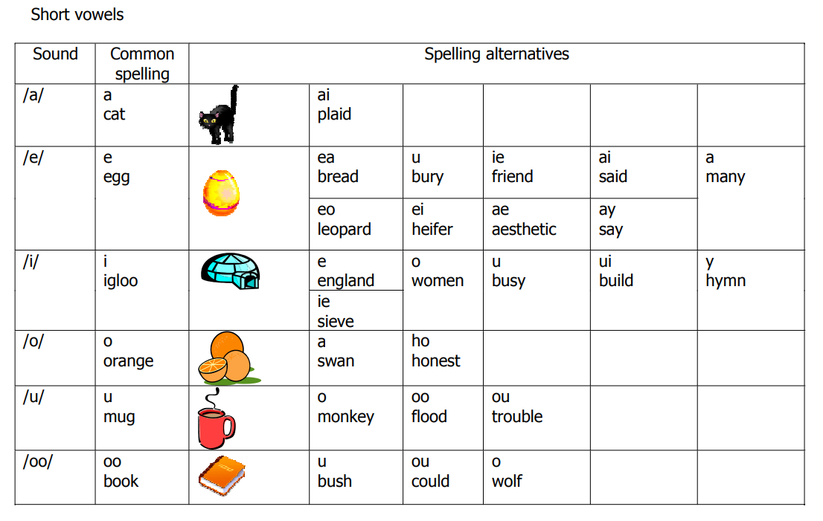
The Short Vowels
Source: Reading Rockets | Launching Young Readers

Slide 9
The Short Vowels
Source: Reading Rockets | Launching Young Readers

Slide 10
The Short Vowels
Short Vowels Can Be Spelled in Four Ways
The most common way: a single vowel in a closed syllable usually says a short sound. Vowel teams can make short vowel sounds. Single vowels can say the short sound of other vowels. A vowel can make the short U or short I sound in an unaccented syllable. Source: A Handy Guide to Short Vowel Sounds (+ 3 FREE Downloads) (allaboutlearningpress.com)
Notes:
Check understanding before proceeding to the next slide

Slide 11
MINIMAL PAIRS
/ɪ/ | /i:/
Bin | Bean
Chip | Cheap
His | He’s
It | Eat
Sit | Seat
Bit | Beat
Knit | Neat
Sip | Seep
Lip | leap

Slide 12
MINIMAL PAIRS
/ɪ/ | /i:/
Did | Deed
Fill | Feel
Fit | Feet
Grin | Green
Hit | Heat
Is | Ease
Mitt | Meet
Slip | Sleep
Still | steal

Slide 13
MINIMAL PAIRS
/ɪ/ | /i:/
Bitch | Beach
Itch | Each
Gin | Gene
Grid | Greed
Hid | Heed
Hill | He’ll
Ill | Eel
Kip | Keep
Lick | Leak

Slide 14
MINIMAL PAIRS
/ɪ/ | /i:/
Mill | Meal
Pick | Peek
Piss | Piece
Pitch | Peach
Risen | Reason
Shit | Sheet
Sick | Seek
Sin | Scene
Still | steel

Slide 15


Let’s Practice!
Pete’s niece loves to eat seeds coated with thick cheese while she sits on a heated bench and sings with her little strings. This kid, who once bit the cheek of a hot chick because she thought she was seeing a roasted chicken, also licked the leaking faucet because she thought she had a beak and was drinking from a river. Pete has even seen his niece peel sleeping pills because she wanted to use the powder as filling for her cheese-coated seeds. One day, this niece went to the mountain peak, picked a deep pit, dipped herself under thick mud then jumped unto the pitch of darkness where hill and hell meet. Her death sounded wicked for the weak-hearted people like Pete. Investigation revealed that Pete’s niece went mad because she mills all day and skips meals. People will surely miss her specially her feet for running.

Slide 16

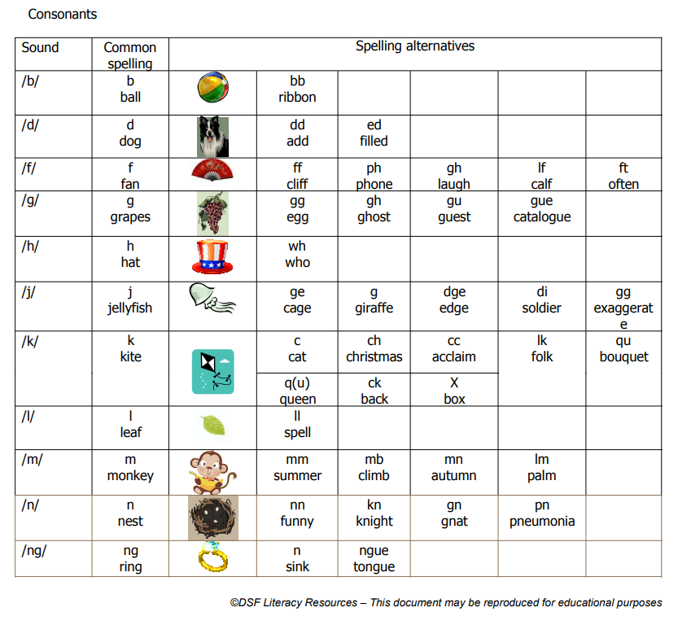
The Consonants
Source: Reading Rockets | Launching Young Readers
Notes:
For the facilitator: check understanding before proceeding to the next slide
Focus on /p/ /f/ /b/ /v/ issues
Also, those with /h/ sound issues, some may pronounce the letter ‘h’ as ‘etch’

Slide 17
The Consonants
Source: Reading Rockets | Launching Young Readers
Notes:
For the facilitator: check understanding before proceeding to the next slide
Focus on /p/ /f/ /b/ /v/ issues
Also, those with /h/ sound issues, some may pronounce the letter ‘h’ as ‘etch’

Slide 18
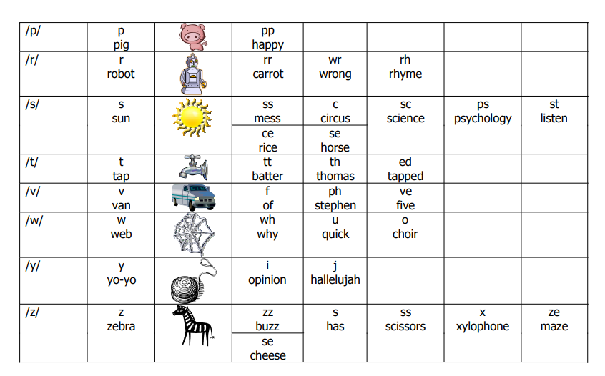
The Consonants
Source: Reading Rockets | Launching Young Readers
Notes:
For the facilitator: check understanding before proceeding to the next slide
Focus on /p/ /f/ /b/ /v/ issues
Also, those with /h/ sound issues, some may pronounce the letter ‘h’ as ‘etch’

Slide 19
The Consonants
Source: Reading Rockets | Launching Young Readers
Notes:
For the facilitator: check understanding before proceeding to the next slide
Focus on /p/ /f/ /b/ /v/ issues
Also, those with /h/ sound issues, some may pronounce the letter ‘h’ as ‘etch’

Slide 20
P – F Minimal Pairs
fast - past | foot- put | fork- pork
face - pace | fan - pan | fax – packs
fee - pee | feel - peel | feet – peat
fig - pig | fine - pine | fleas - please
Notes:
For the facilitator: check understanding before proceeding to the next slide
Focus on /p/ /f/ /b/ /v/ issues
Also, those with /h/ sound issues, some may pronounce the letter ‘h’ as ‘etch’

Slide 21
P – F Minimal Pairs
fool - pool | fought - port | found - pound
from - prom | foe - poe | fox – pox
foam - poem | full - pull | fun - pun
fluke - plook | fume - Pune | flutter - platter
Notes:
For the facilitator: check understanding before proceeding to the next slide
Focus on /p/ /f/ /b/ /v/ issues
Also, those with /h/ sound issues, some may pronounce the letter ‘h’ as ‘etch’

Slide 22
Let’s Practice!
Perry, a fat pink fairy, who lives in Fantasy land, and his pet Paul, a pig that is frighteningly full of fur, went to visit Perry’s paternal grandfather fairy. The grandfather fairy was praying when fat pink Perry and furry Paul arrived. Fat pink Perry noticed a pail on a plank parallel to grandfather fairy’s favorite praying position. He pulled the pail full of paint, fell on grandfather fairy’s frayed feathery pants. Fat pink Perry and furry Paul were full of fright when grandfather fairy stood and pushed the pail away. Grandfather fairy’s face frowned and pointed his fingers towards the pale pink pantry. The frightened fat pink Perry proceeded only to find out that grandfather fairy was pretending to be praying. Fat pink Perry’s family were all there. Papa Frey, fat pink Perry’s father, hugged fat pink Perry and greeted him, “Happy fourth birthday!” Fat pink Perry was no longer frightened. Fat pink Perry was pleased to find out that his family were there to party with him on his fun-filled fourth birthday!

Slide 23
B – V Minimal Pairs
bad – vad | visual – bizhal | brand
bake – vake | very - berry | via
boy – voy | viand – bayad | bow
abide – avayd | van – ban | vow
Notes:
For the facilitator: check understanding before proceeding to the next slide
Focus on /p/ /f/ /b/ /v/ issues
Also, those with /h/ sound issues, some may pronounce the letter ‘h’ as ‘etch’

Slide 24
Let’s Practice!
Berry is called “Very Berry” because he is considered the best for a vet and brightest baseball veteran in the big country of Belgium. Aside from spending time with bunnies, Very Berry is also fond of baseball bats and balls. His villa has a basement with a vault full of balls. Very Berry is also fond of collecting bats in a vat. He and his best buddy, Bubbly Ver, bowed their vow never to vie buying baseball bats and balls anymore. Very Berry and Bubbly Ver did try to ban the van selling bats and balls to boys. They shifted their attention from buying baseball bats to bingeing on beer so every time the banned van visits the vicinity, Very Berry and his best buddy Bubbly Ver realized that beer is vile for the body’s bile production. So, they decided to run after the banned van and buy baseballs instead of bingeing on beer.

Slide 25

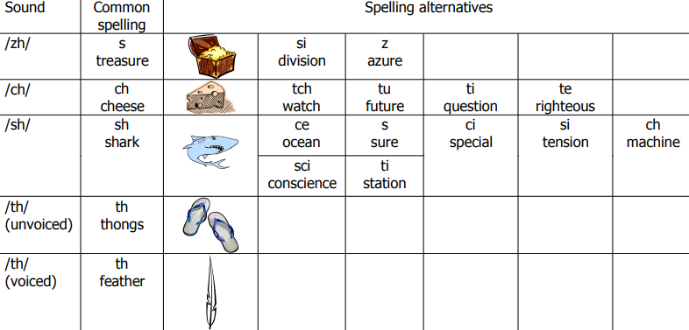
Digraphs
Source: Reading Rockets | Launching Young Readers

Slide 26


MINIMAL PAIRS
Unvoiced /th/
three – tree
throw – trow
thumb – tum
think – tink
thyme – time
through – true
mouth - mout
Voiced /th/
though – doe
those – dose
breathe – breed
then – den
there – dare
although – all doe
bathe - bade

Slide 27
Let’s Practice!
The throng of thermometers from the Thuringian Thermometer Folks arrived on Thursday. There were a thousand thirty-three thick thermometers, though, instead of a thousand thirty-six thin thermometers, which were three thermometers fewer than the thousand thirty-six we were expecting. Not to mention that they were thick ones rather than thin ones. We thoroughly thought that we had ordered a thousand thirty-six, not a thousand thirty-three thermometers, and asked the Thuringian Thermometer Folks to reship the thermometers – thin, not thick. They apologized for sending only a thousand thirty-three thermometers rather than a thousand thirty-six and promised to replace the thick thermometers with thin thermometers.

Slide 28
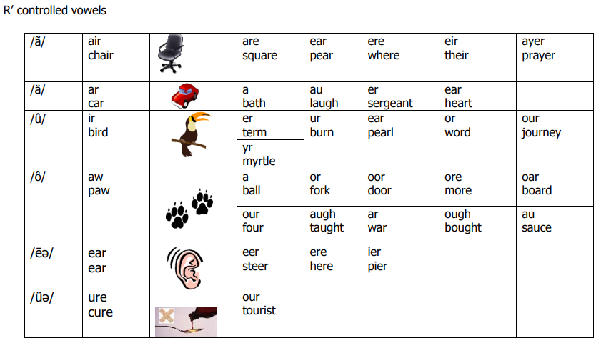
R-Controlled Vowels
Source: Reading Rockets | Launching Young Readers
Notes:
For the Facilitator:
An r-controlled vowel is any vowel followed by an r. The r changes the sound that vowel makes.
R controlled vowels are often called “Bossy R” because the r takes over and makes the vowel make a new sound.
The er, ir, and ur all make the same sound /er/ as in her, bird, and fur.
But ar and or are a little different, as they have more than one sound.
Ar usually makes the sound in car, but can also make the sound in beggar and arrow.
Or usually makes the sound in corn, but can also make the /er/ sound as in the word doctor.
This is a syllable with an r controlled vowel. An r-combination syllable always has at least one vowel followed by r (ar, er, ir, or ,ur, ear).

Slide 29
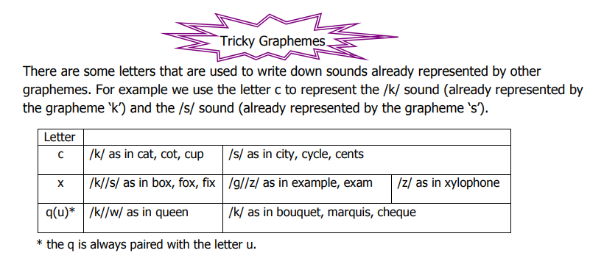
Graphemes
Source: Reading Rockets | Launching Young Readers
Notes:
For the Facilitator: check understanding before proceeding to the next slide
A good time to practice those with spelling issues

Slide 30
Graphemes
Notes:
For the Facilitator: check understanding before proceeding to the next slide
A good time to practice those with spelling issues

Slide 31
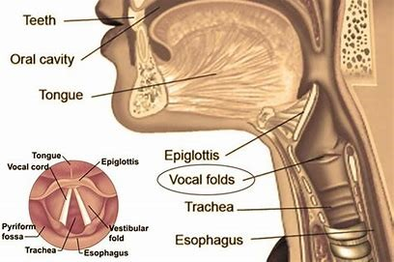
STRETCH YOUR ARTICULATORS!
Notes:
For the Facilitator: check understanding before proceeding to the next slide
A good time to practice those with spelling issues

Slide 32
BREATHING EXERCISES
Open your mouth wide and open the back of your throat.
Say “ma-ma-ma-ma-mama” as many times as you can
Say “kah-kah-kah-kah-kah” as many times as you can.
Say “gah-gah-gah-gah-gah” as many times as you can.
Say “ha-ha-ha-ha-ha” as many times as you can.
Now put all syllables together, “ma-kah-gah-ha” and say these as many times as you can.
Blow out as gently 5 times, feel your belly come in as you blow out.
Produce the /s/ sound gently 5 times and feel your belly in as you blow out.
Produce the /sh/ sound gently 5 times and feel your belly come in.
Repeat the exercises five times daily until you’re aware of that feeling of using your belly to control the airflow improves.
Notes:
For the Facilitator: DEMONSTRATE proper breathing techniques

Slide 33
DRILLS
Practice loosening your jaw with the following syllables:
SAH | KAH | SHA | FAH | RAH
PAH | KAH | SHA | FAH | RAH
WAH | KAH | SHA | FAH | RAH
BAH | KAH | SHA | FAH | RAH
DAH | KAH | SHA | FAH | RAH
Notes:
For the Facilitator: Demonstrate proper breathing techniques; tell about a dentist appointment, to open the mouth wide enough...say ahhhh

Slide 34
BREATHING EXERCISES
Collecting and projecting, | And rattling and battling,
Receding and speeding, | And shaking and quaking,
And shocking and rocking, | And pouring and roaring,
And darting and parting, | And waving and raving,
And treading and spreading, | And flowing and going,
And whizzing and hissing, | And heaving and cleaving,
And dripping and skipping, | And foaming and roaming,
And hitting and splitting, | And moaning and groaning,
And shining and twining, | And dropping and hopping!
Notes:
For the Facilitator: check understanding before proceeding to the next slide
Inhale through the nostrils, exhale through the mouth.
Take one deep breath and hum while exhaling
Take a deep breath and see how far you can read through this grouping of words. Make sure to interpret as you convey meaning and clarity.

Slide 35
ARTICULATION EXERCISES
Say the following words while exaggerating your jaw opening:
Hack | Yacht | Dot
Part | Yard | Dart
Tab | Yak | Dat
Hah | Tat | Lad
Notes:
For the Facilitator:
Check the candidates and watch out for mispronounced ah sound

Slide 36
ARTICULATION EXERCISES
High | Tie | Die
Lie | Rye | Kite
Howl | Noun | Loud
Coin | Loyal | Oil
Notes:
For the Facilitator: check understanding before proceeding to the next slide
These words have diphthongs, which require the jaw to be open at the beginning of the word, shifting to a more closed position at the end:

Slide 37
ARTICULATION EXERCISES
Good blood, bad blood
Bad blood, blood blood
Red leather, yellow leather
Buttah, Guttah, Guttah, Buttah
The leaf police dismisses us.
Notes:
For the Facilitator:
Repeat the following clearly, stretching the mouth or lips, opening the mouth wide enough to produce the /ah/ sound and the tongue should be sticking out between the upper and lower teeth to produce the /th/ sounds.

Slide 38

VOCAL EXERCISES
Take a deep breath and say “AH” in a loud voice.
Try projecting your voice across the room.
Hold “AH” for as long as you can.
REPEAT 3 TIMES
Count 1-10 in a loud voice. Pause for a breath as needed to keep your voice loud. REPEAT 3 TIMES
MONDAY, TUESDAY, WEDNESDAY, THURSDAY, FRIDAY, SATURDAY, SUNDAY
Notes:
FOR THE FACILITATOR:
For the days of the week -- Start in a soft voice and gradually increase to a very loud voice. Then repeat going from a loud to a soft voice.

Slide 39
VOCAL EXERCISES
“Shut the door.” “I want that.”
“Pass the food, please.” “Answer the phone.”
“How are you?” “I’m fine, thanks.”
“Help me!” “Who is this?”
“I need help.” “Please sit down.”
“No big deal.” “I am leaving.”
Notes:
FOR THE FACILITATOR:
For the days of the week -- Start in a soft voice and gradually increase to a very loud voice. Then repeat going from a loud to a soft voice.

Slide 40
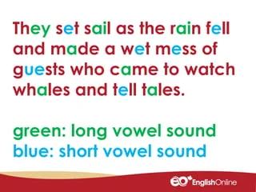

Let’s Practice!
Source: Reading Rockets | Launching Young Readers
TONGUE TWISTER (Free Download) - Guro Tayo

Slide 41

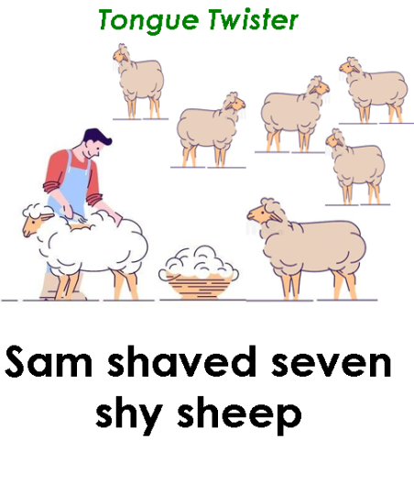
Let’s Practice!
Source: TONGUE TWISTER (Free Download) - Guro Tayo

Slide 42

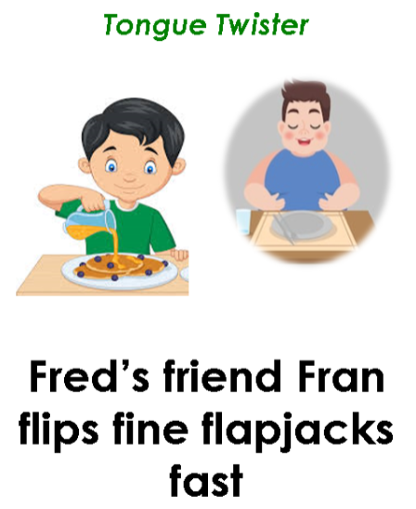
Let’s Practice!
Source: TONGUE TWISTER (Free Download) - Guro Tayo

Slide 43

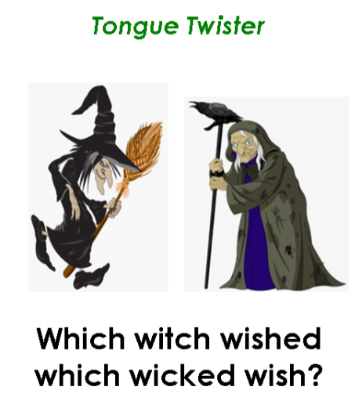
Let’s Practice!
Source: TONGUE TWISTER (Free Download) - Guro Tayo

Slide 44
SPEECH RATE EXERCISE
Early to bed and early to rise, keeps a man healthy, wealthy and wise'. The great advantage of early rising is the good start it gives us in our day’s work. In the early morning, the mind is fresh and there are few sounds so that work done at that time is generally well done.
The early riser also finds time to take some exercise in the fresh morning air, and‚ this exercise supplies him with a fund of energy that will last until the evening. By beginning so early, he knows that he has plenty of time to do through all the work he can be expected to do and is not tempted to hurry over any part of it. All his working being finished in good time, he has a long interval of rest in the evening before he goes to bed.
Notes:
For the Facilitator:
This excerpt contains 140 words. Time yourself as you try this exercise.
Ensure production of phonemes, pauses, stress and tone.

Slide 45
Terminal Objectives
At the end of this course, you should be able to:
Produce the different English sounds; Unlearn Filipino sounds; Properly use articulators; Practice saying the different sounds; Demonstrate the ability to speak with a neutral accent.
Notes:
Check all appropriate before recapping.

