Slide 1
Learning Green’s Functions – M2R Project
Charlie Lowman, Haochen Gu, Lorenzo di Giura del Balzo di Presenzano, Wanying Qi and Yubo Zhang
18/06/2025

Slide 2
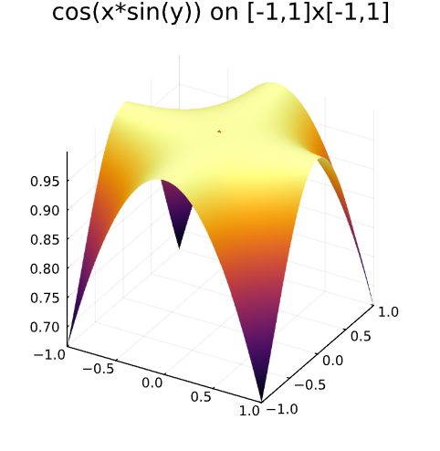
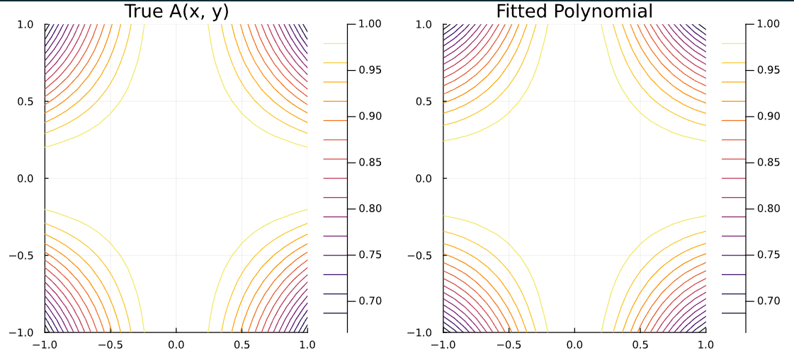
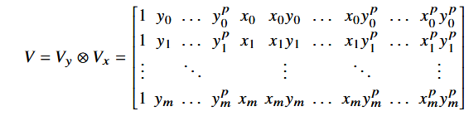
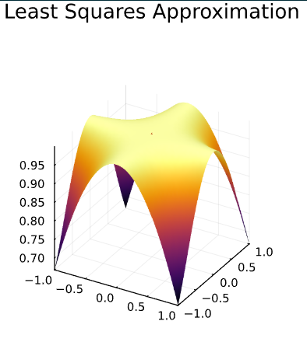
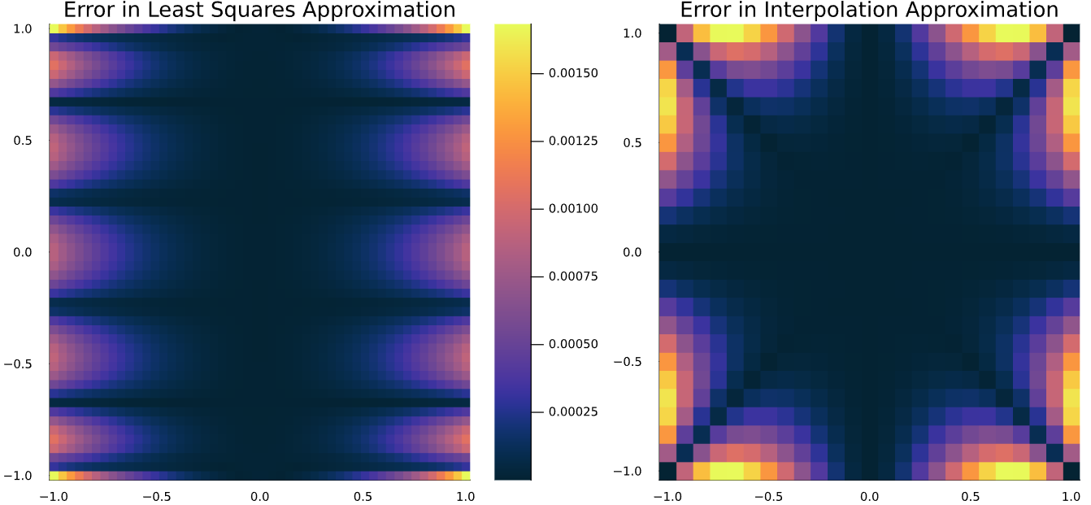
Background – Numerical Methods
Polynomial Interpolation
- Vandermonde Matrices
- Kronecker Product
- Errors and convergence
Least Squares Regression
- Very similar to the above method
- Errors occur in different locations
Charlie Lowman
18/06/2025

Slide 3
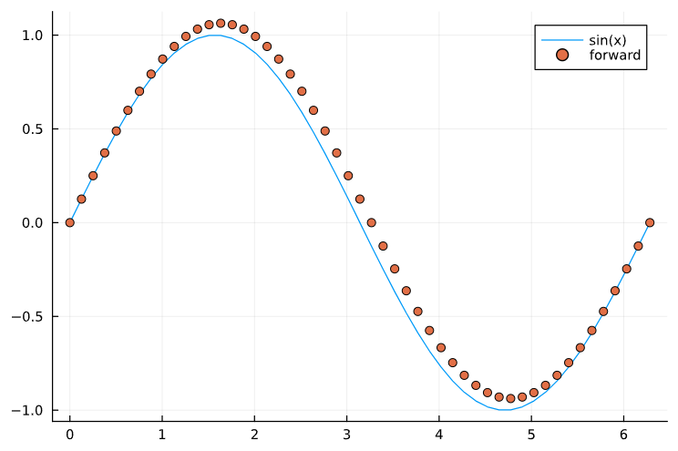
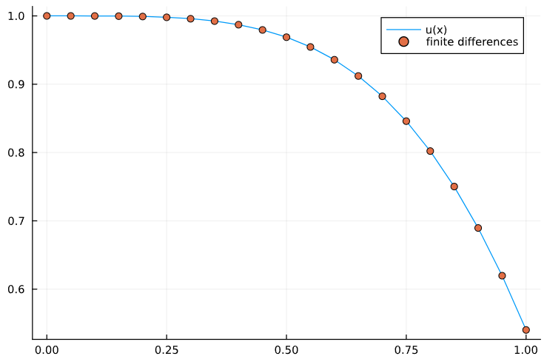
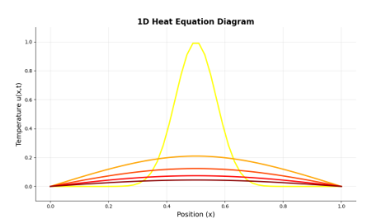
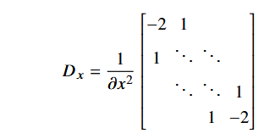
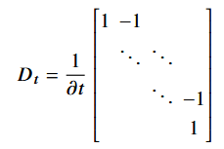
Background – Numerical Methods
Finite Differences
- Numerical solution to differential equations
- Addition of a potential
- Boundary conditions for u = cos(x²)
Heat Equation
- Unforced heat equation
- Two variable heat equation (x and t)
- Solution using Julia
Charlie Lowman
18/06/2025

Slide 4
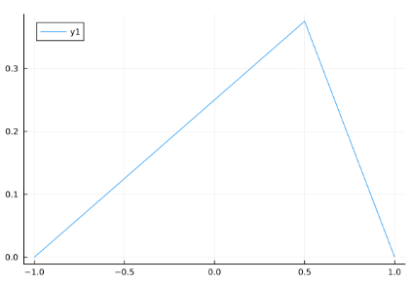
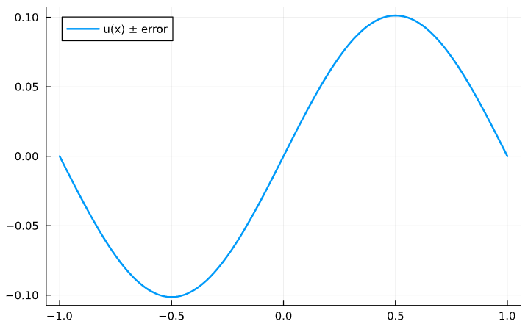
Green’s Functions
Definition
- Fundamental solutions
- Solution to a specific right hand side
Derivation
- Integration of Dirac-delta
- Use of step functions
- Constraints and boundary conditions
- Rarely able to solve analytically
Use in Quadrature
- Used to recover u the solution to the specific problem
- Convolution of the Green’s function and the right hand side over the domain
Charlie Lowman
18/06/2025

Slide 5
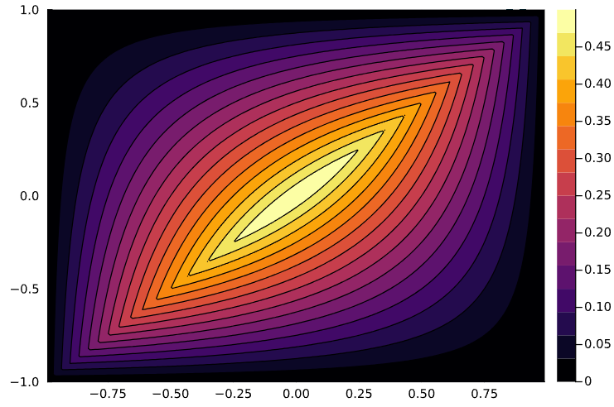
Green’s Functions - Poisson
Derivation of the Green’s Function for the Poisson Equation
$\frac{∂^{2}u}{∂x^{2}}=f\left(x,y\right)$
- We have the equation , the Poisson equation with initial conditions
-
$f\left(x,y\right)$
Charlie Lowman
18/06/2025

