Slide 1
Learning Green’s Functions – M2R Project
Charlie Lowman, Haochen Gu, Lorenzo di Giura del Balzo di Presenzano, Wanying Qi and Yubo Zhang
18/06/2025

Slide 2
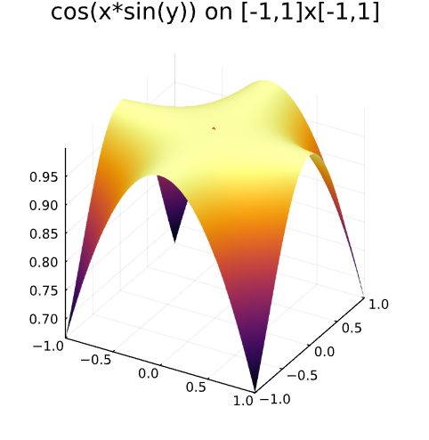
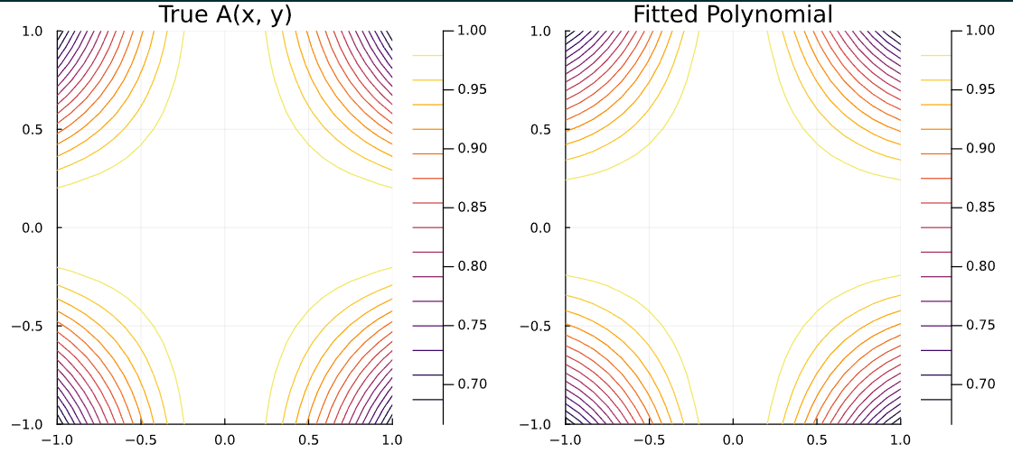
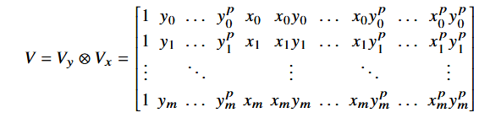
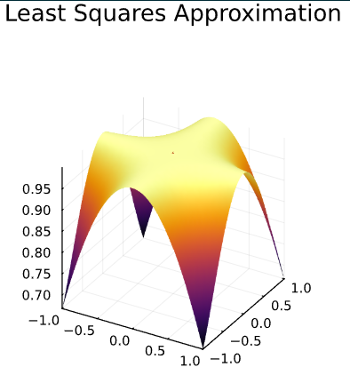
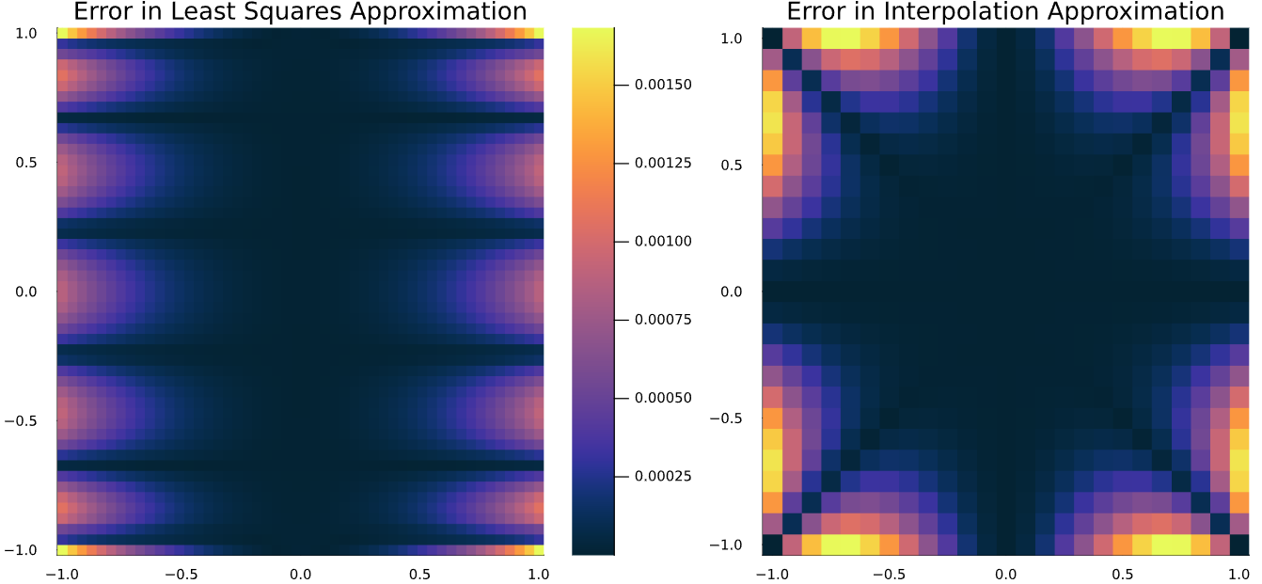
Background – Numerical Methods
Polynomial Interpolation
- Vandermonde Matrices
- Kronecker Product
- Errors and convergence
Least Squares Regression
- Very similar to the above method
- Errors occur in different locations
- Simpler to implement using Julia but less versatile

Slide 3
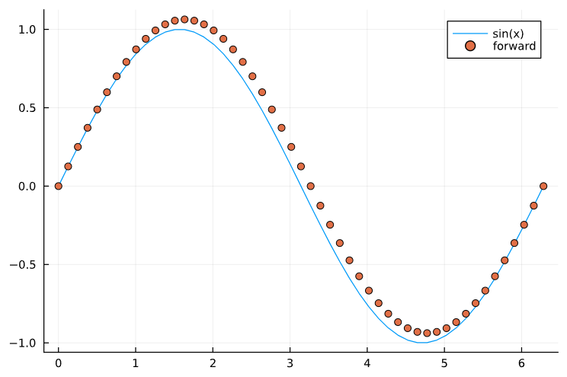
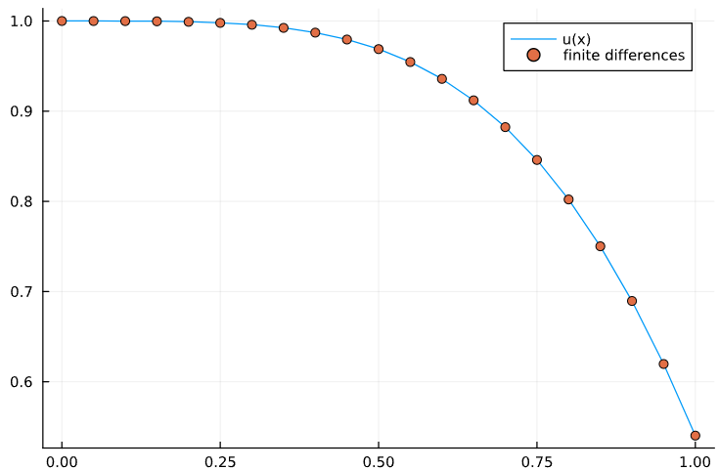
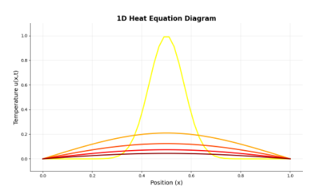
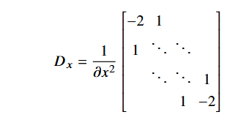
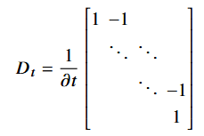
Background – Numerical Methods
Finite Differences
- Numerical solution to differential equations
- Addition of a potential
- Boundary conditions for u = cos(x²)
Heat Equation
- Unforced heat equation
- Two variable heat equation (x and t)
- Vectorise the sampled solution matrix
- Solution using Julia

Slide 4
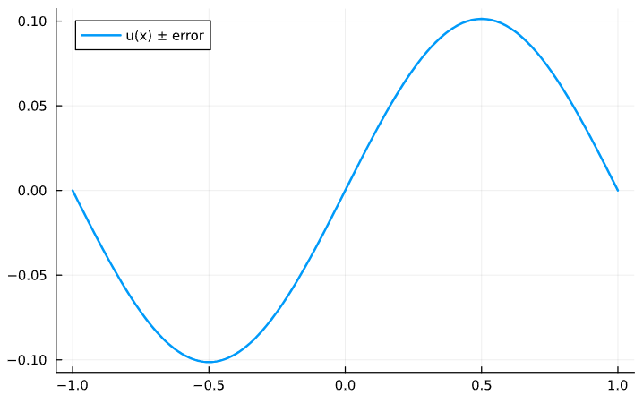
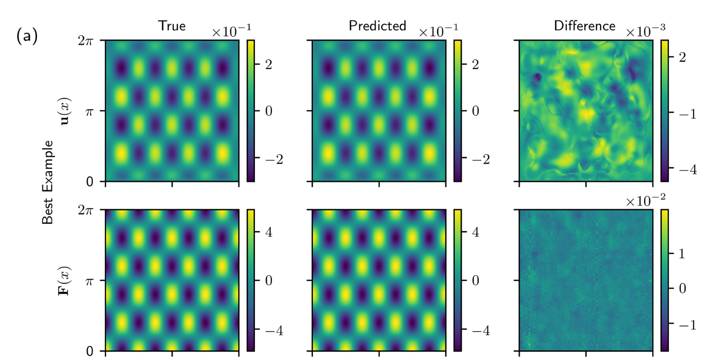
Green’s Functions
Definition
- Fundamental solutions
- Solution to a specific right hand side
- Why the delta function is chosen
Derivation
- Integration of Dirac-delta
- Use of step functions
- Constraints and boundary conditions
- Rarely able to solve analytically
Use in Quadrature
- Used to recover u the solution to the specific problem
- Convolution of the Green’s function and the right hand side over the domain

Slide 5
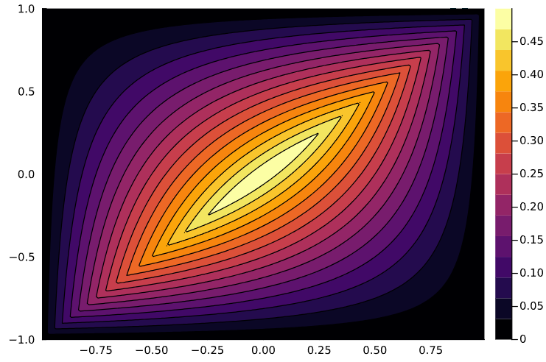

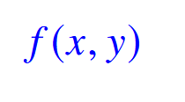


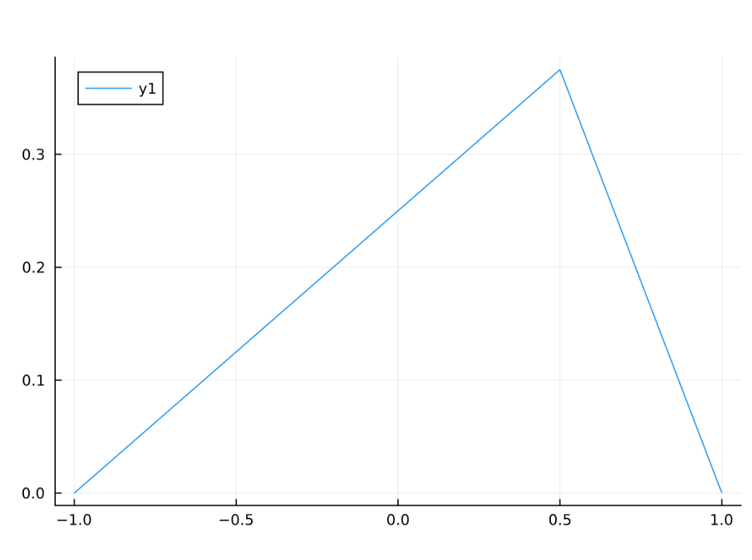

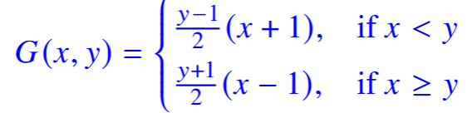
Green’s Functions - Poisson
Derivation of the Green’s Function for the Poisson Equation
- We have the equation , the Poisson equation with initial conditions
- For this example, we take the boundary constraints
- To convert this to a Green’s function problem, we set
- We can integrate this to obtain a step function as well as a constant term, yielding
- Integrating again gives G in terms of ramp and unknown functions, and then we apply the boundary conditions
- We also know the jump discontinuity is 1, and that the function must be continuous at y
- These are enough constraints to give our full function, which in this case turns out to be:
Contour plot for the Green’s function to the Poisson equation
A slice of the above plot for y = 0.5

