Slide 1
Learning Green’s Functions – M2R Project
Charlie Lowman, Haochen Gu, Lorenzo di Giura del Balzo di Presenzano, Wanying Qi and Yubo Zhang
18/06/2025

Slide 2
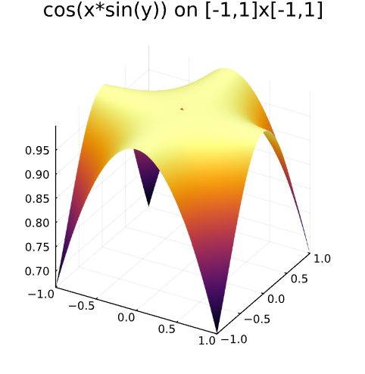
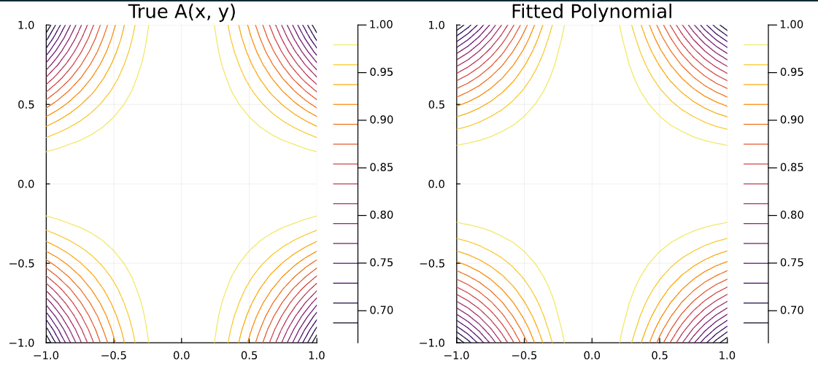
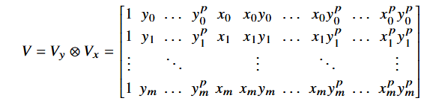
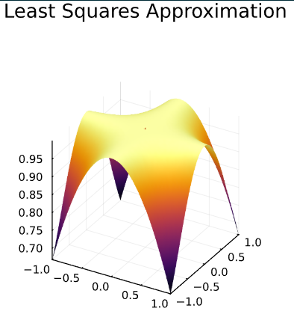
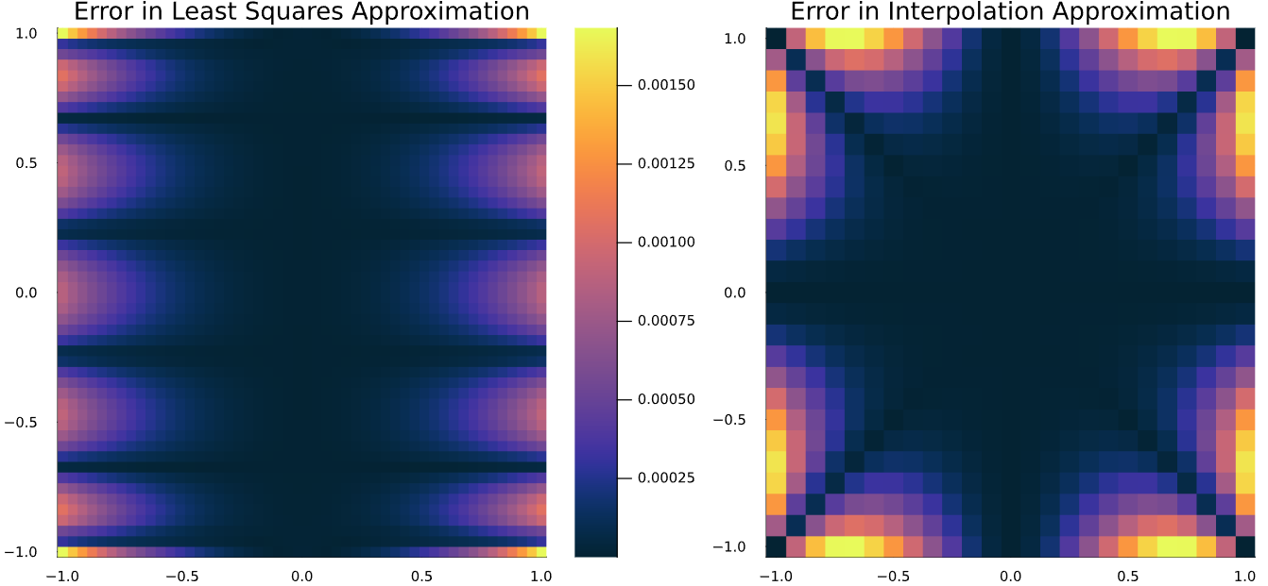
Background – Numerical Methods
Polynomial Interpolation
- Vandermonde Matrices
- Kronecker Product
- Errors and convergence
Least Squares Regression
- Very similar to the above method
- Errors occur in different locations
- Simpler to implement using Julia but less versatile

Slide 3
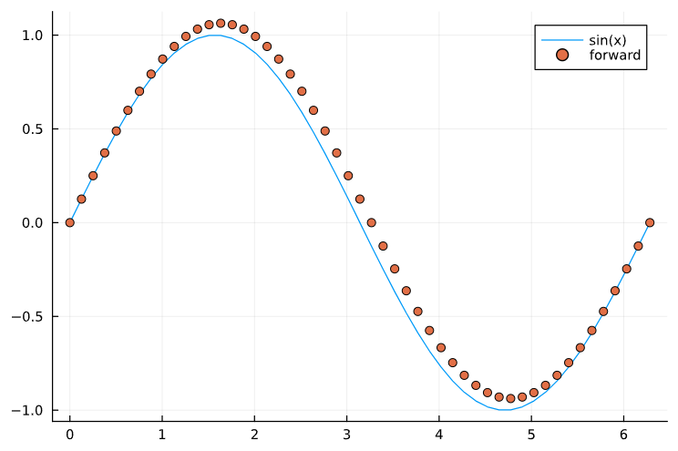
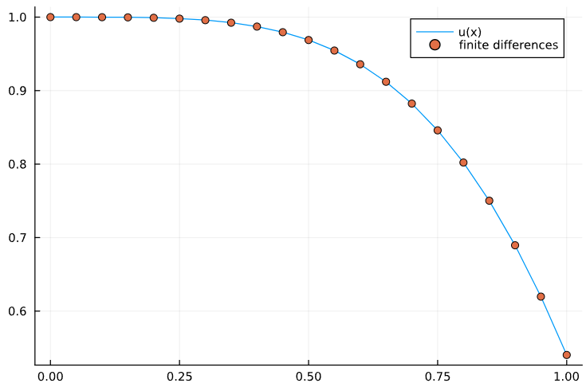
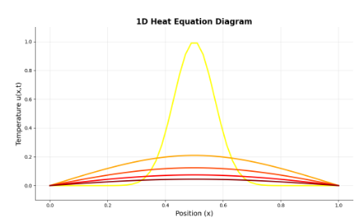
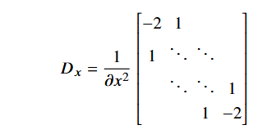
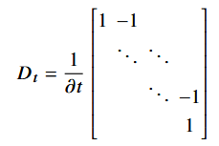
Background – Numerical Methods
Finite Differences
- Numerical solution to differential equations
- Addition of a potential
- Boundary conditions for u = cos(x²)
Heat Equation
- Unforced heat equation
- Two variable heat equation (x and t)
- Vectorise the sampled solution matrix
- Solution using Julia

Slide 4
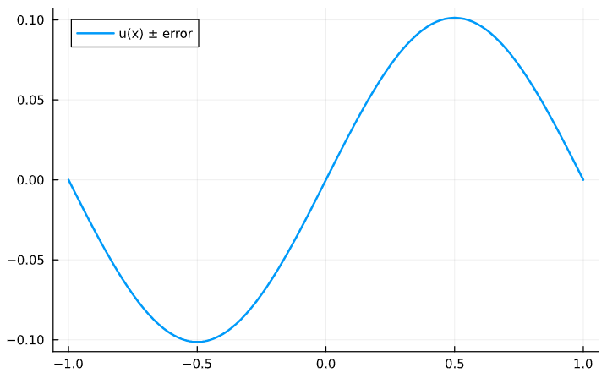
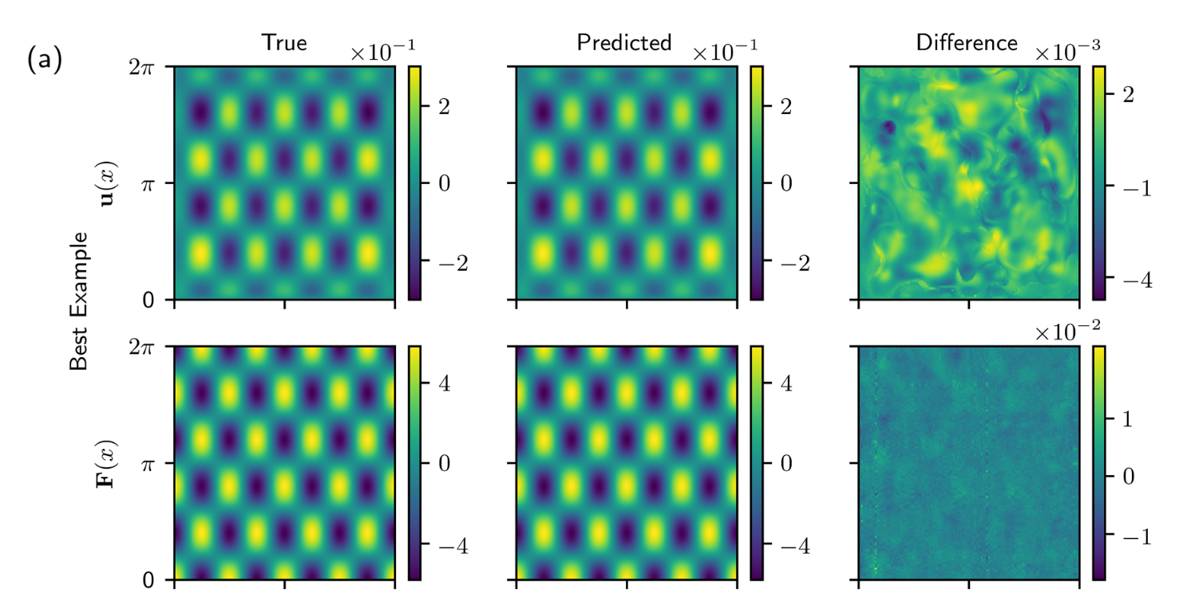
Green’s Functions
Definition
- Fundamental solutions
- Solution to a specific right hand side
- Why the delta function is chosen
Derivation
- Integration of Dirac-delta
- Use of step functions
- Constraints and boundary conditions
- Rarely able to solve analytically
Use in Quadrature
- Used to recover u the solution to the specific problem
- Convolution of the Green’s function and the right hand side over the domain

Slide 5
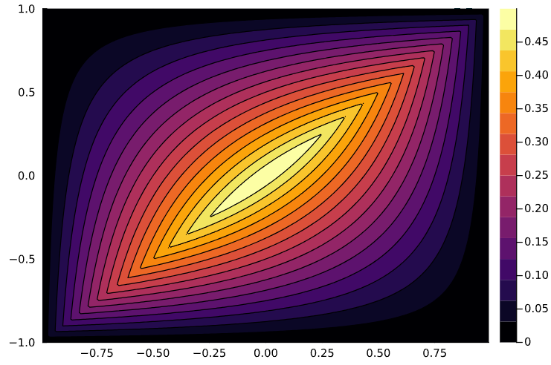

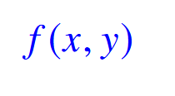


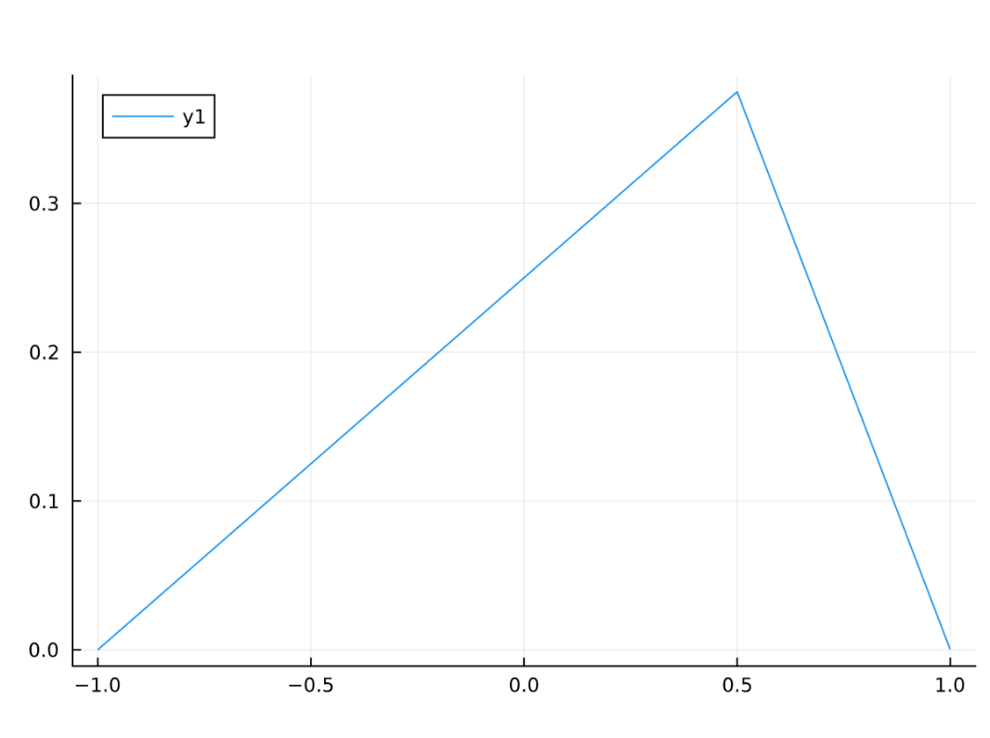

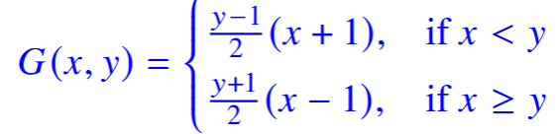
Green’s Functions - Poisson
Derivation of the Green’s Function for the Poisson Equation
- We have the equation , the Poisson equation with initial conditions
- For this example, we take the boundary constraints
- To convert this to a Green’s function problem, we set
- We can integrate this to obtain a step function as well as a constant term, yielding
- Integrating again gives G in terms of ramp and unknown functions, and then we apply the boundary conditions
- We also know the jump discontinuity is 1, and that the function must be continuous at y
- These are enough constraints to give our full function, which in this case turns out to be:
Contour plot for the Green’s function to the Poisson equation
A slice of the above plot for y = 0.5

Slide 6
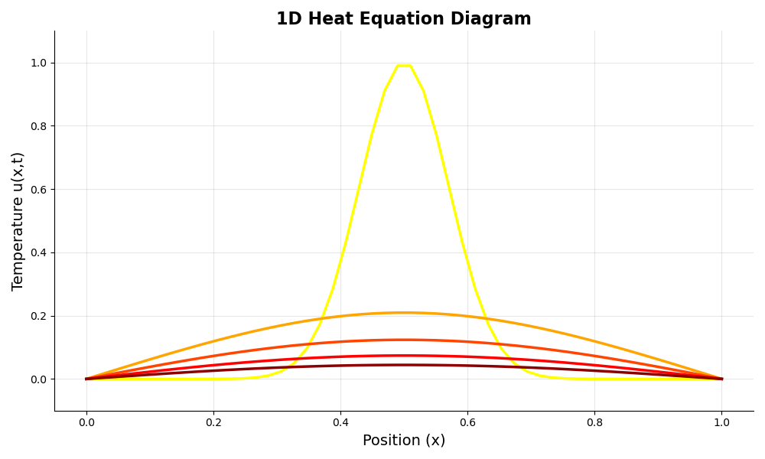


What is the Heat Equation?
The heat equation is a fundamental partial differential equation (PDE) that describes how heat distributes or diffuses through a given region over time.
Homogeneous (no heat source): Describes heat flow in an isolated system.
$$\frac{∂u}{∂t}=c\frac{∂^{2}u}{∂x^{2}}$$
Inhomogeneous (with a heat source): Accounts for an external heat source, g (x, t).
$$\frac{∂u}{∂t}−c\frac{∂^{2}u}{∂x^{2}}=g\left(x\right)$$

Slide 7
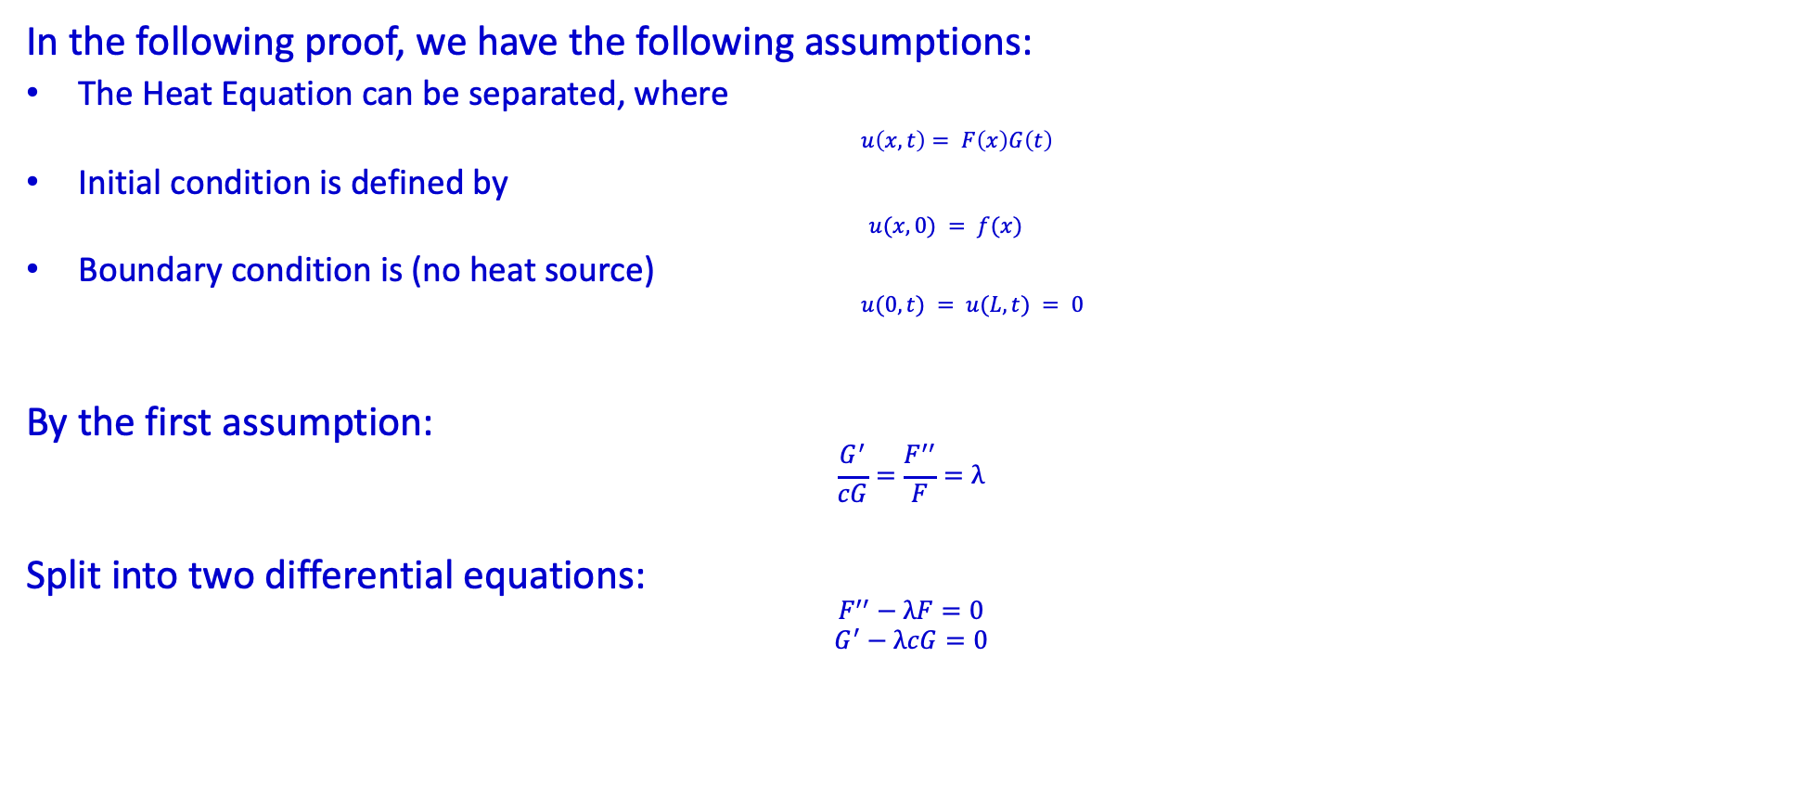
Solving the Homogeneous 1D Heat Equation
In the following proof, we have the following assumptions:
The Heat Equation can be separated, where
$u\left(x, t\right)= F\left(x\right)G\left(t\right)$
Initial condition is defined by
$u(x, 0) = f(x)$
Boundary condition is (no heat source)
$u(0, t) = u(L, t) = 0$
By the first assumption:
$$\frac{G^{′}}{cG}=\frac{F^{′′}}{F}=λ$$
Split into two differential equations:
$$F^{′′}−λF=0$$
$$G^{′}−λcG=0$$

Slide 8
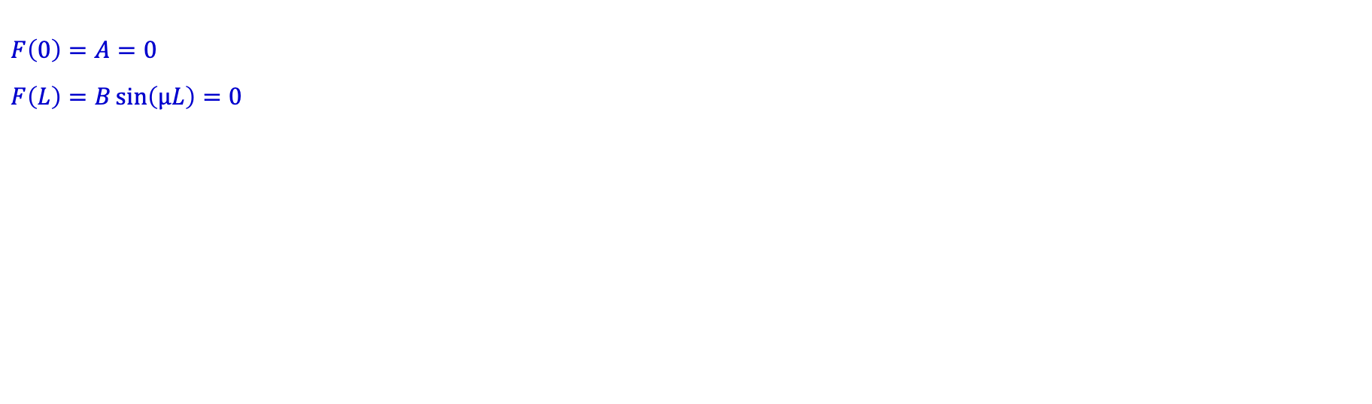
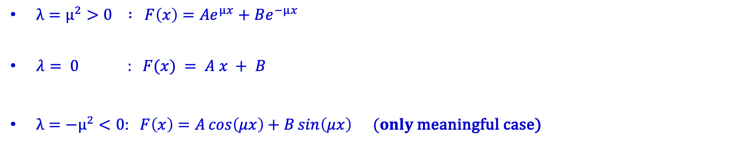

Solving F
$λ=μ^{2}>0 : F\left(x\right)=Ae^{μx}+Be^{−μx}$
$λ= 0$ : $F(x) = A x + B$
$λ=−μ^{2}<0$: $F\left(x\right)=A\cos\left(μx\right)+B\sin\left(μx\right) (only$meaningful case)
$$F\left(0\right)=A=0$$
$$F\left(L\right)=B\sin\left(μL\right)=0$$
$$μ=\frac{nπ}{L}$$
$$F_{n}\left(x\right)=\sin\left(\frac{nπx}{L}\right)$$

Slide 9

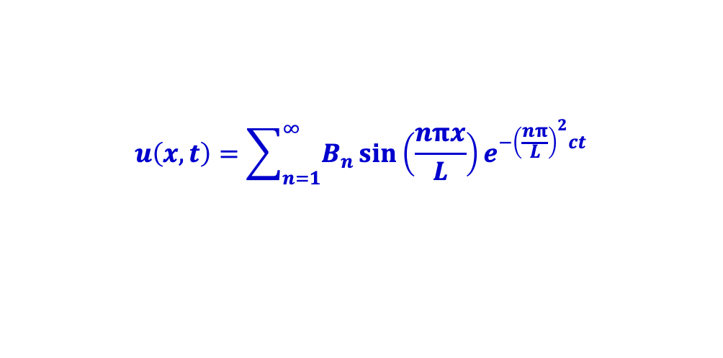

Solving G
$$G^{′}+{\left(\frac{nπ}{L}\right)}^{2}cG= 0$$
$$G_{n}\left(t\right)=B_{n}e^{−{\left(\frac{nπ}{L}\right)}^{2}ct}$$
$$u_{n}\left(x,t\right)=F_{n}\left(x\right)G_{n}\left(t\right)=B_{n}\sin\left(\frac{nπx}{L}\right)e^{−{\left(\frac{nπ}{L}\right)}^{2}ct}$$
$$u\left(x,t\right)=\sum_{n=1}^{∞}{B_{n}}\sin\left(\frac{nπx}{L}\right)e^{−{\left(\frac{nπ}{L}\right)}^{2}ct}$$

Slide 10
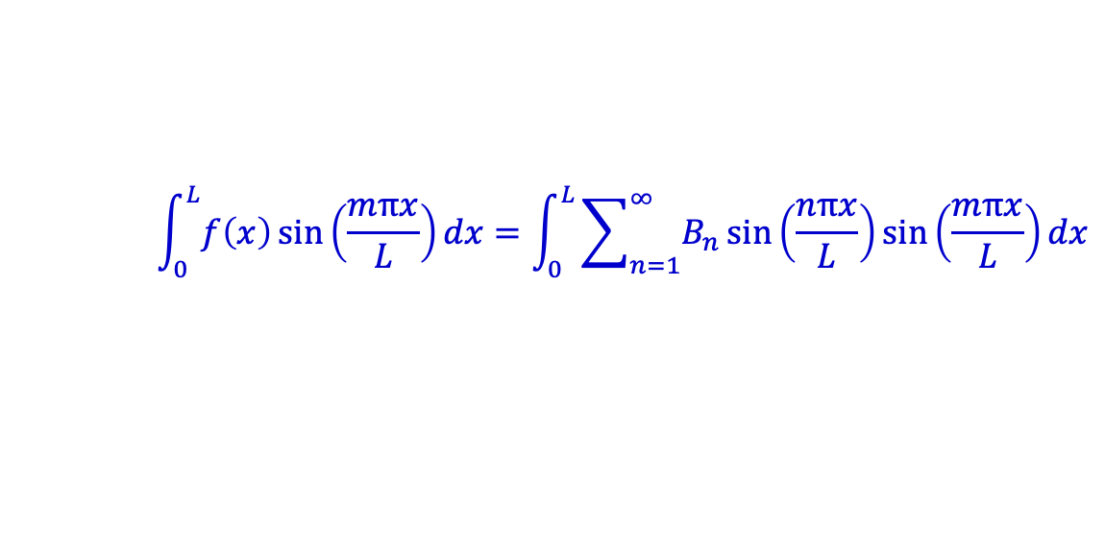
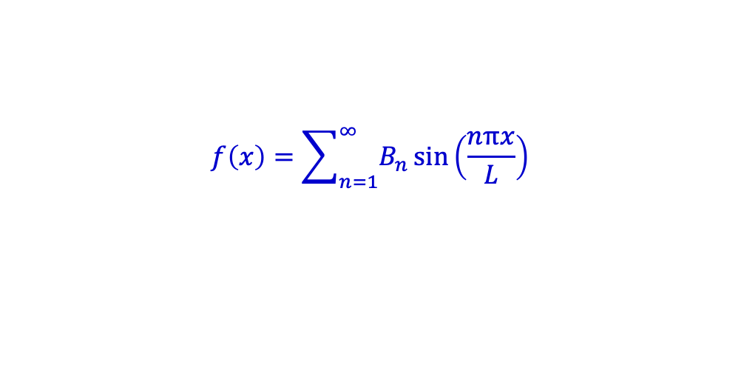
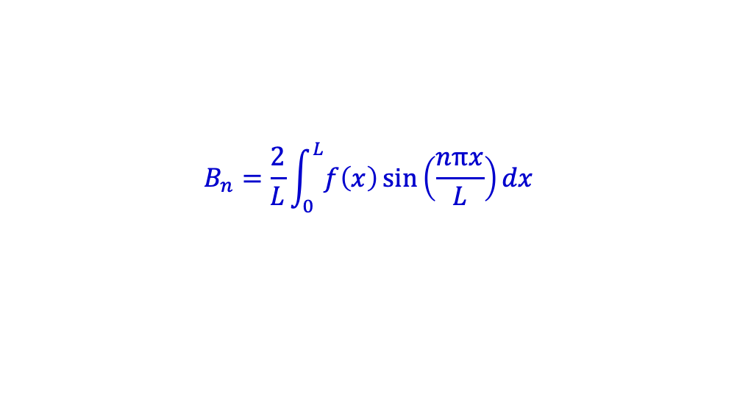
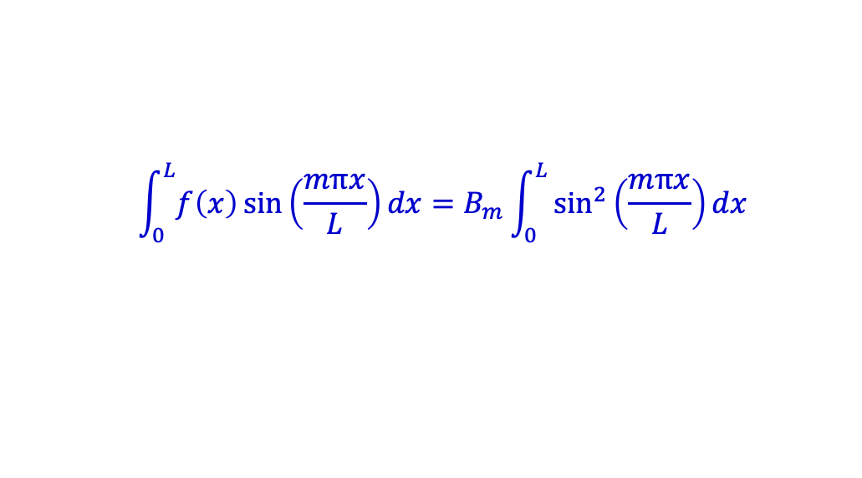
Solving B
$$f\left(x\right)=\sum_{n=1}^{∞}{B_{n}}\sin\left(\frac{nπx}{L}\right)$$
$$\int_{0}^{L}{f\left(x\right)}\sin\left(\frac{mπx}{L}\right)dx=\int_{0}^{L}{\sum_{n=1}^{∞}{B_{n}}\sin\left(\frac{nπx}{L}\right)}\sin\left(\frac{mπx}{L}\right)dx$$
$$\int_{0}^{L}{f\left(x\right)}\sin\left(\frac{mπx}{L}\right)dx=B_{m}\int_{0}^{L}{\sin^{2}\left(\frac{mπx}{L}\right)dx}$$
$$B_{n}=\frac{2}{L}\int_{0}^{L}{f\left(x\right)}\sin\left(\frac{nπx}{L}\right)dx$$

