Slide 1

CitiBike
Marketing & Expansion

Slide 2
Agenda
General Information
Proposal
Next Steps

Slide 3
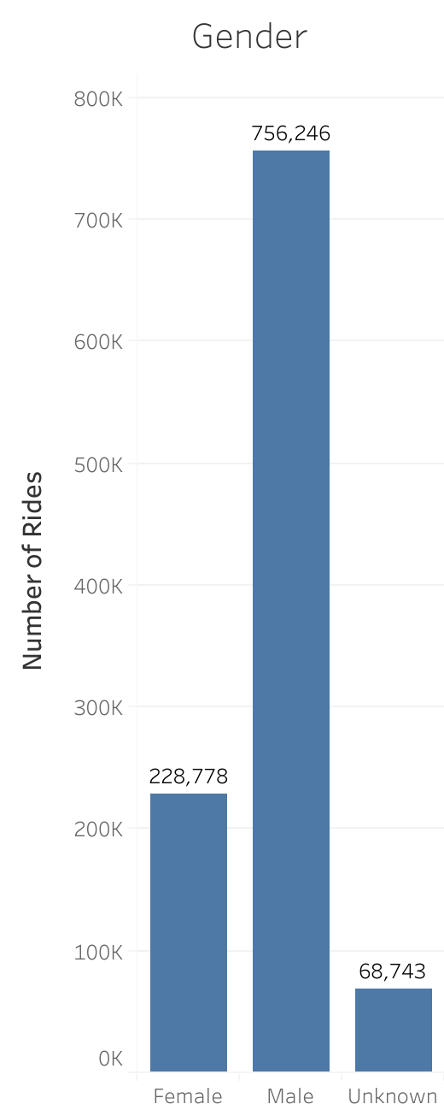
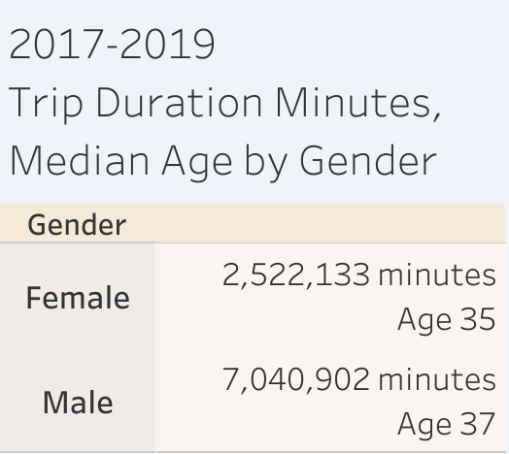
General Information

Slide 4
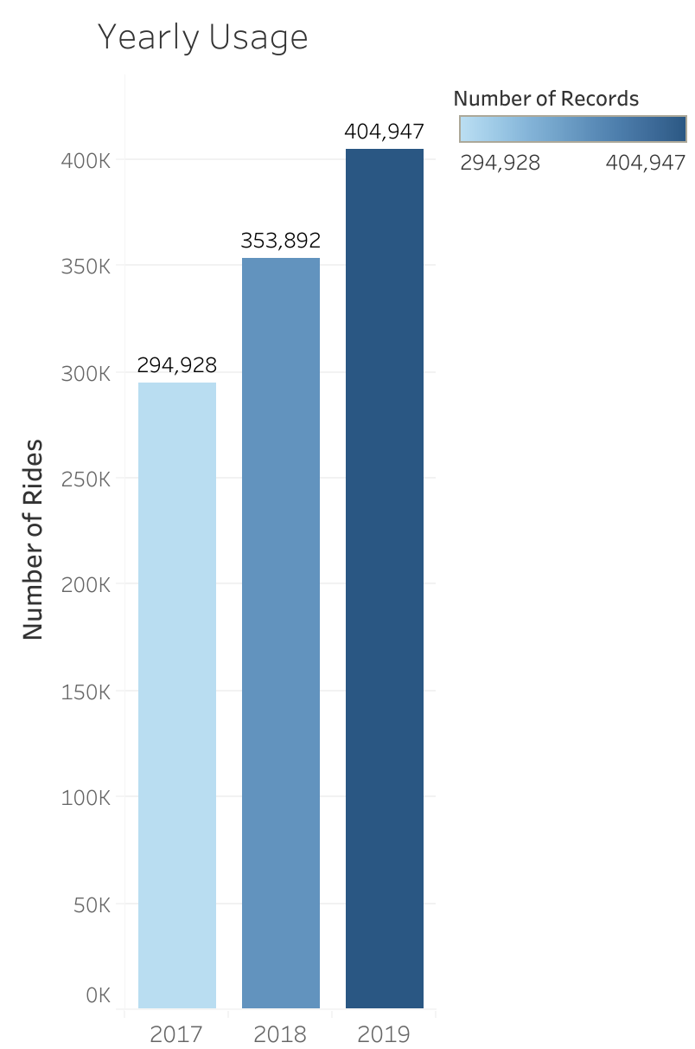


Slide 5
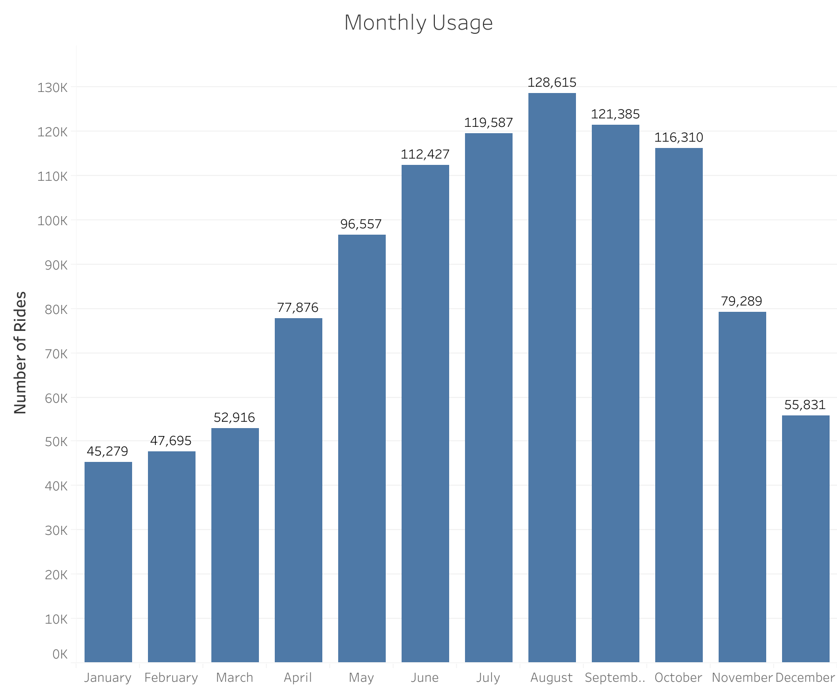
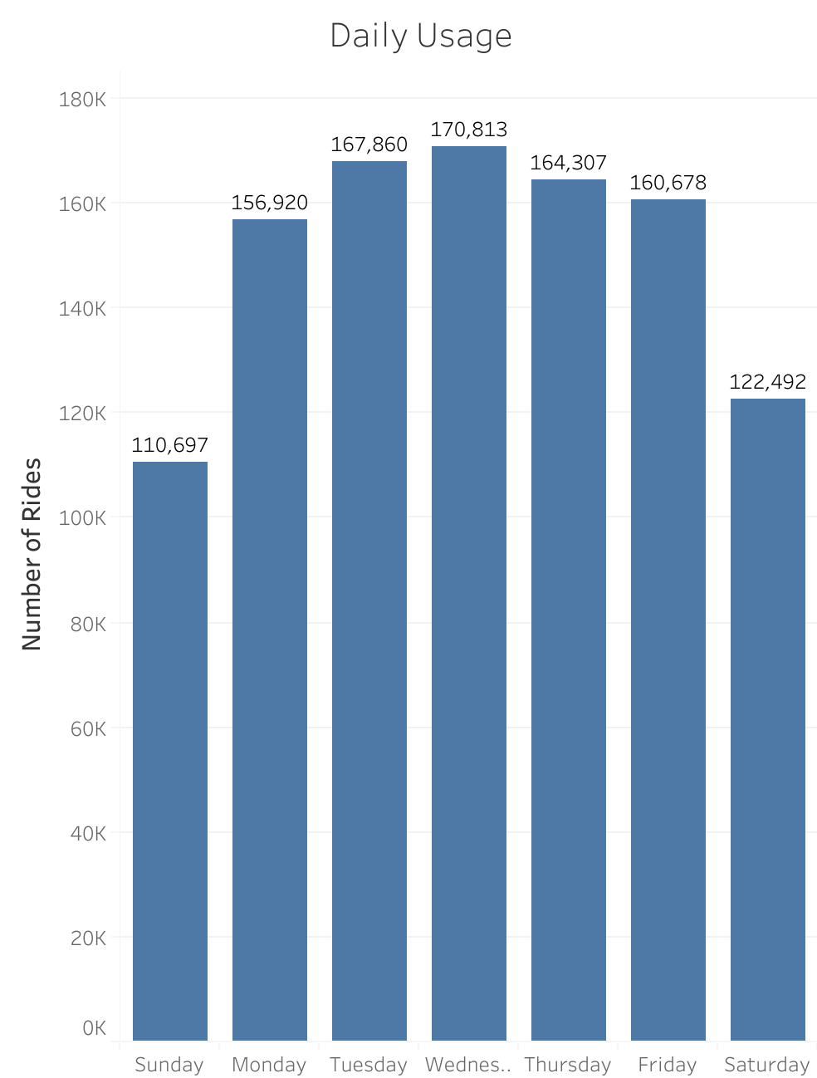

Slide 6
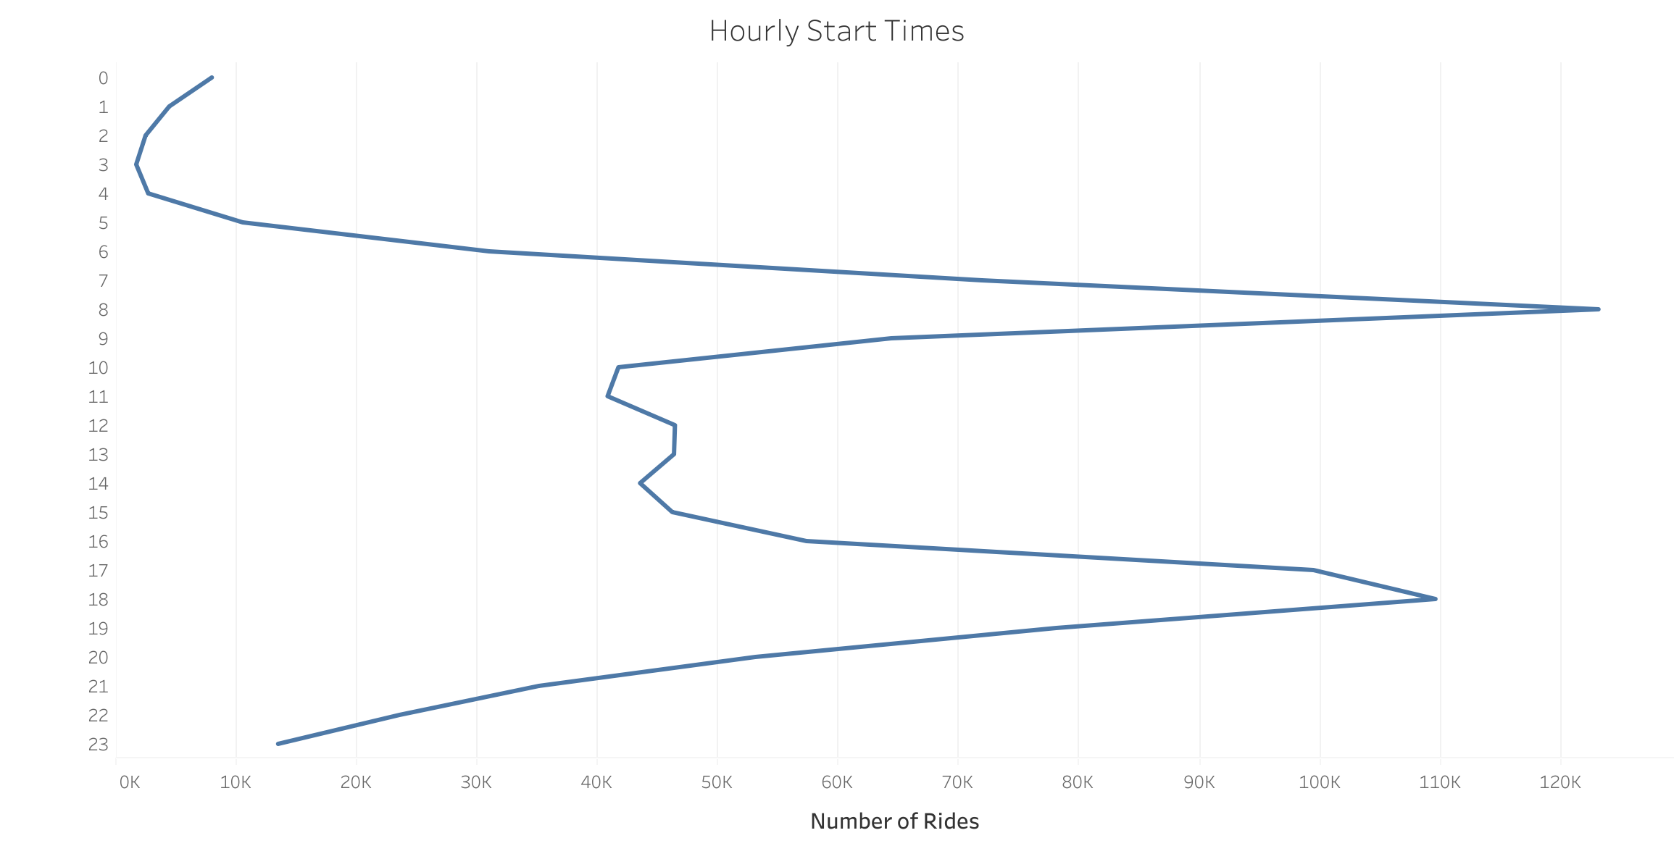

Slide 7
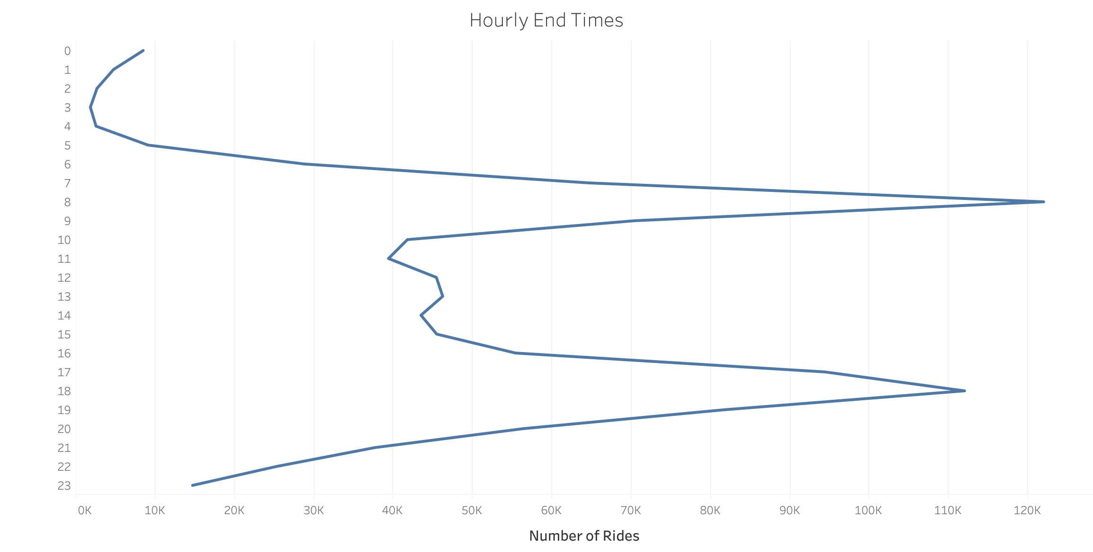

Slide 8
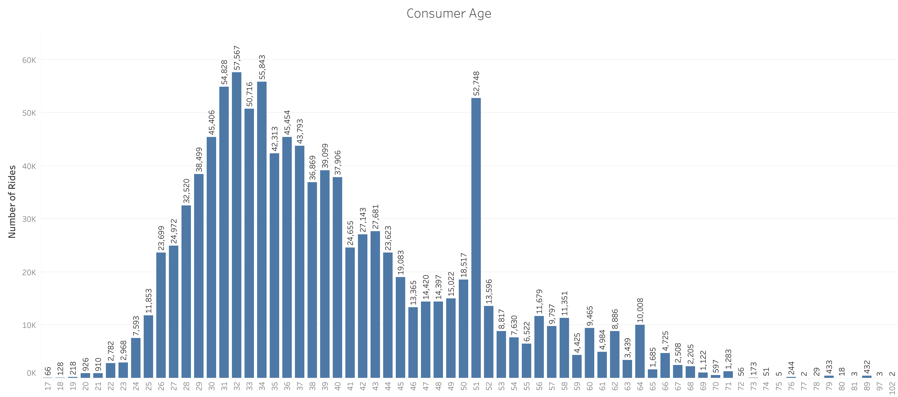

Slide 9
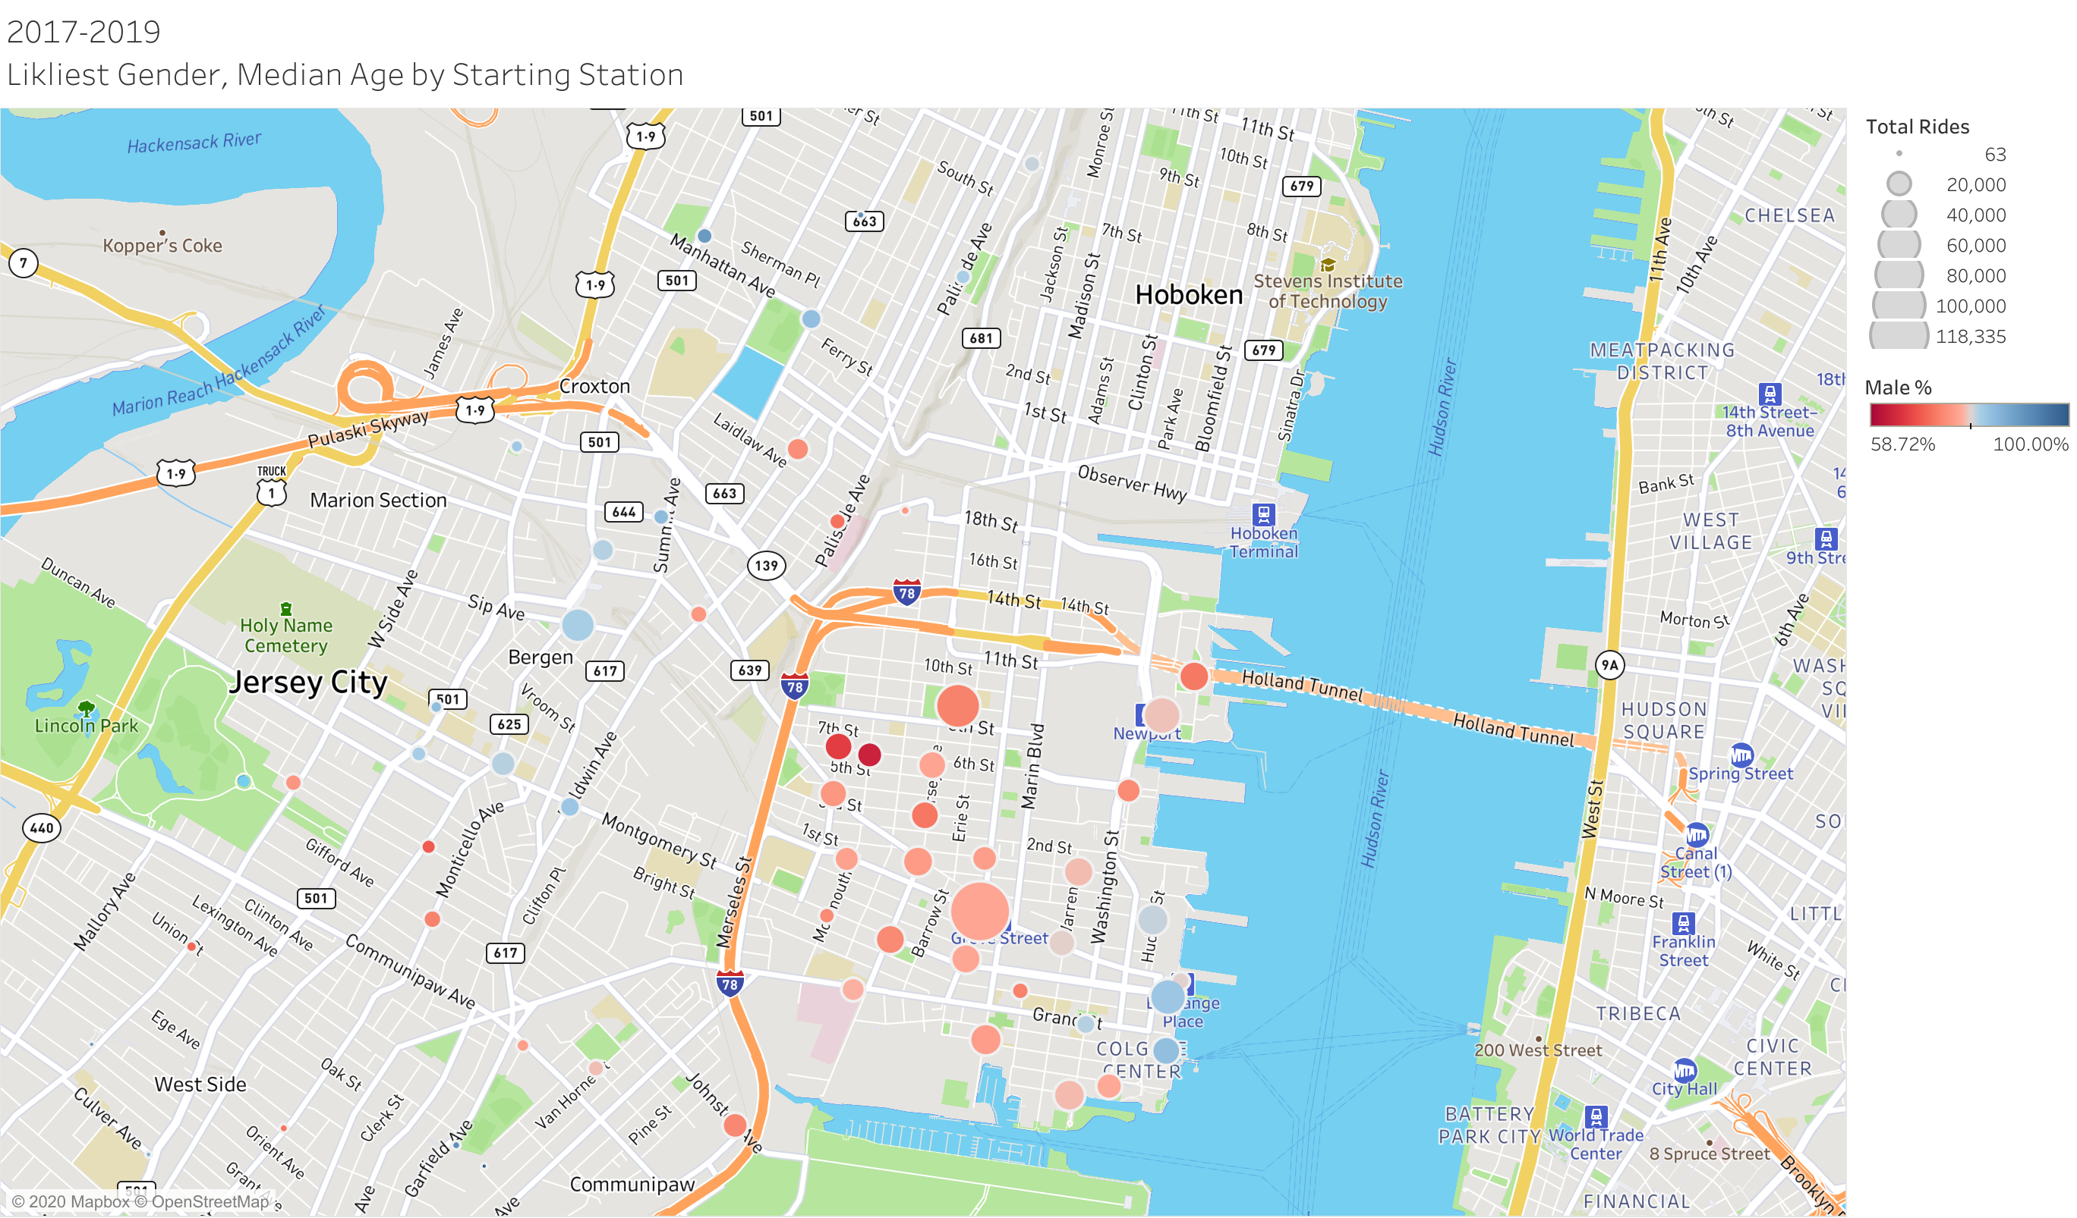

Slide 10
Proposal
Source: Citi Bike System Data; January 1, 2017 through December 31, 2019

Slide 11
Next Steps

