Slide 1
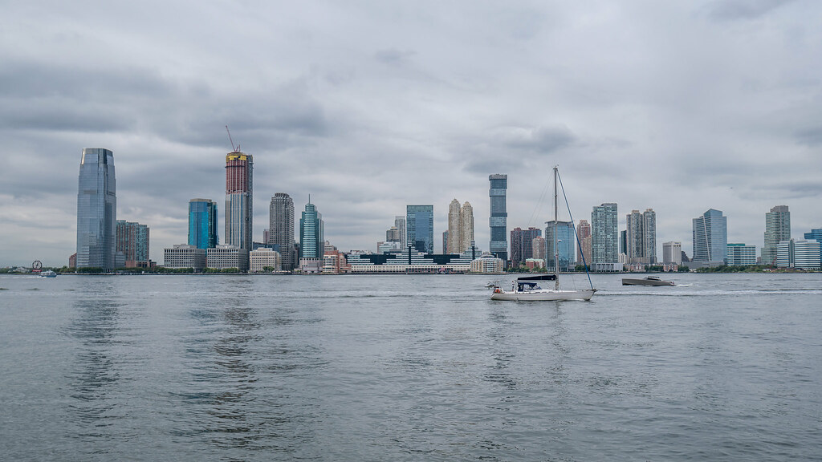
CitiBike
Jersey City
Marketing & Expansion
Charles Glover
Ryan Millikan

Slide 2
Agenda
Rider Information
Proposal
Next Steps

Slide 3
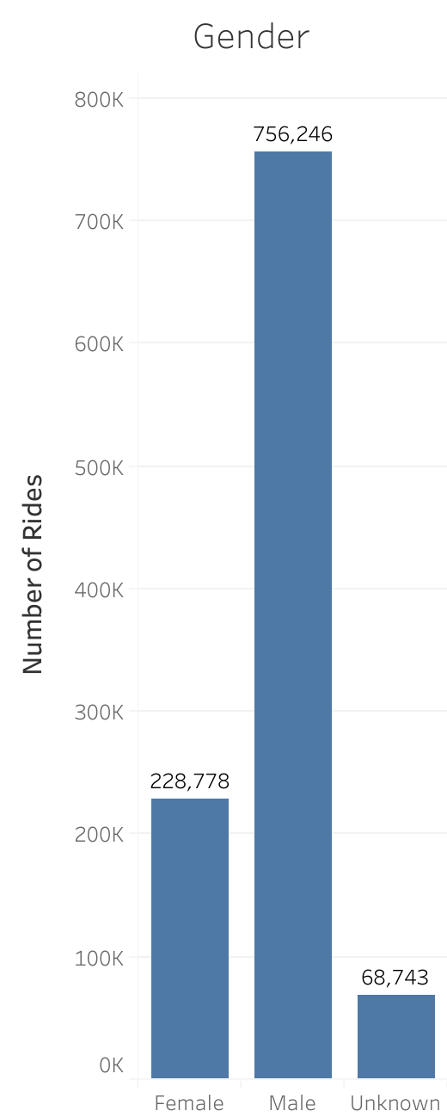
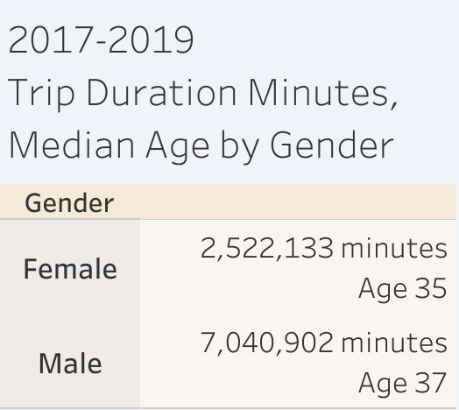
Citi Bike riders have logged 9.56 million minutes over the last 3 years
Male riders account for 71.7% of Citi Bike Rides
Female Riders = 21.7% of rides
Unknown = 6.5% of rides
Rider median age is similar for Men and Women
Source: Citi Bike System Data; January 1, 2017 through December 31, 2019

Slide 4
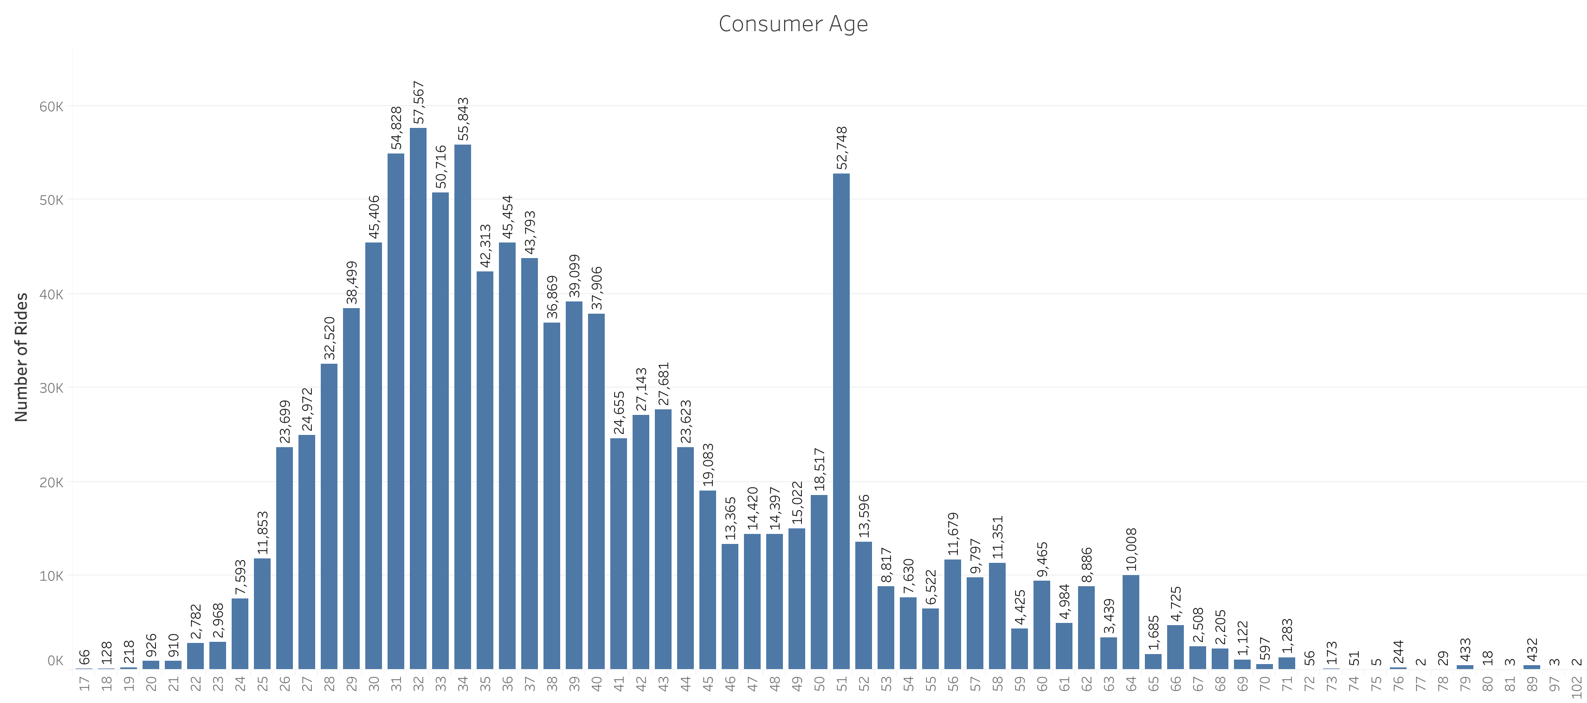
55.1% of riders are between the ages of 28-40
Riders tend to be older in age
51 year old riders spike
Source: Citi Bike System Data; January 1, 2017 through December 31, 2019

Slide 5
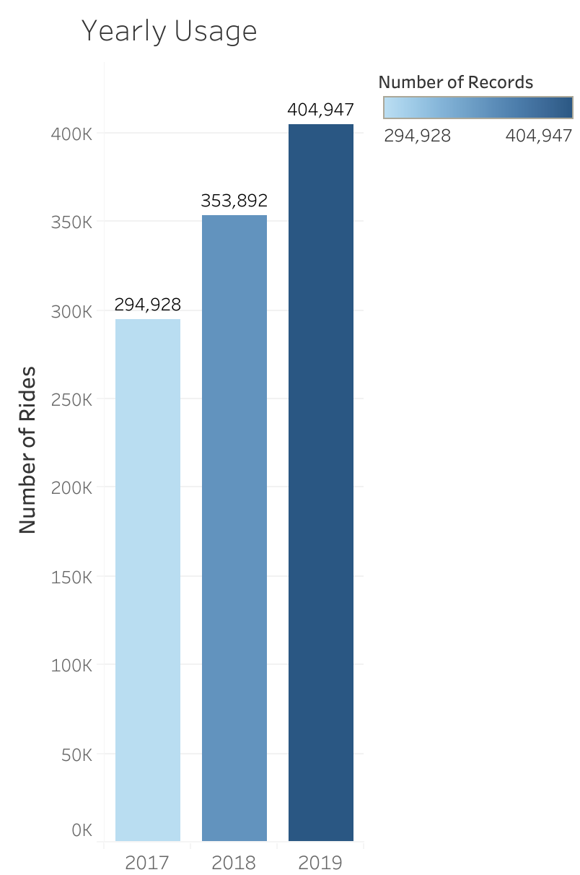
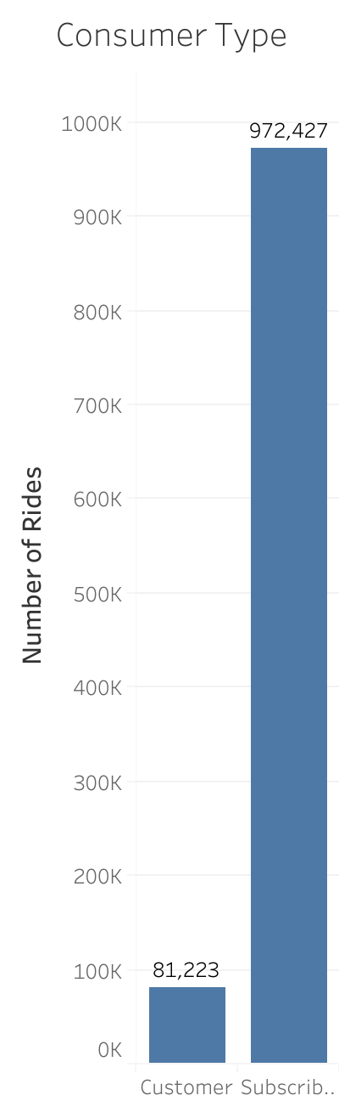
37.3% increase in rides since 2017
Subscribers account for 92.3% of all rides
Subscribers have an annual membership
$169/yr
Customers purchase daily or three day passes
Daily: $12
Three Day: $24
Source: Citi Bike System Data; January 1, 2017 through December 31, 2019; Pricing found on WikiPedia

Slide 6
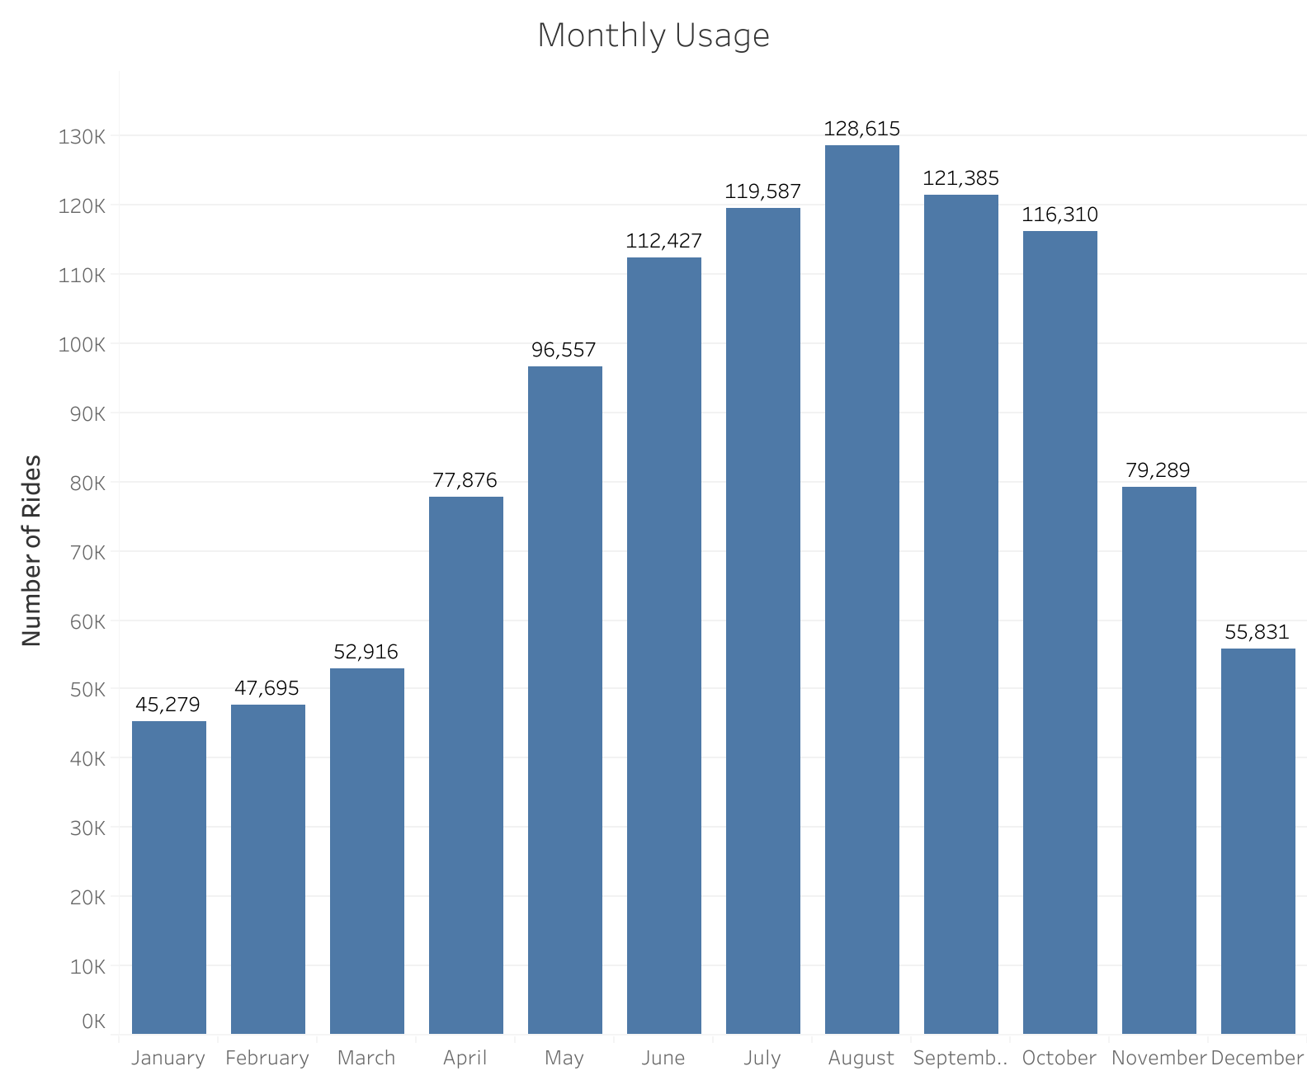
Ride usage peaks from May - October
Ride usage peaks in August with 128,615 trips
Usage goes down during the winter months
Source: Citi Bike System Data; January 1, 2017 through December 31, 2019

Slide 7
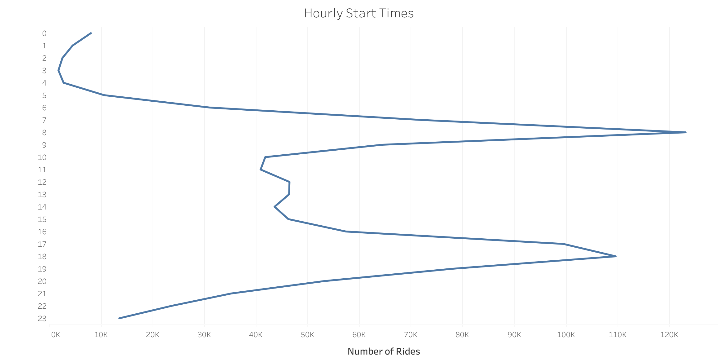
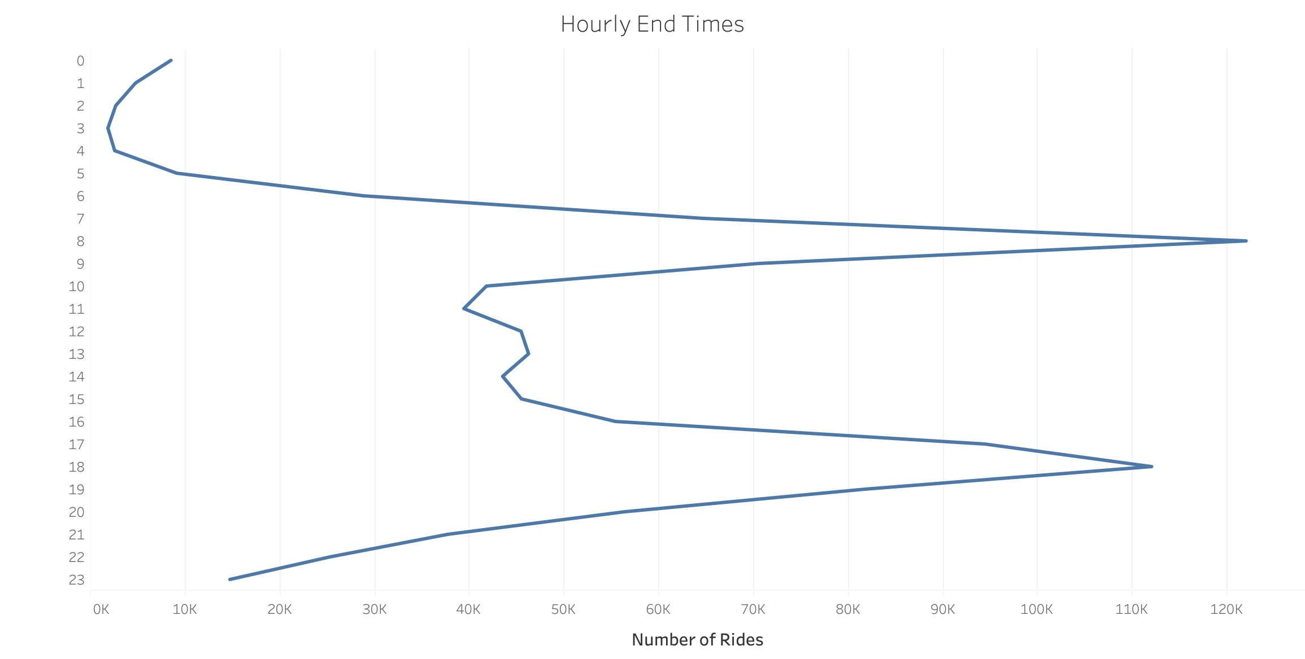
Rides peak during rush hour times in the morning and evening
Source: Citi Bike System Data; January 1, 2017 through December 31, 2019

Slide 8
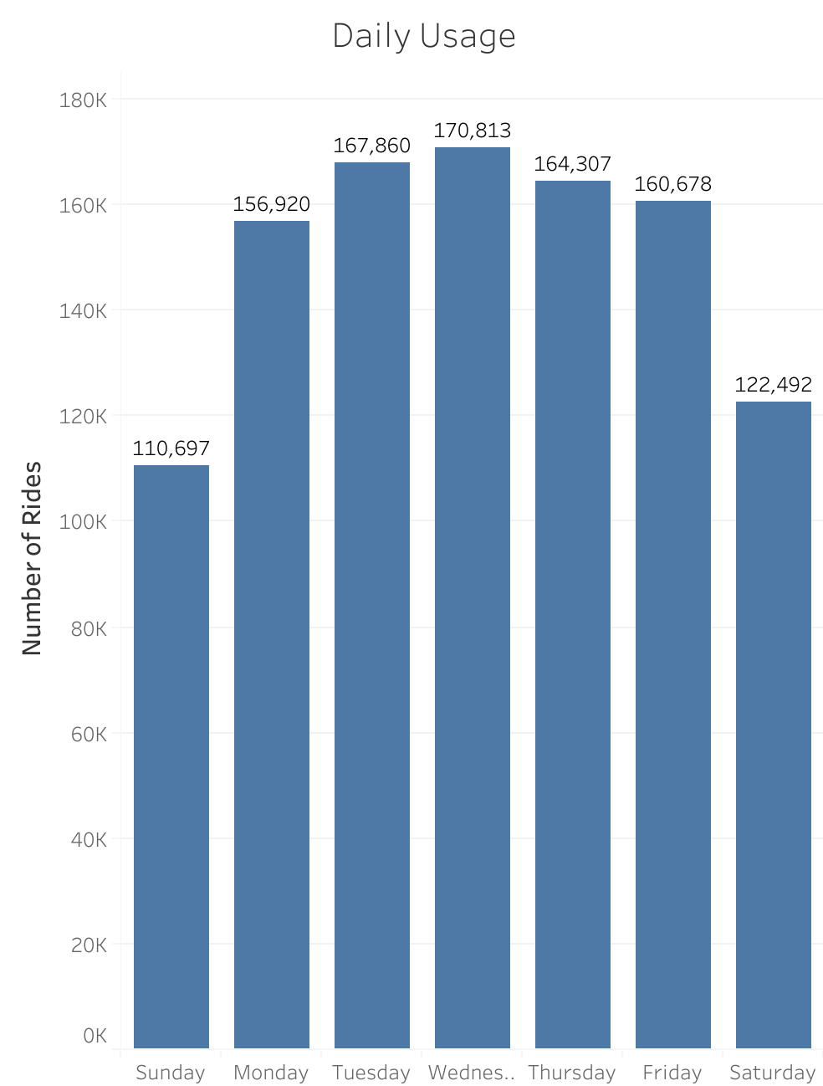
Ride usage is most frequent during the week
Weekday rides is higher than the weekend because Citi Bike riders use our bikes for the commute to work
Source: Citi Bike System Data; January 1, 2017 through December 31, 2019

Slide 9
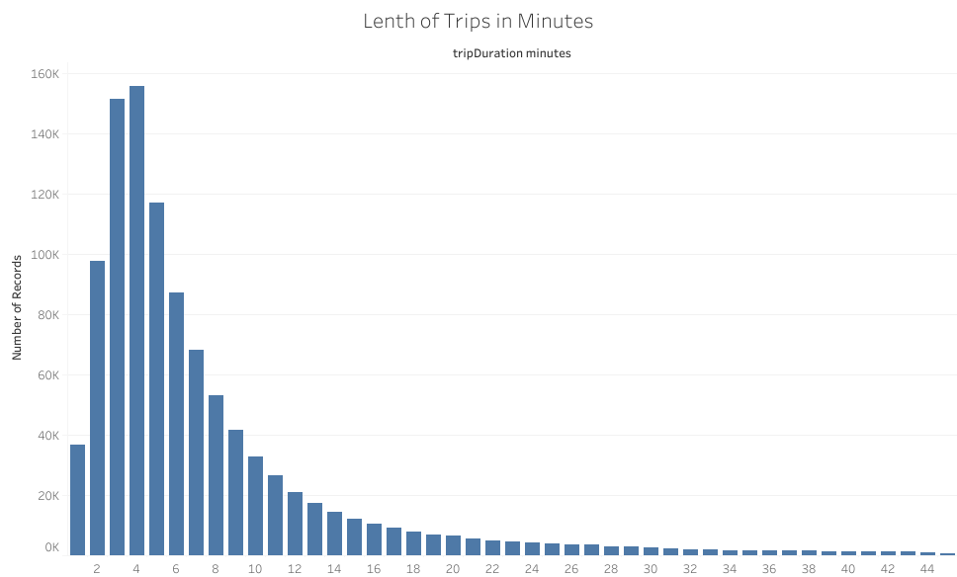
57.8% of rides last between two and seven minutes
The average length of a ride is 6 minutes
Source: Citi Bike System Data; January 1, 2017 through December 31, 2019

Slide 10
Proposal

Slide 11
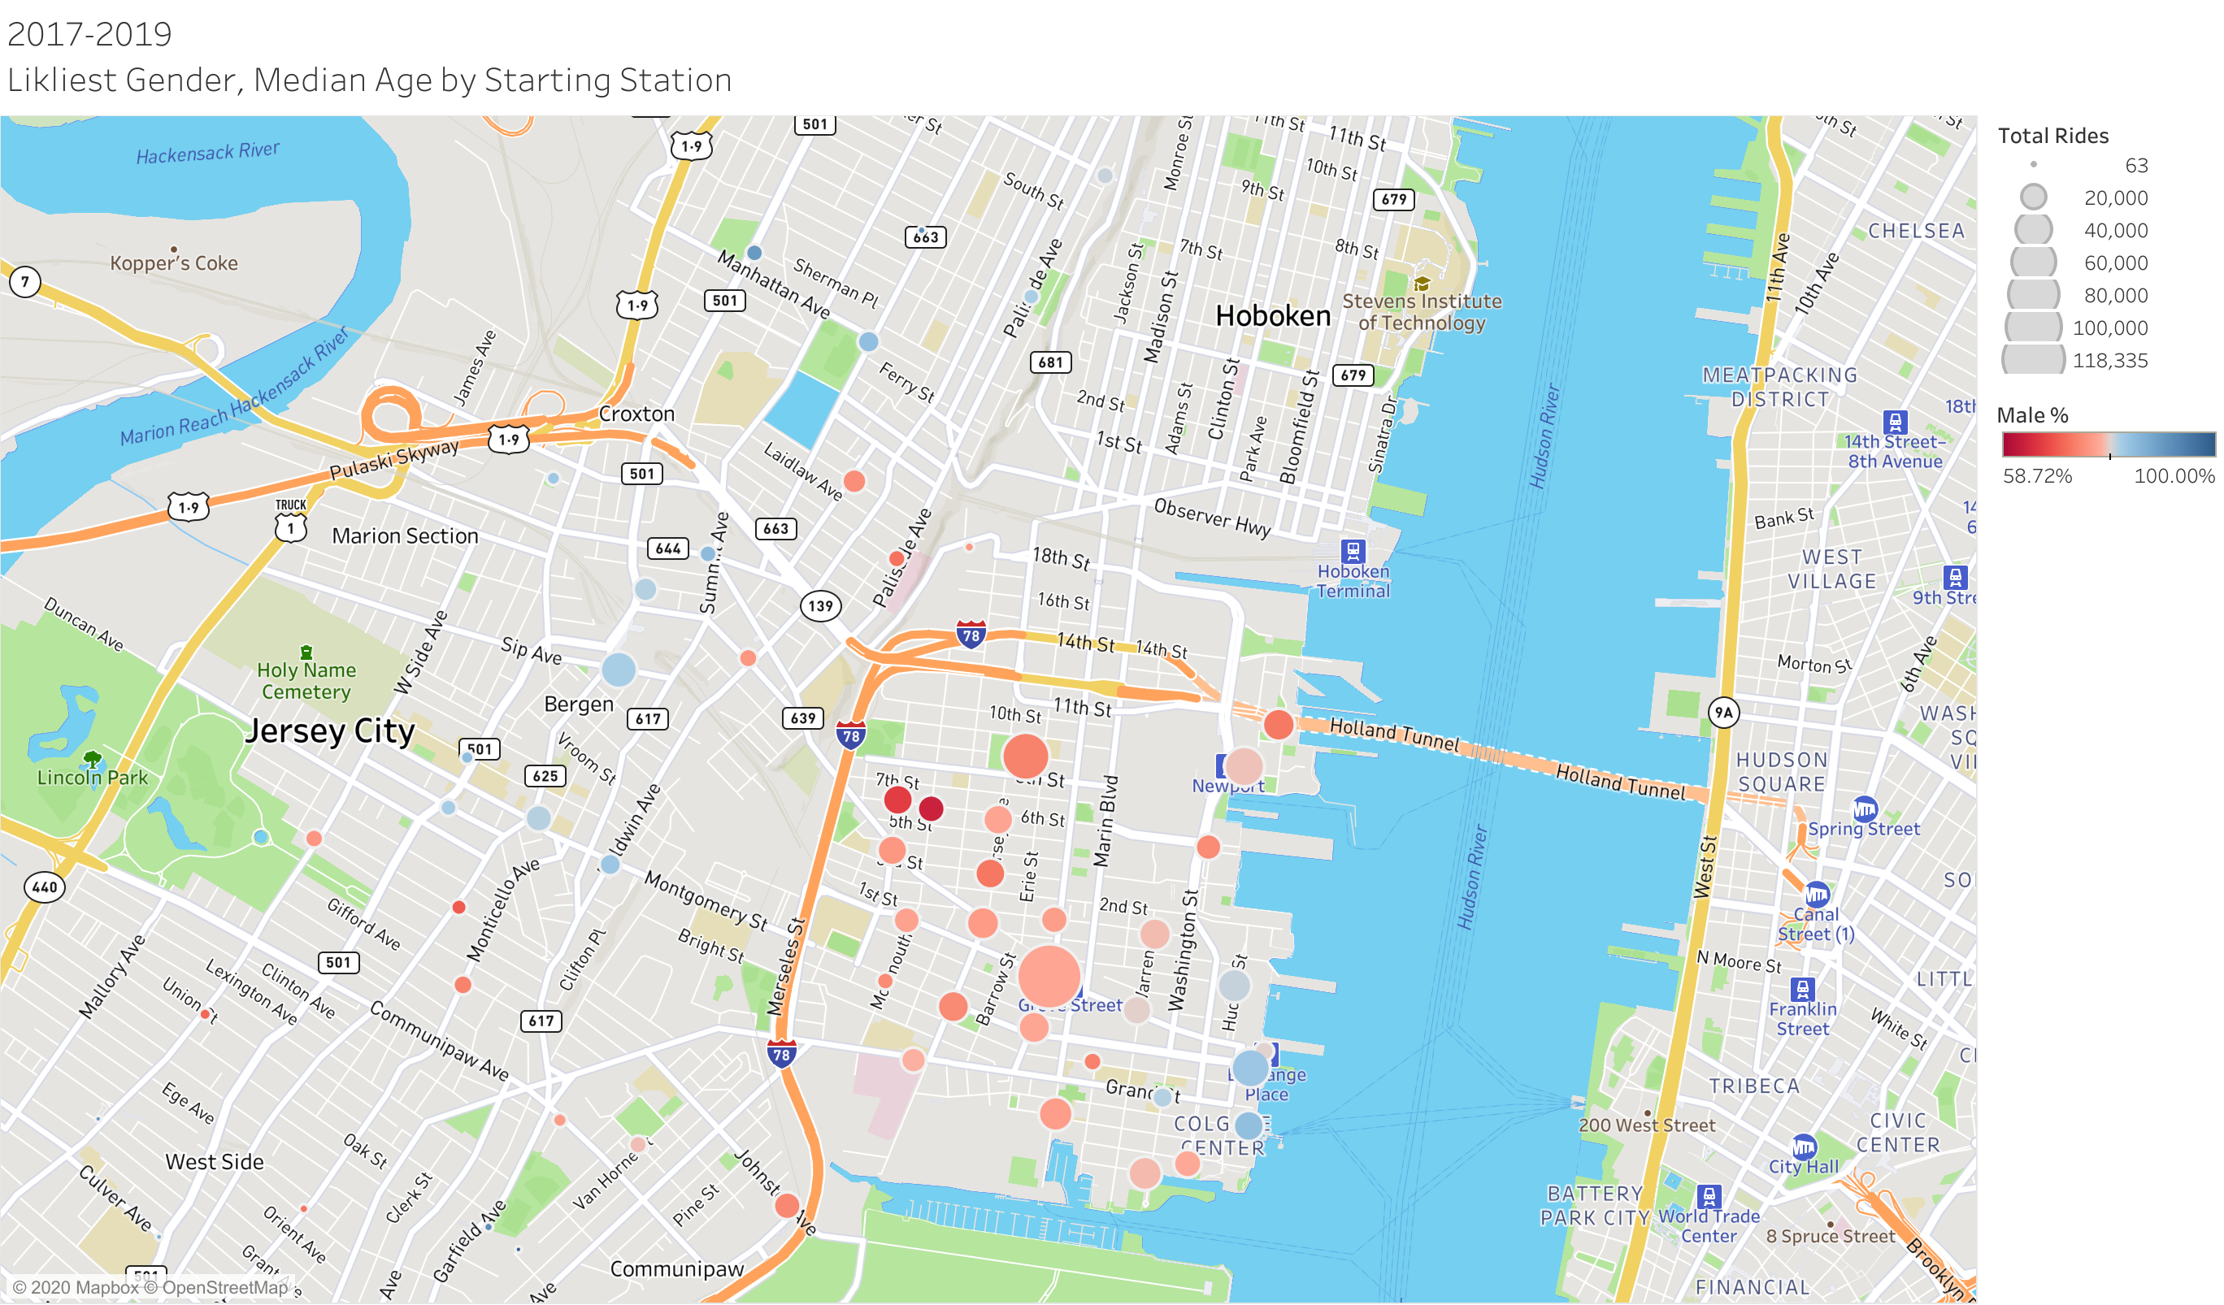
Jersey City Citi Bike Terminal Locations
Source: Citi Bike System Data; January 1, 2017 through December 31, 2019

Slide 12
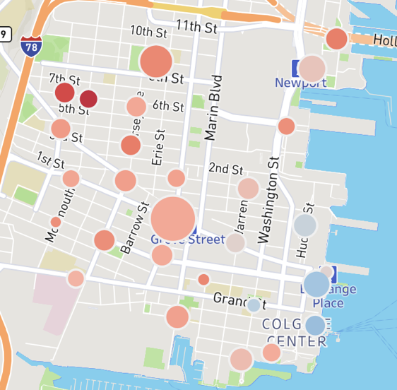
Increase Bike Terminals in the Downtown Area
Predictive Model shows rider growth will continue with a 58% certainty
Get more Citi Bikes into the downtown area to meet the demand of current and future riders
Source: Citi Bike System Data; January 1, 2017 through December 31, 2019

Slide 13
Next Steps
Work with Jersey City to identify bike terminal locations
Jersey City will provide cost proposal to Citi Bike
Citi Bike to understand our riders better to help market the new stations
Citi Bike to come up with a marketing plan to increase women usage
Submit specific site locations to Jersey City for final approval
Jersey City to approve new public right-of-way permits
Jersey City to approve equitable increase to current grant
Citi Bike to develop targeted marketing campaign for new and existing stations

