Slide 1
Fatality Analysis
US Department of Transportation
Analyzing fatal vehicle accidents for year 2017
Justin Bertrand Megan Finley Charles Glover Joumana Rahime

Slide 2
Core Message, Comparison and Question
We aim to discover compelling correlations, if any, between varying elements of fatal vehicle crashes as shown below.
How do weather and lighting conditions affect fatal accidents?
What is the relationship between fatal accidents and driver age?
Are there trends between fatal drunk driving accidents and age or gender?
What are the trends in types of collision that result in fatality, and how does drunk driving factor in?
Do these varying elements play a role in fatal accidents at all, and if so, how?
Application: Could correlations found within the data help craft relevant messaging to US drivers, to raise awareness and decrease annual fatalities on US roads?

Slide 3
Where did we find it?
We needed comprehensive US fatal vehicle crash data, and it was found in total from the US Federal Government as downloadable .csv files, making up the Fatality Analysis Reporting System (FARS); Analytical User’s Manual.
Included was data on every fatal crash on US roads since 1975, with roughly 160 variables reported. We chose to focus on the most recent statistical year, 2017.

Slide 4
What did we find?
Findings were satisfactory, some expected, some surprising, others were somehow both.
Driver’s age, as it relates to fatal accidents, was not a surprise, albeit worthwhile and important to confirm what we may have guessed. Results for gender were as expected, yet also surprising.
The time when most accidents occur results were also as expected, drinking & drugs also played a heavy role in those results as well.
As anticipated, we discovered that drinking did in fact play a role in the types of collisions that occurred.
Unexpectedly, we found out that the higher number of fatalities occurred during the day on clear days; the least number of fatalities was on snowy days at dawn.

Slide 5
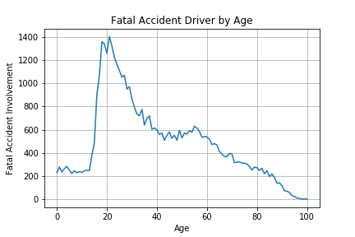
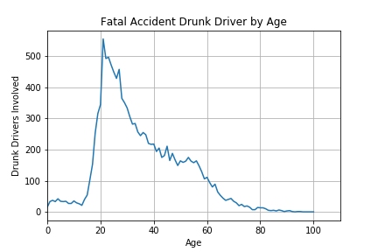

Slide 6
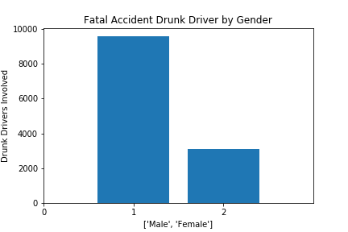

Slide 7
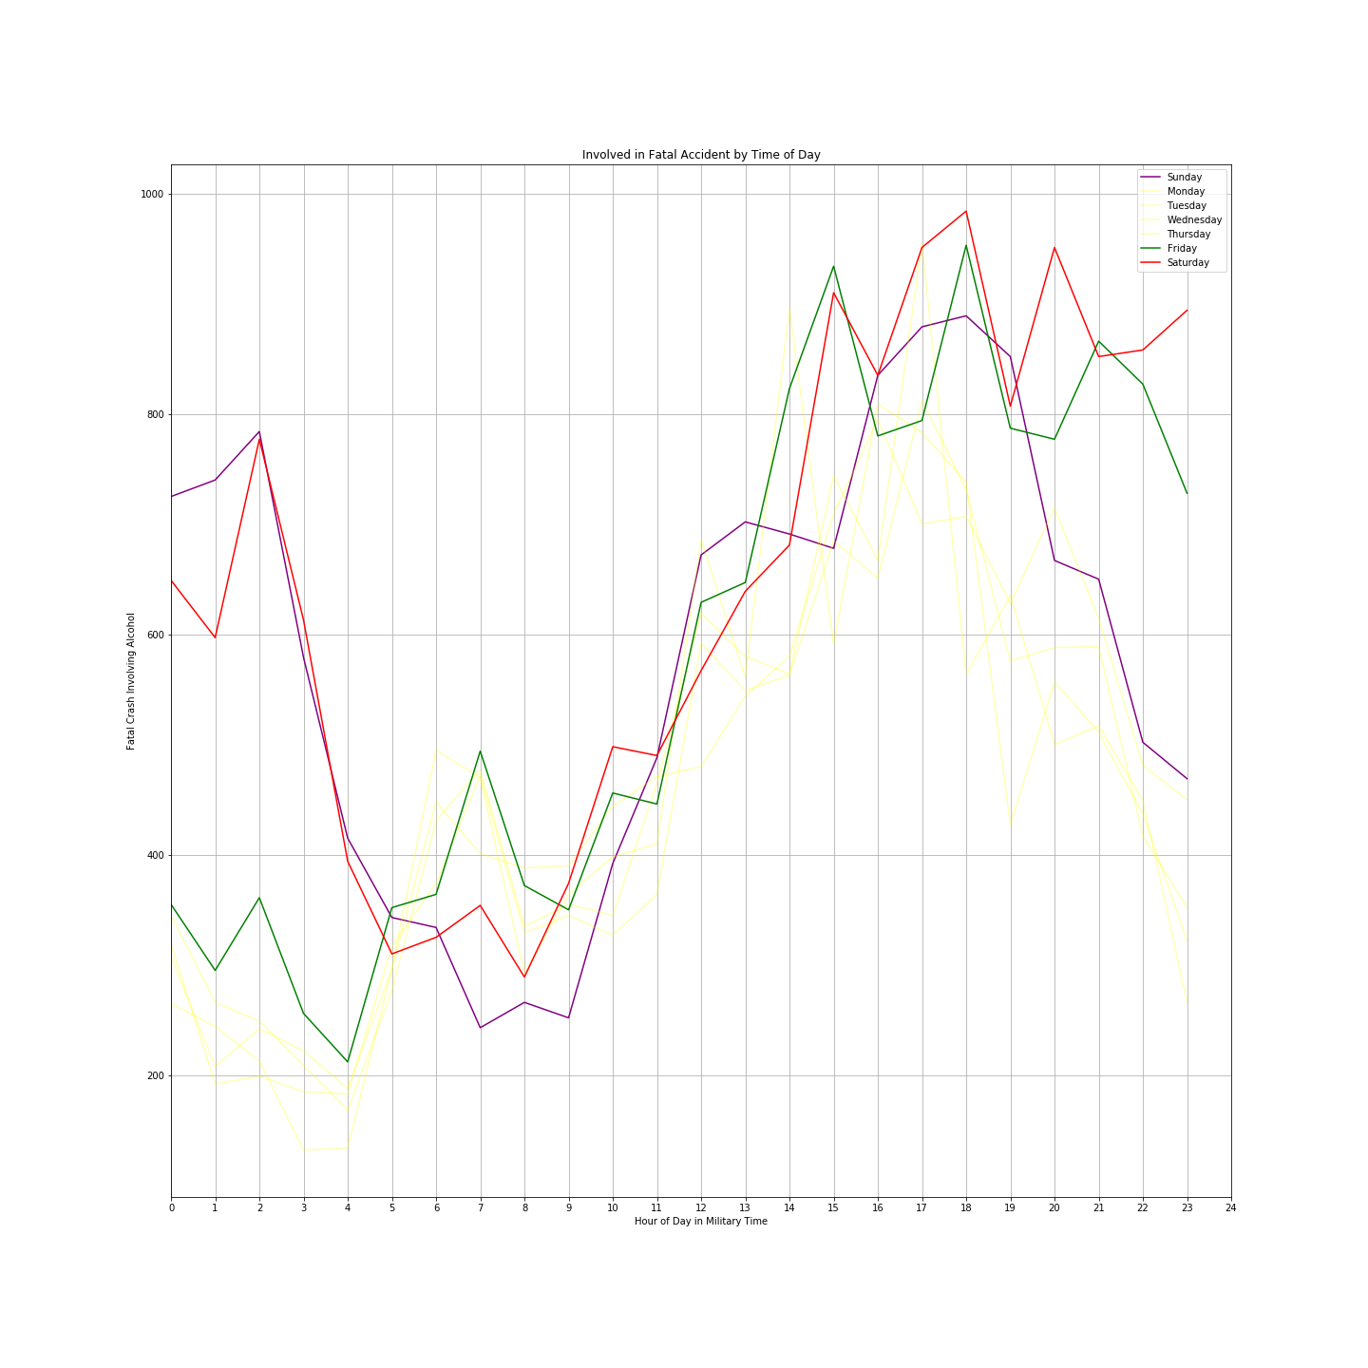
Fatal Car Accidents Involving Alcohol Over Time
Most car accidents involving alcohol tend to happen during the weekends in the early hours of the morning/very late at night.

Slide 8
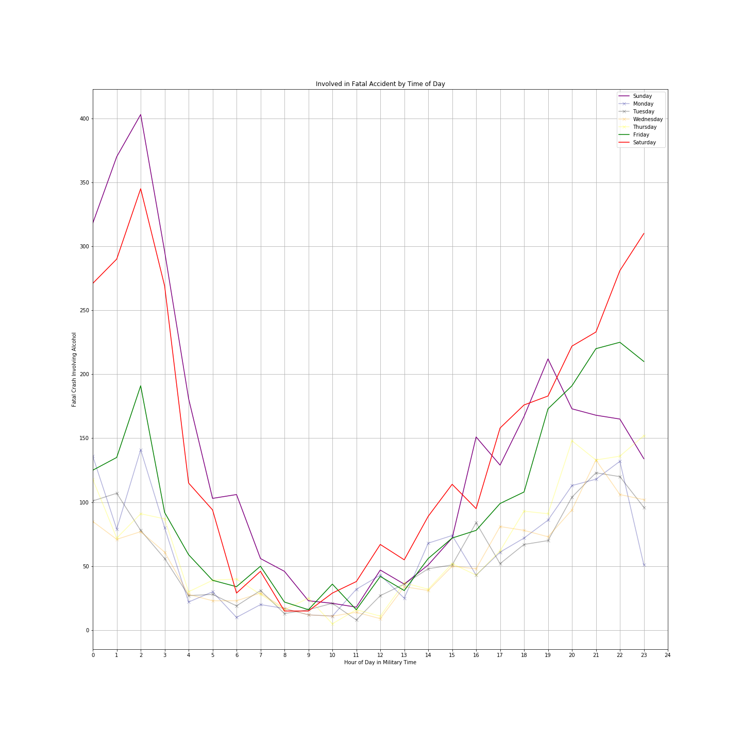

Slide 9

Fatal Car Accidents Involving Drugs Over Time
Accidents involving drugs, yields similar results to alcohol. Way more late night weekend accidents.

Slide 10
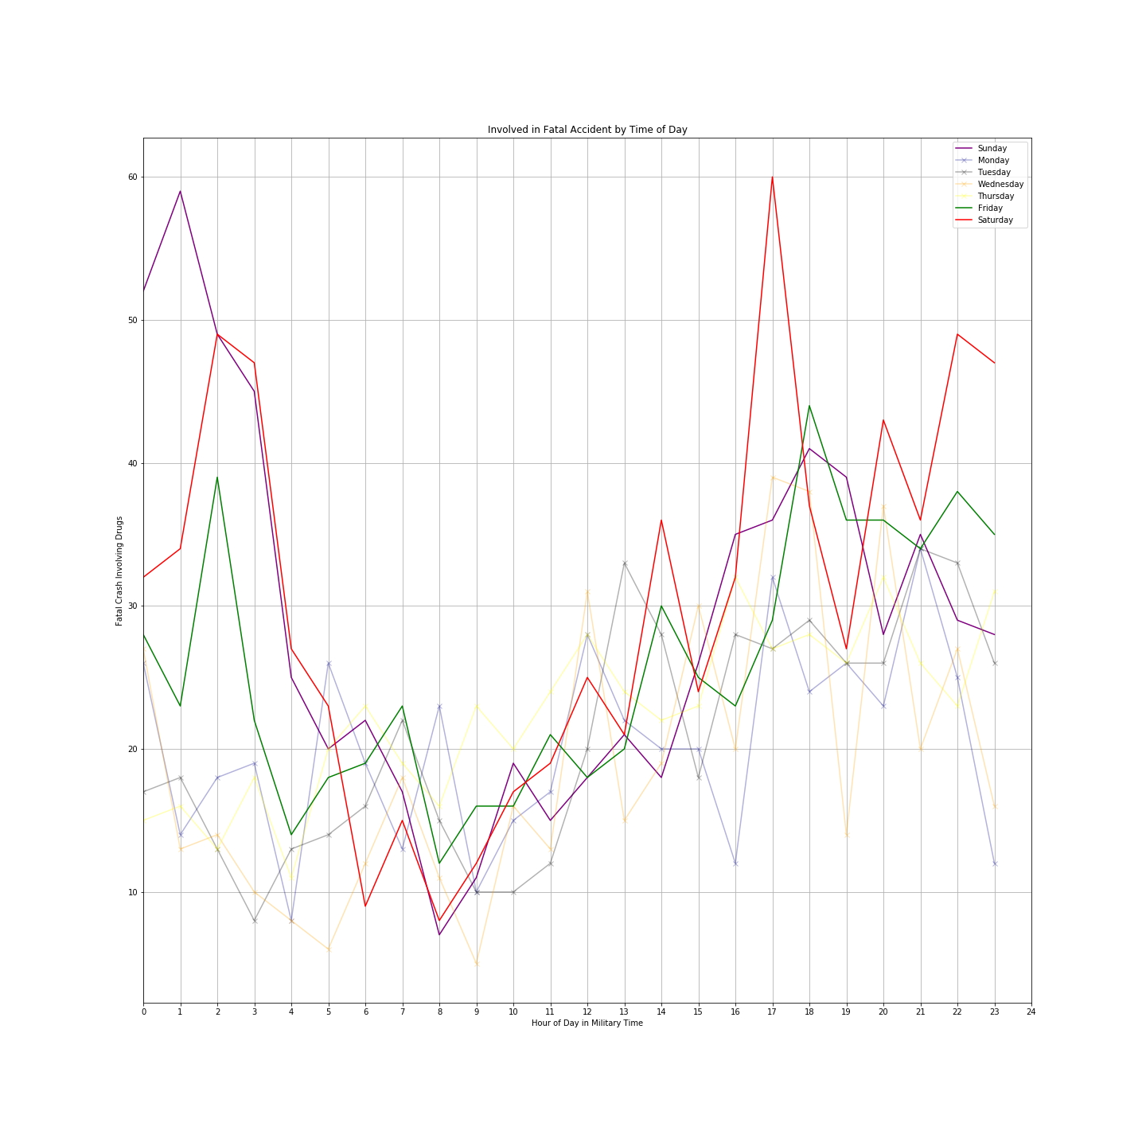

Slide 11
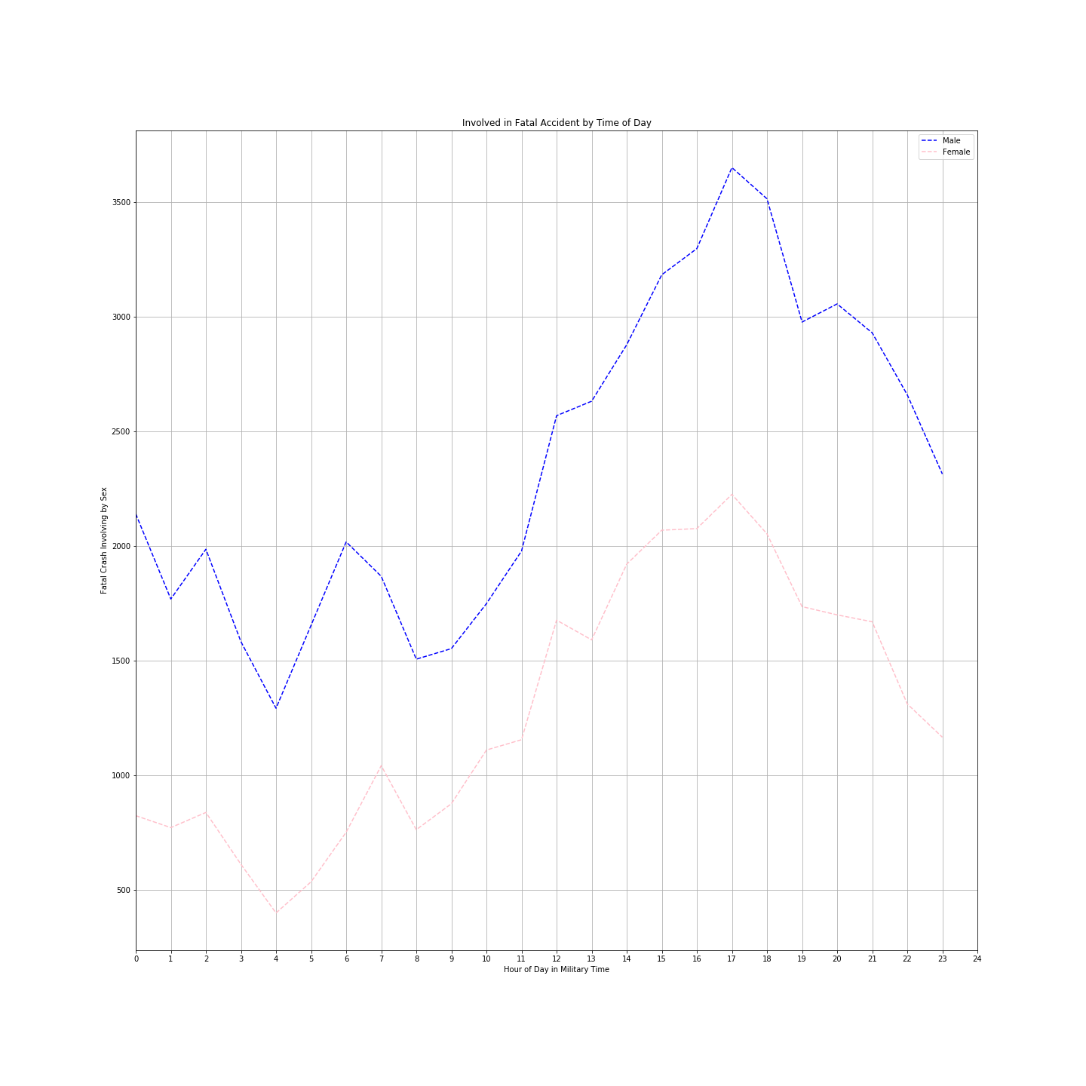
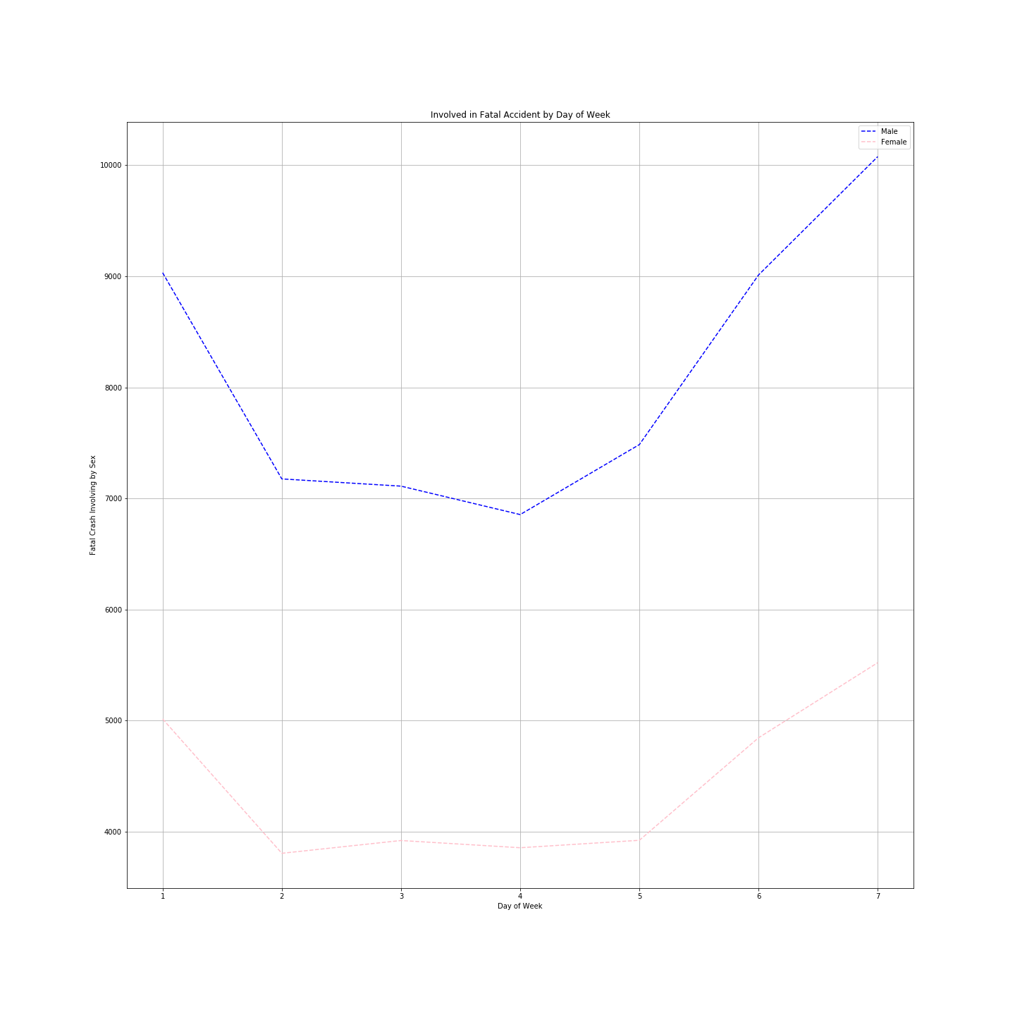
Fatal Accidents by Sex by Time of Day v. Day of Week
Everyone tends to get in accidents on the weekends & late at night/early morning

Slide 12
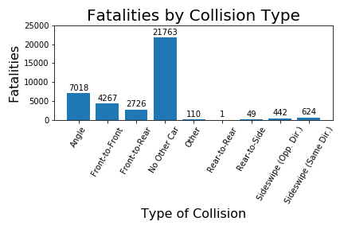

Slide 13
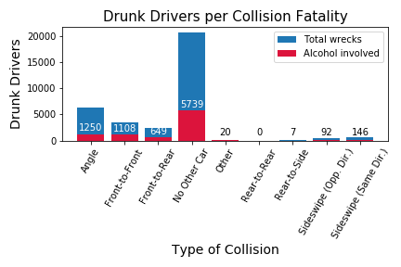

Slide 14
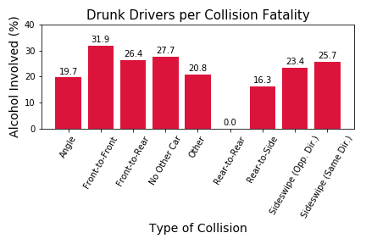

Slide 15
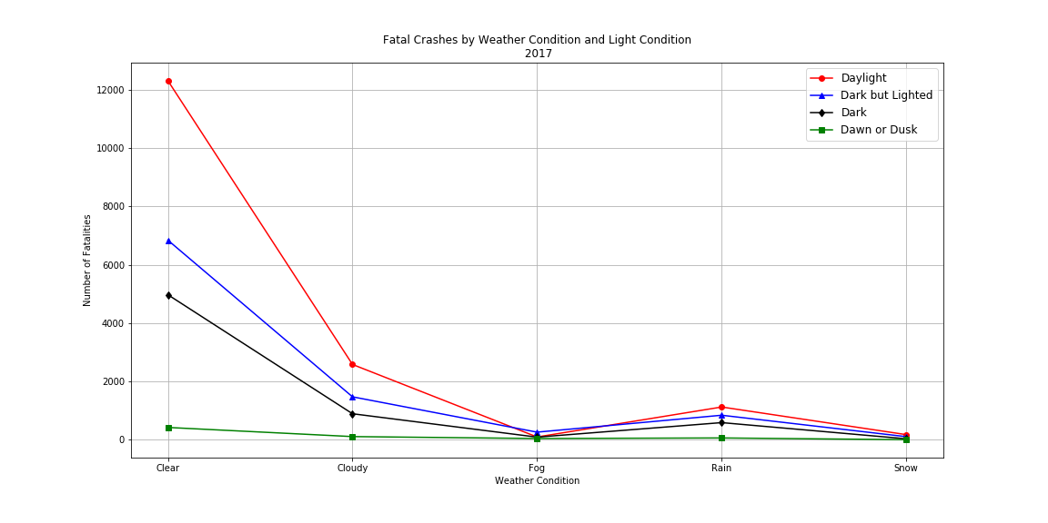
Fatal Crashes by Weather Condition and Light Condition

Slide 16
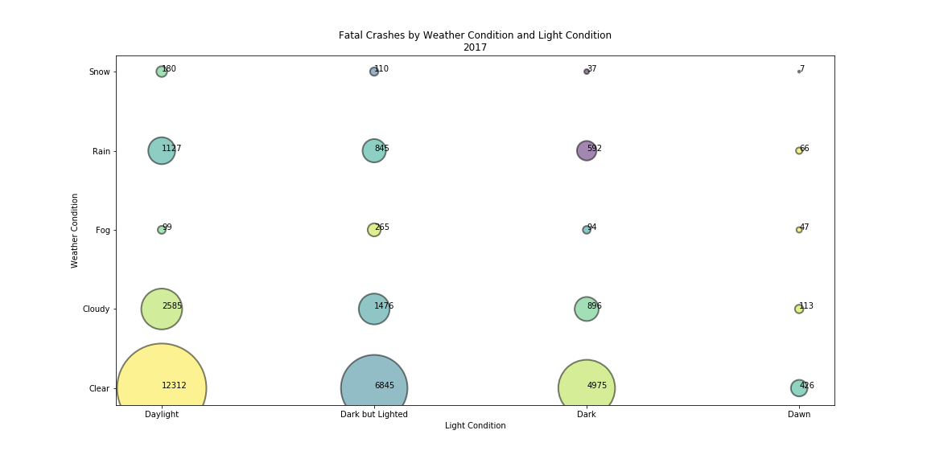
Fatal Crashes by Weather Condition and Light Condition

Slide 17
Discussion - what would we do with this?
The goal, again, is preventing fatal vehicle accidents. We would pitch every level of government and related awareness groups (think MADD). Encourage them to put the word out on high-risk scenarios for fatal accidents (TV commercials, etc). Target marketing to 21 year old men, for example.
Let people know driving late at night, especially during the weekends, has a higher risk of fatal accidents. Tell people to drive with caution and to utilize ride-sharing apps if impaired.
Drinking while driving is of course one of the most powerful and well-known risk factors, but it might be useful to compare the increased rates of head-on collisions tied to alcohol that we found with what are almost certainly higher fatality rates in head-on collisions than other types of crashes, potentially for the purpose of an awareness campaign.

Slide 18
Post Mortem
We were fortunate to find great data (thanks Federal Gov’t!), easily accessible, adequate and downloadable.
With approximately 160 variables, we did experience some momentary scope creep. Framing our questions first thing, and having them to fall back on, made certain that we didn’t creep too hard.
Our greatest challenge, and this in itself was unforeseen, was sharing incremental work as a group. Our challenges Git-related were many, and at times we had to circumvent the highest and best use of Git, in order to just move along.
We feel quite successful, albeit with much room to grow and improve as data pros.

