Slide 1
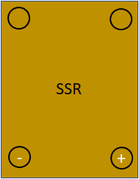
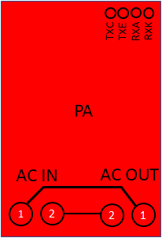
ACU1A
TO ACU1A
LIGHT1
TO LIGHT1
N
PANELBOARD
CONTROLLER
12 Vdc

