Slide 1
Novel Framework for Applying Reinforcement Learning for Core Loading Optimization
Cameron Maras
Gregory Delipei
North Carolina State University
Reactor Dynamics and Fuel Modeling Group
Machine Learning Subgroup
March 18, 2020

Slide 2
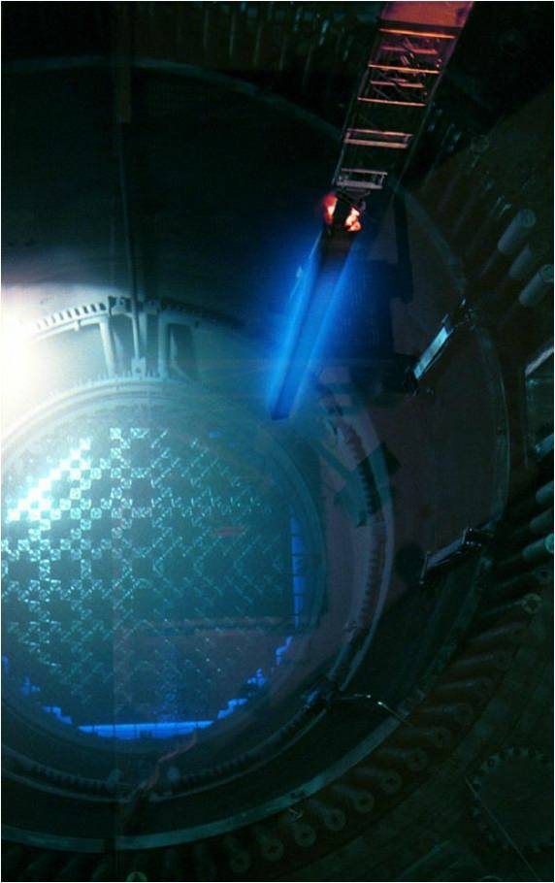
Overview
Introduction
Project Background
Project Focus
Progress Update
Reward Function
RL Algorithm
Next Steps for Project

Slide 3
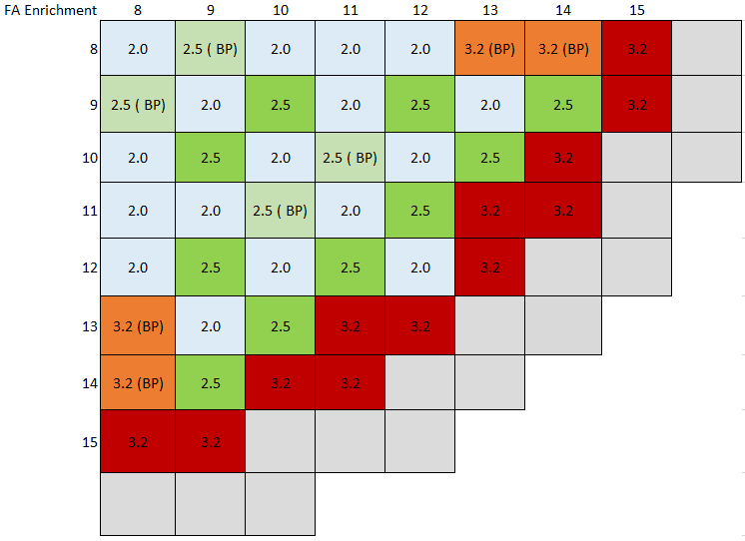
Introduction
For nuclear reactors, the fuel loading pattern (LP) must be optimized for various safety margins, cycle length, and economic factors
Typical methods for core optimization require a high level of engineering intuition and a set of heuristic guidelines
Machine Learning can be used, at different scales, to exceed the capabilities of a human nuclear engineer

Slide 4
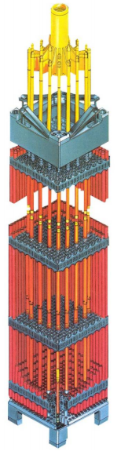
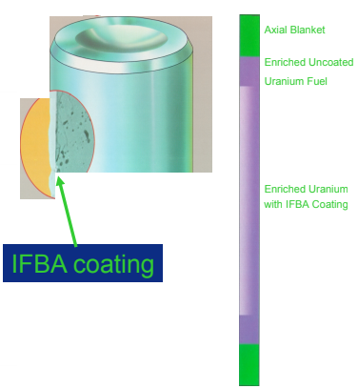
Introduction – LP Considerations
Cycle Energy requirements
Peaking Factors
Soluble Boron Concentration
Core Symmetry
(1/4th vs. 1/8th core)
Low-leakage L³P design preferred
Burnable Absorbers (BA)
Integral BAs including IFBA and Gadolinia
Shuffling scheme
Rotations vs. Translations
Fuel duty/burnup limits

Slide 5
Project Background
Broader AI techniques, however, have been applied to core LP optimization
Simulated Annealing (FORMOSA), Genetic Algorithm
Reinforcement Learning (RL) uses a psychology-based approach with to determine optimized action in an environment for the maximum reward
Involves Markov decision processes, non-supervised, data-driven, trial-and-error, dynamic programming
With new approach, RL may have certain benefits:
Low variance
Low Bias
Results near to true value
Fast Convergence

Slide 6


Project Focus
This project focuses on LP optimization a 157 FA 3-Loop Westinghouse PWR modeled using CASMO/SIMULATE3
Specifically, a custom Q-learning algorithm is being develop to aid the process of loading pattern optimization
States : All possible loading patterns
Action: Which fuel assembly type to change at which location (2D)
Q(S,A) : Table with values associated with probabilities of reaching a better state
Policy : At state S select the action A with maximum Q(S,A)
Reward: Function quantifying the quality of the new state
Q(S, A) update based on current action reward and future possible rewards
S₀
S₁
R₁
Q(S₀, A₀) = f(Q(S₀, A₀), R₁, Q₁)
A₀
$$\underset{}{Q_{1}=max}{Q(S_{1},A)}$$
$$\max_{A_{0}}{Q(S_{0},A_{0})}$$

Slide 7
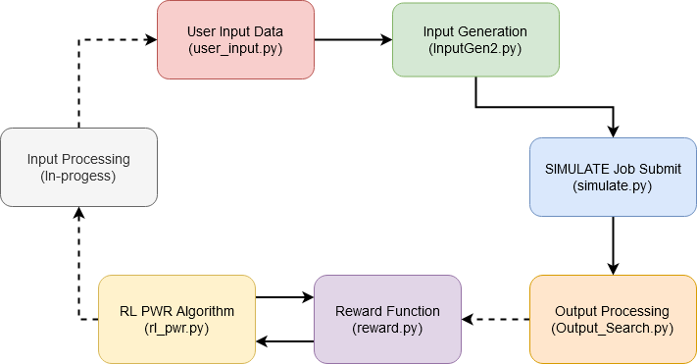
Progress Update – 3/18 - Scheme
Creates a Q-table consisting of state-action pairs for the loading patterns
Computes Q-value using the result from the reward function
Searches through Q-table for maximum value in order to guide next action

Slide 8
Progress Update – 3/18 – RL PWR
Focus on 512 PWR optimization
Add details about the optimization with figure of optimized core. Include fuel types, optimization criteria etc…
Dimensionality problem for the Q table (order of 6⁴⁵)
Initial focus on 4 assemblies to test the RL algorithm (order 6⁴).
Try to use the 4 assemblies RL to optimize the whole core by moving the location of focus
Use neural networks and compare (either directly on the whole core or on 4 assemblies)

Slide 9
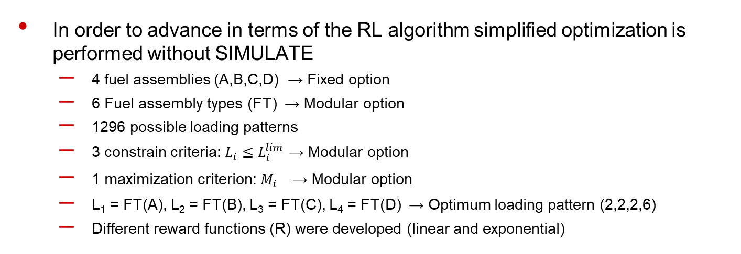
Progress Update – 3/18 – RL PWR test
In order to advance in terms of the RL algorithm simplified optimization is performed without SIMULATE
4 fuel assemblies (A,B,C,D) → Fixed option
6 Fuel assembly types (FT) → Modular option
1296 possible loading patterns
3 constrain criteria: ${L_{i}≤L}_{i}^{lim}$ → Modular option
1 maximization criterion: ${M_{i}}_{}^{}$ → Modular option
L₁ = FT(A), L₂ = FT(B), L₃ = FT(C), L₄ = FT(D) → Optimum loading pattern (2,2,2,6)
Different reward functions (R) were developed (linear and exponential)
Space of all possible loading patterns
R < 0
Loading patterns that exceed the limit criteria
R > 0
Loading patterns that meet the limit criteria

Slide 10
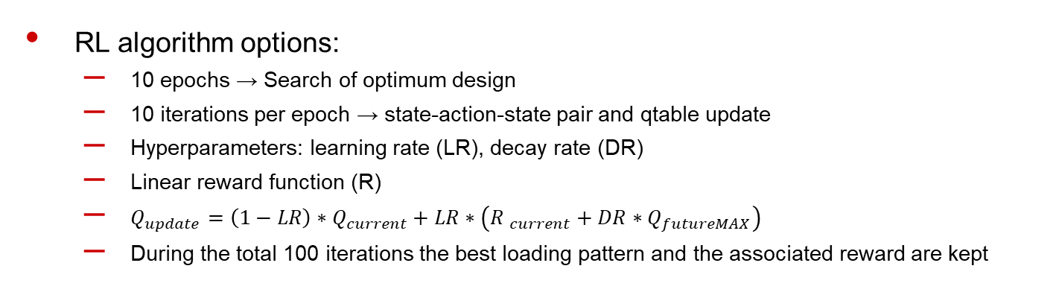
Progress Update – 3/18 – RL PWR test
Q(S) table form example
 | A | B | C | D
1 | -0.1 | -0.2 | -0.5 | -3.5
2 | -1.5 | -7.1 | -6.1 | -9.3
3 | -0.6 | -0.4 | -0.2 | 0.3
4 | -1.1 | -0.2 | -5.1 | 1.5
5 | -1.5 | -3.5 | -6.2 | 3.2
6 | -5.5 | -1.1 | -7.5 | 6.5
D6 is selected as the action at this state
RL algorithm options:
10 epochs → Search of optimum design
10 iterations per epoch → state-action-state pair and qtable update
Hyperparameters: learning rate (LR), decay rate (DR)
Linear reward function (R)
$Q_{update}=\left(1−LR\right)∗Q_{current}+LR∗\left({R }_{current}+DR∗Q_{futureMAX}\right)$
During the total 100 iterations the best loading pattern and the associated reward are kept

Slide 11
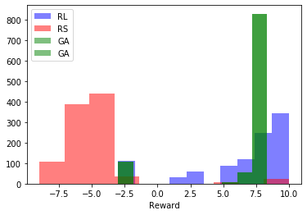
Progress Update – 3/18 – RL PWR test
Comparison between RL, random selection (RS) and genetic algorithm (GA)
100 random selections for RS
10 generations with population 10 for GA
1000 optimizations were performed with random initialization
Computation of mean and standard deviation of the best reward
Histograms of the three approaches
RL manages to find good loading patterns although GA shows better performance (less variance)

Slide 12
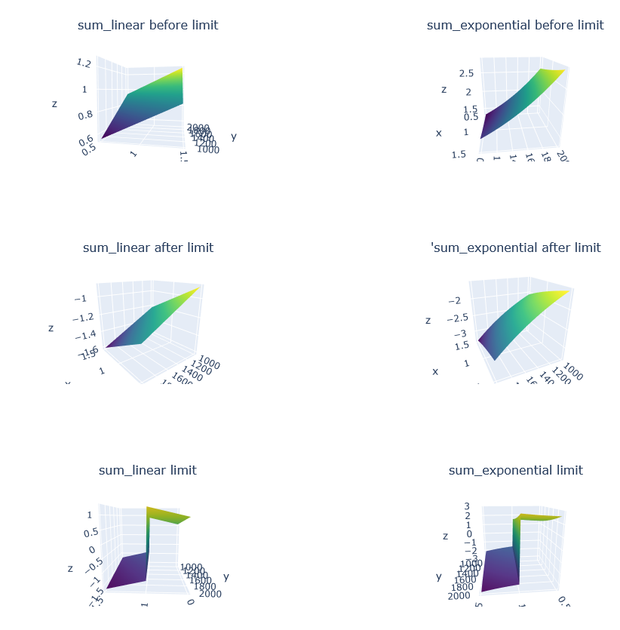
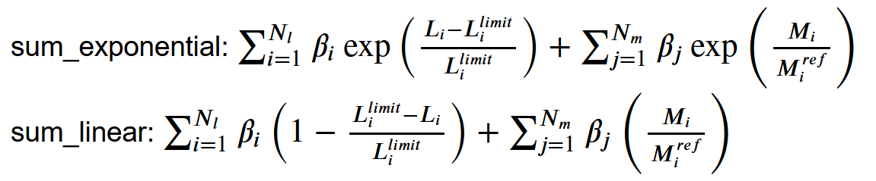
Progress Update – 3/18 – RL PWR rewards
The reward is set up so that there is a sharp change when a criteria limit is exceeded (ex. Fdh exceeds 1.5)
Trying to capture the behavior of multiple design constraints for LP optimization as best as possible
Two reward functions are developed with an alternate sign if the limit is reached

Slide 13
Progress Update – 3/18 - RL PWR code
Developments
reward.py includes a Reward class which defines the function for computing the rewards from simulation output data. The criteria are treated dynamically for both constraints and maximization.
RL4Assembly.py contains a RL class, which initializes the q-table to random values and works with the state-action pairs to update q-values. The number of fuel types is dynamically coded. The number of assemblies is fixed at 4.
rl_pwr.py is the driver of the RL algorithm itself, utilizing a specified number of epochs, iterations, and user input regarding the criteria for the reward function.

Slide 14
Add maybe a couple of slides for the state of the other blocks of the full scheme

Slide 15
Next Steps for Project
Finishing connecting components of overall code framework
Setting up script to modify and update user input file from the results of the RL algorithm (Changing LP input map)
Finalize output script for reading SIMULATE output files and put into correct format for RL algorithm and reward function
Continue testing RL algorithm for various numbers of runs
Asymptotic behavior, hyperparameters options
Test RL algorithm specifically with batch of SIMULATE run data
Replace the test function with SIMULATE and test the optimization for the 4 assemblies
Full PWR RL algorithm
Try to optimize locally the core by 4 assemblies at each iteration
Use neural network either directly for the full core or for the 4 assemblies

Slide 16

Questions?

