Slide 1




OpenCircles
Network Connection Job Discovery
Careerbuilder API Hack 10-2012
Martin Cortez
Chris McKeever

Slide 2





The American Dream

Slide 3
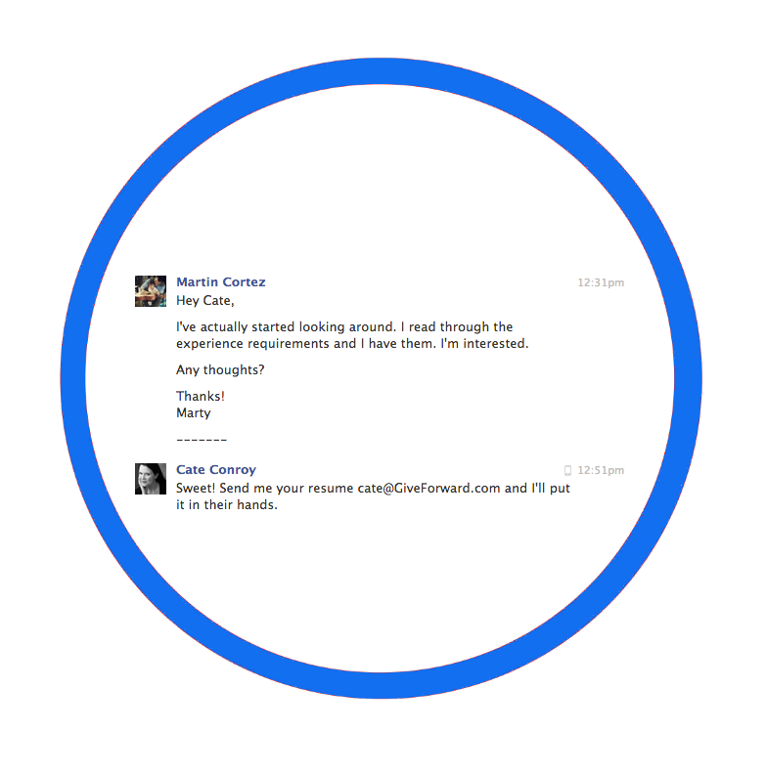

Circles of Friends

Slide 4
Job Discovery
Not what you know ...
Who you know …

Slide 5


OpenCircles

Slide 6
OpenCircles
Careerbuilder API
CB PHP SDK
PHP CB API Proxy
Lightweight AJAX frontend
underscore.js
bootstrap.js
Facebook API

Slide 7
OpenCircles
Network Job Discovery
Martin Cortez – martco@gmail.com
Chris McKeever – cgmckeever@gmail.com

