Slide 1
ETL Project
Sofia Mbega, Lawson James, Cody Miracle, Jahangir Deewan & Sajad Yarzada
11-14-2020

Slide 2
Overview and Purpose
The objective of the project is performing a complete ETL process using three different datasets and an API on United States unemployment rates, diversity index and median income:
1- Extracting – data from three different sources to show unemployment rates, diversity indexes and the median income for all US counties.
2- Transformation – finding the relevant variables, dropping unnecessary columns, and creating different relevant and useful tables
3- Load – Creating a database using MySQL and loading the Data Frames in a data base using SQLAlchemy and Postgress.

Slide 3
E- Extraction
The following datasets were used on the US States and Counties’ unemployment rates, diversity index and median income:
- US Counties Diversity Index - https://www.kaggle.com/mikejohnsonjr/us-counties-diversity-index
- US States and Counties Median Income - https://data.world/tylerudite/2015-median-income-by-county
- US States and Counties Unemployment - https://www.kaggle.com/jayrav13/unemployment-by-county-us
- US Bureau of Labor Statistics - https://www.bls.gov/bls/api_features.htm

Slide 4
T- Transformation
In the “Transform” step of ETL, we took the raw data collected from our various sources and cleaned them into more usable data.
This part of the process ensures that that data used in analysis is more reliable and less likely to provide misleading results.

Slide 5
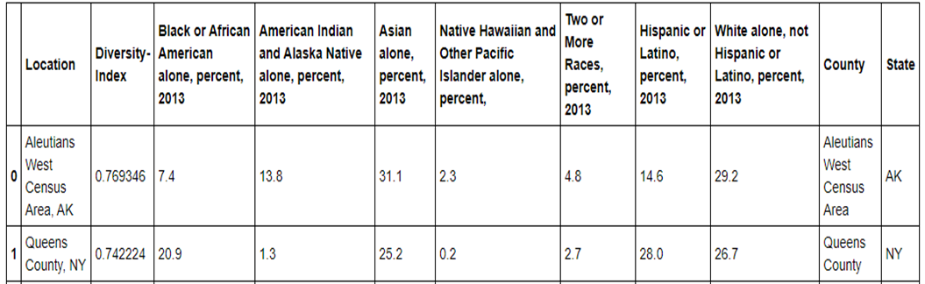
Diversity Index Data Set
The first step was to load the diversity index dataset. The “location” column is separated in to two columns to show “States” and “Counties” separately (Table 1). This will help us in merging and grouping with the other two datasets

Slide 6
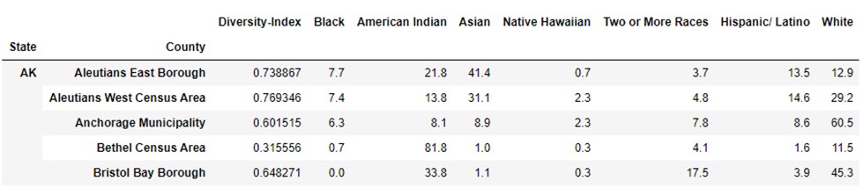
Diversity Index Data Set (Cont.)
A new table is created by grouping each race by “State” and “County” (Table 2)

Slide 7
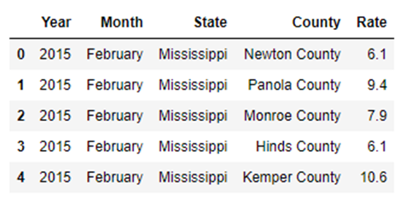
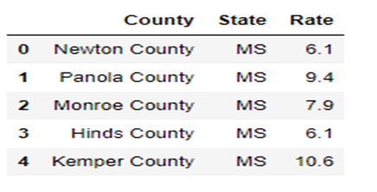
Unemployment Rate Dataset
The “State” column in the unemployment dataset used the full name of the states (Table 3). To use this column for merging with other datasets, we had to abbreviate it. A dictionary of states with their abbreviations were used to loop through the dataset. The year and month columns were deemed not useful thus, they were also dropped. (Table 4).

Slide 8
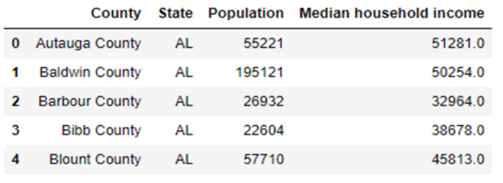
Median Income Dataset
From the Median Income Dataset, we dropped several unnecessary columns, and renamed the “State-Code” column to “State” as that will help us in merging all three datasets in the next step. (Table5).

Slide 9
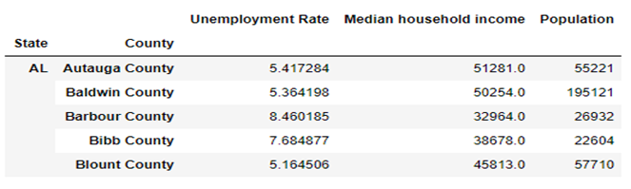
Merging Tables
First, the Unemployment Rate dataset is merged with Median Income dataset on State and County. (Table 6)

Slide 10
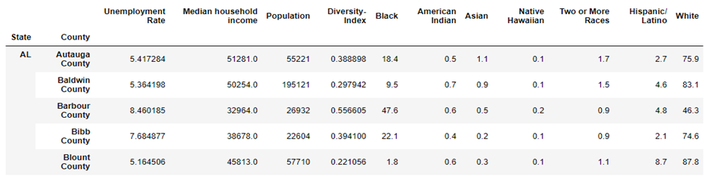
Merging Tables (Cont.)
Then, this new table containing unemployment rate and median income was merged with the diversity dataset again on State and County, using an inner join. (Table 7)

Slide 11
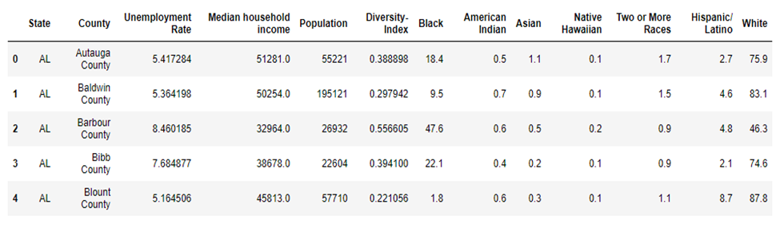
Merging Tables (Cont.)
Finally, with all three datasets merged in to one table, the State index was reset to turn it back in to a column. (Table 8)

Slide 12
L – Load
After the transformation stage, we cleaned the data and created several usable tables. A database was created to match the columns from our final data frame in pandas using SQL and Postgress. Data was then loaded to the Postgres using the following processing logic:
Created the db connection through sqlalchemy
Imported the create_engine function
Authenticated access to the db using my username and password
If the table existed, it was dropped
Created the table
Committed the creation
Inserted the merged data to the table

Slide 13
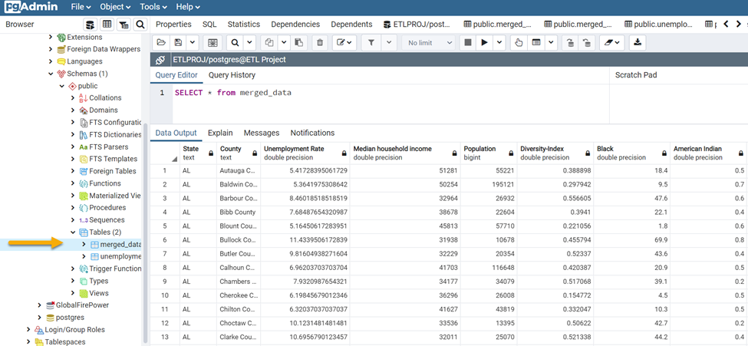
L – Load (Cont.)
The data frames were then connected to the database using SQLAlchemy to load the results

Slide 14
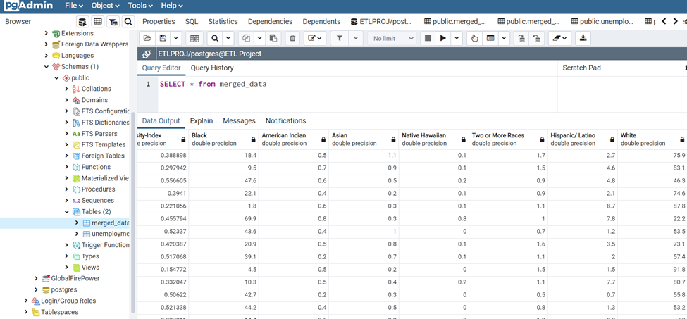
L – Load (Cont.)

Slide 15
Bonus – API to JSON to SQL
As a bonus, we used some python code to extract data from the Bureau of Labor Statistics API, convert it to a JSON file, and load it into a SQL database.
Compared to the previous examples, less transformation was done, as we mainly just wanted to display an alternative method of extraction.

Slide 16
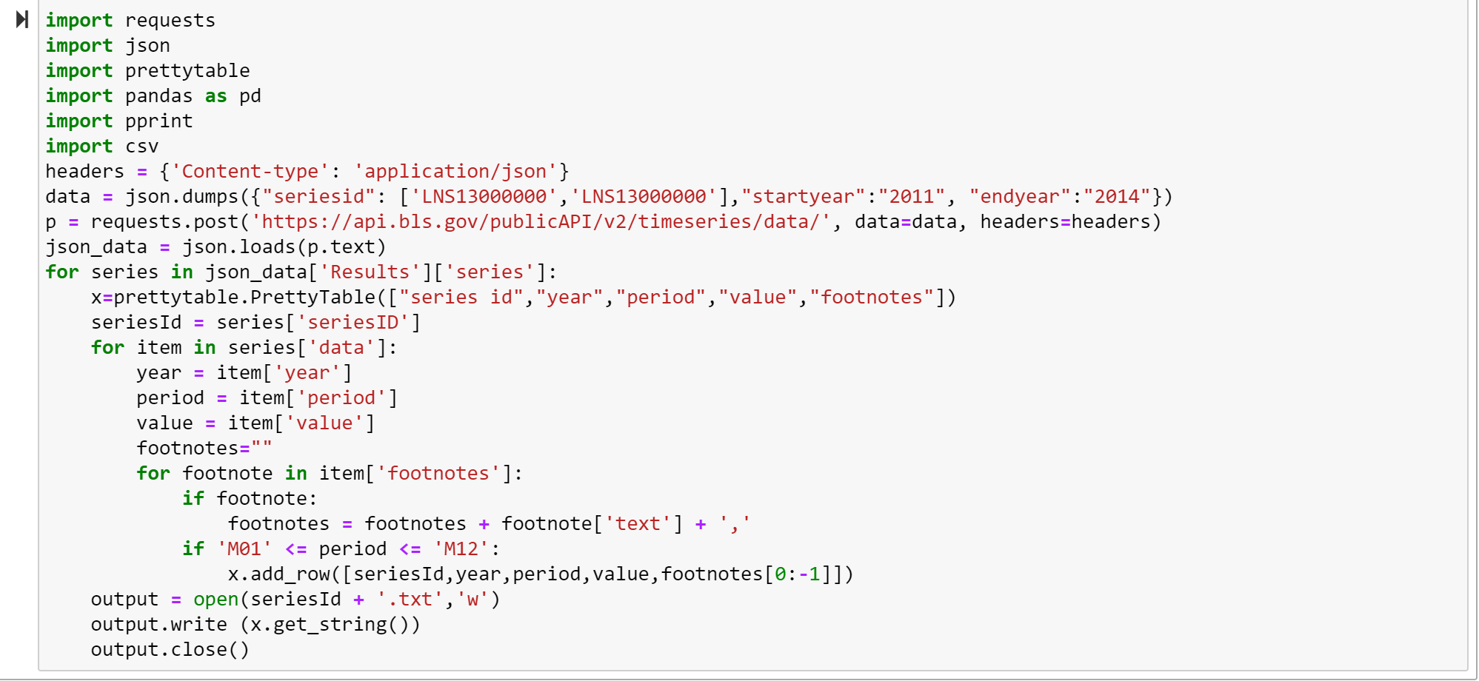
Bonus – Code, Extract

Slide 17
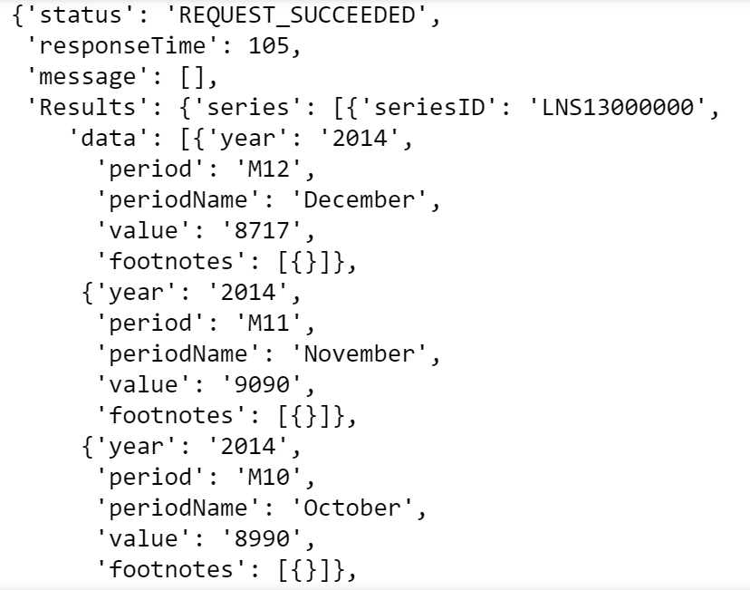
Bonus - JSON

Slide 18
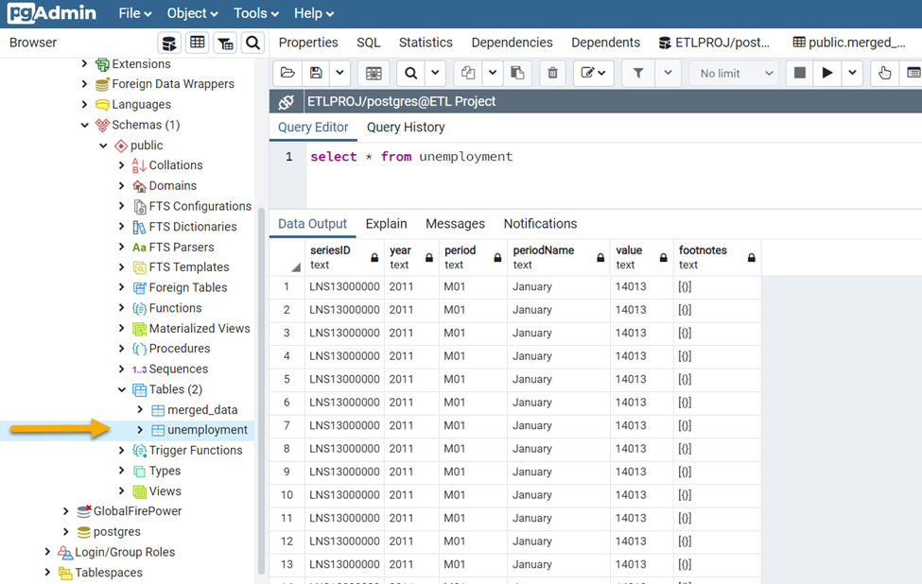
Bonus – SQL Database

