Slide 1
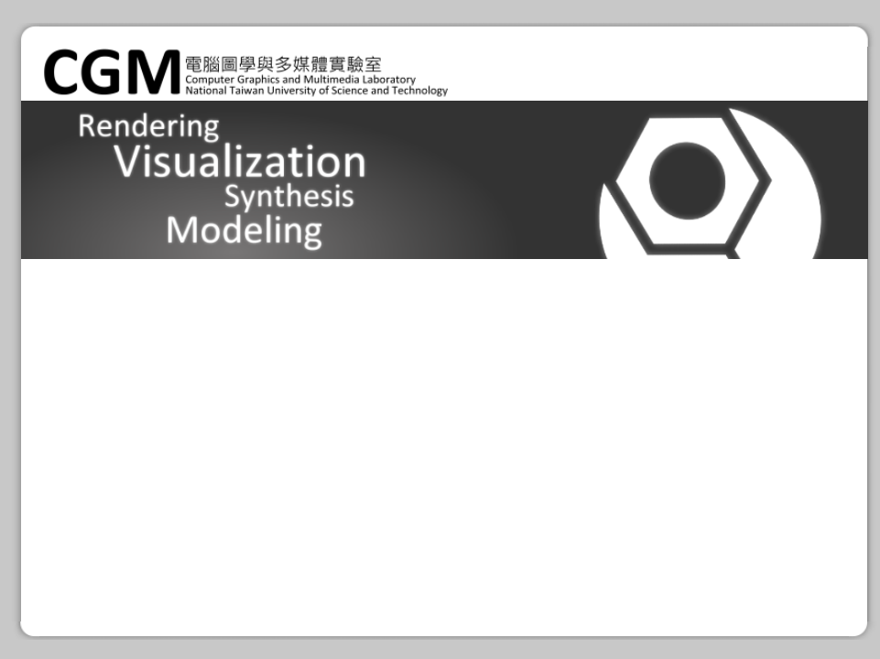
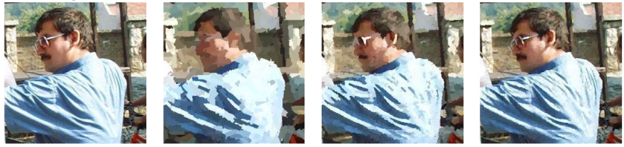
Non-Photorealistic Rendering and Content-Based Image Retrieval
Pacific Graphics (2003)
Yuan-Hao Lai

Slide 2
[Problems of CBIR]
Which low-level features is the best to measure the similarity of images
Color is important in human perception but histogram cannot provide spatial distribution of colors

Slide 3
[How do humans interpret an image]
A talented painter will give a painted interpretation of the world
Plain surfaces paint with greater strokes
Provides information about both color and structural properties

Slide 4
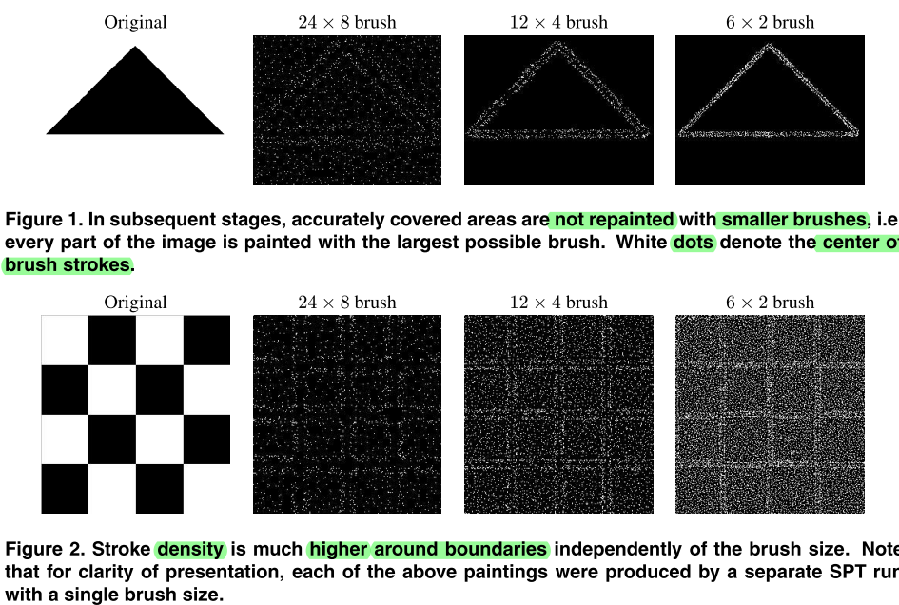

Slide 5
[Stochastic Paintbrush Transformation]
Based on a random searching to insert brush-strokes into a generated image at decreasing scale of brush-sizes, without predefined models or interaction.
All brush shape are in rectangle

Slide 6
[Modified SPT]
To improved in several places for CBIR
Stroke color of any size is majority-vote in the stroke area of the original image
Use Simulated Annealing for our optimization problem (painting process)

Slide 7
[Simulated Annealing]
For global optimization problem, locate a good approximation
Each step replaces current solution by a random "nearby" solution, chosen by a probability with global parameter T (temperature)

Slide 8
[Simulated Annealing Algorithm]
Initial state, energy, "best" solution
While time left & not good enough
Pick some neighbor
Compute its energy
Random decide with T to move to new solution
If this is a new "best" solution
Then save new neighbor to best found
Return best

Slide 9
[SPT Algorithm ]
1. Set to next brush size and initialize T₀
2. Produce distortion map (Δn = |L - Pn|)
3. Produce εn (smoothed version of Δn)
4. Randomly choose s, Φ, such that εn(s)≧ ϵ
(Distortion at s is high enough)
Set C to majority vote inside new stroke

Slide 10
[SPT Algorithm ]
5. Compute new distortion D'. It is accepted with a probability min{1,(D/D')^{1/Tn})
6. Update Δn. If stroke number < threshold, then go to step 4.
7. T_{n+1}=0.8T_{n}, n=n+1. If average Δn in last 10 iteration < threshold δ, go to step 3
8. Go to step 1 until smallest brush is over

Slide 11
[SPT Algorithm (Variables)]
D：Distortion (stroke area⇔image)
D'：Distortion (stroke area⇔new stroke)
Tn：Simulated Annealing temperature
Pn：Current Painting L：Original image
Δn：Distortion-map (Δn = |L - Pn|)
ε：Error image (smoothed version of Δn)
s：Brush position Φ：Brush orientation
C：Brush color d：Brush size

Slide 12
[Why use SPT render for CBIR?]
Transformation to brush parameters
Keep sharp edges, remove details below limit
Every part painted by largest possible brush
Stroke orientation ⇔ Structural properties
No human intervention or pre-processing

Slide 13
[Similarity Value Algorithm]
1. Pick same size s₁,s₂ from S₁,S₂
2. Produce sim_{col}(s₁,s₂), sim_{ori}(s₁,s₂), sim_{pos}(s₁,s₂)
3. Sum with weights w_{col}, w_{ori}, w_{pos} as sim(I₁,I₂)
4. Repeat until running out of same size stroke
5. n=remaining same size stroke of S₁,S₂
6. Adjust sim(I₁,I₂) by n

Slide 14
[Similarity Value Algorithm (Variables)]
Use CIE-L*u*v* color space
I₁, I₂：Original Images
S₁, S₂：Stroke Sequences
s₁, s₂：single stroke
sim(I₁, I₂)：similarity value

Slide 15
[Semantic Measurement Algorithm]
BLOBWORLD was applied to obtain regions.
Each stroke group corresponds to a region
Centroids of the strokes in a group are all located in the corresponded region

Slide 16
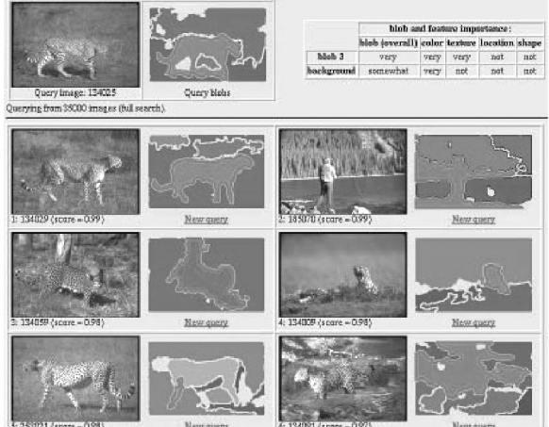
[Blobworld Segmentation]

Slide 17
[Blobworld Segmentation]
Find particular objects (things), not low-level features (stuff)
Each region has its feature description
User can specify the importance of region in query image

Slide 18
[Blobworld Segmentation Steps]
1. Extract color, texture, and position features for each pixel.
2. Group into regions by distribution of features with a mixture of Gaussians using Expectation-Maximization.
3. Describe the color distribution and texture of each region for use in a query.

Slide 19
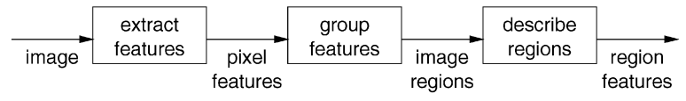
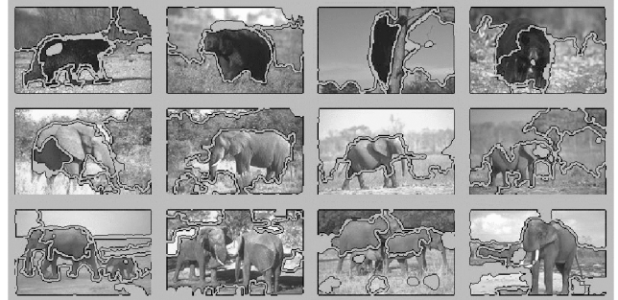
[Blobworld Segmentation]

Slide 20
[Querying in Blobworld]
Atomic query
  Particular blob to match
Compound query
  conjunction/disjunction of queries
  "like-blob-1" and "like-blob-2"

Slide 21
[Blobworld Compound Query Algorithm]
For each blob b_{j} in DB image (feature vector v_{j}):
Mahalanobis from v_{i} to v_{j} : d_{ij}=( v_{i}-v_{j})^{T}Σ( v_{i}-v_{j})
Similarity between two blobs μ_{ij}=e^{-dij/2}
(1 means blobs are same in all features)
Take u_{i}=max_{j} u_{ij}

Slide 22
[Semantic Measurement Algorithm]
Until all regions in Q been selected as foreground
Until all regions in I been selected as foreground
Select next region in Q as foreground
Select next region in I as foreground
Similarity S_{f} (foreground), S_{b}(background)
Similarity S = (2/3)S_{f}+(1/3)S_{b}
Choose max S between Q and I

Slide 23
[Implementation and Experiment Study]
1,017 images (human portraits, natural scene, city scene, etc.)
Resize in bound of 256×256, keep original ratio
3 stage SPT, with brush size of 24×8, 12×4, 6×2
Similarity weight w_{col}=0.4,w_{ori}=0.35,w_{pos}=0.25
Ground truth produced by manual classification
Similarity judged by user

Slide 24
[Implementation and Experiment Study]
On a Pentium III 930MHz PC
<500msec to decide two images are similar or not
300sec on indexing 256×256 images
10sec on 64×64 thumbnail, 30sec on 128×128
  Retrieval quality is the same!

Slide 25
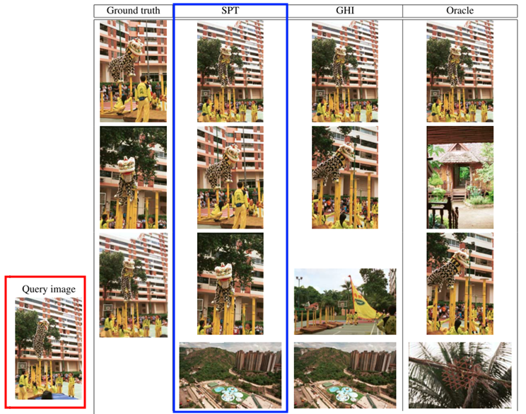

Slide 26
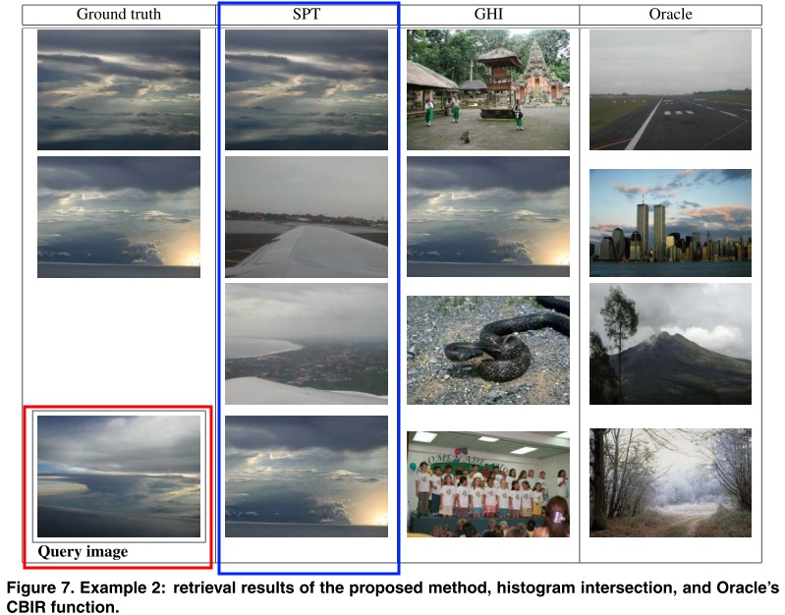

Slide 27
[Conclusion]
NPR+CBIR
New image similarity measure
  Brush-stroke parameters as features
  Computed by matching strokes
Higher retrieval rate compared to color or texture based features.

Slide 28
[Limitation and Future issue]
More index time and use more CPU
Orientation variant
  Shift orientation histograms image 8 times and choose the maximum value?
Try other NPR methods

Slide 29

Thank You.

