Slide 1
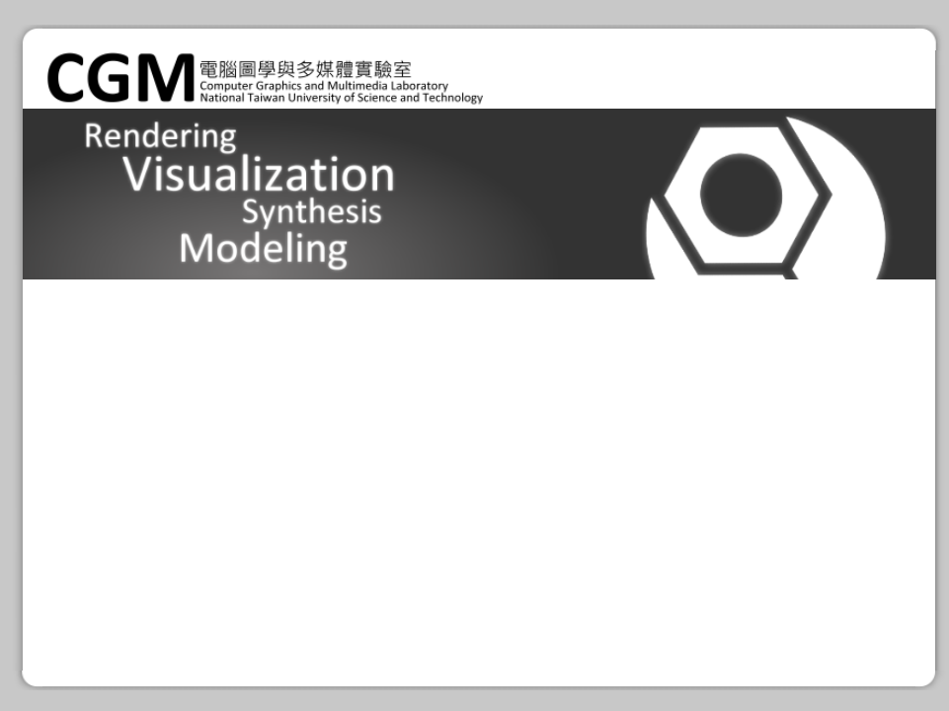

Developing on GPU with Nvidia CUDA
Yuan-Hao Lai

Slide 2
[Why use GPU?]

Slide 4
[CUDA features]
Massive parallel computing architecture
  Thousands of threads
Fast floating-point operations
Fast local memory access
Base on Extended C
  Also on Matlab, Fortan…

Slide 5
[CUDA features]
Slower than CPU when less threaded
Slow speed passing data from/to CPU
Slow speed in flow control
Synchronize problem issue

Slide 6
[CUDA requirements]
Base on Extended C
  Also on Matlab, Fortan…
Hardware requirements (suggested)
  GeForce 400 Series (Fermi )
Operation System requirements
  Win XP or higher, Linux, Mac OS X

Slide 7
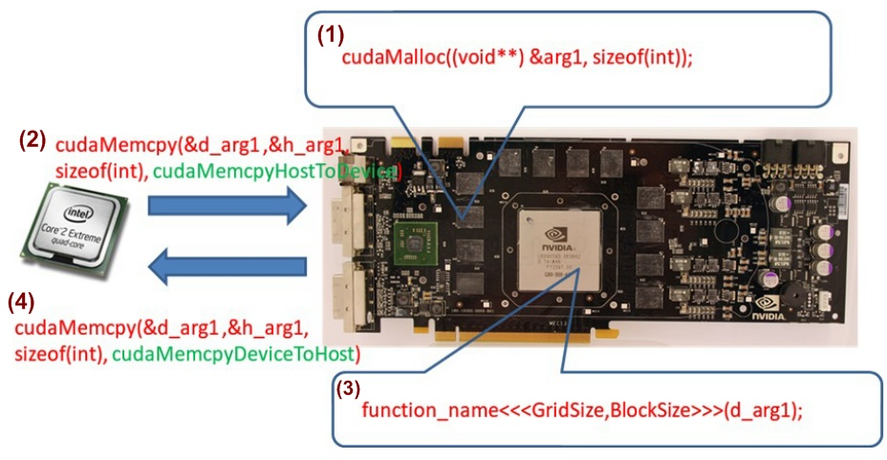

Slide 8
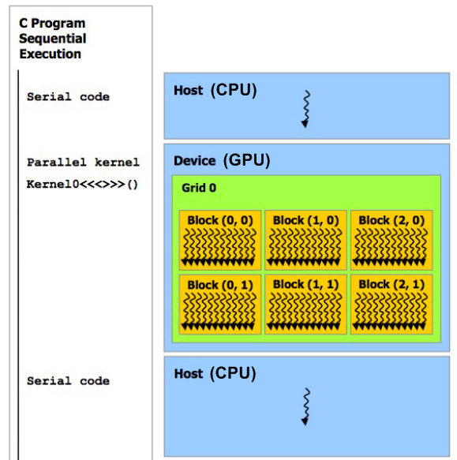

Slide 9
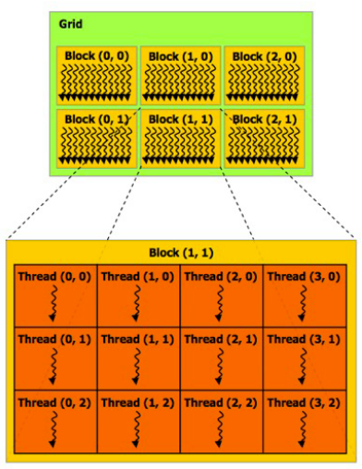
[Thread Index System]
Grid
↓
Block
↓
Thread

Slide 10
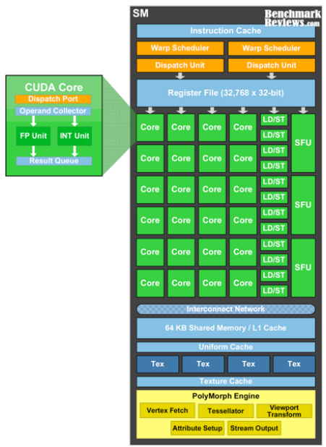
MP
multi-processor

Slide 11
Coding CUDA

Slide 12
[How to compile/debug CUDA program?]
Linux: NVCC
  CUDA-gdb
Windows: Visual Studio 2005 or higher
  CUDA 3.0: CPU emulation mode
  CUDA 3.2: Printf function with Fermi
  CUDA 4.0+Parallel Nsight(WinVista needed)

Slide 13
[GPU kernel function]

Slide 14
[Calling GPU kernel function]
vecAdd_gpu_kernel<<<2048, 512>>>(d_vecA, d_vecB, d_vecC);
↑
Function
name
↑
Blocks
per grid
↑
Threads
per block
↑
Arguments
(same as C)

Slide 15
CUDA sample:
Sum of Squares

Slide 16
/* [host side] */
#include <cuda_runtime.h>
#define DATA_SIZE 1048576
int data[DATA_SIZE], *gpudata, *result;
GenerateNumbers(data, DATA_SIZE);
cudaMalloc(&gpudata, sizeof(int)*DATA_SIZE);
cudaMalloc(&result, sizeof(int));
cudaMemcpy(gpudata, data, sizeof(int)*DATA_SIZE,
cudaMemcpyHostToDevice);

Slide 17
/* [device side] */
__global__ static void sumOfSquares(int *num, int* result) {
int sum = 0, i;
for(i = 0; i < DATA_SIZE; i++)
sum += num[i] * num[i];
*result = sum;
}

Slide 18
/* [calling in CPU] */
sumOfSquares<<<1, 1>>>(gpudata, result);
// 1048576 elements
// 0.43 second used
// same or slower than CPU (0.3~0.4 second)

Slide 19
Parallelization

Slide 20
/* [device side] */
#define THREAD_NUM 256
__global__ static void sumOfSquares(int *num, int* result) {
int tid = threadIdx.x;
int size = DATA_SIZE / THREAD_NUM;
int sum = 0, i;
for(i = tid; i < DATA_SIZE; i += THREAD_NUM)
sum += num[i] * num[i];
result[tid] = sum;
}

Slide 21
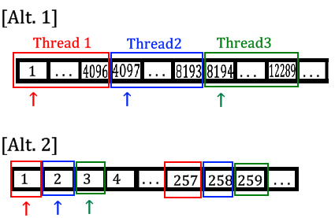

Slide 22
/* [calling in CPU] */
sumOfSquares<<<1, THREAD_NUM>>>(gpudata, result);
// 1048576 elements
// 0.0094 second used
// 246 times faster !!

Slide 23
Optimization

Slide 24
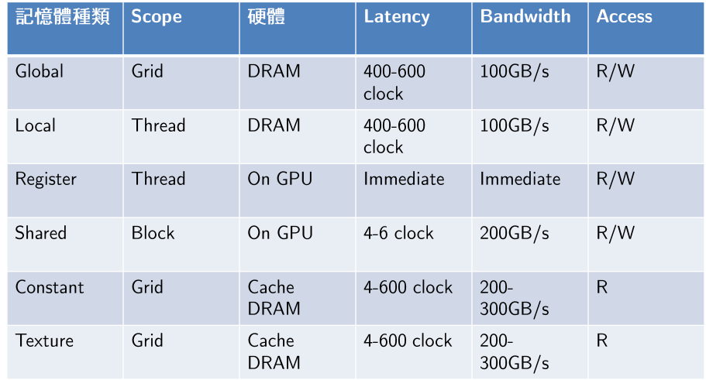
[CUDA Device Memory Space Overview]

Slide 25
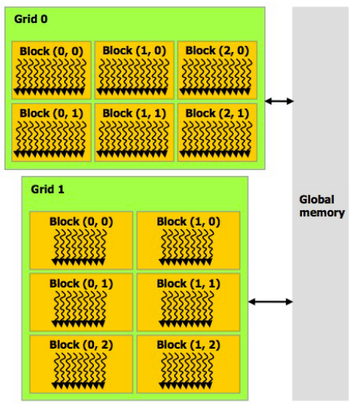
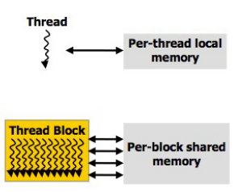

Slide 26
CUDA sample:
Matrix Multiply

Slide 27
__global__ static void matMultCUDA(float* A, size_t lda,
float* B, size_t ldb, float* C, size_t ldc, int n) {
int idx = blockIdx.x * blockDim.x + threadIdx.x;
int row = idx / n, column = idx % n;
if(row < n && column < n) {
float sum = 0;
for(int i = 0; i < n; i++)
sum += A[row* lda + i] * B[i * ldb + column];
C[row * ldc + column] = sum;
}
}

Slide 28
/* [calling in CPU] */
matMultCUDA<<<BLOCKS, THREADS>>>(A, n, B, n, C, n, n);
// 1000*1000 Matrix
// 1.15 second used
// 14.56 second in CPU version
// Can be more faster!

Slide 29
__global__ static void matMultCUDA(….) {
extern __shared__ float data[];
for(i = tid; i < n; i += blockDim.x)
data[i] = A[row * lda + i];
if(row < n && column < n) {
float sum = 0;
for(int i = 0, sum=0; i < n; i++)
sum += data[i] * B[i * ldb + column];
C[row * ldc + column] = sum;
}
}

Slide 30
/* [calling in CPU] */
matMultCUDA<<<BLOCKS, THREADS, sizeof(float)*n>>>
(A, n, B, n, C, n, n);
// 1000*1000 Matrix
// 0.42 second used
// 3 times faster than previous version!

Slide 31
[CUDA Programming Tips]
Distribution and Parallelization
Hardware, CUDA, Compiler version
  Buffer size, number of cores
  Better with Fermi Architecture
Optimization
  Coalesced I/O
  Memory using

Slide 32

Thank You.

