Slide 1
Video Retrieval using
Spatio-Temporal Descriptors
Daniel DeMenthon, David Doermann
University of Maryland
ACM Multimedia conference(2003)
Yuan-Hao Lai

Slide 2
[Existing Approaches]
Text data from closed captions
Speech transcription
Keyframes
Specialized detectors for face and vehicle
Color, shape, texture
But temporal features are often ignored

Slide 4
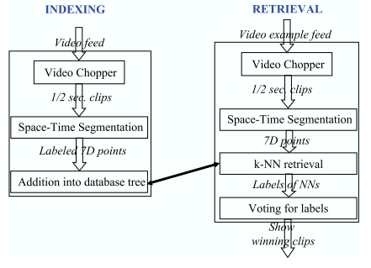

Slide 6
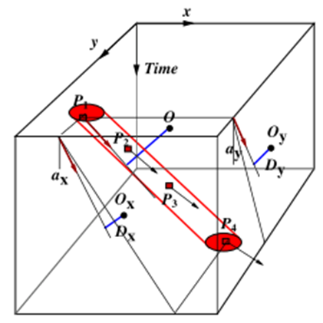

Slide 7
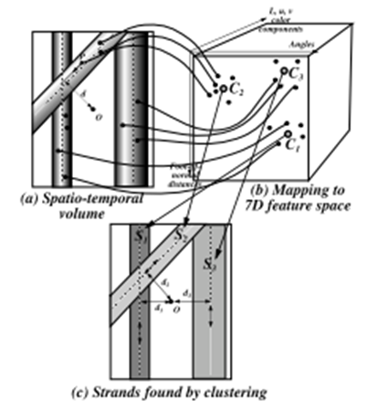

Slide 8
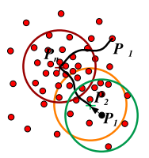
[Mean shift analysis]

Slide 9
[Hierarchical mean shift analysis]

Slide 10
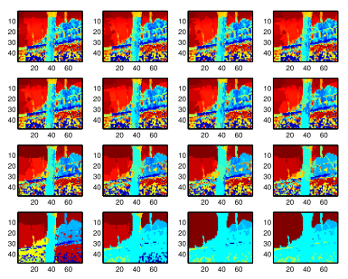

Slide 11
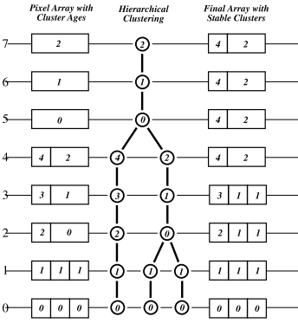

Slide 12
[Retrieval of near-duplications]

Slide 13
[Retrieval of near-duplications]
Recognize dynamic logos
  Search for speciﬁc shows in a large DB
19 dynamic logos, 15 to 100 frames
chopped into 12-frame clips, 11 point in avg
90% points is not from logos, total 5300
Ava cost O(log N) in build and search tree
45 clips used as queries, 97% success rate

Slide 15
[Retrieval of near-duplications]
Find location in full story
5300 frames total, chop into 430 clip
5000 point
6 correct clip. 2 incorrect
Can be used to jump from summary to main content

Slide 16
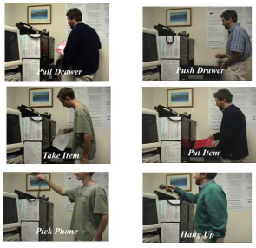

Slide 20
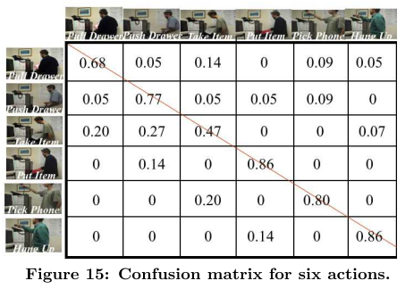

Slide 21
[Conclusions]
Space-time segmentation
  Transform the dynamic content of video clips into simple purely geometric patterns
Dynamic interaction of color regions in videos for the use of pattern recognition techniques
Combining k-nearest neighbors search and voting on the retrieved labels

Slide 22
[Conclusions]
High level of resilience against video clip variability caused by editing and overlays.
Provide good discriminative power in recognition of actions occurring at ﬁxed places in the ﬁeld of view of ﬁxed surveillance cameras

Slide 23
Thank You.

