Slide 1
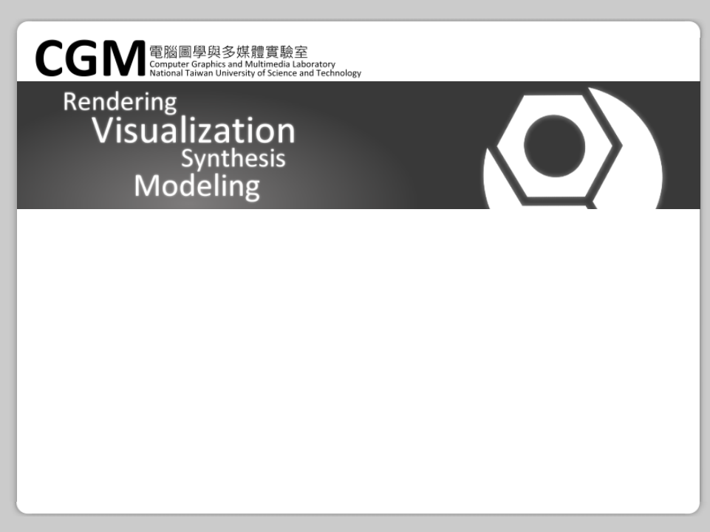
Learning color and locality cues for moving object detection and segmentation
Feng Liu and Michael Gleicher
University of Wisconsin-Madison
CVPR 2009
Yuan-Hao Lai

Slide 2
[Background subtraction]
Detect/segment a moving object
From monocular video
Object motion is sparse and insufficient

Slide 3
[Subtraction method]
Learn object color and locality cues
Detect keyframes with reliable motion
Use MRF network to estimate sub-objects
  Learn an appearance GMM model
Propagated to neighboring frames as locality cues

Slide 5
[Learning moving object cues]
If a region moves differently from the global motion, it belongs to a moving object
If a region moved in certain frames, consider it a moving object throughout video
  A boy walks for a while and stops to swing hands

Slide 6

[Motion cues]
Discrepancy between the local motion and the global background motion
Use SIFT to estimate homography
Notes:
mc: motion cue
mo: optical flow
mg: global motion

Slide 7

[Key frame extraction]
Motion cues are likely reliable when they are strong and compact.
Notes:
上：最小區域
下：用這些mc在畫面位置的變異數來分析空間上的分佈，要小於threshold

Slide 8
[Segment moving sub-objects]
Not all pixels of the object have significant motion cues. Often only the boundary
  Neighbor are likely to have same label
  Neighbor with similar colors are more likely to have the same label.

Slide 9
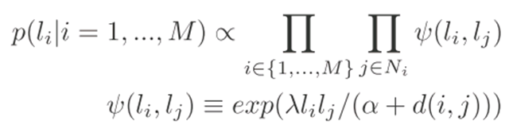
[MRF prior on labels]
Notes:
li: label, -1:moving object, 1:BG
M: 影像大小
Ni: 8-connected neighbor
d(i, j): color diff
α、λ: param
I: image

Slide 10

[Learning color and locality cues]
The color distribution of moving objects can be characterized by GMM
Notes:
用Lab顏色空間
i=1…n, n: GMM components
gi(): GMM的相似預測值
pi: prior of component gi respectively
ui: covariance matrix
Σi: color的平均
pc(ci | li): affinity of a pixel with color c to the
moving object Gf
δc is a parameter

Slide 11
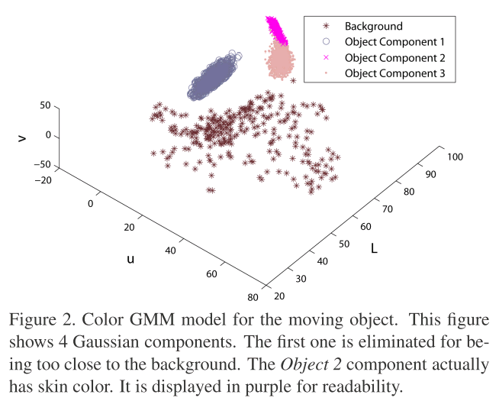

Slide 12
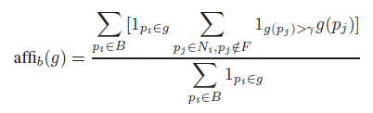
[Learning color and locality cues]
Detect false components by checking affinity, if too close to background, set as outlier.
Notes:
g: component
g與所有鄰接背景B的相似性加總
F: 所有moving object的集合
B: 物件邊緣
1expr: 如果expr為true，設定成1，false設定成0
Ni: pi的8方向鄰居
g(pj): 相似性，前張投影片有提到
γ: parameter

Slide 13
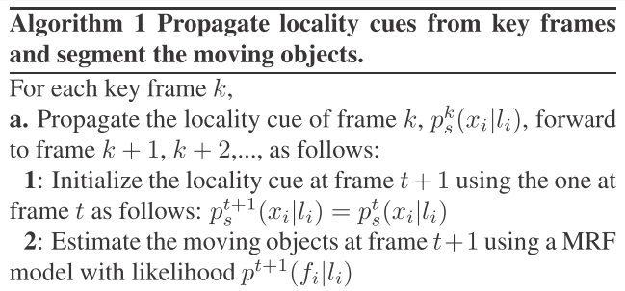

Slide 14
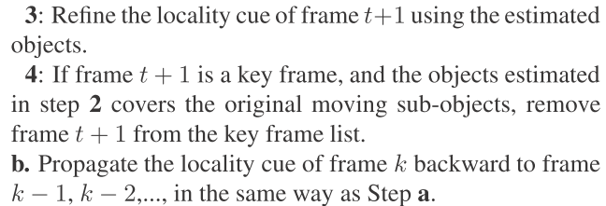

Slide 15
[Moving object segmentation]
Motion cues are sparse and incomplete
Locality cues are available only on key frames
Cause false detection when the background has regions with similar color
Notes:
mc: motion cue
ci: 顏色相似性
xi: 位置相似性

Slide 16
[Experiments]
320 × 240, 30 fps. 40 frames per minute
  40 frames per minute
About 80% of the time is spent on the global motion and optical flow estimation
Compare with HMOE (ICCV2007) method

Slide 17
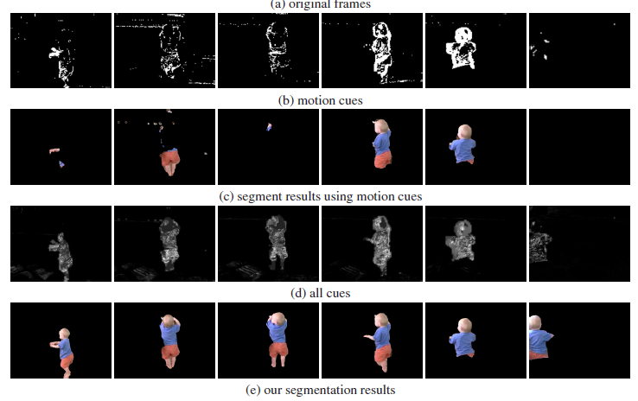
Notes:
小朋友玩鋼琴，接著又走開的video
zoom-in/out
雖然在走開的時候有很明顯的motion cue，但彈鋼琴的時候沒有很明顯(b)
learn color

Slide 18
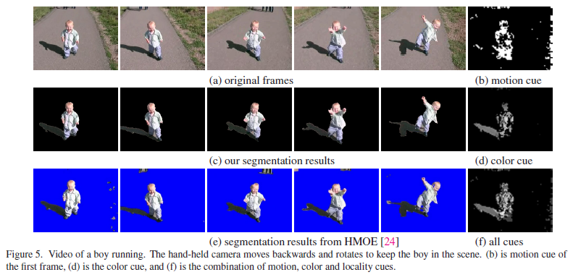

Slide 19
[Conclusion]
Small object motions make contrast between object and background sparse, ambiguous and insufficient / Small camera motions make depth estimation difficult.
Supervised algorithm to learn the color and locality
Works off-line because color and locality cues are learned from the whole video.
Notes:
HMOE (ICCV2007)

Slide 20

Thank You.

