Slide 1

Coupled Detection and Trajectory Estimation for Multi-Object Tracking
Bastian Leibe, Konrad Schindler, Luc Van Gool
ETH Zurich, Switzerland
ICCV 2007
Yuan-Hao Lai

Slide 2
[Multi-object tracking]
Pedestrian detector
Object detection
Spacetime trajectory estimation
Hypothesis selection of globally optimal set

Slide 3
[Optimization procedure]
Kept efficient through incremental computation and hypothesis pruning
Recover from mismatches and temporarily lost tracks

Slide 4
[Previous Works]
First-order Markov chain
  Locations are predicted from previous
Trackers cannot recover from failure once they have lost track

Slide 5
[Aim of this work]
Tracking by coupling object detection and a non-Markovian hypothesis selection
Feedback loop
Find a globally optimal combined solution for all detections and trajectories
  No two objects can occupy the same physical space

Slide 6
[MDL Hypothesis Selection.]
Sdata: number N of data points explained by hypothesis h
Smodel: cost of coding the model
Serror: cost for the error by representation
κ1 , κ2: weight

Slide 7
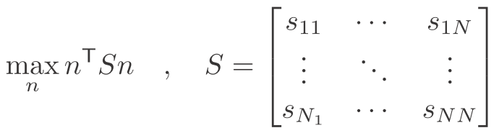

[Quadratic Boolean Problem]
A data point only assign to one model. Overlapping hypothesis compete for data points
n_{i}=1 if hypothesis h_{i} is accepted, n_{i}=0 otherwise
S is an interaction matrix, s_{ii} are the merit terms of individual hypotheses

Slide 8
[Coupled Detection & Trajectory Estimation]
Merit of assumed trajectory depends on number & strength of the related detections {n_{i} = 1}
Merit of assumed detection depends on current object trajectories {m_{i} =1}

Slide 9
[Coupled Detection & Trajectory Estimation]
Relationship between detections and trajectories is not symmetric
Trajectories rely on detections but new detections can occur without a trajectory to assign to (e.g. A new object enters the scene)

Slide 12
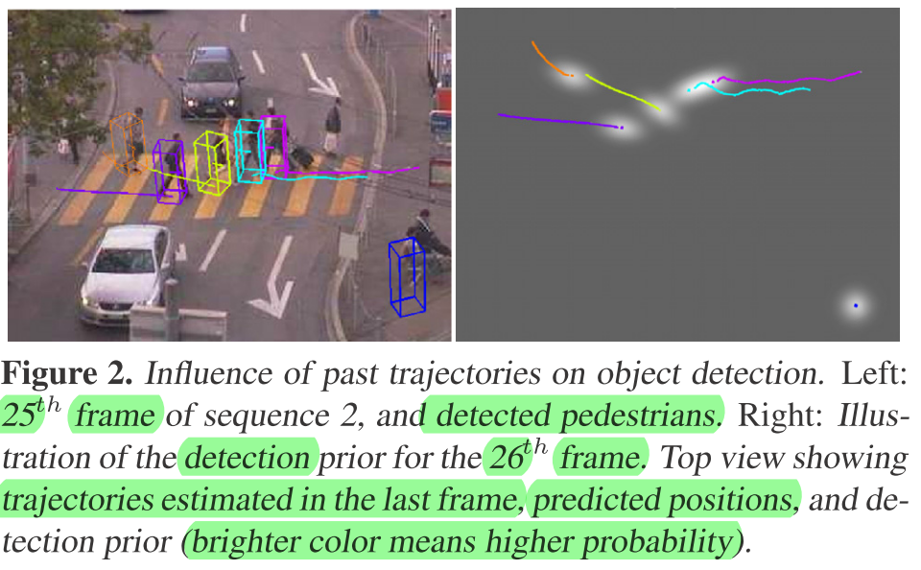

Slide 13
[Coupled optimization problem]
A trajectory is selected if its score outweighs
If trajectory H_{i} is selected, and a compatible detection H_{j} also, then H_{j} contributes to the trajectory score through v_{ij}.
If a detection H_{j} is not part of any trajectory, but its score outweighs the base cost in s_{jj}, it is still selected.

Slide 14
[Coupled optimization problem]
If a detection is part of any selected trajectory, then its virtual trajectory will not be selected, due to the interaction costs u_{ij} and the merit r_{jj} of a virtual trajectory is less than that of any real trajectory.
Finally, the detections compete for pixels in the image plane through the interaction costs, and the trajectories compete for space

Slide 15
[Detailed Implementation]
Static Objects
  Initialized with meanshift clustering on groundplane with continuity over time
Moving Objects
Start from detections in last few frames, trajectory predict fore/backward, location and appearance models updated by a weighted mean

Slide 16
[Detailed Implementation]
Hypothesis Pruning
Control the number of hypotheses evaluate: Too long without finding evidence are removed
Identity Management
Not rely on stepwise trajectory extension alone. If at any time a newly generated hypothesis provides a better explanation, it will replace the older version

Slide 17
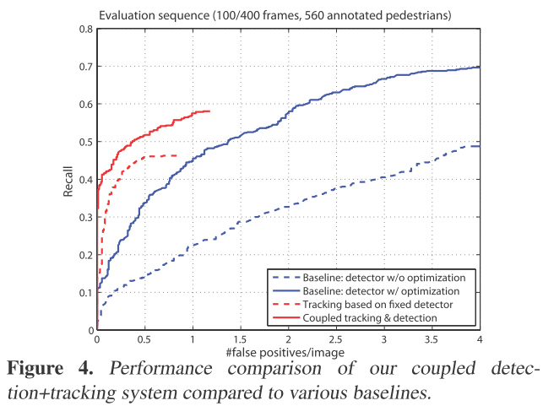

Slide 18
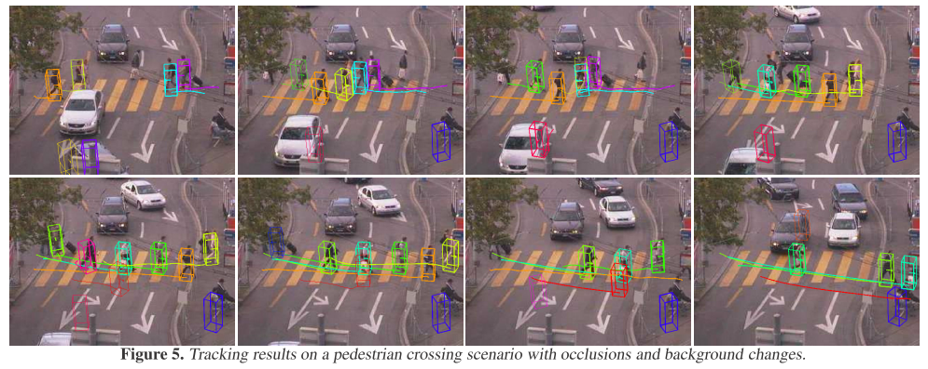

Slide 19

Thank You.

