Slide 1
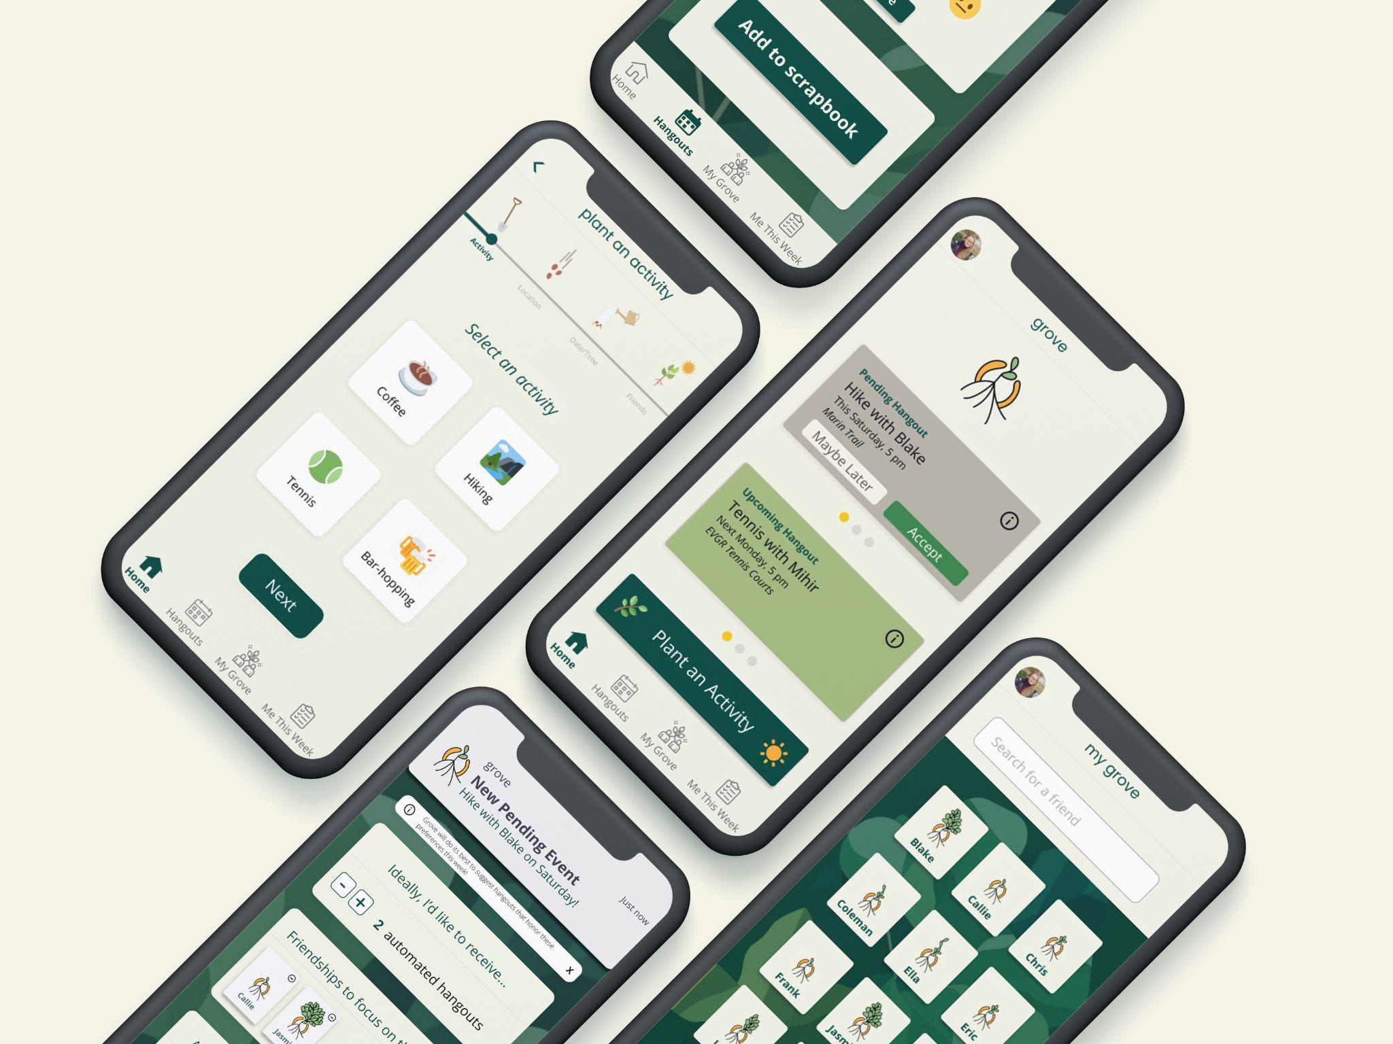
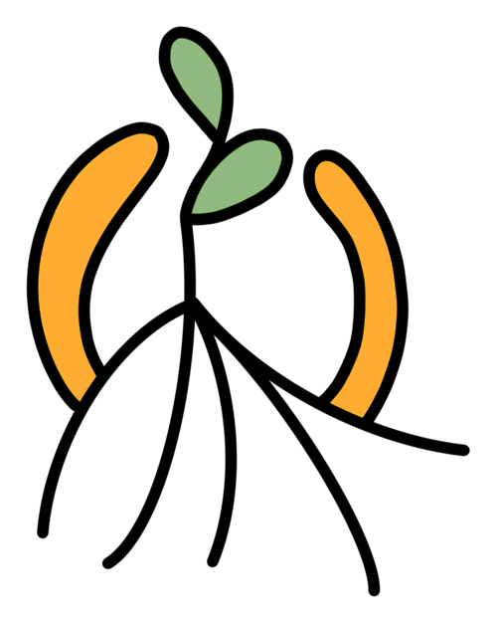
grove
Cultivate your post-grad community
hangout with new friends
deepen new connections
receive auto-generated activities

