Slide 1
Diagnosticador de Fallos en Autoclaves
Autor: Christian Guzmán Noda A31
Tutor: Ms. C. Adriana Villalon Falcon

Slide 2
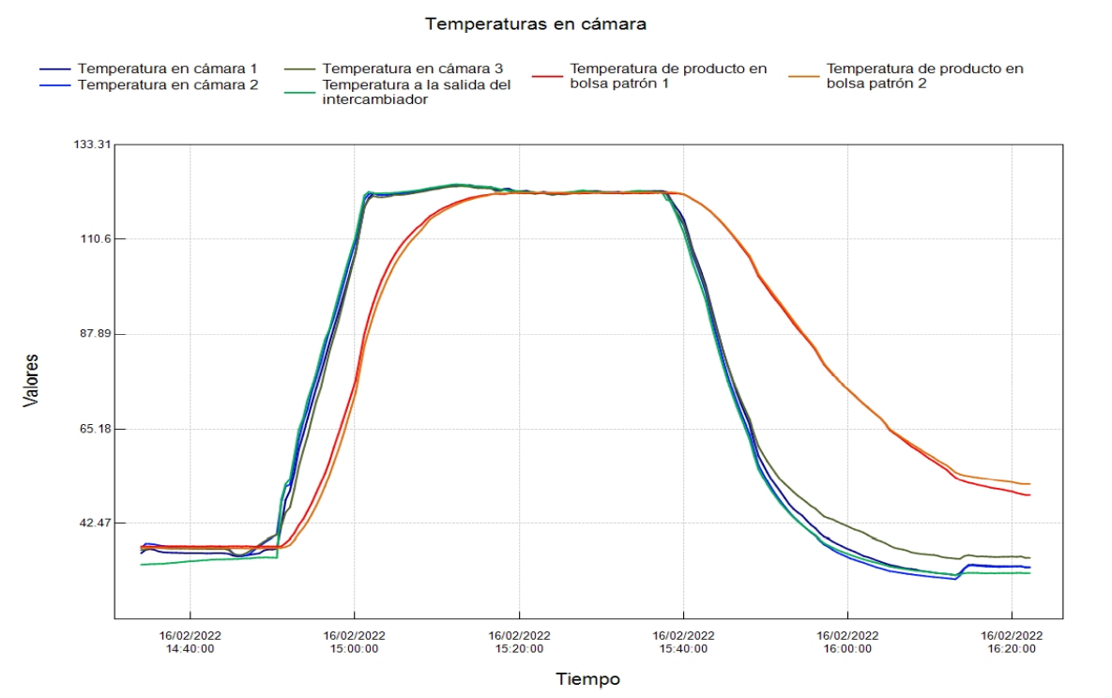

Slide 3
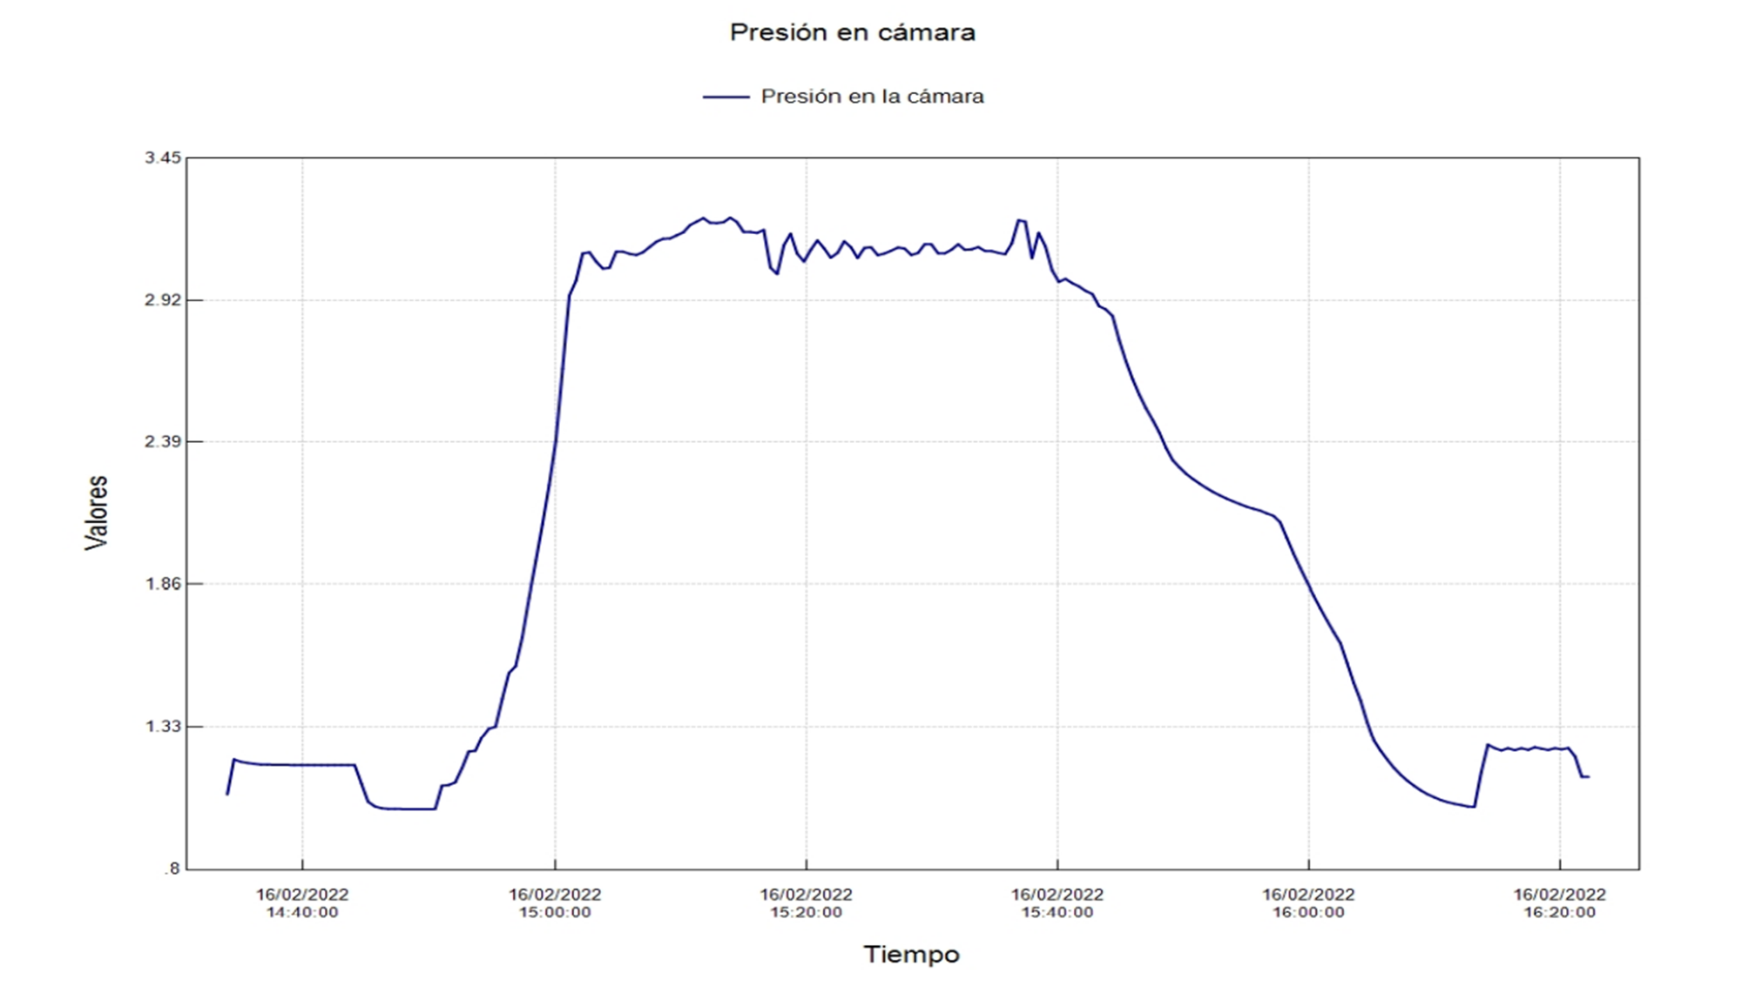

Slide 4
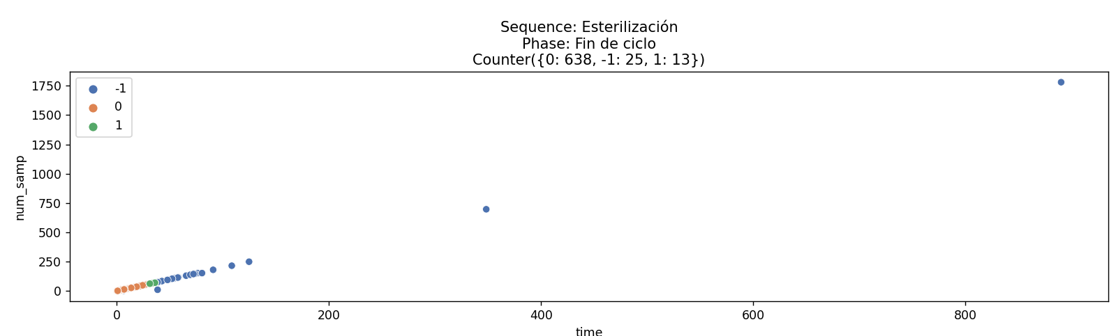

Slide 5
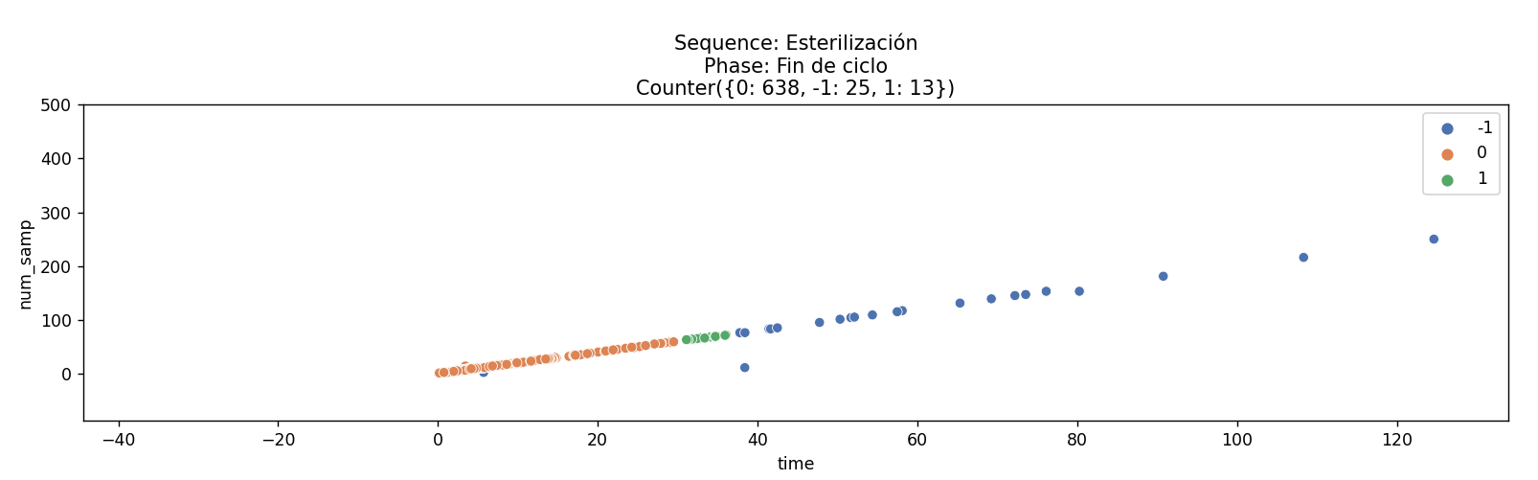

Slide 6
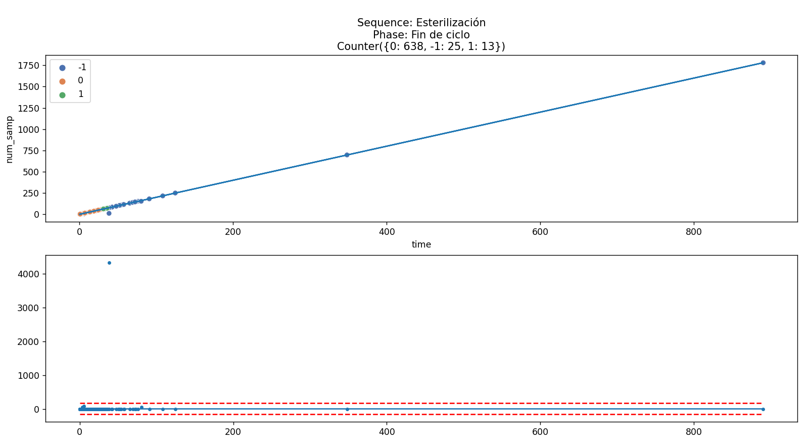

Slide 7






Slide 10
Slide Title
Make Effective Presentations
Using Awesome Backgrounds
Engage your Audience
Capture Audience Attention

Slide 11
Slide Title
Make Effective Presentations
Using Awesome Backgrounds
Engage your Audience
Capture Audience Attention

Slide 12
Slide Title
Product A
Product B
Feature 1
Feature 2
Feature 3
Feature 1
Feature 2
Feature 3

Slide 13


