Slide 1
Politische Psychologie
Informationsverarbeitung und Heuristiken

Slide 2
Übersicht
1 – Wie funktioniert eigentlich „denken“?
2 – Verbindung zu anderen Kursthemen
3 – Anwendungsbeispiele aus der Forschung
4 – Gruppenpräsentationen & Diskussionen

Slide 3
1
Informations-verarbeitung und Heuristiken

Slide 4
Ein (sehr) einfaches Model
Informationsverarbeitung
Informationen
Politische Wahrnehmungen und Verhalten

Slide 5
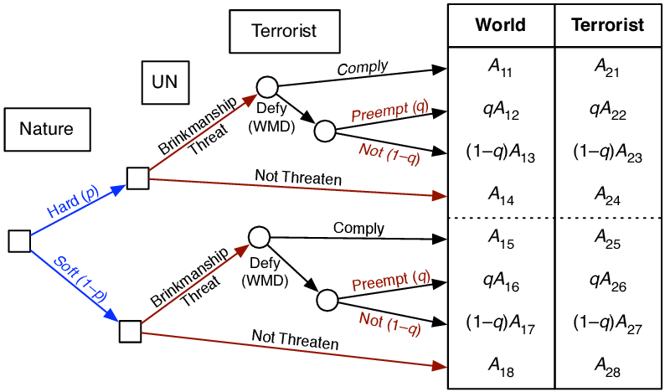
Das„rationale“ Denken in Reinform
Alle möglichen Ergebnisse & Schritte zum Ergebnis werden aufgelistet
Der relative Nutzen aller Möglichkeiten wird berechnet
Die Wahrscheinlichkeit aller Möglichkeiten wird berechnet
Der wahrscheinlichkeits-gewichtete Nutzen der Ergebnisse wird berechnet und maximiert
Notes:
https://www.researchgate.net/figure/Brinkmanship-Game-Tree-Probabilities-Payoffs_fig1_227214506

Slide 6
Das ist anstrengend / langsam

Slide 7
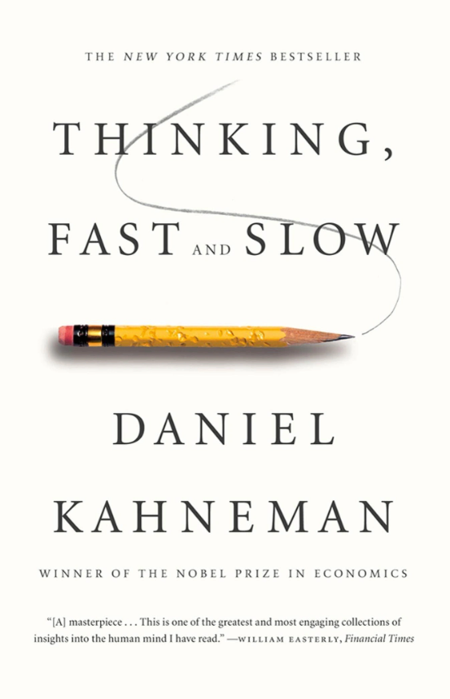
Heuristiken als Abkürzung
Tversky and Kahneman (1974)
Entscheidung in Unsicherheitssituationen und Risikosituationen
Heuristiken als Werkzeug der Komplexitätsreduktion
Heuristiken „schneller“ und weniger anstrengend als deliberatives Denken
Heuristiken führen (oft) zu „Bias“ oder Verfälschungen
Gigerenzer, Hertwig, and Pachuk (2011)
Heuristiken können „besser“ sein als rationale Entscheidungen → Geschwindigkeit
„Adaptive Rationalität“, „bounded rationality“und verhaltensökonometrische Ansätze
*
*Die Replikationskrise macht auch vor diesem Buch nicht halt

Slide 8
Beispiele von Heuristiken
Heuristik | Beschreibung
Verfügbarkeit | Urteile über Häufigkeiten und Wahrscheinlichkeiten von Ereignissen sind abhängig davon wie leicht man sich an das Ereignis erinnern kann
Repräsentativität | Urteile über Häufigkeiten und Wahrscheinlichkeiten sind abhängig davon wie repräsentativ es für gewisse Prototypen sind
Anker/ Anpassung | Urteile werden an Kontext oder „Primes“ angepasst. Z.B. Ausgangspunkte oder Startwerte von Schätzungen oder Herstellung von Assoziationen
Rekognition | Beim Vergleich von zwei Objekten wird das bekannte Objekt als wichtiger / repräsentativer Erkannt

Slide 9
Dual Process Modelle
Typ 1: Intuition /schnelles denken
Schnell
Hohe Kapazität
Parallele Verarbeitung
Nicht im Bewusstsein
Automatisch
Kontextualisiert und Assoziativ
Erfahrungsbasierte Entscheidungen
Unabhängig von kognitiven Eigenschaften
(Verzerrt) oder „Biased“
Typ 2: reflektiertes / langsames denken
Langsam
Begrenzte Kapazität
Serielle Verarbeitung
Bewusst
Abstrakt
Regel-basiert
Verbunden mit kognitiven Eigenschaften
Ziel-orientierte Entscheidung
Notes:
Quelle: Dual-Process Theories of Higher Cognition
May 2013
Perspectives on Psychological Science 8(3):223-241
DOI:10.1177/1745691612460685

Slide 10
Ein (etwas) komplexeres Model
Kontext & Gruppen ID
Informationen
Heuristiken
Politische Wahrnehmungen und Verhalten
Reflektiertes Denken
Persönlichkeit
Werte & Ideologie

Slide 11
2
Verbindung zu anderen Kursthemen

Slide 12
Heuristiken und Werte
Petersen, M. B., Slothuus, R., Stubager, R., & Togeby, L. (2011). Deservingness versus values in public opinion on welfare: The automaticity of the deservingness heuristic. European Journal of Political Research, 50(1), 24-52.
Public attitudes towards welfare policy are often explained by political values and perceptions of deservingness of welfare recipients. This article addresses how the impact of values and perceptions varies depending on the contextual information that citizens have available when forming welfare opinions. It is argued that whenever citizens face deservingness-relevant cues in public debate or the media, a psychological ‘deservingness heuristic’ is triggered prompting individuals spontaneously to think about welfare policy in terms of who deserves help. This is an automatic process, equally influential among the least and the most politically sophisticated. Moreover, when clear deservingness cues are present, the impact of values on opinions vanishes. These arguments are supported by data from two novel experimental studies embedded in separate nationwide opinion surveys. The findings revise conventional wisdom of how values and heuristics influence public opinion and have major implications for understanding dynamics in aggregate welfare opinion and attempts from political elites to manipulate public opinion

Slide 13
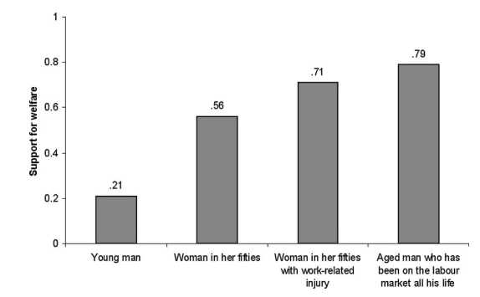
Heuristiken und Werte

Slide 14
Heuristiken & Werte & Identität
Kahan, D. M. (2012). Ideology, motivated reasoning, and cognitive reflection: An experimental study. Judgment and Decision making, 8, 407-24.
Social psychologists have identified various plausible sources of ideological polarization over climate change, gun violence, national security, and like societal risks. This paper describes a study of three of them: the predominance of heuristic-driven information processing by members of the public; ideologically motivated cognition; and personality-trait correlates of political conservativism. The results of the study suggest reason to doubt two common surmises about how these dynamics interact. First, the study presents both observational and experimental data inconsistent with the hypothesis that political conservatism is distinctively associated with closed-mindedness: conservatives did no better or worse than liberals on an objective measure of cognitive reflection; and more importantly, both demonstrated the same unconscious tendency to fit assessments of empirical evidence to their ideological predispositions. Second, the study suggests that this form of bias is not a consequence of overreliance on heuristic or intuitive forms of reasoning; on the contrary, subjects who scored highest in cognitive reflection were the most likely to display ideologically motivated cognition. These findings corroborated the hypotheses of a third theory, which identifies motivated cognition as a form of information processing that rationally promotes individuals’ interests in forming and maintaining beliefs that signify their loyalty to important affinity groups. The paper discusses the normative significance of these findings, including the need to develop science communication strategies that shield policy-relevant facts from the influences that turn them into divisive symbols of identity.

Slide 15
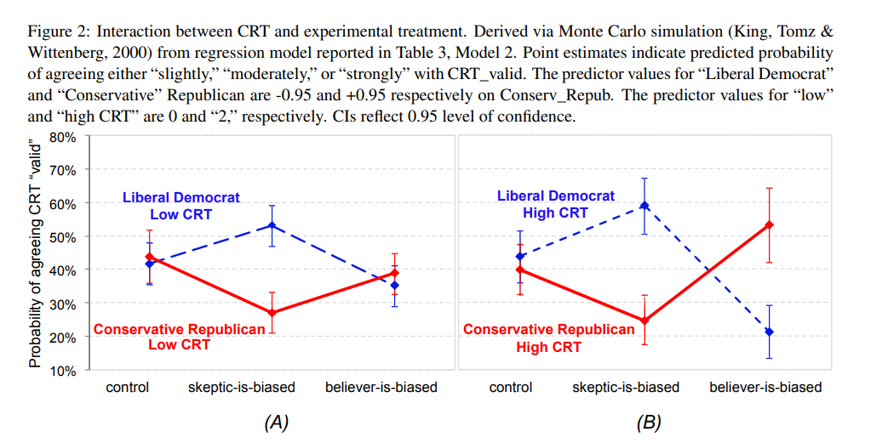
Heuristiken & Werte & Identität

Slide 16
3
Beispiele aus der Forschung

Slide 17
Politische Kultur&„Deservingness“
Aarøe, L., & Petersen, M. B. (2014). Crowding out culture: Scandinavians and Americans agree on social welfare in the face of deservingness cues. The Journal of Politics, 76(3), 684-697.
A robust finding in the welfare state literature is that public support for the welfare state differs widely across countries. Yet recent research on the psychology of welfare support suggests that people everywhere form welfare opinions using psychological predispositions designed to regulate interpersonal help giving using cues regarding recipient effort. We argue that this implies that cross-national differences in welfare support emerge from mutable differences in stereotypes about recipient efforts rather than deep differences in psychological predispositions. Using free-association tasks and experiments embedded in large-scale, nationally representative surveys collected in the United States and Denmark, we test this argument by investigating the stability of opinion differences when faced with the presence and absence of cues about the deservingness of specific welfare recipients. Despite decades of exposure to different cultures and welfare institutions, two sentences of information can make welfare support across the U.S. and Scandinavian samples substantially and statistically indistinguishable.

Slide 18
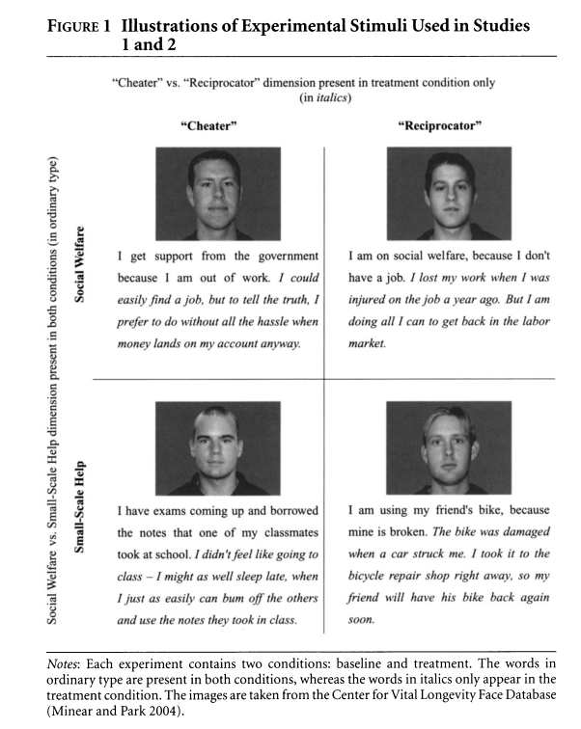
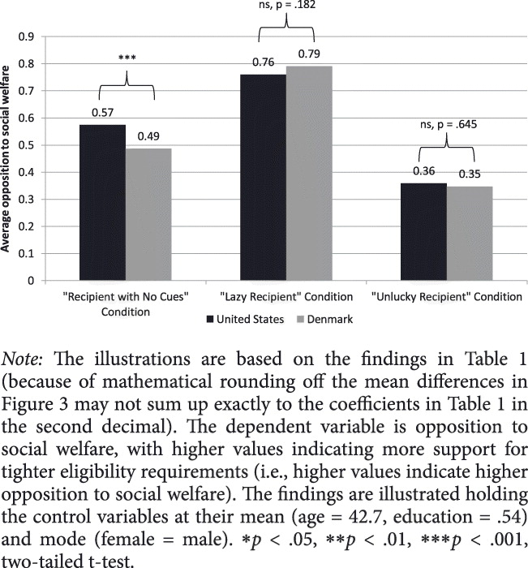
Politische Kultur&„Deservingness“

Slide 19
Parteien & Polit. Verantwortung
Tilley, J., & Hobolt, S. B. (2011). Is the government to blame? An experimental test of how partisanship shapes perceptions of performance and responsibility. The journal of politics, 73(2), 316-330.
The idea that voters use elections to hold governments to account for their performance lies at the heart of democratic theory, and countless studies have shown that economic performance can predict support for incumbents. Nonetheless recent work has challenged this simple link between policy performance and party choice by arguing that any relationship is conditioned by prior political beliefs, notably partisanship. Some have argued that economic perceptions are shaped by party choice rather than vice versa. Others have claimed that voters tend to attribute responsibility for perceived successes to their favored party, but absolve them of responsibility if performance is poor. This study examines the effect of partisanship on both performance evaluations and responsibility attributions using survey experiments to disentangle the complex causal relationships. Our findings show that partisan loyalties have pervasive effects on responsibility attributions, but somewhat weaker effects on evaluations of performance.

Slide 20
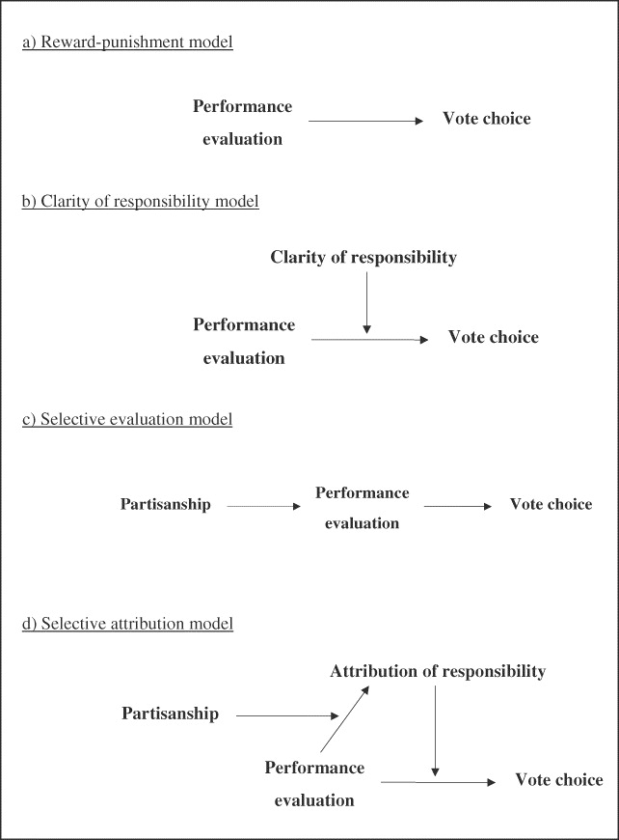
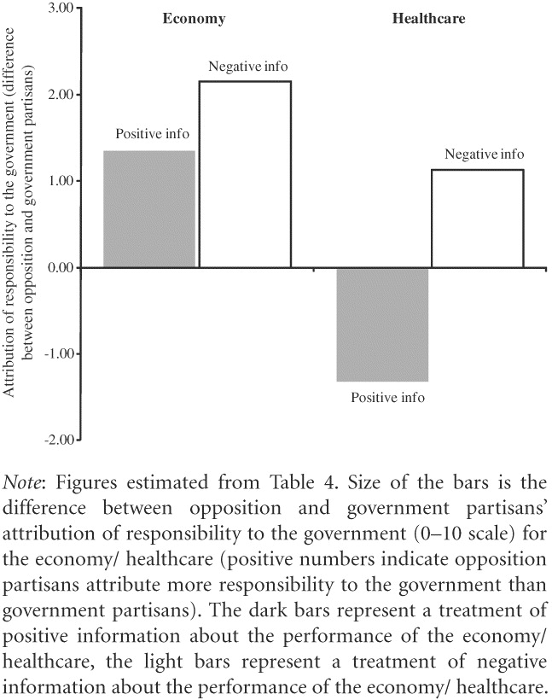
Parteien & Polit. Verantwortung

Slide 21
4
Gruppenarbeit und Disksussion

Slide 22
Anwendungsdiskussionen
Anwendung – Politisches Verhalten
Redlawsk, David P. (2004): What Voters Do. Information Search During Election Campaigns. In: Political Psychology 25(4): pp. 595-610.
Anwendung – Vorurteile, Rassismus & gruppenbezogene Menschenfeindlichkeit
Schmuck, Desirée, and Jörg Matthes. “Effects of Economic and Symbolic Threat Appeals in Right-Wing Populist Advertising on Anti-Immigrant Attitudes: The Impact of Textual and Visual Appeals.” Political Communication 34, no. 4 (October 2, 2017): 607–26. https://doi.org/10.1080/10584609.2017.1316807.

