Slide 1
Politische Psychologie
Emotionen

Slide 2
Übersicht
1 – Warum sind Gefühle wichtig?
2 – Verbindung zu anderen Kursthemen
3 – Anwendungsbeispiele aus der Forschung
4 – Gruppenpräsentationen & Diskussionen

Slide 3
1
Emotionen und Gefühle

Slide 4
Ein noch komplexeres Model
Emotionen
Kontext & Gruppen ID
Informationen
Heuristiken
Politische Wahrnehmungen und Verhalten
Reflektiertes Denken
Persönlichkeit
Werte & Ideologie

Slide 5
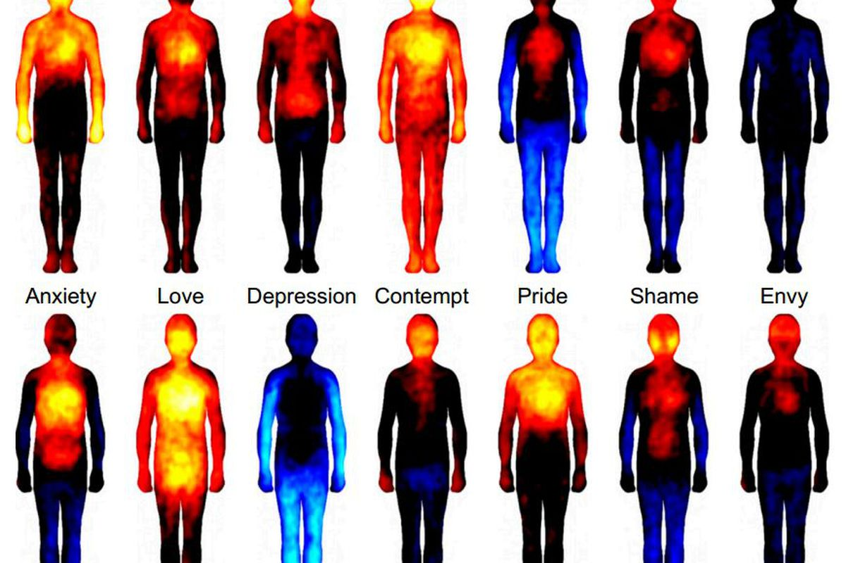
Emotionen & Politik
Seit der Klassische Philosophie: Gefühle sind wichtig aber sollten der „Ratio“ untergeordnet werden
Klassische Politikwissenschaft: Emotionen sind ein Aspekt der Politik aber sollten minimiert werden (normativ & analytisch)
Politische Psychologie: Emotionen sind integraler Bestandteil der Kognition und können theoretisch und empirisch betrachtet werden.

Slide 6
Emotionen & Psychologie
Emotionen sind nicht irrational sondern eine Form von Kognition / Denken
Emotionen können mit bestimmten kognitiven Mustern, Wahrnehmungen oder Verhaltensmustern assoziiert werden
Emotionen können pre-kognitiv wirken: Emotionen haben einen Einfluss, bevor das Nachdenken anfängt
Unterscheidung zwischen „state“ und „trait“ Emotionen
Unterscheidung zwischen „affect“, „emotion“, „mood“
Sehr viel Diskussion über Typologien der Emotion

Slide 7
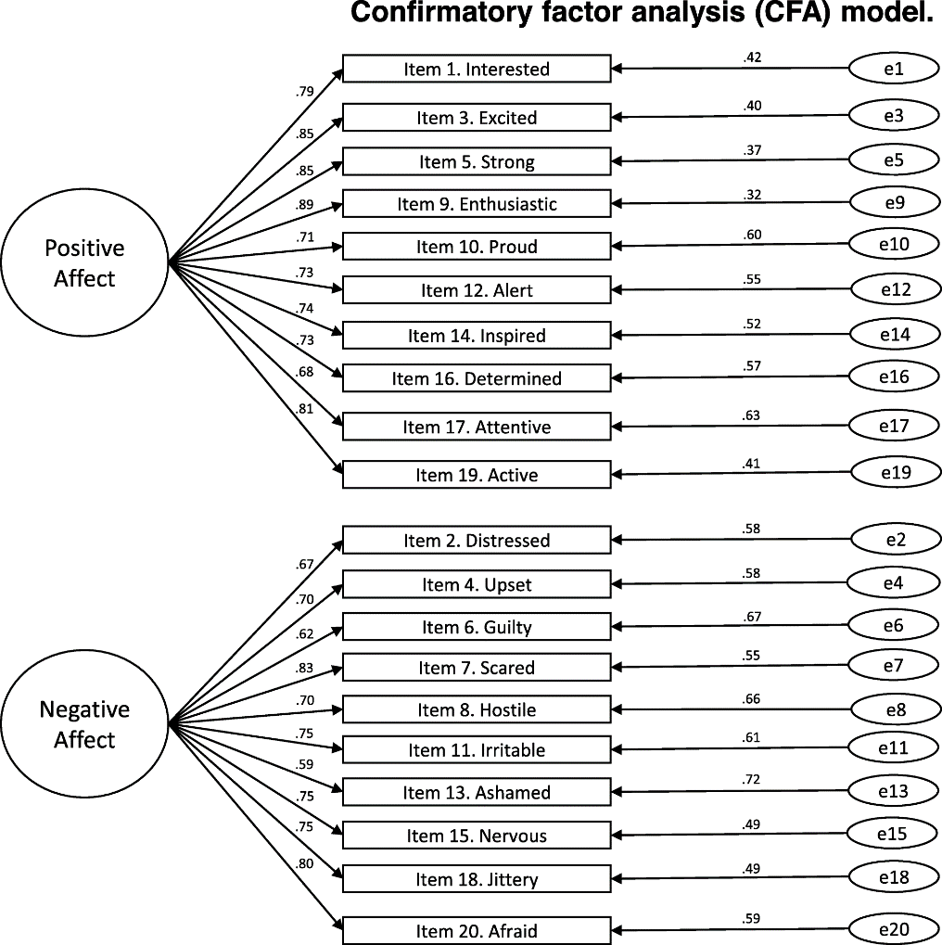
Model 1: Valenz-Modelle
- Negativ
Positiv +

Slide 8
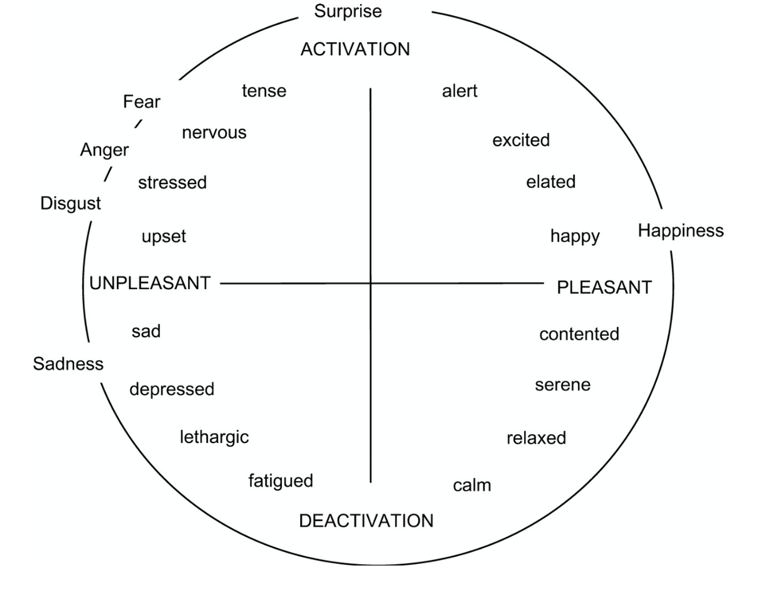
Model 2: Circumplex Modelle

Slide 9
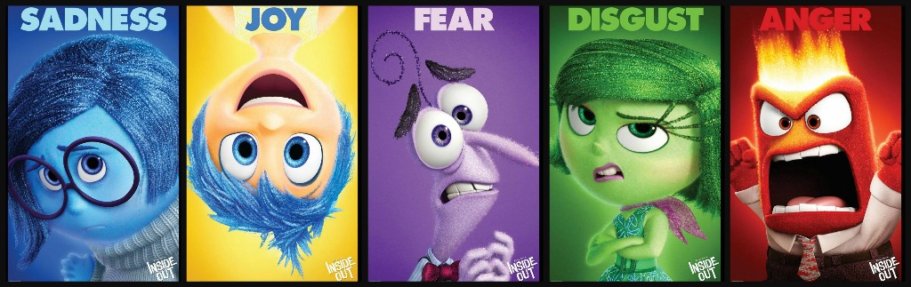
Model 3: Diskrete Emotionen

Slide 10
Model 3: Diskrete Emotionen
Wut
Verantwortungszuschreibung und Bestrafen von Vergehen
„approach behavior“ , Risikofreude & verminderte Typ 2 Kognition
Angst:
Rückzugsverhalten
Verringerte Verantwortungszuschreibung & erhöhte Informationssuche
Ekel: Rückzugsverhalten + Ausgrenzung
Freude: Höhere Risikofreude & verminderte Typ 2 Kognition
Trauer:
Weniger aktives Verhalten
Situative Verantwortungszuschreibung

Slide 11
2
Verbindung zu anderen Kursthemen

Slide 12
Emotionen und Werte
Inbar, Y., Pizarro, D., Iyer, R., & Haidt, J. (2012). Disgust sensitivity, political conservatism, and voting. Social Psychological and Personality Science, 3(5), 537-544.
In two large samples (combined N = 31,045), we found a positive relationship between disgust sensitivity and political conservatism. This relationship held when controlling for a number of demographic variables as well as the “Big Five” personality traits. Disgust sensitivity was also associated with more conservative voting in the 2008 U.S. presidential election. In Study 2, we replicated the disgust sensitivity–conservatism relationship in an international sample of respondents from 121 different countries. Across both samples, contamination disgust, which reflects a heightened concern with interpersonally transmitted disease and pathogens, was most strongly associated with conservatism.

Slide 13
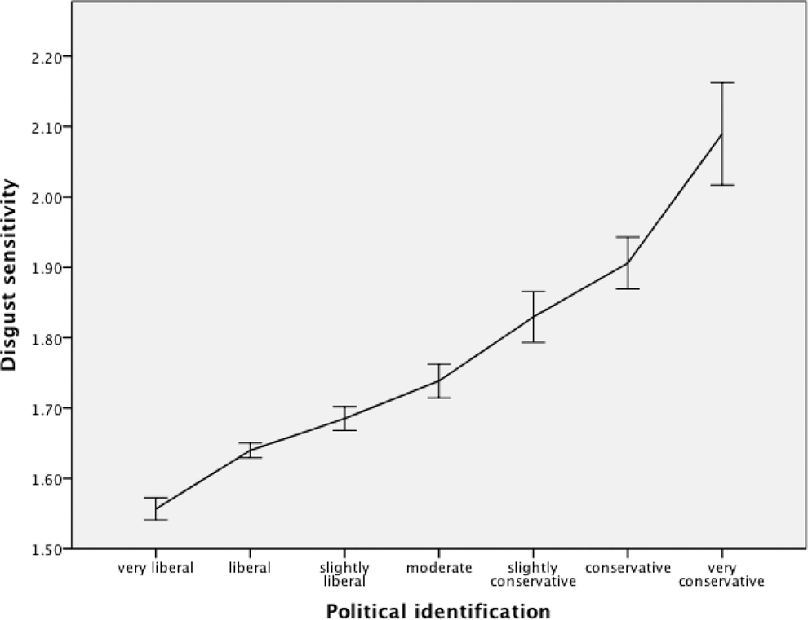
Emotionen und Werte

Slide 14
Emotionen, Persönlichkeit & Werte
Mayer, S. J., & Nguyen, C. G. (2021). Angry reactionary narcissists? Anger activates the link between narcissism and right-populist party support. Politics and Governance, 9(3), 248-259.
Even though previous research connected personality traits and support for radical-right populist parties (RRP), the question of which mechanisms connect these concepts is still underexplored. In particular, we focus on narcissistic rivalry, a maladaptive path of grandiose narcissism. Drawing on the affective intelligence framework and the narcissistic admiration and rivalry concept, we propose that the effect of rival narcissism on vote choice for the German Alternative für Deutschland is mediated by reactionary political orientations and activated by anger. Drawing on 2017 data from the mixed-mode representative GESIS panel (N = 2,552 & 1,901), we employ moderated mediation analyses. We show that reactionary political orientations mediate the relationship between narcissistic rivalry and RRP support. However, high levels of generalised anger are needed to activate the relationship between personality, reactionary values, and RRP support, whereas the mediating role of anti-immigrant sentiment is not affected by anger. Our study emphasises the role of anger in RRP support, thus showing that anger might explain why only some people with a specific predisposition support RRPs. The study also stresses the complexity of the relationship between personality, value orientations, and political behaviour

Slide 15
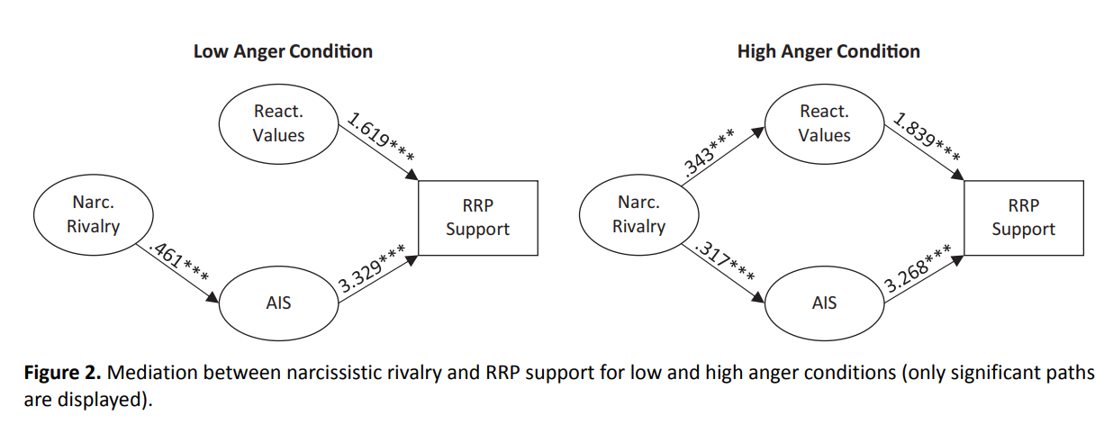
Emotionen, Persönlichkeit & Werte

Slide 16
Emotionen und Gruppenidentität
Huddy, L., Mason, L., & Aarøe, L. (2015). Expressive partisanship: Campaign involvement, political emotion, and partisan identity. American Political Science Review, 109(1), 1-17.
Party identification is central to the study of American political behavior, yet there remains disagreement over whether it is largely instrumental or expressive in nature. We draw on social identity theory to develop the expressive model and conduct four studies to compare it to an instrumental explanation of campaign involvement. We find strong support for the expressive model: a multi-item partisan identity scale better accounts for campaign activity than a strong stance on subjectively important policy issues, the strength of ideological self-placement, or a measure of ideological identity. A series of experiments underscore the power of partisan identity to generate action-oriented emotions that drive campaign activity. Strongly identified partisans feel angrier than weaker partisans when threatened with electoral loss and more positive when reassured of victory. In contrast, those who hold a strong and ideologically consistent position on issues are no more aroused emotionally than others by party threats or reassurances. In addition, threat and reassurance to the party's status arouse greater anger and enthusiasm among partisans than does a threatened loss or victory on central policy issues. Our findings underscore the power of an expressive partisan identity to drive campaign involvement and generate strong emotional reactions to ongoing campaign events

Slide 17
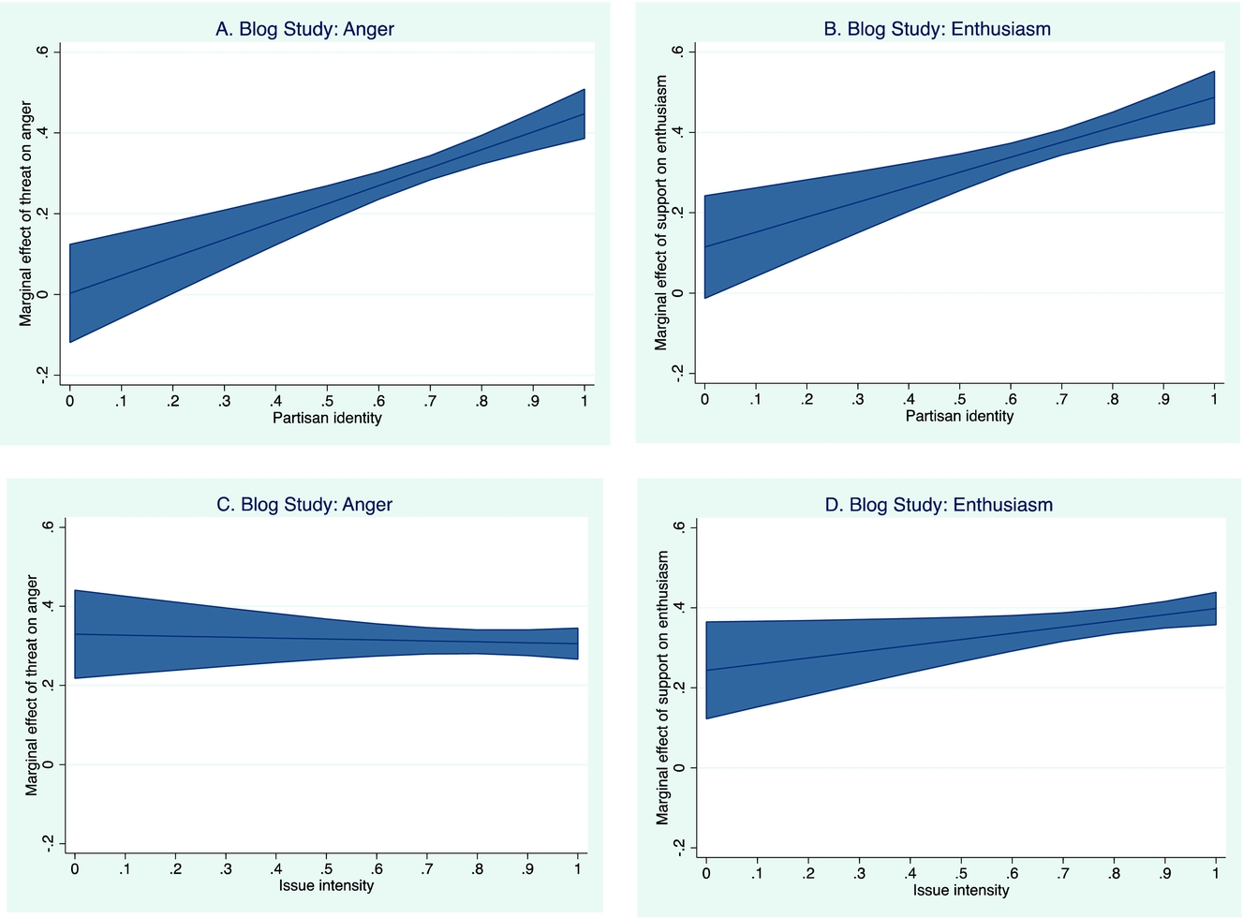
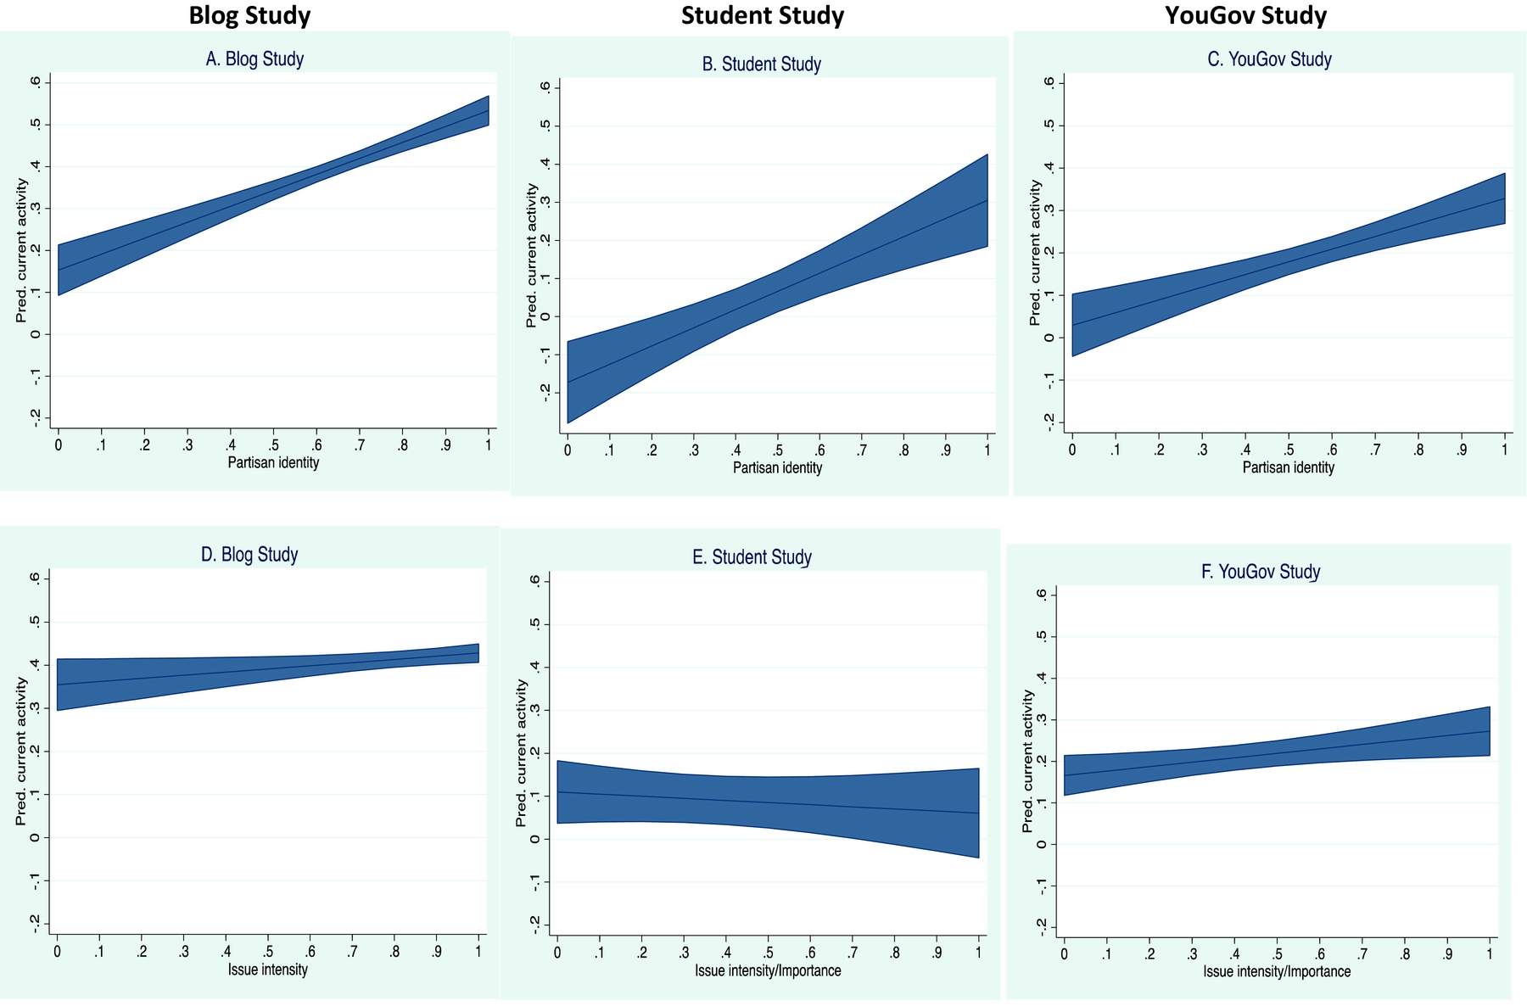

Slide 18
3
Beispiele aus der Forschung

Slide 19
Emotionen und Policy Preferenzen
Small, D. A., & Lerner, J. S. (2008). Emotional policy: Personal sadness and anger shape judgments about a welfare case. Political Psychology, 29(2), 149-168.
When making decisions about a welfare case, it is reasonable for one's thoughts and feelings about the potential welfare recipient to influence the decision. It is less reasonable for one's “incidental” feelings (e.g., sadness or anger arising from an event in one's personal life) to influence such decisions. In two studies, however, data reveal that incidental anger and sadness do in fact carry over, shaping welfare policy preferences. Study 1 found that incidental anger decreased the amount of welfare assistance participants recommended providing relative to neutral emotion, whereas sadness increased the amount recommended. Study 2 replicated the results and found that limiting participants’ cognitive resources eliminated the difference between sadness and anger, thus implying that differences in depth-of-thought drove the effects. In sum, the results reveal ways in which: (a) personal emotions carry over to shape preferences for public policies, (b) emotions of the same valence have opposing effects, and (c) differential depth-of-cognitive-processing contributes to such effects.

Slide 20
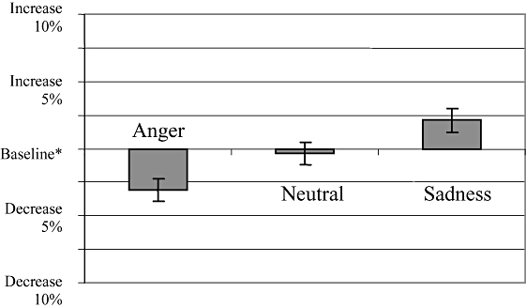
Emotionen und Policy Preferenzen
Notes:
Patricia Smith is a 25-year-old, white female. She is a divorced mother of three children: ages 3, 5, and 8. She dropped out of high school at the beginning of her senior year when she had her first child and has received no subsequent education. She has had several jobs since high school, mostly waitressing. She has had no job in the past six months. She has been receiving standard levels of government assistance for the past six months.

Slide 21
Wut und Sexismus
Sasse, J., van Breen, J.A., Spears, R. et al. The Rocky Road from Experience to Expression of Emotions—Women’s Anger About Sexism. Affec Sci 2, 414–426 (2021). https://doi.org/10.1007/s42761-021-00081-7
We investigated women’s anger expression in response to sexism. In three studies (Ns = 103, 317, and 241), we tested the predictions that women express less anger about sexism than they experience—the anger gap—and that the anger expressed by women is associated with instrumental concerns, specifically perceived costs and benefits of confronting sexism. To estimate the specificity of the proposed gap, we compared women’s anger reactions to men’s anger reactions as well as anger reactions to sadness reactions. Across studies, we found support for the anger gap, that is, lower anger expression than experience, and the gap was more pronounced for women than for men (Study 3). Surprisingly, a gap also occurred in sadness reactions. Regarding instrumental concerns, there was converging evidence that expressed anger was negatively associated with individual costs. We also investigated whether anger expression can be encouraged through women’s identification with feminists (Studies 1 and 2) and support by other women (Study 2); yet, we found no evidence. We conclude that, to understand women’s—and men’s—reactions to sexism, it is critical not to mistake their emotion expression for how they really feel, but instead to also consider strategic concerns.

Slide 22
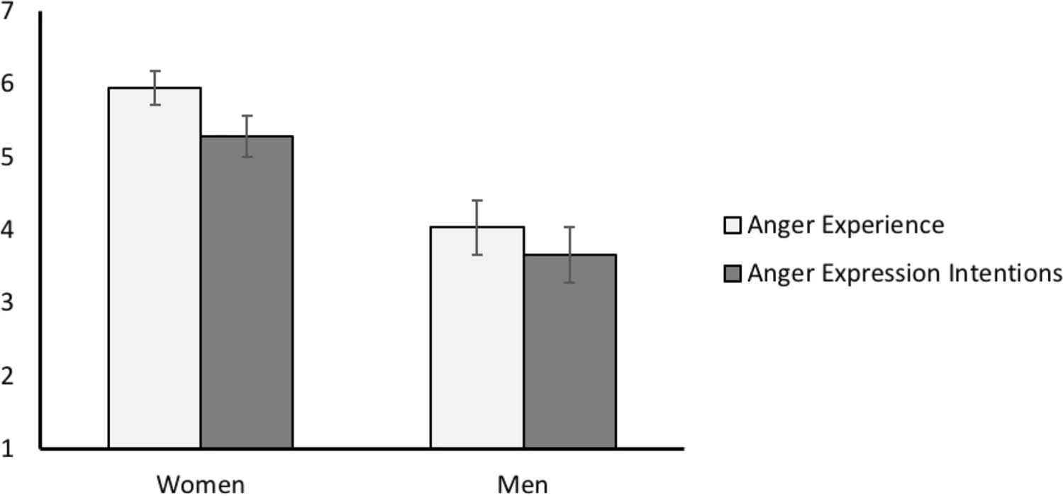
Wut und Sexismus

Slide 23
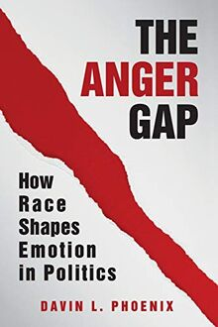
Wut und Rassismus
Anger is a powerful mobilizing force in American politics on both sides of the political aisle, but does it motivate all groups equally? This book offers a new conceptualization of anger as a political resource that mobilizes black and white Americans differentially to exacerbate political inequality. Drawing on survey data from the last forty years, experiments, and rhetoric analysis, Phoenix finds that - from Reagan to Trump - black Americans register significantly less anger than their white counterparts and that anger (in contrast to pride) has a weaker mobilizing effect on their political participation. The book examines both the causes of this and the consequences. Pointing to black Americans' tempered expectations of politics and the stigmas associated with black anger, it shows how race and lived experience moderate the emergence of emotions and their impact on behavior. The book makes multiple theoretical contributions and offers important practical insights for political strategy.

Slide 24
4
Gruppenarbeit und Disksussion

Slide 25
The terrorist attacks of September 11 elicited many forms of negative affect, including anger and sadness. They also elicited a search for explanations. A national field study that experimentally primed emotion evaluated how priming anger and sadness differentially evoked causal judgments about the attacks. It found that priming anger triggered more causal attributions than did priming sadness. Thus, specific emotions, rather than general negativity, shaped citizens' attributions regarding September 11. In addition to its theoretical implications, the study demonstrates a method for studying ecologically valid emotions, under conditions of experimental control, with a nationally representative sample.

Slide 26
Methode I: Daten
Our sample was drawn from Knowledge Networks' nationally representative panel, originally recruited through random-digit dialing. Those individuals who agreed to participate in the panel received a WebTV and free interactive Internet access, in return for completing three to four surveys per month. Characteristics of the panel's 75,000 households closely match the U.S. Census on key demographic dimensions (see http://www.knowledgenetworks.com/ganp/).
Notice of survey was sent on November 10, 2001, to a national random sample of 1,786 individuals ages 13-88 (886 males and 900 females), asking if they could spend 20 uninterrupted minutes alone. Of those individuals, 57.7% (502 males and 528 females) provided informed consent and completed the survey. We removed 57 individuals because (a) they answered less that than 25% of the questions (n = 13), (b) skipped all the emotion manipulation check questions (n = 14), or (c) gave zeros to all of the emotion manipulation-check (see below) questions (n = 30). The final sample had 973 respondents (472 males and 501)

Slide 27
Methode II: Experiment
The terrorist attacks evoked a lot of emotion in Americans. We are particularly interested in what makes you most angry/sad about the attack Please describe in detail the one thing that makes you most angry/sad about the attacks. Write as detailed a description of that thing as possible. If you can, write your description so that someone reading it might even get angry/sad from learning about the situation.
What aspect of the terrorist attacks makes you the most angry/sad ?
Why does it make you so angry /sad ?

Slide 28
Method 3: Messung
Five research assistants, blind to emotion condition and were trained to code responses to the open-ended questions. To reduce coder bias, the authors removed all emotion terms from each statement. First, for the presence terrorism, then for whether it described people or situations a separate code (0 = not present; 1 = partially present; 2 = co each type of attribution. Typical people (or dispositional) Bin Laden, Al-Qaeda, Bill Clinton, and "the terrorists." Typical situational attribution included world fanaticism and violence, religious entities, and foreign governments. Because "partially present" codes were infrequent), they were combined with "completely present."

Slide 29
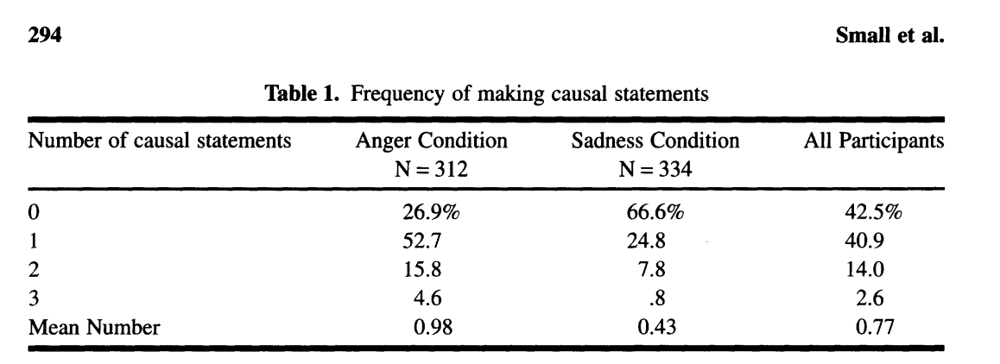
Ergebniss

