Slide 1
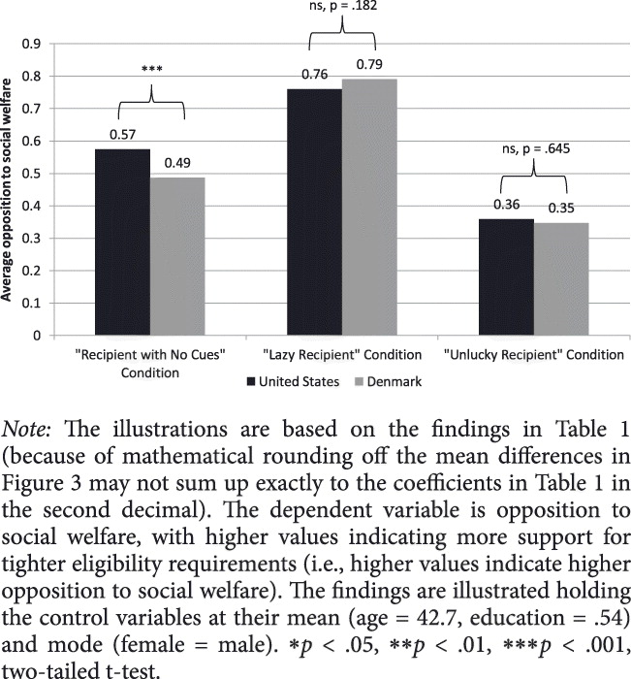
Figure 3 Opposition to Social Welfare by Experimental Condition and Country
Lene Aarøe, et al. Crowding Out Culture: Scandinavians and Americans Agree on Social Welfare in the Face of Deservingness Cues. The Journal of Politics 2014 76:684-697.
DOI: 10.1017/S002238161400019X
Copyright © 2014 Southern Political Science Association

