Slide 1
Politische Wahrnehmungen in Zeiten der Krise
Anwendungen 4: Panel Models

Slide 2
Übersicht
1 – Methoden: Problem Set 4
2 – Methoden: Komplexere Zeit-Modelle – Cross-Lag Modelle
3 – Theorie und Methoden: Veränderungen über die Zeit
4 – Anwendung BUA Daten

Slide 3
1
Problem Set Besprechung

Slide 4
Problem Set 4 Besprechung
Code auf Blackboard
Andere Tests für Panel Modelle
Probleme mit CRAN

Slide 5
Andere Tests
Individual oder Time Fixed Effects
H0: Alle Fixed Effekte sind 0
R-Befehl in "plm" für den Poolbarkeitstest: pFtest()
Breusch-Pagan-Lagrange-Multiplikator (LM)-Test
Test auf Heteroskedastizität in Panelmodellen
Vergleich der Varianzen der Residuen über Einheiten oder Zeitperioden hinweg
R-Befehl in "plm" für den Breusch-Pagan-LM-Test: bptest
Poolbarkeitstest
Vergleich der individuell-spezifischen Effekte in einem Panelmodell
Chow Test
R-Befehl in "plm" für den Poolbarkeitstest: pooltest

Slide 6
2
Komplexere Modelle: Cross-Lag Modelle

Slide 7

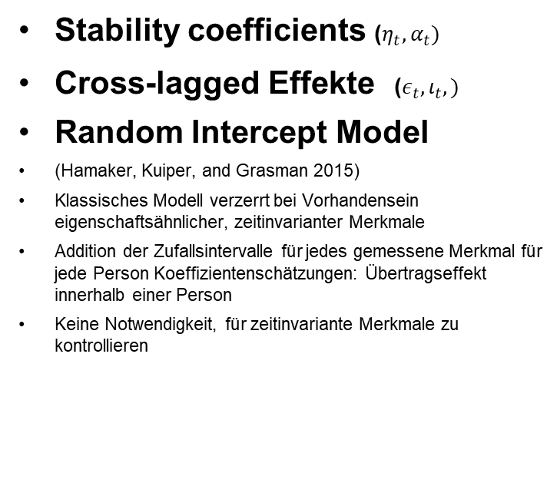



Cross-lagged panel Model
Stability coefficients ($η_{t}, α_{t})$
Cross-lagged Effekte ($ε_{t}, ι_{t},)$
Random Intercept Model
(Hamaker, Kuiper, and Grasman 2015)
Klassisches Modell verzerrt bei Vorhandensein eigenschaftsähnlicher, zeitinvarianter Merkmale
Addition der Zufallsintervalle für jedes gemessene Merkmal für jede Person Koeffizientenschätzungen: Übertragseffekt innerhalb einer Person
Keine Notwendigkeit, für zeitinvariante Merkmale zu kontrollieren
T1
T2
$$α_{t}$$
Variable 1
Variable 1
$$ι_{t}$$
$$ε_{t}$$
Variable 2
$$η_{t}$$
Variable 2

Slide 8
3
Theorien und Methoden: Veränderungen über die Zeit

Slide 9
Vertrauen als Ressource
Bittmann, F. How Trust Makes a Difference: The Impact of the First Wave of the COVID-19 Pandemic on Life Satisfaction in Germany. Applied Research Quality Life 17, 1389–1405 (2022). https://doi.org/10.1007/s11482-021-09956-0
The extraordinary COVID-19 pandemic is one of the most severe disruptions of human life since the end of World War II, even in rich and industrialized countries like Germany. The introduction of a rather comprehensive “lockdown” and the restriction of multiple basic civil rights have affected the population in many areas of life, like employment, economic prosperity, health and trust in public institutions. The question arises how life satisfaction is influenced by these measures in detail and whether there are interactions between institutional trust, life satisfaction and time of crisis. Fixed-effect regression analyses using German National Educational Panel Study (NEPS) data demonstrate that life satisfaction has fallen sharply after the onset of the crisis and that interaction effects with institutional trust are present. Individuals with low levels of pre-crisis trust in institutions like the government, courts or the media report a stronger decrease of satisfaction than individuals with higher levels of trust. We believe that these results are relevant to explain the role of institutions in times of crisis and might serve as foundations for interventions to strengthen trust and increase overall satisfaction.

Slide 10
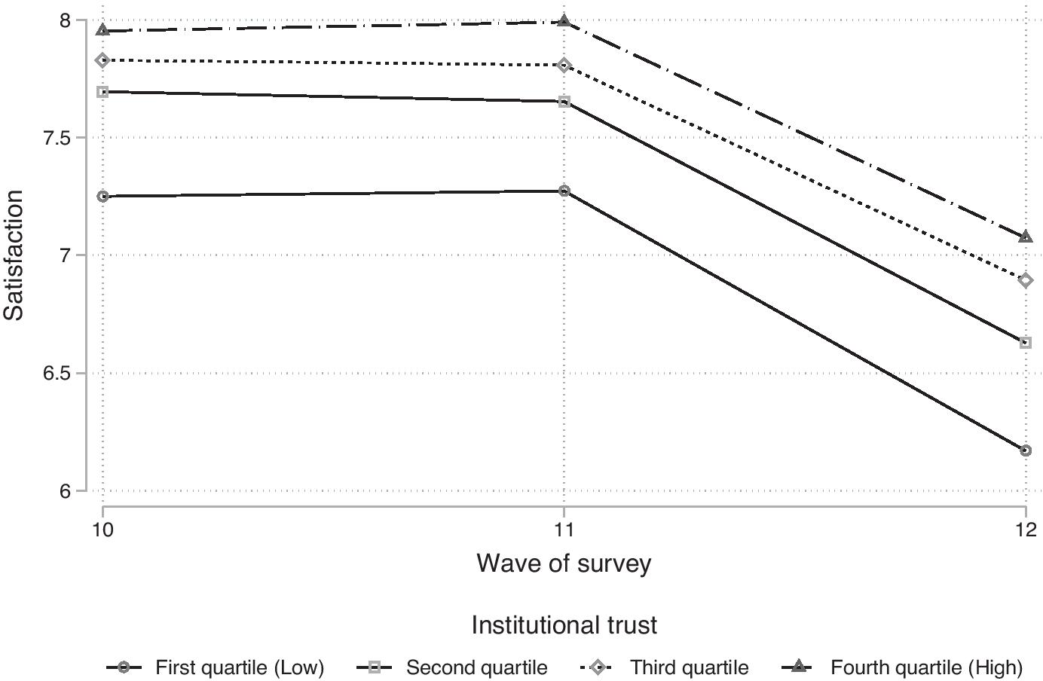
Vertrauen als Ressource

Slide 11
Vertrauen als Ressource
 | M1 | M2 | M3
Wave 11 | Ref | Ref | Ref
Wave 12 | -1.007*** (0.0370) | -1.105*** (0.0735) | -1.453*** (0.219)
Wave 12 × 1. Quartile Trust |  | Ref
Wave 12 × 2. Quartile Trust |  | 0.0783 (0.0771)
Wave 12 × 3. Quartile Trust |  | 0.191* (0.0943)
Wave 12 × 4. Quartile Trust |  | 0.187# (0.112)
Wave 12 × Trust (continuous) |  |  | 0.181* (0.0842)
Constant | 7.633*** (0.0152) | 7.633*** (0.0152) | 7.633*** (0.0152)
Observations | 16,238 | 16,238 | 16,238
Individuals | 8119 | 8119 | 8119

Slide 12
Vertrauen und Lebenszufriedenheit
Glatz, C., Schwerdtfeger, A. Disentangling the Causal Structure Between Social Trust, Institutional Trust, and Subjective Well-Being. Soc Indic Res 163, 1323–1348 (2022). https://doi.org/10.1007/s11205-022-02914-9
Previous research indicates a positive relation between social trust, institutional trust and subjective well-being. Besides theoretical assumptions and cross-sectional relations, only few studies so far examined the causal structure between these concepts. However, previous studies showed contradictory results, possibly due to different methods and datasets used. Hence, we analyzed the causal structure between the three concepts on the aggregate country-level using the European Social Survey, which offers a total of 217 observations from 30 countries, nested in nine time-points between 2002 and 2018. We targeted a causal effect by using a multilevel bivariate cross-lagged analysis. This way we analyzed if previous values of the respective explanatory variable predicts future values of the respective criterion variable. Using this method, we were able to (1) separate the relevant within-country from the between-countries effect, (2) control for different effects in different countries, (3) control for covariates as well as for autoregression of the respective criterion variable over time, and (4) control for residual correlation between the respective criterion variables. Our results suggest a causal effect from subjective well-being to social trust, but little evidence for a reverse causal pathway. Further, we found no effect from social trust and subjective well-being on institutional trust and only small but negative effects vice versa. The results suggest treating social and institutional trust not as preconditions of subjective well-being, but rather as independent facets for the quality of life of a society as already implemented by the OECD’s better-life index, amongst others.

Slide 13
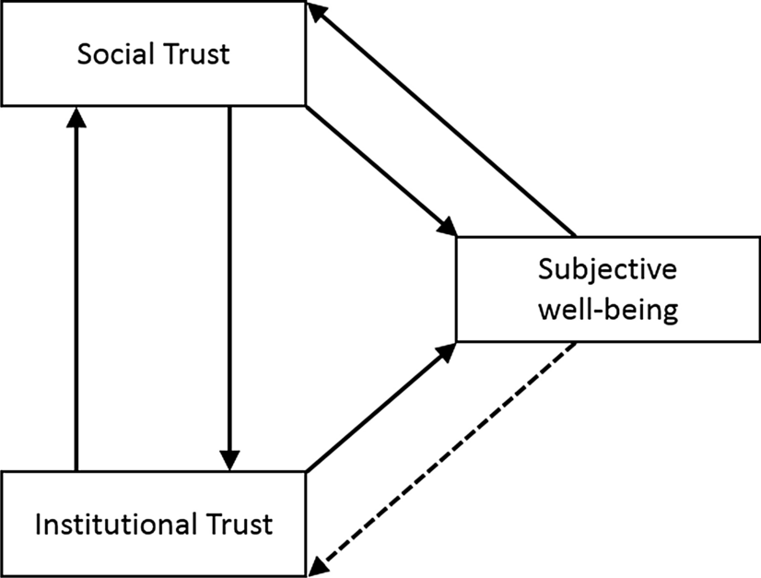
Vertrauen und Lebenszufriendeheit

Slide 14
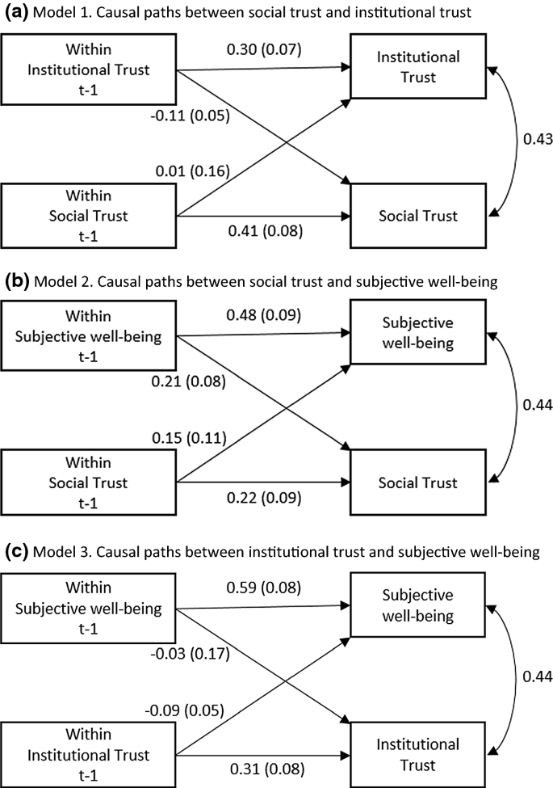
Vertrauen und Lebenszufriedenheit

Slide 15
Sorgen, Emotionen und die AfD
Nguyen, C.G., Salmela, M., von Scheve, C. (2022). From Specific Worries to Generalized Anger: The Emotional Dynamics of Right-Wing Political Populism. In: Oswald, M. (eds) The Palgrave Handbook of Populism. Palgrave Macmillan, Cham. https://doi.org/10.1007/978-3-030-80803-7_8
Right-wing populist parties have transformed the political landscape across many advanced, democratic economies. Their continued strength has been linked to an increasing sense of both economic and cultural insecurity, driven by the conjunction of economic deregulation, globalization, and increased socio-cultural competition. However, socioeconomic factors alone do not fully capture the dynamics of populist activation and support. In this chapter, we argue that emotional processes are a fundamental component that underpins support for right-wing populist parties. We argue that one ignored mechanism of ‘“ressentiment’” explains how support for right-wing populists can transform specific and targeted negative emotions, such as insecurity and worries, into generalized anger and resentment. We furthermore propose that this generalized anger does not only create a new political identity of shared grievance, it also furthers political polarization and leads to further strengthening of a newly found right-wing populist lifeworld.

Slide 16
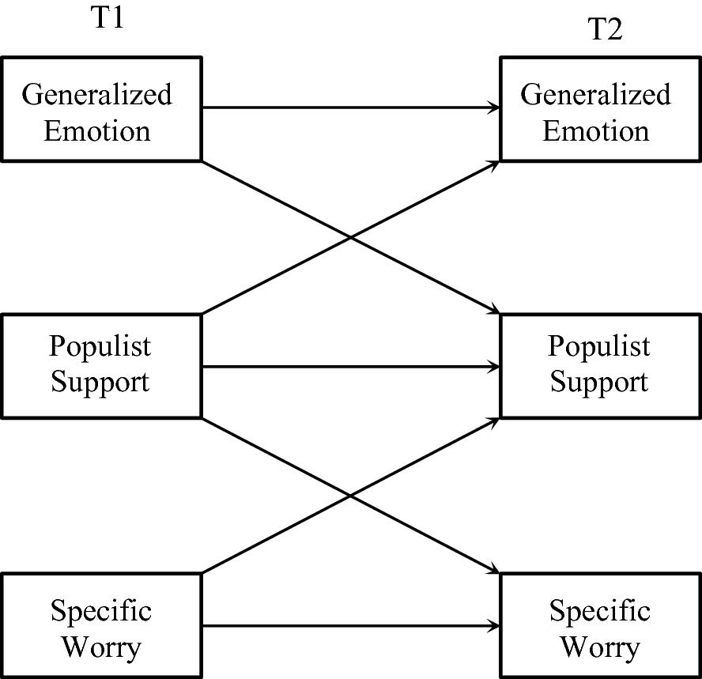
Sorgen, Emotionen und die AfD

Slide 17
Sorgen, Emotionen und die AfD
Determinants of AfD Support |  |  | Effects of AfD support |  |  | Sum. Stat
Specific Worry | Worry | Anger | Fear | Worry | Anger | Fear | RMSEA | P
Immigration | 0.013 *** | 0.005 * | – | 0.114 *** | 0.033 ** | – | 0.033 | 0
Crime | 0.011 *** | 0.006 ** | – | 0.133 *** | 0.039 ** | – | 0.031 | 0
Own Econ | 0.009 *** | 0.005 * | – | 0.074 *** | 0.041 *** | – | 0.03 | 0
General Econ | 0.01 *** | 0.006 ** | – | 0.1 *** | 0.042 *** | 0.024 * | 0.03 | 0
Health | – | 0.006 ** | – | – | 0.044 *** | 0.023 * | 0.031 | 0
Environment | −0.009 *** | 0.006 ** | – | −0.101 *** | 0.047 *** | 0.025 * | 0.031 | 0
Climate | −0.006 ** | 0.006 ** | – | −0.078 *** | 0.042 *** | 0.026 * | 0.03 | 0
Xenophobia | – | 0.006 ** | – | −0.032 * | 0.043 *** | 0.026 * | 0.031 | 0

Slide 18
Vertrauen in Staatliche Instit.
Oliveira, T.R., Jackson, J., Murphy, K. et al. Are Trustworthiness and Legitimacy ‘Hard to Win, Easy to Lose’? A Longitudinal Test of the Asymmetry Thesis of Police-Citizen Contact. J Quant Criminol 37, 1003–1045 (2021). https://doi.org/10.1007/s10940-020-09478-2
Test the asymmetry thesis of police-citizen contact that police trustworthiness and legitimacy are affected more by negative than by positive experiences of interactions with legal agents by analyzing changes in attitudes towards the police after an encounter with the police. Test whether prior attitudes moderate the impact of contact on changes in attitudes towards the police.
A two-wave panel survey of a nationally representative sample of Australian adults measured people’s beliefs about police trustworthiness (procedural fairness and effectiveness), their duty to obey the police, their contact with the police between the two waves, and their evaluation of those encounters in terms of process and outcome. Analysis is carried out using autoregressive structural equation modeling and latent moderated structural models.
The association between both process and outcome evaluation of police-citizen encounters and changes in attitudes towards the police is asymmetrical for trust in police effectiveness, symmetrical for trust in procedural fairness, and asymmetrical (in the opposite direction expected) for duty to obey the police.

Slide 19
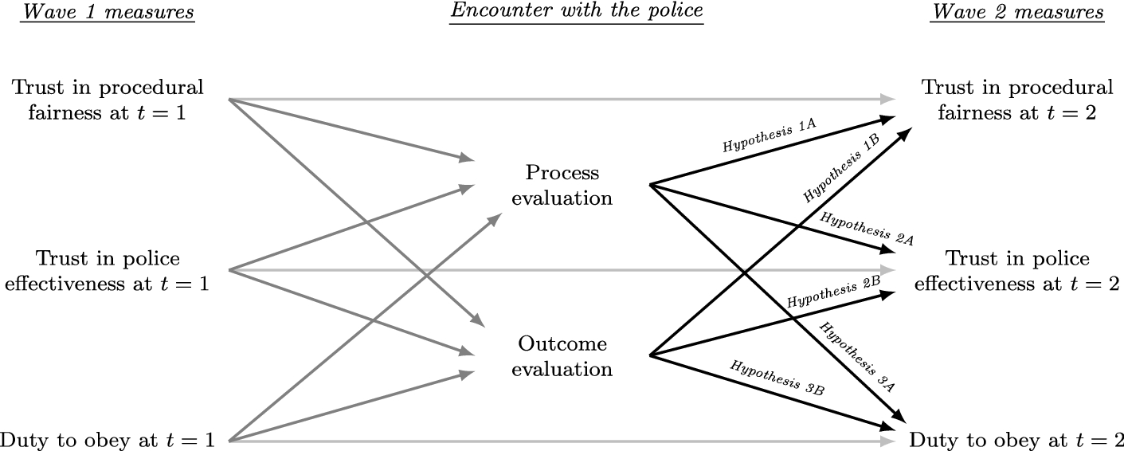
Vertrauen in Staatliche Instit.

Slide 20
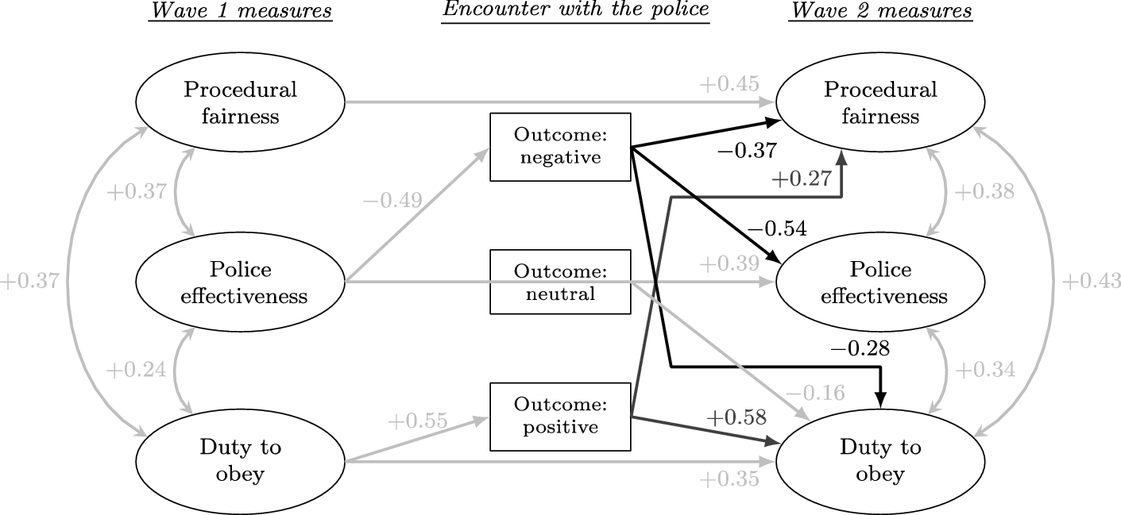
Vertrauen in Staatliche Instit.

Slide 21
4
Anwendung

Slide 22
Schaut euch eigene Fragen an
BUA Daten auf Blackboard
Methodenbericht → Variablenübersicht
Mögliche Vorbereitung auf Projektarbeit nächste Woche

