Slide 1
Politische Wahrnehmungen in Zeiten der Krise
Anwendungen 2

Slide 2
Übersicht
1 – Methoden: Problem Set Besprechung
2 – Theorie & Diskussion: Rassismus (in der Krise und auch sonst)
3 – Anwendung (BUA Daten)

Slide 3
1
Problem Set Besprechung

Slide 4
Problem Set 2 Besprechung
Code auf Blackboard
Abgabe bitte auch auf Blackboard
Abgaben waren sehr gut!
Detaillierte Antworten
Gute Auseinandersetzung mit inhaltlicher und statistischer Signifikanz
Gute theoretische Überlegungen

Slide 5
2
Theorie & Diskussion

Slide 6
Fragestellung(en)
Welche Faktoren erklären Xenophobie / Rassistische Einstellungen?
Wie potenzieren/ verringern sich diese Faktoren miteinander?
(Welchen Einfluss haben Krisen auf diese Einstellungen)
Take-Away Punkte
Methodisch: Verständnis der Regressionsanalyse vertiefen
Methodisch: Interaktionseffekte
Methodisch: Verbindung zu Qualitativer Forschung

Slide 7
Diskussion 1
Welche Faktoren sind eurer Meinung nach wichtig?
Welche Auswirkungen könnten Krisen haben?

Slide 8
Allgemeine Determinanten
Lauren M. McLaren, Anti-Immigrant Prejudice in Europe: Contact, Threat Perception, and Preferences for the Exclusion of Migrants, Social Forces, Volume 81, Issue 3, March 2003, Pages 909–936, https://doi.org/10.1353/sof.2003.0038
This article introduces the theoretical approaches of contact, group conflict, and symbolic prejudice to explain levels of exclusionary feelings toward a relatively new minority in the West European context, the immigrant. The findings indicate that even after controls for perceived threat are included in the model, intimate contact with members of minority groups in the form of friendships can reduce levels of willingness to expel legal immigrants from the country. A contextual variable, level of immigration to the country, is also introduced into the model because it is likely that this variable affects both threat perception and exclusionary feelings. While context does not seem to directly affect levels of willingness to expel or include immigrants in the society, it does have a rather powerful impact on perceived threat. Perhaps even more importantly, the findings suggest that contact mediates the effect of the environment, helping to produce lower levels of threat perception in contexts of high immigration.

Slide 9
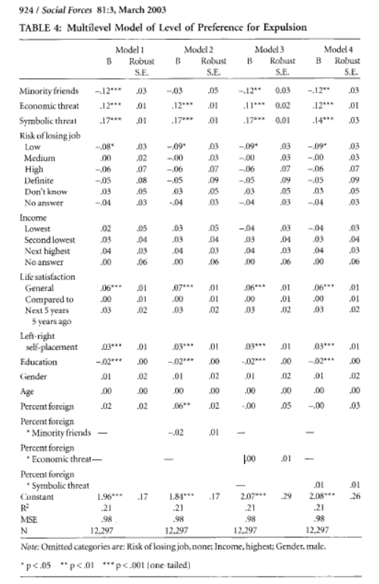
Allgemeine Determinanten
Kontakt
Wirtschaftliche Bedrohung
Symbolische Bedrohung
Persönliche Wirtschaftliche Lage
Einkommen
Arbeitslosigkeitsrisiko
Andere Faktoren
Links-Rechts Selbsteinstufung
Lebenszufriedenheit
Interaktionen/Modeartion

Slide 10
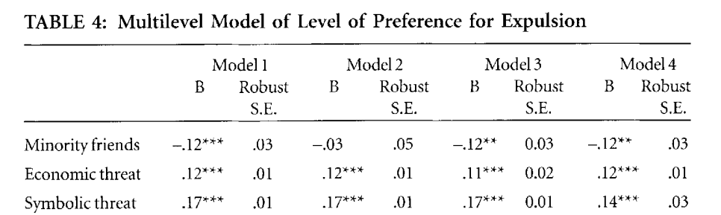
Allgemeine Determinanten

Slide 11
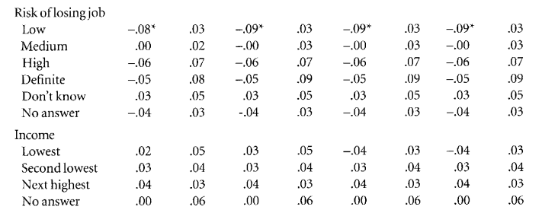
Allgemeine Determinanten

Slide 12
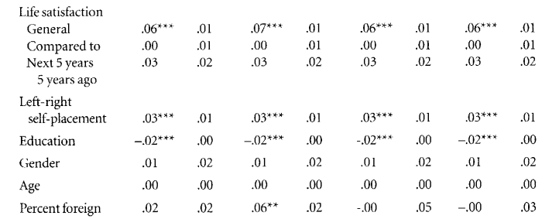
Allgemeine Determinanten

Slide 13
Moderation/ Interaktionseffekte
Kauff, Mathias, et al. When immigrant groups misbehave: The influence of perceived deviant behavior on increased threat and discriminatory intentions and the moderating role of right‐wing authoritarianism. European Journal of Social Psychology 45.5 (2015): 641-652.
In two studies, we tested the relationship between non-immigrant individuals' perceptions of deviant behavior carried out by Muslims and foreigners and discriminatory intentions towards these outgroups. Based on a longitudinal and a representative cross-sectional sample, we showed that two different types of perceived deviant behavior (Study 1, Muslims' unwillingness to integrate; and Study 2, foreigners' hostility towards the non-immigrant majority group) are related to increased intergroup threat, which in turn is related to increased intentions to show passive discrimination (i.e., avoidance) towards these outgroups. In line with theorizing about an increased sensitivity for threat in authoritarian individuals, the relationship between perceptions of deviant behavior and threat was especially strong among high authoritarian individuals. Theoretical and practical implications of our results are discussed.

Slide 14
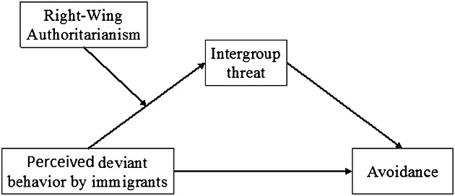
Moderation/ Interaktionseffekte

Slide 15
Moderation/ Interaktionseffekte
Perceived Integration
Many Muslims want to keep to themselves,
Most Muslims are not interested in integrating into Germany society
Muslims in Germany have willfully created a world in which they do not need to engage in contact with Germans
Intergroup Threat
The large number of Mosques in Germany shows that Islam tries to increase its power
Muslims living here are threatening the German culture
Our welfare system is overburdened by Muslims.
Avoidance
I would be reluctant to send my children to a school where the teacher wears a headscarf
I would be reluctant to move into a district where many Muslims were living
Right Wing Authoritarianism
Obedience and respect for authority are the most important values one should have
We should be grateful for leaders that tell us what to do,
Wrongdoings should be punished more severely
Stronger action should be taken against troublemakers and outsiders

Slide 16
Moderation/ Interaktionseffekte
Data showed that there was a significant autoregressive relationship for intergroup threat (b = .592, CI_{95%} = .434, .746, p < .001) as well as for discriminatory intentions (b = .421, CI_{95%} = .293, .551, p < .001).
In line with our assumptions, discriminatory behavioral intentions (t2) were significantly predicted by intergroup threat (t1; b = .293, CI_{95%} = .133, .450, p < .001) and unwillingness to integrate (t1; b = .188, CI_{95%} = .040, .340, p = .013).
Moreover, intergroup threat (t2) was significantly predicted by perceived unwillingness to integrate (t1; b = .179, CI_{95%} = .042, .325, p = .013) but was not predicted by RWA (t1; b = −.147, CI_{95%} = −.412, .142, p = .296).
Consequently, there was a significant indirect effect of perceptions of unwillingness to integrate on discriminatory behavioral intentions via intergroup threat over time (b = .052, CI_{95%} = .012, .102, p = .023).
Most importantly, however, the relationship between unwillingness to integrate (t1) and intergroup threat (t2) was moderated by RWA (t1; b = .083, CI_{95%} = .008, .148, p = .017), resulting in a stronger conditional indirect effect for those participants high in RWA (RWA +1SD; b = .067, CI_{95%} = .014, .134, p = .027) than for those low in RWA (RWA −1SD; b = .038, CI_{95%} = .005, .077, p = .039).
In addition, we also analyzed whether RWA moderated the relationship between intergroup threat (t1) and discriminatory behavioral intentions (t2). The interaction was not significant (b = −.002, CI_{95%} = −.072, .079, p = .962).

Slide 17
Rassismus in der Coronakrise
Farhart, Christina E. and Philip Chen. “Racialized Pandemic: The Effect of Racial Attitudes on COVID-19 Conspiracy Theory Beliefs.” Frontiers in Political Science (2022).
As national and international health agencies rushed to respond to the global spread of a novel coronavirus (SARS-CoV-2, commonly known as COVID-19), one challenge these organizations faced was the spread of misinformation and conspiracy theories about the virus. Troublingly, much of the misinformation was couched in racialized language, particularly regarding the source of the virus and responsibility for its spread, fostering the development of related conspiracy theories. Media coverage of these conspiracy theories, particularly early on in the pandemic, had negative impacts on individuals' engagement in protective behaviors and concern with the spread of COVID-19. From extant work, racial resentment and white identity have been shown to be deeply woven into the fabric of contemporary American politics, affecting perceptions of public opinion even after accounting for social and political identities. While racial attitudes have been less studied in relation to conspiracy theory belief, we expect racial resentment and white identity to affect compliance with public health behaviors and COVID-19 conspiracy theory belief. Using observational and experimental survey data (N = 1,045), quota-sampled through Lucid Theorem (LT) in the spring of 2020, we demonstrate that framing the virus in racialized language alters endorsement of COVID-19 conspiracy theories, contingent upon levels of racial resentment and white identity and find that higher levels of conspiracy theory belief decreased compliance with preventative measures.

Slide 18
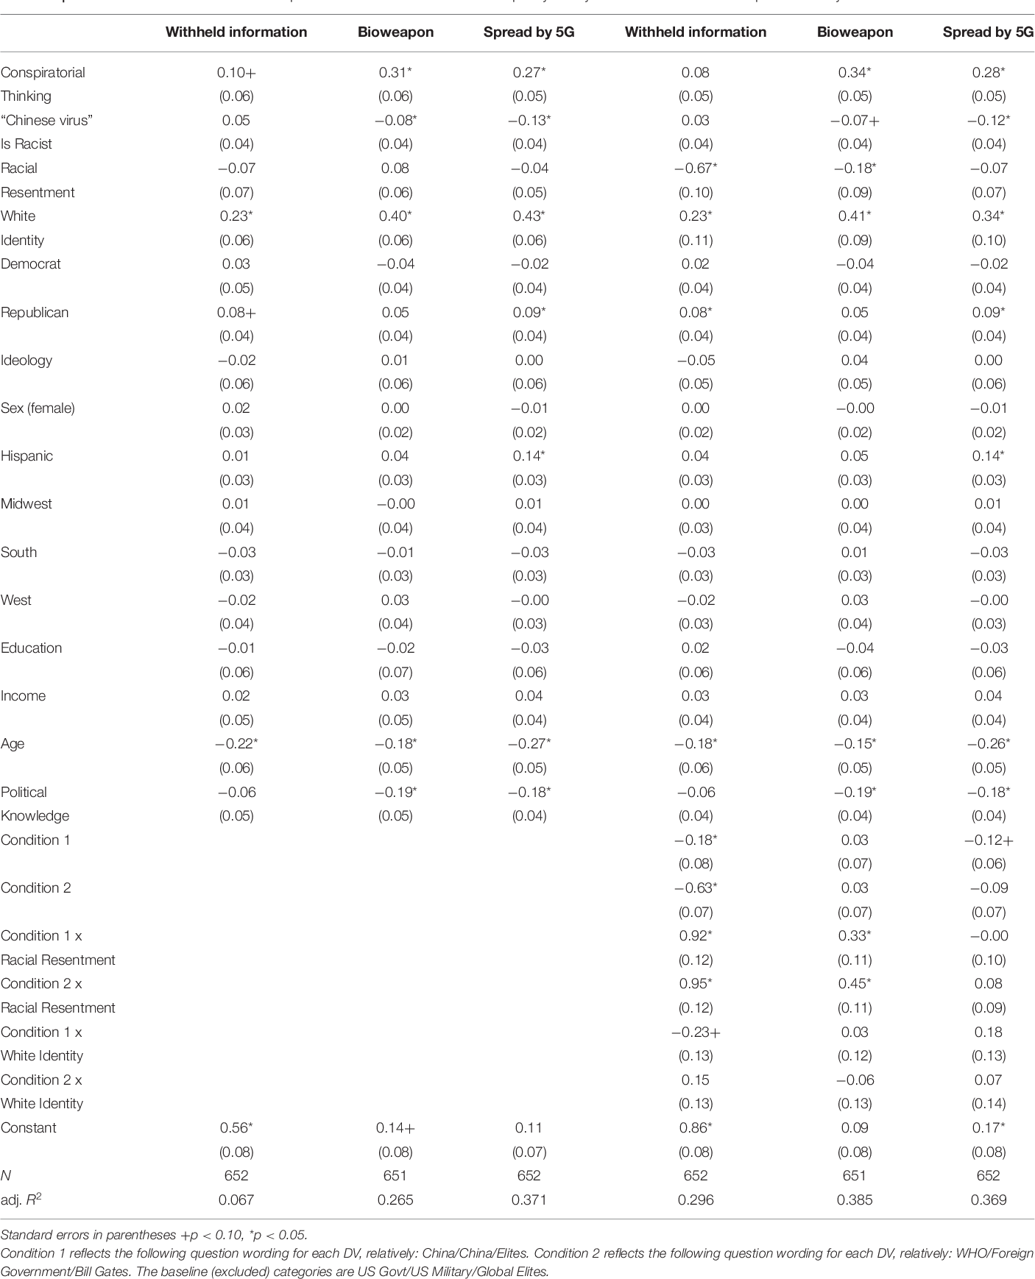

Slide 19
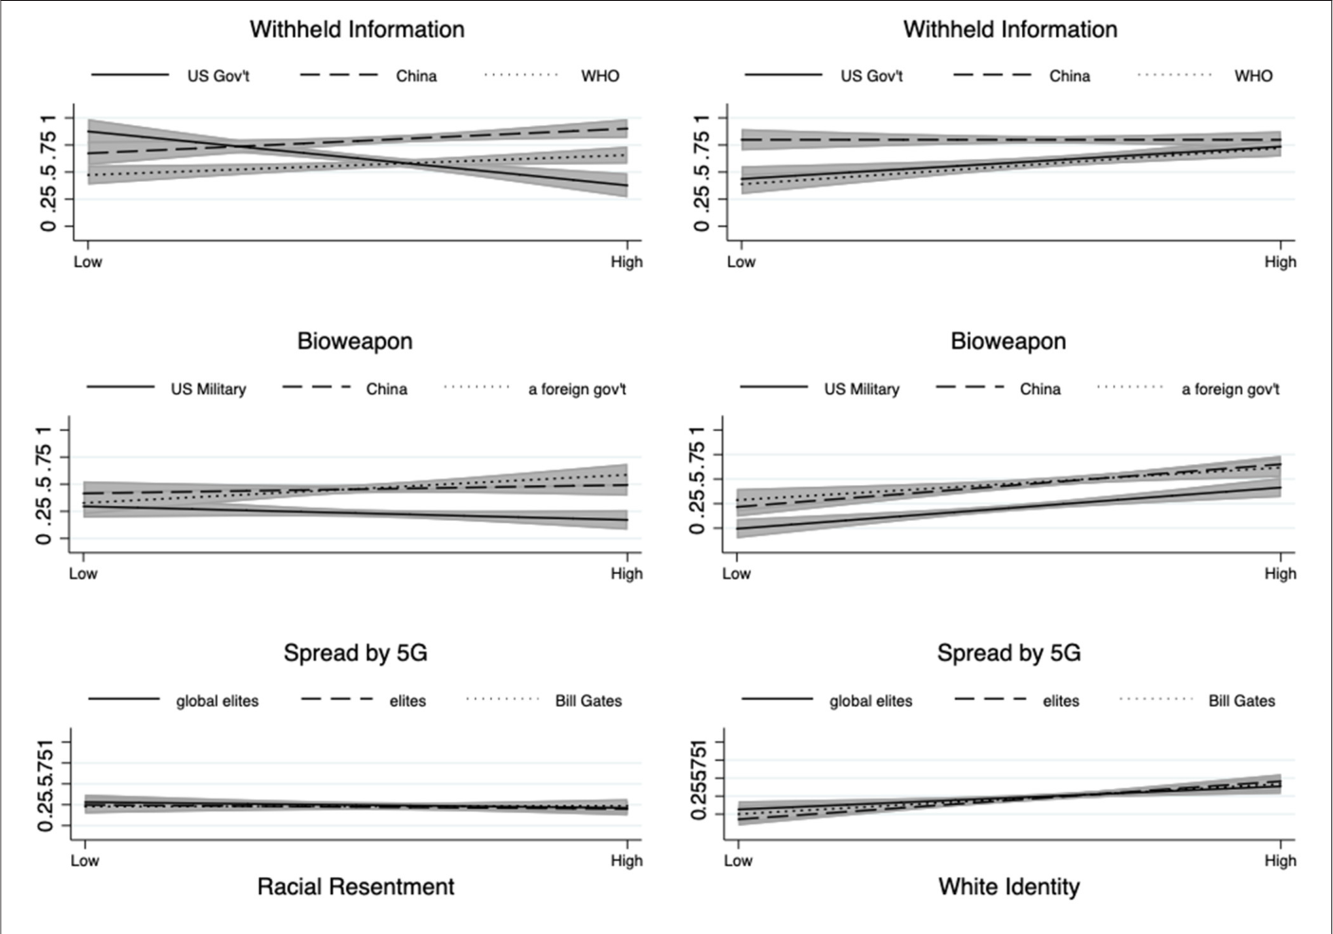

Slide 20
3
Eigene Datenarbeit

Slide 21
Diskussion 2
Was würdet ihr euch gerne anschauen?

Slide 22
Eigene Analyse: BUA Daten
Daten Vorbereiten
Daten Herunterlande und in R öffnen
Bereinigt die Daten (Neuer und besserer Code auf Blackboard)
Sichtet den Fragebogen
Welche Erklärungsfaktoren sind eurer Meinung nach wichtig?
Theoretisiert eine mögliche Interaktion
Findet diese Variablen im Datensatz
Analyse
Bivariate Regression
Multivariate Regression

Slide 23
BUA Daten- Rassismus Skalen
Modern Racism Scale Index (1 to 5, α =0.86) :
How much would you disagree/agree with the following statements:
Discrimination of members of ethnic and religious minorities is no longer a problem in Germany
Ethnic and religious minorities make too many demands for equal rights
Members of ethnic & religious minorities should not interfere without being asked
In the last few years, ethnic and religious minorities in Germany have profited economically more than they deserve
In the last few years, government and media have Shown more respect to ethnic and religious minorities than they deserve
It is easy to understand the anger of ethnic and religious minorities (RC)
Preferred Social Distance (-3 to 3) How unpleasant/ pleasant if a
German without migrant background (α = 0.96)
an Asian person (α = 0.94)
a Black Person (α = 0.93)
a Muslim (α = 0.92)
your neighbor
your colleague
Marries into your family
becomes

