Slide 1
Politische Wahrnehmungen in Zeiten der Krise
Theoretischer Hintergrund und Fragestellungen

Slide 2
Übersicht
1 – Theoretischer Hintergrund:
Was ist soziale Kohäsion & Wie analysieren wir Krisen?
Was sagt uns die Forschung
Welche Fragen interessieren euch?
2 – Vorstellung der Daten
BUA: Soziale Kohäsion in Krisenzeiten → Entstehung der Daten / Projekthintergrund
European Social Survey & Anwendungsbeispiele
3 – Anwendung: Was finden wir in den Daten?
Einführung: Wie lesen wir Umfragedaten?
Sichtung der BUA Daten
Sichtung der ESS Daten

Slide 3
1
Theoretischer Hintergrund

Slide 4
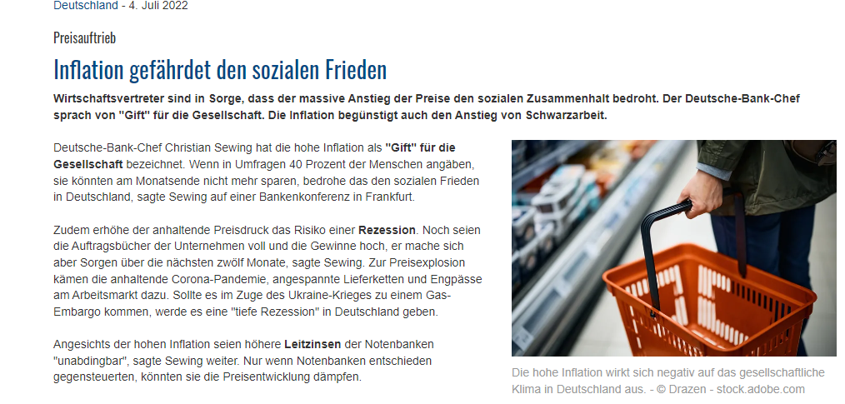
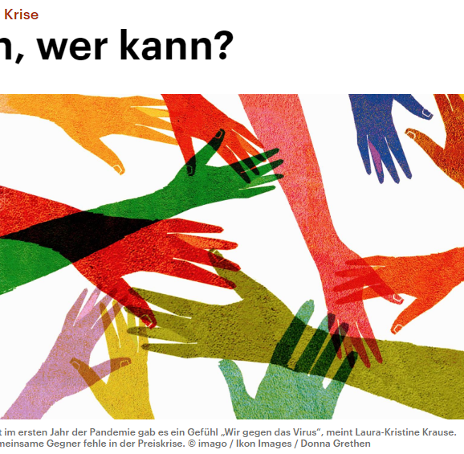
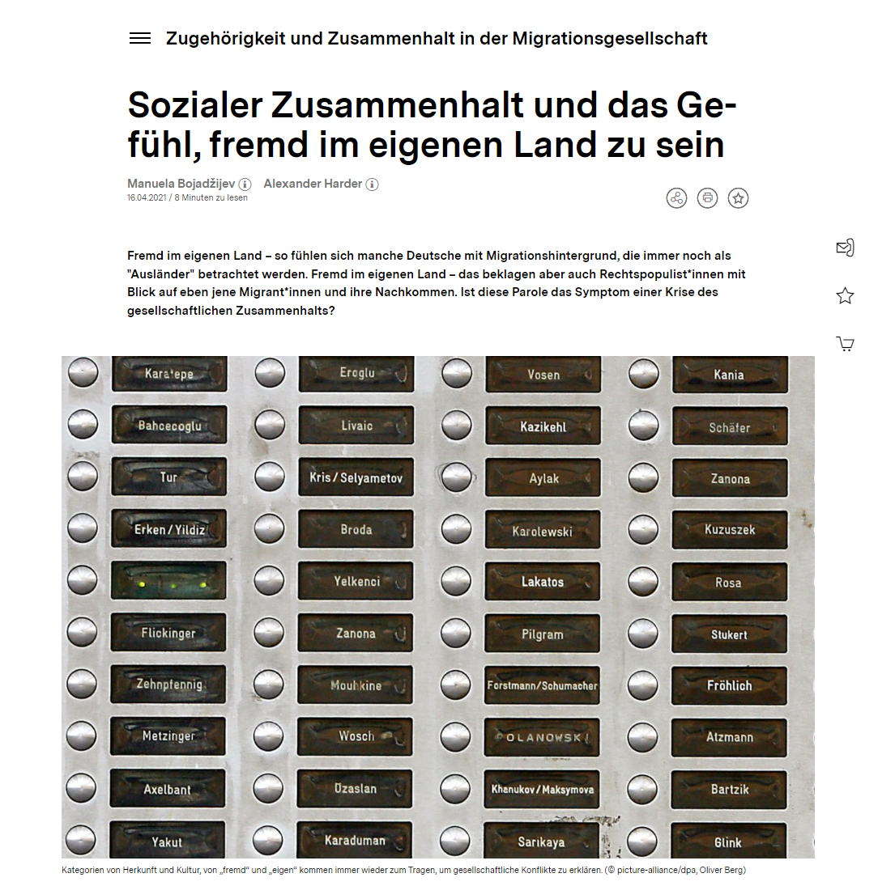
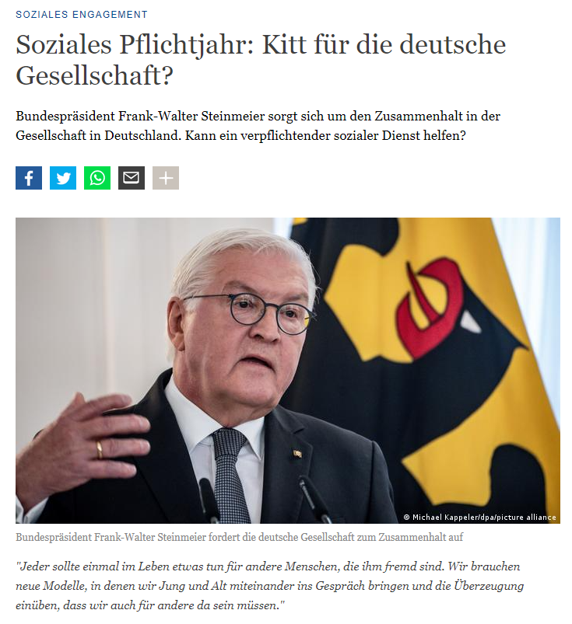
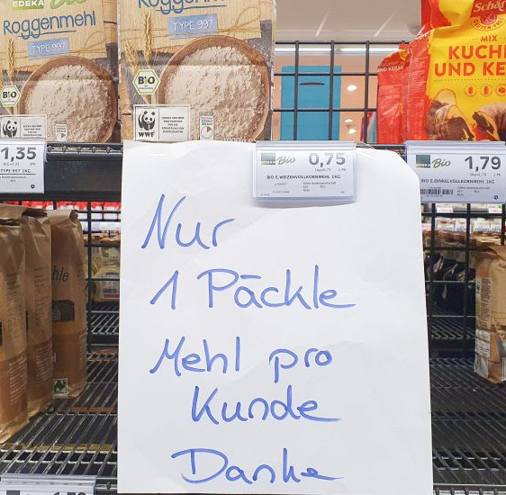
Sozialer Zusammenhalt und Krisen

Slide 5
Was ist soziale Kohäsion?
Viele Definitionen, viele Felder
Politikwissenschaft
Soziologie
Psychologie
Individual vs. Meso/Makroebene der Analyse
Mögliche Unterdimensionen
Grundsatzfrage 1: Konstitutive Dimensionen vs. Vorrausetzungen und Kausalfaktoren
Grundsatzfrage 2: Operationalisierung

Slide 6
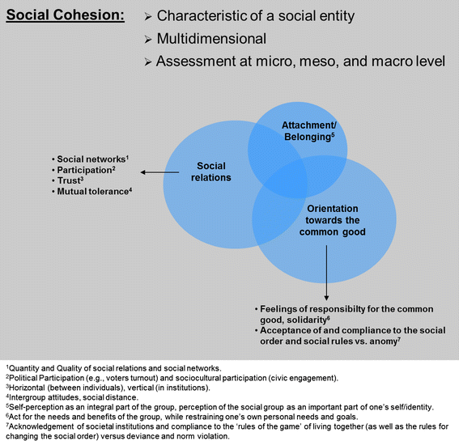
Was ist soziale Kohäsion?
Sechs Dimensionen (3+3)
Soziale Beziehungen
Identifikation mit der (geografischen) Einheit
Orientierung am Gemeinwohl
Geteilte Werte
Lebensqualität
(Un)Gleichheit
Notes:
Schiefer, D., van der Noll, J. The Essentials of Social Cohesion: A Literature Review. Soc Indic Res 132, 579–603 (2017). https://doi.org/10.1007/s11205-016-1314-5

Slide 7
Beispiele aus der Forschung I
Andrews, Rhys, Sebastian Jilke, and Steven Van de Walle. "Economic strain and perceptions of social cohesion in E urope: Does institutional trust matter?." European Journal of Political Research 53.3 (2014): 559-579.
The degree to which different social groups get along is a key indicator of the cohesiveness of a society. This study examines perceptions of social cohesion among Europeans and explains variations in those perceptions by considering the separate and combined effects of economic strain and institutional trust. Analyses were conducted with the 27 member countries of the EU based on the Eurobarometer 74.1 on poverty and social exclusion conducted in 2010. Results show that individuals living in households experiencing economic strain perceive social cohesion to be weaker than their less economically hard-pressed counterparts. By contrast, individuals trusting their political institutions perceived there to be higher levels of cohesion. Furthermore, institutional trust substantially moderates the negative relationship between economic strain and perceptions of cohesion. These results are robust to various model specifications. Moreover, extending the analysis revealed that this moderating effect held when considering social relations between the poor and rich and between different racial and ethnic groups. Theoretical and practical implications of the results are discussed.

Slide 8
Beispiele aus der Forschung I
Andrews, Rhys, Sebastian Jilke, and Steven Van de Walle. "Economic strain and perceptions of social cohesion in E urope: Does institutional trust matter?." European Journal of Political Research 53.3 (2014): 559-579.
Individuals' behaviours and actions depend as much on how a social situation is perceived, as the picture presented in official statistics. Thus, we operationalise social cohesion as a low degree of perceived social tensions among various socioeconomic groups, including the poor and the rich (wealth), managers and workers (social class), old and young people (age), and different racial and ethnic groups (ethnicity). Within the Eurobarometer survey, respondents were asked to indicate whether they perceive tensions between those social groups. More precisely they were asked: ‘In all countries there sometimes exists tension between social groups. In your opinion, how much tension is there between each of the following groups in (YOUR COUNTRY)?’ Answer possibilities ranged between ‘A lot of tensions’ (1), ‘Some tensions’ (2) and ‘No tensions’ (3). We assume, the lower the degree of tensions between indicated groups, the higher the perceived social cohesiveness of a given country.
Because social cohesion is generally regarded as a latent construct, we constructed a measure of all four foci of tensions between social groups using principal components analysis, as displayed in Table 2. Due to the ordinal nature of our four social cohesion items, we used a polychoric correlation matrix to obtain the dependent variable (see Holgado-Tello et al. 2010). All four items loaded on a single factor and further tests on their internal reliability revealed an underlying latent concept of social cohesion (as exemplified by a Cronbach's alpha of 0.70). Our extracted factor revealed an Eigenvalue of 2.39, explaining 60 per cent of the total variance. Moreover, we tested whether our revealed factor structure is supported within each country by means of a confirmatory factor analysis, finding acceptable fit values.2

Slide 9
Beispiele aus der Forschung II
Vergolini, L. (2011). Social cohesion in Europe: How do the different dimensions of inequality affect social cohesion? International Journal of Comparative Sociology, 52(3), 197–214. https://doi.org/10.1177/0020715211405421
This article examines the relationships between social cohesion and social inequalities in Europe by considering three interrelated issues. The first regards the definition and measurement of the concept of social cohesion. The second issue concerns the identification of the aspects of social inequality that affect the overall level of social cohesion. More precisely, I investigate two main hypotheses: the first argues the existence of a direct negative association between economic inequality and social cohesion. The second states that this relation is influenced by other aspects of social inequality such as the individuals’ position in the stratification system and the educational level. The third issue introduces the comparative analysis that has been based on the welfare regime approach. More specifically, I hypothesize that welfare state is relevant because it influences both the relationship between social position and economic inequality, and the relationship between social cohesion and economic inequality. Data from the first round of the 2002 European Social Survey have been analysed applying structural equation models in order to measure social cohesion and to estimate the effects, both direct and indirect, exerted by the different dimensions of inequalities on social cohesion. Moreover, through a multi-group analysis, I investigate the effects resulting from the different welfare regimes. It emerges that social position and welfare state are not able to fully mediate the effect played by economic condition.

Slide 10
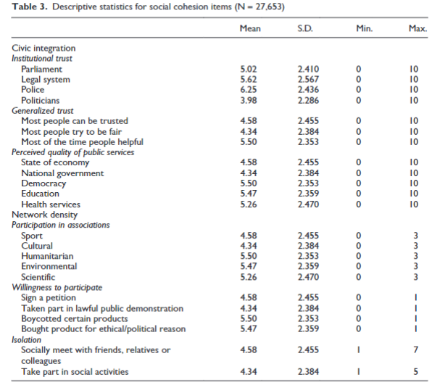
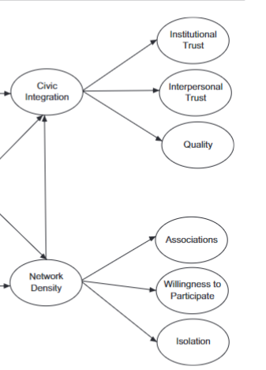
Beispiele aus der Forschung II

Slide 11
Andere Messungen/Konzepte
Affektive Polarisierung
Institutionelles Vertrauen
Generalisiertes Vertrauen
Soziales Kapital
Soziale und politische Teilhabe
Soziale Inklusion
Wahrnehmung von geteilten Werten
(Wahrnehmungen von „Outgroups“ / Migrant*Innen)

Slide 12
Übung & Diskussion: Eigene Fragen
Gruppendiskussion (15 Minuten):
Welches Unterkonzept der Sozialen Kohäsion ist für eure eigenen Fragestellungen am relevantesten?
Welchen Faktoren könnten hohe/niedrige Kohäsion für euer Unterkonzept erklären?
Wie könnten sich Krisen auf diesen Zusammenhang auswirken?
Beschreibt eine (spezifischen) Forschungsfrage / ein spezifisches Projekt
Kurze Vorstellung des Projekts (2-3 Minuten pro Gruppe)

Slide 13
2
Vorstellung der Daten

Slide 14
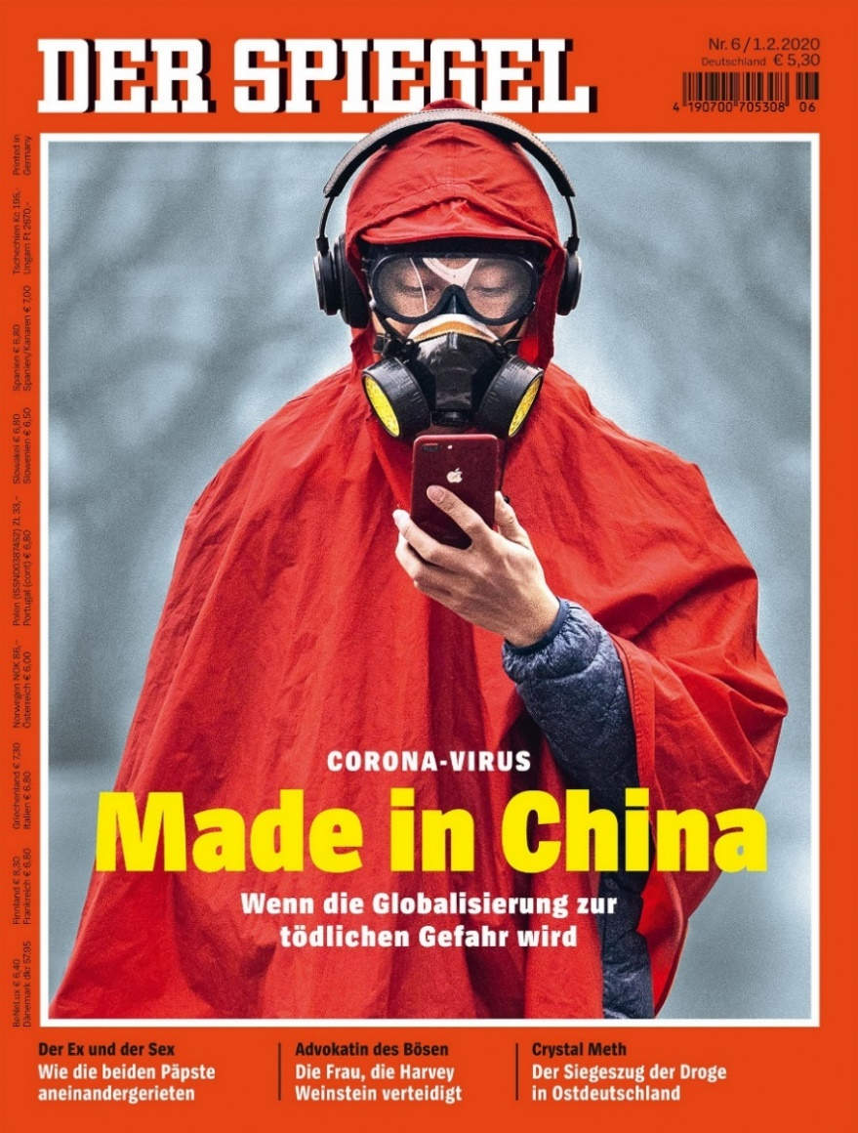
Daten 1: BUA Project
Soziale Kohäsion in Krisenzeiten
Die Corona-Pandemie und (anti-asiatischer) Rassismus in Deutschland
Kollaboration mit HU und DeZIM
Struktur
Innenperspektive: Umfrage+ (Qualitative) Tagebuchstudie
Außenperspektive: Quantitative 3-Wellen Studie
Projektteam
Politikwissenschaft, Psychologie & Soziologie

Slide 15
Daten 1: BUA
Erhebungszeitraum
Welle 1: Dezember 2020
Welle 2: Februar 2021
Welle 3: April 2021
Konzepte im Fragebogen
Persönlichkeitsstruktur (z.B. Big-5, Narzissmus, RWO, SWO, Need for Control)
Ideologie und Parteienaffinität
Soziale Evaluationen und Emotionen
Gruppenzugehörigkeit und Gruppenwahrnehmungen
Online-Panel (gewichtet nach Geschlecht, Bundesland, Bildungsgrad, oversampled Migrationshintergrund)

Slide 16

Daten 2: European Social Survey
Erhebungszeitraum
Welle 1: 2002
Welle 10: 2020
Erhebung alle zwei Jahre
Konzepte im Fragebogen
Sozialpolitische & Politikwissenschaftliche Standarditems
Werte, Ideologie und Parteienaffinität
Gruppenzugehörigkeit und Gruppenwahrnehmungen
Rotierende Wellen zu unterschiedlichen Themen
Stratifiziertes Random Sample, Querschnittsdaten
Sehr hohe Datenqualität

Slide 17
Daten 2: European Social Survey
Standardthemen in jeder Welle
Medien und Soziales Vertrauen
Politische Einstellungen
Soziodemographische Variablen
Human Values Scale
Rotierende Wellen zu unterschiedlichen Themen
ESS round 10 - 2020. Democracy, Digital social contacts ESS round 9 - 2018. Timing of life, Justice and fairness ESS round 8 - 2016. Welfare attitudes, Attitudes to climate change ESS round 7 - 2014. Immigration, Social inequalities in health ESS round 6 - 2012. Personal wellbeing, Democracy | ESS round 5 - 2010. Family work and wellbeing, Justice ESS round 4 - 2008. Welfare attitudes, Ageism ESS round 3 - 2006. Timing of life, Personal wellbeing ESS round 2 - 2004. Health and care, Economic morality, Family work and wellbeing ESS round 1 - 2002. Immigration, Citizen involvement

Slide 18
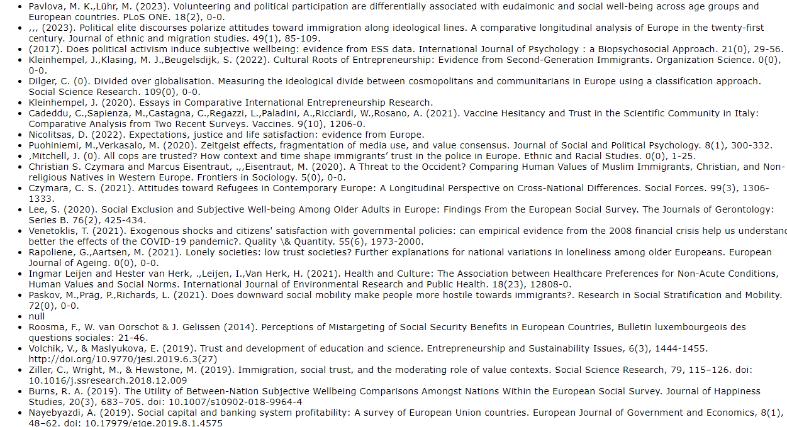
Daten 2: ESS Publikationen
Sehr grosse Anzahl → Link zur Auflistung https://bibliography.europeansocialsurvey.org/browse

Slide 19
1: Wirtschaft & Pol. Vertrauen
DOTTI SANI, G.M. and MAGISTRO, B. (2016), Increasingly unequal? The economic crisis, social inequalities and trust in the European Parliament in 20 European countries. European Journal of Political Research, 55: 246-264. https://doi.org/10.1111/1475-6765.12126
The 2008/2009 economic crisis has been identified as an important element contributing to declining trust in institutions in Europe and worldwide. However, it is unclear whether this decline in trust is distributed homogenously among citizens or whether there are differences across social strata. This article applies multilevel models to six waves of European Social Survey (ESS) data to analyse changes in trust in the European Parliament (EP) from 2002 to 2012 in 20 European Union countries. Moreover, it investigates whether individuals with different socioeconomic backgrounds experienced different reductions in trust. The results indicate that trust in the EP declined the most in the peripheral European countries hit hardest by the economic crisis: Portugal, Italy, Ireland, Cyprus, Greece and Spain. Furthermore, the results suggest that the decline in trust was more pronounced among subjects with lower social status. The tightening of the link between social and political inequalities is especially preoccupying considering the importance of trust in institutions for citizens to actively participate in society, voice their needs and demand their place at the table. Hence, the worsening economic conditions, combined with declining levels of trust, are not only troublesome for the functioning of democracies as a whole, but they are also problematic at the individual level as they are likely to perpetuate the divide among subjects at different ends of the social ladder.

Slide 20
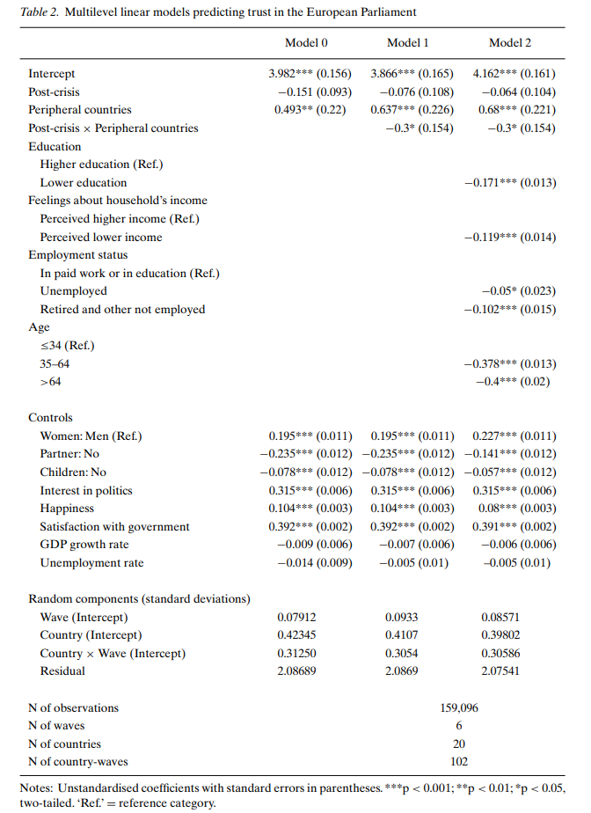
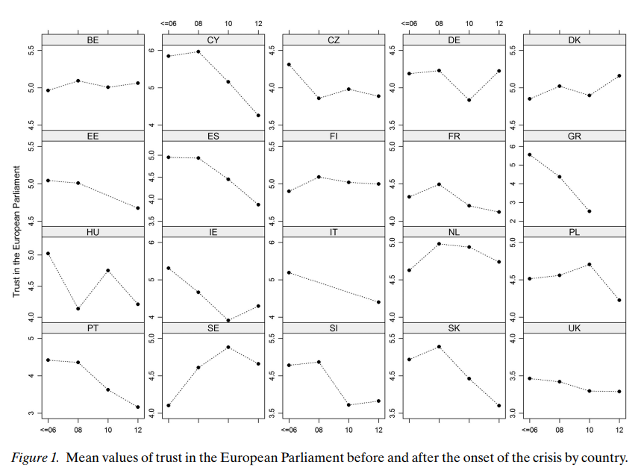
1: Wirtschaft & Pol. Vertrauen

Slide 21
2: Migration & Krise
Jaak Billiet, Bart Meuleman, Hans De Witte, The relationship between ethnic threat and economic insecurity in times of economic crisis: Analysis of European Social Survey data, Migration Studies, Volume 2, Issue 2, July 2014, Pages 135–161, https://doi.org/10.1093/migration/mnu023
Abstract
This study analyses the relationship between attitudes toward immigration and deteriorating economic conditions in times of crisis. We examine three questions: First, how are a vulnerable position in the labour market and recent changes to an individual’s economic situation related to perceived ethnic threat? Second, what is the role of the nation’s economic and immigration context? Last, are relationships at the individual level between economic conditions and perceived ethnic threat affected by contextual variables?
Data from 23 countries sampled in the fifth round of the European Social Survey (ESS-5, 2010) is used. At the micro level, unemployment, job insecurity and income deprivation during the three years prior to the survey affect perceived ethnic threat, as predicted by group conflict theory. These effects are, however, relatively small. Among the contextual variables, only growth in gross domestic product (GDP) shows an effect in the expected direction: perceived threat is higher in countries where GDP growth is lower. However, the study design does not allow the conclusion that changes in the economic context lead to changes in attitudes toward immigrants. The significant cross-level interaction for economic growth indicates that the threat-inducing effect of unemployment is stronger in contexts where the growth in GDP is high. This finding contradicts our hypothesis. One could explain this by the emergence of a generalized feeling of economic insecurity in countries severely hit by the economic crisis. In these countries, strong feelings of economic insecurity—and the resulting levels of perceived ethnic threat—might also be present among those who are employed, thereby diminishing the gap between them and the unemployed.

Slide 22
3: Wirtschaft, Vertrauen, Migration
Pellegrini, V., De Cristofaro, V., Salvati, M. et al. Social Exclusion and Anti-Immigration Attitudes in Europe: The mediating role of Interpersonal Trust. Soc Indic Res 155, 697–724 (2021)
Managing immigration is a challenge at the political, economic, and social levels. Clarifying the social psychological antecedents behind the onset of negative attitudes towards immigrants might help overcome this challenge. The present study investigates the relationships between people’s experience of social exclusion, feelings of generalized interpersonal trust, and anti-immigrant attitudes across 23 European countries. We used data from the European Social Survey 8 (2016), employing a representative sample of the European population. A 1–1–1 multilevel mediation model showed that: (a) the higher the experience of social exclusion, the lower the generalized trust towards others; (b) the experience of social exclusion related positively and directly with anti-immigration attitudes; and (c) generalized interpersonal trust mediated the relationship between experienced social exclusion and anti-immigrant attitudes so that the experience of being socially excluded reduced feelings of generalized interpersonal trust that, in turn, promoted hostile attitudes towards immigrants. Taken together, these results create a platform for future research on the emergence of negative attitudes towards immigrants and factors that might facilitate the development of a climate of integration and acceptance.

Slide 23
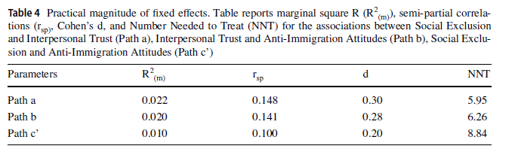
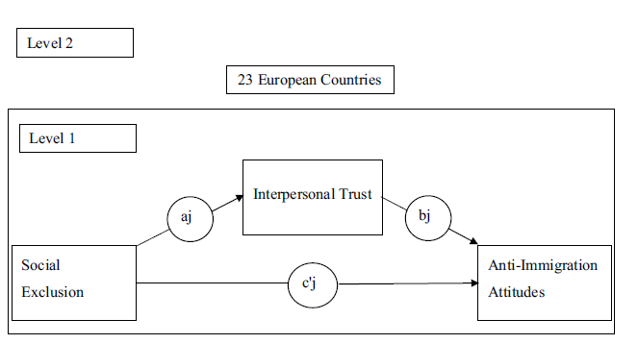
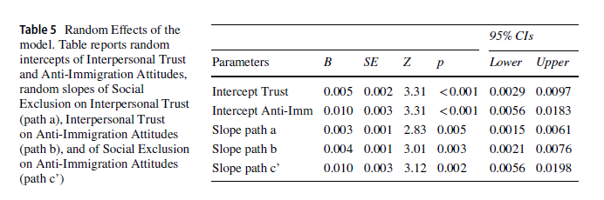
3: Wirtschaft, Vertrauen, Migration

Slide 24
3
Anwendung: Umfragedaten sichten und verstehen

Slide 25
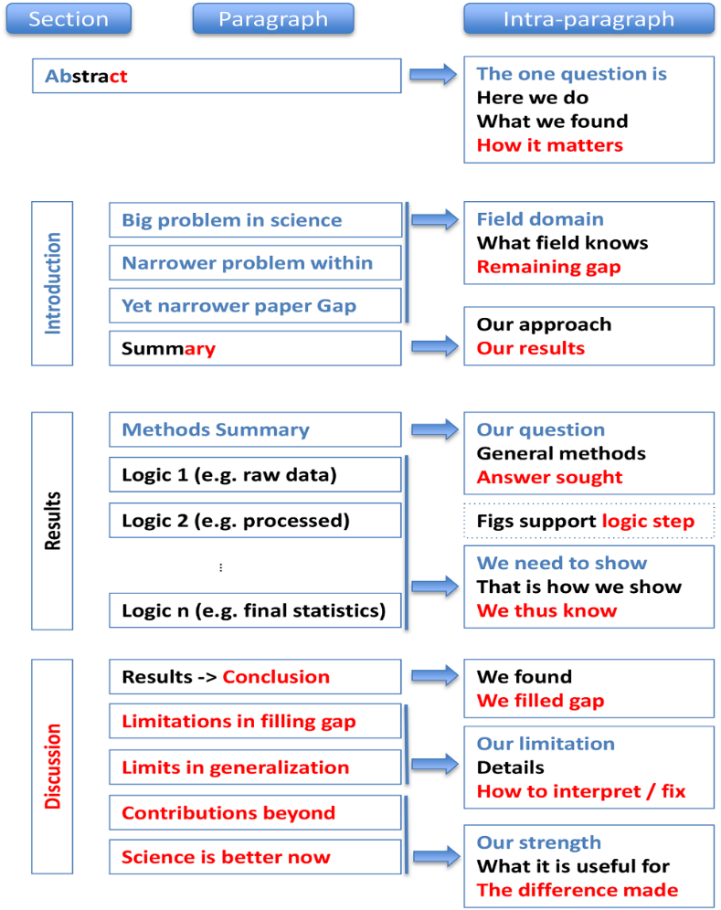
Struktur einer quant. Arbeit
Notes:
https://journals.plos.org/ploscompbiol/article/file?id=10.1371/journal.pcbi.1005619&type=printable

Slide 26
Wo finden wir Daten?
Suchmaschinen
https://www.icpsr.umich.edu/web/pages/ICPSR/index.html
https://datasearch.gesis.org/start
https://dataverse.harvard.edu/
Datenlisten
https://github.com/erikgahner/PolData
Primo
Literaturreview
Im Seminar etc.
(Eigene Erhebung)

Slide 27
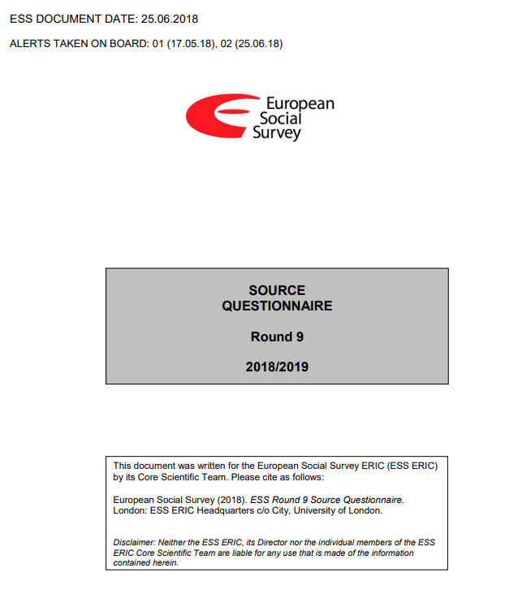
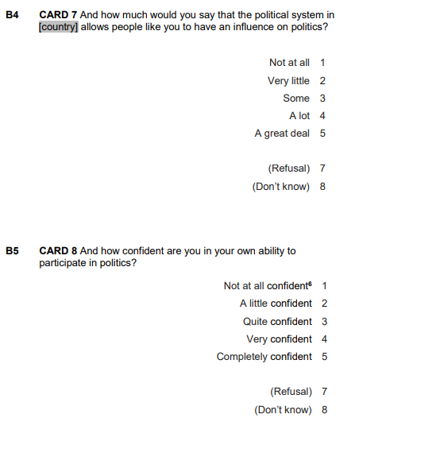
Daten Sichten
Fragebogen & Variablenübersicht
Liste der Fragetexte
Messung der Variablen
Namen der Variablen im Datensatz
(Liste der Konzepte)
Technischer Report
Rekrutierungsmethode (Repräsentativität)
Modus der Erhebung
Räumliche und zeitliche Ausprägung
Antwortrate
(Operationalisierung von Variablen)

Slide 28
Übung 2: Surveydaten anschauen
Sichtet den Fragebogen des ESS Welle 9 & des BUA Projekts (jeweils 20-25 Minuten)
Identifiziert Variablen, die ihr für die Messung von sozialer Kohäsion nutzen könntet
Identifiziert „interessante“ Variablen, die ihr damit in Verbindung bringen könntet (entweder als abhängige oder unabhängige Variable)
Identifiziert andere „spannende“ Variablen, die für euch interessant sind
Stellt eure Ergebnisse vor (5 Minuten)

Slide 29
Übung Optional: Literatur finden
Findet Artikel, die die Fragen aus Übung 1 mit Hilfe des European Social Surveys betrachten
Was ist der theoretische Rahmen der Arbeit
Wie werden die Kernkonzepte operationalisiert?
Abhängige Variable
Unabhängige Variable
Kontrollvariablen
Daten
Spatial coverage: Welche Länder werden betrachtet
Temporal coverage: Welcher Zeitraum wird analysiert?

