Slide 1
LocalEats
Celeste Nobrega & Pierce Gillim

Slide 2
01
02
03
04
Into to LocalEats
All about LocalEats
Project Demo
Goals and Discussion
What is the project and why is it important
Where did we get our data and what is the schema?
See how this app is intended to be used with a few query examples
What we hope to accomplish and what we struggled with

Slide 3
01
Intro to LocalEats
Why is this application important

Slide 4
What is it
LocalEats is a specially designed food delivery app that is geared towards small business restaurants that may be struggling due to the pandemic.
Notes:
p

Slide 5

Impact
This app provides a safer way for the residents of the area to support their local restaurants and build relationships within communities
Notes:
p

Slide 6
How we’re different
Core Features
We focus on only local restaurants
We allow for users to order together
We allow for restaurant collaboration
LocalEats
Notes:
c

Slide 7
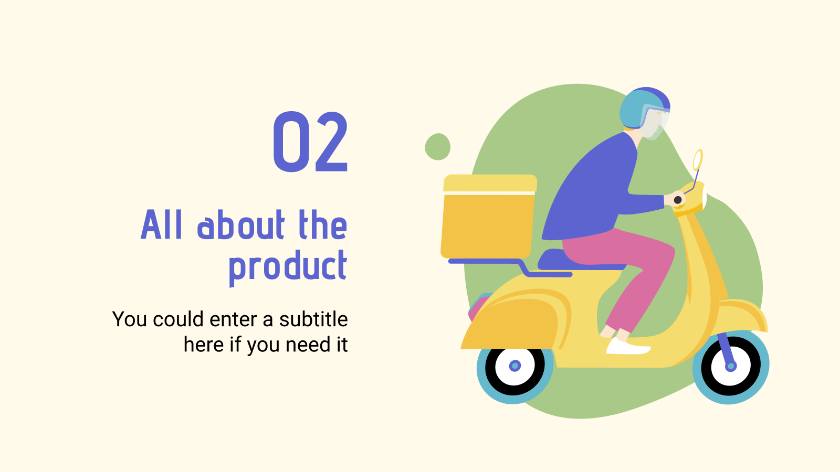
02
All about LocalEats
What is the schema and where did we get the data

Slide 8
Schema Overview
Users
Orders
Driver
Menu
Restaurant
Alert
A table of all users. ID, name, address
Every order made on the app. ID, orderedBy, orderTime, delivery Time, itemID, price, quantity, extendedPrice, fulfilledBy
All drivers, employees. ID, name, carMake, carModel, license
menuID, itemID, type, price, restaurantID
Restaurants available on the app. ID, name, address, category
orderID, deliverdBy, alertTime, pickupTime
Notes:
c

Slide 9
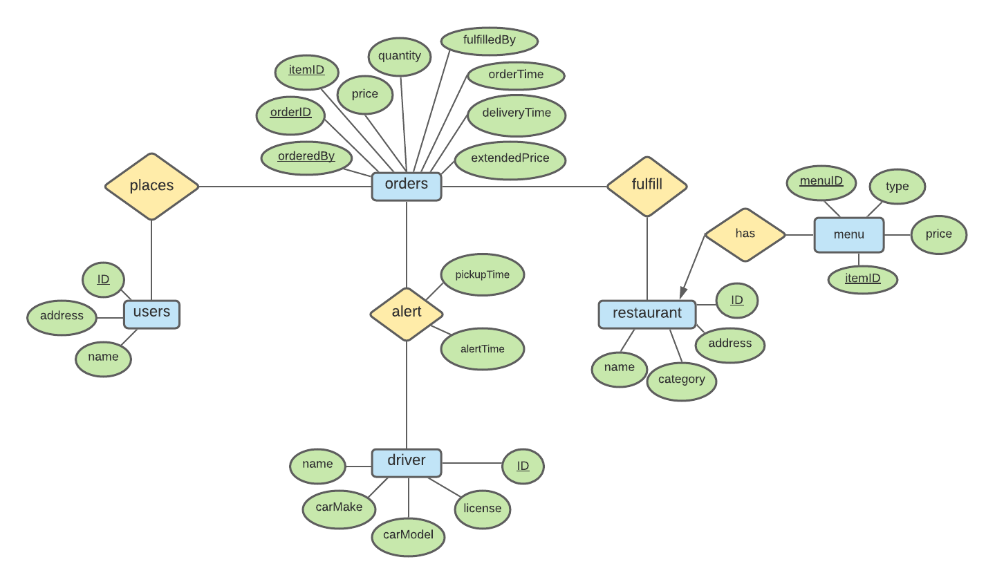
ER Diagram
Notes:
p

Slide 10

How did we produce our data?
We used a data fabrication service called Mockaroo. Mockaroo is a very powerful tool that allows a user to create several schemas and upload datasets to make mock data. There are 145 different types of data mockaroo can create, on top of being fully customizable using the Ruby language, SQL Expressions, formulas, and more
Notes:
c

Slide 11

User
Driver
Restaurant
Order
Alert
Menu
200 rows
ID is row number. Used mockaroo pre-defined data types: full name and street address.
200 rows
ID is row number. Used mockaroo pre-defined data types: full name, car make, car model, and car VIN.
100 rows
ID is row number. Category is a custom list describing type of food sold. Name was manually entered.
300 order IDs (6 digits). 627 total rows, as some orders are collaborative. Delivery time and order time generated to be randomly 10-30 minutes apart. Quantity is a rand int 1-20. Extended price is the price * quantity
300 rows. Alert time and pick up time are generated to be 2 to 10 minutes apart. Alert time is the same as order time. Delivered by is pulled from driver ID randomly.
500 rows. ID is a number 1-200, menu type is Breakfast, Lunch, Dinner, or All Day. Price is a rand real 1-20, itemID is 4 digit number.
Notes:
c

Slide 12
03
Project Demo
How it all comes together
Notes:
p

Slide 13
04
Goals and Discussion
What we hope to accomplish and issues we had
Notes:
c

Slide 14
How the project evolved
Proposal
Progress Report
Now
Ratings Menu entity Order info
Bad tables Inconsistencies New attributes
Collab orders Meaningful data Python “front end”
Notes:
c

Slide 15
Challenges
We had issues going from ER diagram to relational model and creating a working schema.
It was difficult to determine what should make up the primary keys which then indicated further schema changes.
Working with a new tool (Mockaroo) always has its challenges, and we noticed that a lot of our data didn’t make sense. It took some manual quality control to make sure we had meaningful and consistent data.

Slide 16
Solutions
We made a menu its own entity to allow for more functionality and descriptive shema.
A few tables were dropped due to data redundancy in efforts to make a more robust and meaningful schema.
We chose to drop the ratings function of the app to pare down the number of tables
We were able to create a “front end” through Python using Wing 101 that allows for a more intuitive way to interact with the database
The order table grew in size as our schema required more and more information to be tracked, and as we realized that we wanted to preserve the collaborative order feature.

Slide 17
Thanks!
Questions?

