Slide 1
Compilers and Computers:
Partners in Performance
Fran Allen
(IBM Fellow Emerita)
T. J. Watson Research Center
Yorktown Heights, NY 10598
allen@watson.ibm.com

Slide 2
Components of Performance
Latency Reduction
  Data and Instructions in the right place at the right time
Fast Computations
Concurrency

Slide 3
Talk will Cover
Three high performance systems:
  1955-61: Stretch-Harvest System
  1962-68: Advanced Computing System
  1975-78: 801 System (RISC)
And how the Compiler-Computer partnership for performance evolved

Slide 4
Some Context
1954-57: Fortran I
1955-62: Stretch-Harvest System
1962-68: Advanced Computing System
1975-78: 801 System (RISC)

Slide 5
FORTRAN I
Spectacular object code!!
Some features:
  Formal parsing techniques (beginnings)
  Intermediate language form for optimization
  Control flow graphs
  Common sub-expression elimination
  Generalized register allocation - for only 3 registers!

Slide 6
Some Context
1954-57: Fortran I
1955-62: Stretch-Harvest System
1962-68: Advanced Computing System
1975-78: 801 System (RISC)

Slide 7
Stretch (1955-61)
Goal: 100 x faster than 704
Main performance limitation (identified in 1955): Memory Access Time

Slide 8
Stretch Memory
1Mb magnetic core memory
Memory word lengths: 64 bits + 8 check bits
Memory organization:
  8 core storage units of 16K words each
  addresses interleaved across units
  each unit independently connected via memory bus unit to cpu, I/O, disk
  2.1 us cycle time per unit
Up to 6 storage accesses could be underway at the same time!!!!

Slide 9
Stretch Concurrency
Instruction Lookahead
  up to 11 successive instructions executing in cpu at the same time
  lookahead unit of virtual registers buffered instructions and data between memory and cpu
  elaborate backout system to assure sequential consistency when interrupted
Pipelining

Slide 10
Stretch Concurrency (cont’d)
Overlapped storage references
I/O and disk operations
Multiprogramming
  to compensate for slow I/O
  not shipped due to schedule

Slide 11
A Few Other Stretch Innovations
Generalized interrupt system
Memory protection
Bytes [8 bits]
Variable word length operands
Multiple forms of floating point arithmetic
Coupling two computers to a single memory

Slide 12
A Programmer's Dream
735 instructions (including modes)
Bit addressable
List walk took 2 instructions
Multiple modes of arithmetic
Registers and control functions part of addressable memory
Word-level storage protection traps

Slide 13
A Compiler Writer's Nightmare!
Too many ways of doing the same thing
FORTRAN could not use some features, e.g.multiple forms of arithmetic
Organizing storage
Scheduling instructions
Etc……

Slide 14
Compiler as Part of the System
A Stretch Objective: "The objective of economic efficiency was understood to imply minimizing the cost of answers, not just the cost of hardware. ... A consequent objective was to make programming easier -- not necessarily for trivial problems but for problems worthy of the computer, problems whose coding in machine language would usually be generated automatically by a compiler from statements in the user's language." Fred Brooks in "Planning a Computer System", 1962

Slide 15
HARVEST (1956-1962)
Hosted by Stretch
Designed for NSA for code breaking
Streaming data computation model
Seven instructions, e.g. Sort, SBBB
Unbounded single operation times
Only system with balanced I/O and computational speeds (per conversation with Jim Pomerene 11/00)
Notes:
Microcode-level, self-modifying program instructions
More than twice the size of Stretch
~500,000 transistors (Stretch: 169,200)
~250,000 instructions (Stretch: 735)

Slide 16
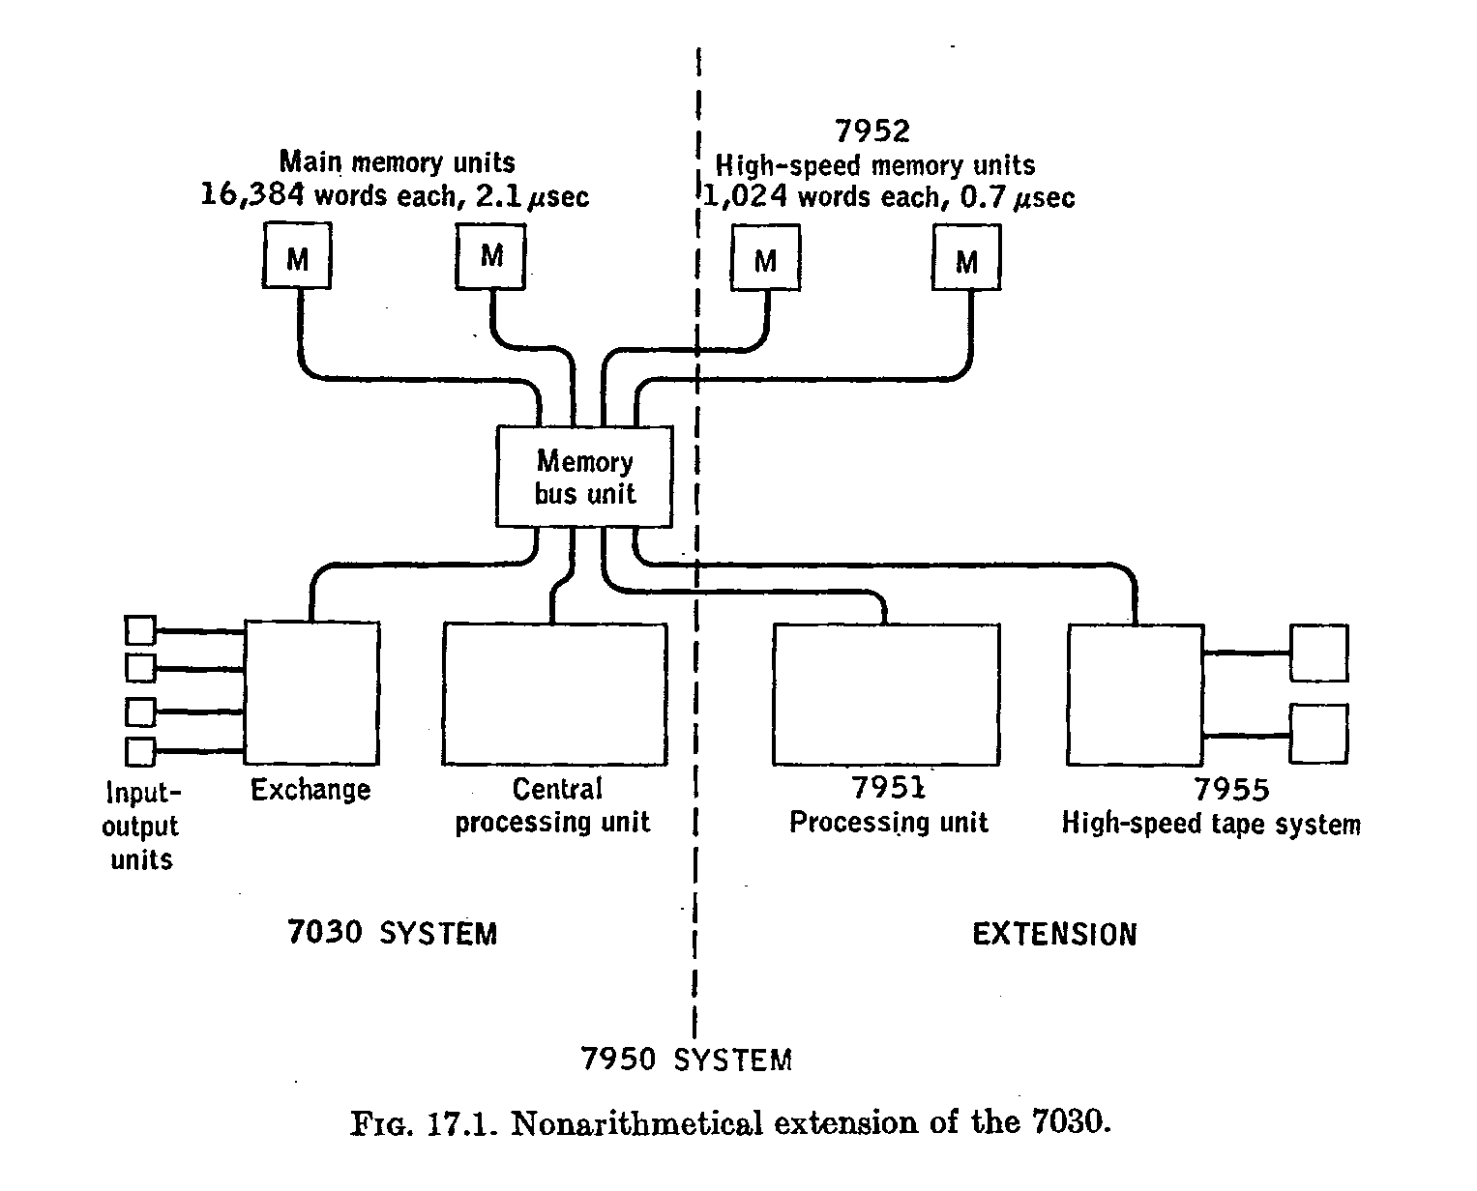
Harvest System

Slide 17
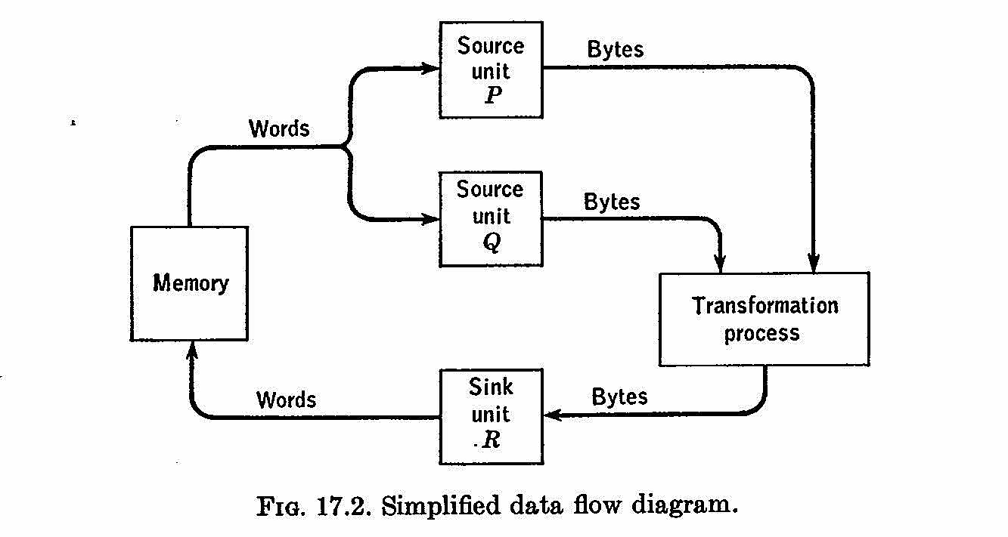
Harvest Streaming Unit

Slide 18
Alpha Language for Harvest
Language for cryptologists
  Alphabet definition capability
  Result descriptors by implication
Matched the Harvest instructions but hid all details.

Slide 19
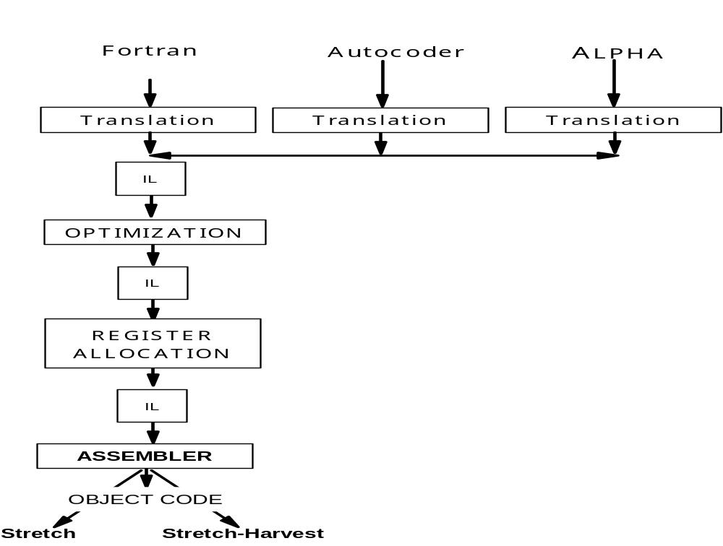
Stretch-Harvest Compiler

Slide 20
Stretch Retrospective
Stretch machine missed 100 x goal
Stretch compiler for Fortran replaced with simpler, faster compiler
But “Stretch defined the limits of the possible for later generations of computer designers and users.” (Dag Spicer - Curator Computer History Museum)
Notes:
Los Alamos machine used for 10 years with the then astonishing average reliability of 17 hours before failure.

Slide 21
Harvest Retrospective
Harvest heavily used for 14 years
  Hardware was very successful
  ALPHA and Compiler use is unknown
Nov. 1968 NSA report: “Recently HARVEST scanned 7,075,315 messages of approximately 500 characters each -- examining every possible offset -- to see if they contained any of 7,000 different words or phrases. This ... required three hours and 50 minutes to complete -- an average of over 30,000 messages a minute.”
Notes:
Nov. 1968 NSA report: "Recently HARVEST scanned 7,075,315 messages of approximately 500 characters each -- examining every possible offset -- to see if they contained any of 7,000 different words or phrases. This ... required three hours and 50 minutes to complete -- an average of over 30,000 messages a minute."
1976: HARVEST decommissioned after 14 years because tractor tape part was no longer available.Jan. 1980 paper by S. S. Snyder (NSA):
"Harvest's most important effect was undoubtedly on the engineers who designed it, since the program brought out the best in all who were involved."

Slide 22
Next Step
1954-57: Fortran I
1955-62: Stretch-Harvest System
1962-68: Advanced Computing System
1975-78: 801 System (RISC)

Slide 23
What We Had Learned
Design compiler & computer together
No instructions the compiler can’t use
Keep the instruction set simple
Keep the compiler simple
A lot about building compilers and computers

Slide 24
ACS System (1962-1968)
Goal: To build the fastest scientific computer feasible
Compiler built early to drive hardware design

Slide 25
ACS Computer (1964-1968)
Single instruction counter
Superscalar: up to 7 ops per cycle;
Pipelined
Branch prediction
> 50 insts in execution concurrently
Programmable condition codes

Slide 26
ACS Compiler
Early design used to establish:
  Branch prediction strategies
  Performance bottlenecks
  Instruction scheduling techniques
Code was sometimes faster than the best handcode

Slide 27
Some Compiler Results
A theoretical basis for program analysis and optimization
A Catalogue of Optimizations including:
  Procedure integration
  Loop transformations: unrolling, jamming, unswitching
  Redundant subexpression elimination, code motion, constant folding, dead code elimination, strength reduction, linear function test replacement, carry optimization, anchor pointing
  Instruction scheduling
  Register allocation

Slide 28
ACS
ACS was cancelled in May 1968
Too costly, too big, …..

Slide 29
Next Step
1954-57: Fortran I
1955-62: Stretch-Harvest System
1962-68: Advanced Computing System
1975-78: 801 System (RISC)

Slide 30
The 801 System (RISC)
Goal: High Performance and Low Cost
Simple, 1-cycle instructions
Hardware, compiler, and new programming language (PL.8) developed simultaneously

Slide 31
Some 801 Project Results
Graph coloring register allocator
Influenced Berkeley RISC Project
IBM’s Power PC family of computers
Optimizer became the core of IBM’s XL family of retargetable compilers for multiple source languages.

Slide 32
More Steps
1954-57: Fortran I
1955-62: Stretch-Harvest System
1962-68: Advanced Computing System
1975-78: 801 System (RISC)
Parallel Systems
C
Java
Etc…..

Slide 33
Challenges
The memory wall is getting worse
  Caches
  Locality
Parallelism
Programming languages
Compilers for the New Millenium!

Slide 34
BACKUP CHARTS

Slide 35
Stretch Machine
speed: ~ 500 KIPS (code dependent)
base machine cycle: 300 ns (3.3MHz)
transistors: 169,200
disk: 2MW and 8Mbps
tape drives: 12 *IBM 729 IV units
card reader: 1000 cpm
printer: 600 lpm
card punch: 250 cpm
cpu size: 900 sq. ft. (30 x 6 x 5)
cpu power req: 21 KW
total size: 2,500 sq. ft.
weight: 40,000 lbs.

Slide 36
Tractor Tape for Harvest
Tape library system with automatic retrival & storage
3 Cartridge handling units
160 cartridges/handler
90 million characters/tape
1,128,000 characters/sec transfer rate
Automatic checking and error correction
The 3 cartridge handlers could execute in parallel

Slide 37
Tractor Tape
The max read/write transfer rate was > 3.3MB/sec,
matching the rate of the streaming unit!

