Slide 1
Compiler Technology for Productivity and Performance
Kevin Stoodley
IBM Fellow and CTO: Compilation Products
SWG Toronto Laboratory
stoodley@ca.ibm.com

Slide 2
Outline
IBM Compilation Technology Group
Brief overview of static compilation technology
Brief overview of dynamic compilation technology
What’s next?

Slide 3
IBM Compilation Technology Group
More than 300 development, test and service engineers in Toronto, Canada
Product responsibility for high performance C, C++ and Fortran 200x compilers targeting IBM servers/CPUs (ie. Power5+, Cell)
Responsible for Java JIT compilers targeting handheld devices to 64-way servers and everything in between.
XML parsers and XSLT processors
All in-house technology developed over the past 25 years in close conjunction with IBM Research
Our Mission:
To deliver the highest performance, most robust, most up-to-date language implementations in support of IBM’s Hardware, Software and Services businesses

Slide 4
Static compilation system

Slide 5
Static compilation system
C Front End
C++ Front End
Fortran Front End
Platform neutral
Intermediate
Language
(IL)
IL to IL Inter-
Procedural
Optimizer
Optimizing
Backend
Profile-Directed
Feedback (PDF)
Machine
Code

Slide 6
Static Compilers
Traditional compilation model for C, C++, Fortran, …
Extremely mature technology
Static design point allows for extremely deep and accurate analyses supporting sophisticated program transformation for performance.
ABI enables a useful level of language interoperability
But…

Slide 7
Static compilation…the downsides
Difficult or impossible to evolve language implementation because of compatibility concerns (ex. C++ object model support for multiple inheritance)
CPU designers restricted by requirement to deliver increasing performance to applications that will not be recompiled
  Slows down the uptake of new ISA and micro-architectural features
  Constrains the evolution of CPU design by discouraging radical changes
Model for applying feedback information from application profile to optimization and code generation components is awkward and not widely adopted thus diluting the performance achieved on the system

Slide 8
Static compilation…the downsides
Largely unable to satisfy our increasing desire to exploit dynamic traits of the application
Even link-time is too early to be able to catch some high-value opportunities for performance improvement
Whole classes of speculative optimizations are infeasible without heroic efforts

Slide 9
Tyranny of the “Dusty Deck”
Binary compatibility is one of the crowning achievements of the early computer years
But…
It does (or at least should) make CPU architects think very carefully about adding anything new because
  you can almost never get rid of anything you add
  it takes a long time to find out for sure whether anything you add is a good idea or not

Slide 10
80x87 ISA: A cautionary tale
Has to be the hands-down canonical example
As much as I loved RPN calculators, this is the worst excuse to save 3 bits of opcode space in the history of computing
Effects still felt 30 years later despite
  SSE instruction set with flat scalar fp ISA introduced in the late 90s
  At least 20 years of deeply visceral pain and not just for writers of instruction schedulers and register assigners
Paradoxically, AMD provided the eventual solution by introducing X86-64 without an “x87-64” to go with it ☺

Slide 11
Profile-Directed Feedback (PDF)
Two-step optimization process:
  First pass instruments the generated code to collect statistics about the program execution
    Developer exercises this program with common inputs to collect representative data
    Program may be executed multiple times to reflect variety of common inputs
  Second pass re-optimizes the program based on the profile data collected

Slide 12
Data collected by PDF
Basic block execution counters
  How many times each basic block in the program is reached
  Used to derive branch and call frequencies
Value profiling
  Collects a histogram of values for a particular attribute of the program
  Used for specialization

Slide 13
Optimizations affected by PDF
Inlining
  Uses call frequencies to prioritize inlining sites
Function partitioning
  Groups the program into cliques of routines with high call affinity
Speculation
  Forces evaluation of expressions guarded by branches determined to be infrequently taken

Slide 14
Optimizations triggered by PDF
Specialization triggered by value profiling
  Arithmetic ops, built-in function calls, pointer calls
Extended basic block creation
  Organizes code to frequently fall-through on branches
Specialized linkage conventions
  Treats all registers as non-volatile for infrequent calls
Branch hinting
  Sets branch-prediction hints available on the ISA
Dynamic memory reorganization
  Groups frequently accessed heap storage

Slide 15
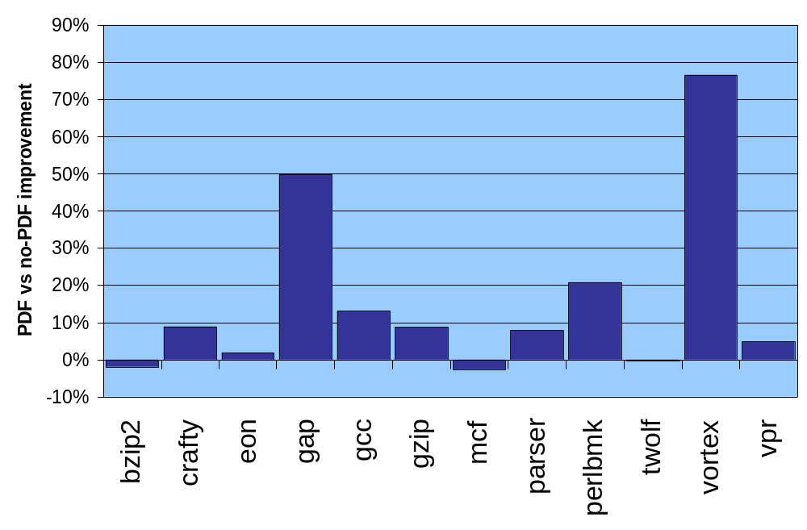
Impact of PDF on specInt 2000*
* estimated
On a PWR4 system running AIX using the latest IBM compilers,
at the highest available optimization level (-O5)

Slide 16
Sounds great…what’s the problem?
Only the die-hard performance types use it (eg. HPC, middleware)
It’s tricky to get right…you only want to train the system to recognize things that are characteristic of the application and somehow ignore artifacts of the input set
In the end, it’s still static and runtime checks and multiple versions can only take you so far
Undermines the usefulness of benchmark results as a predictor of application performance when upgrading hardware
In summary…it’s a usability/socialization issue for developers that shows no sign of going away anytime soon

Slide 17
Dynamic Compilation System

Slide 18
Dynamic Compilation System
class
class
jar
Java Virtual Machine
JIT Compiler
Machine
Code

Slide 19
Dynamic Compilation
Traditional model for languages like Java
Rapidly maturing technology
Exploitation of current invocation behaviour on exact CPU model
Recompilation and other dynamic techniques enable aggressive speculations
Profile feedback to optimizer is performed online (transparent to user/application)
Compile time budget is concentrated on hottest code with the most (perceived) opportunities
But…

Slide 20
Dynamic compilation…the downsides
Some important analyses not affordable at runtime even if applied only to the hottest code (array data flow, global scheduling, dependency analysis, loop transformations, …)
Non-determinism in the compilation system can be problematic
  For some users, it severely challenges their notions of quality assurance
  Requires new approaches to RAS and to getting reproducible defects for the compiler service team
Introduces a very complicated code base into each and every application
Compile time budget is concentrated on hottest code with the most (perceived) opportunities and not on other code, which in aggregate may be as important a contributor to performance
  What do you do when there’s no hot code?

Slide 21
Our vision: The best of both worlds

Slide 22
Our vision: The best of both worlds
Front
Ends
xlc
xlC
xlf
class
class
jar
W-Code
CPO
J9 Execution Engine
(Java + Others)
Toronto Portable
Optimizer (TPO)
TOBEY
Backend
Testarossa
JIT
Dynamic
Machine
Code
Binary
Translation
Profile-Directed
Feedback (PDF)
Static
Machine
Code

Slide 23
Our vision: The best of both worlds
class
class
jar
W-Code
CPO
J9 Execution Engine
(Java + Others)
Testarossa
JIT
Dynamic
Machine
Code
Binary
Translation
Profile-Directed
Feedback (PDF)
Static
Machine
Code

Slide 24
More boxes, but is it better?
If ubiquitous, could enable a new era in CPU architectural innovation by reducing the load of the dusty deck millstone
  Deprecated ISA features supported via binary translation or recompilation from “IL-fattened” binary
  No latency effect in seeing the value of a new ISA feature
  New feature mistakes become relatively painless to undo

Slide 25
There’s more
Transparently bring the benefits of dynamic optimization to traditionally static languages while still leveraging the power of static analysis and language-specific semantic information
  All of the advantages of dynamic profile-directed feedback (PDF) optimizations with none of the static pdf drawbacks
    No extra build step
    No input artifacts skewing specialization choices
    Code specialized to each invocation on exact processor model
    More aggressive speculative optimizations
    Recompilation as a recovery option
  Static analyses inform value profiling choices
    New static analysis goal of identifying the inhibitors to optimizations for later dynamic testing and specialization

Slide 26
Break through the layers
Abstraction is both the cause of and the solution to many software problems
Language and programming model design communities have been adding abstractions to solve their problems and thereby creating new problems for underlying software and hardware implementations
Inter-language barriers
  Inline and optimize across the JNI boundary (VM ’05 IBM paper)
Web Services or other loosely coupled systems
  Eliminate high dispatch costs when local or especially when in-process
Application-OS boundaries
  Optimize and specialize OS user space code into the application calling it (à la Synthesis)
Common thread is the need for higher level semantic input to the compilation and runtime systems

Slide 27
There’s always a rub
Non-trivial amount of work to bring this technology to full fruition
Socialization of dynamic compilation in domains where it has never been accepted is a daunting task
  Only works when it is based on merit
  Courage required to start
  No quick fix here…it just takes time for people to change their views
Benchmarking community needs to deal thoughtfully with this kind of system
  Naïve reaction is that these are benchmark buster technologies
  Need run rules, benchmarks and input sets that discourage hacking while rewarding techniques and implementations that provide real differentiation for real codes

Slide 28
Summary
A crossover point has been reached between dynamic and static compilation technologies.
They need to be converged/combined to overcome their individual weaknesses
Mounting software abstraction complexity forces the scope of compilation to higher levels in order to deliver efficient application performance realizable by non-heroic developers
Hardware designers struggle under the mounting burden of maintaining high performance backwards compatibility
Welcome to the era of the Über-compiler ☺

Slide 29
Thank you
Q and A

