Slide 1
Code Generation and Optimization for Transactional Memory Construct in an Unmanaged Language
Cheng Wang, *Wei-Yu Chen, Youfeng Wu,
Bratin Saha, Ali Adl-Tabatabai
Programming Systems Lab
Microprocessor Technology Labs
Intel Corporation
*Computer Science Division
University of California, Berkeley

Slide 2
Motivation
  Existing Transactional Memory (TM) constructs focus on managed Language
  Efficient software transactional memory (STM) takes advantages of managed language features
    Optimistic Versioning (direct update memory with backup)
    Optimistic Read (invisible read)
  Challenges in Unmanaged Language (e.g. C)
    Consistency
      No type safety, first-class exception handling
    Function call
      No just-in-time compilation
    Stack rollback
      Stack alias
    Conflict detection
      Not object oriented
Notes:
As the background, the existing transactional memory constructs foucs on managed language. And the software transactional memory can take advantages of the managed language features for efficiency. For example, Instead of buffering all the temporary results of transactions, we can use optimistic version, which directly update program memory with the backup of old data for transaction abort. The optimistic version is very efficient for memory read because we do not need to check the buffered data. It is also efficient for the common case for transaction commit because at the transaction commit time, the memory contains the correct data.
Also instead of make the memory read visible to other thread, we can implement optimistic read. In optimistic read, we get a memory versions at the reads and verify it before transaction commit for conflict detection. Previous work shows that the optimistic read is an order of magnitude of more efficiency than the corresponding pessimistic read.
However, there are a lot of challenge to implement the efficient software transactional memory implementation in unmanaged language like C. First, the optimistic versioning and optimistic read can make the transaction execution temporarily inconsistent. The managed language has many good features to make inconsistent state always within the transaction roll them back through transaction abort. However, we can not always do that in unmanaged language. So we need special work to make the program execution is always consistent.
Second, the just-in-time in the managed time has no problem to handle transaction across function calls. In static compilation of unmanaged languages, we have to specially handle the transaction across function call due to the separate compilations and indirect function calls.
Third, we do not need consider stack rollback in managed language. But we must consider it in unmanaged language due to the stack alias.
At last, in object oriented managed language, we can simply allocate different version of data in the object. In the unmanaged language, we have to allocated them seperately. We need special version management for the correct mapping between different version of memory.

Slide 3
Contributions
  First to introduce comprehensive transactional memory construct to C programming language
    Transaction, function called within transaction, transaction rollback, …
  First to support transactions in a production-quality optimizing C compiler
    Code generation, optimization, indirect function calls, …
  Novel STM algorithm and API that supports optimizing compiler in an unmanaged environment
    quiescent transaction, stack rollback, …

Slide 4
Outline
  TM Language Construct
  STM Runtime
  Code Generation and Optimization
  Experimental Results
  Related Work
  Conclusion

Slide 5
TM Language Constructs
#pragma tm_atomic
{
stmt1;
stmt2;
}
  #pragma tm_atomic
  {
  stmt 1;
  #pragma tm_atomic
  {
  stmt2;
  …
  tm_abort();
  }
  }
  #pragma tm_function
  int foo(int);
  int bar(int);
  #pragma tm_atomic
  {
  foo(3); // OK
  bar(10); // ERROR
  }
  foo(2) // OK
  bar(1) // OK
Notes:
We use a pragma to declare a block of statement to be a transaction. We allows transactions to be nested. We also allow user to specify transaction abort with an intrinsic function calls. The user specified transaction abort only roll back the current level of nested transaction. Finally, we allow user to specify a function that can be called within transaction. In this example, the function foo is allowed to be called within transaction and but is not. Out of transaction, both of them are allowed.

Slide 6
Consistency Problem
Thread 1
Thread 2
Not NULL
  #pragma tm_atomic
  {
  if(tq->free) {
  for(temp1 = tq->free;
  temp1->next &&…,
  temp1 = temp1->next);
  task_struct[p_id].loc_free = tq->free;
  tq->free = temp1->next;
  temp1->next = NULL;
  …
  }
  }
#pragma tm_atomic
  {
  if(tq->free) {
  for(temp2 = tq->free;
  temp2->next &&…,
  temp2 = temp2->next);
  task_struct[p_id].loc_free = tq->free;
  tq->free = temp2->next;
  temp2->next = NULL;
  …
  }
  }
shared free list
NULL
local free list
Memory Fault
NULL
  Solution: timestamp based aggressive consistent checking
Notes:
As we mentioned before, the optimistic read can make the transaction execution temporarily inconsistent, as shown in this example. This code comes from a real splash2 benchmark. It grabs a list of free memory from a shared memory list pointed by tq->free and put it into a local free list pointed by loc_free.
This example comes from real splash2 benchmark
It implements a task queue. Transverse the global task queue get a list of task from it. then put the list of tasks into local task queue. Then process task from local task queue one by one
Optimistic read do not immediately abort either of the transaction. The first transaction will abort only when it verify all its reads at transaction commit
This example shows inconsistency between two reads of the same memory. Inconsistency can also happen between two reads of different memory.
associate a timestamp with each committed transaction. This timestamp is used as version of its committed data
Each transaction keep track of the latest timestamp of all it read. If a data with newer timestamp is read, we know a transaction is committed in between. Then we verify all the memory reads.

Slide 7
Inconsistency Caused by Privatization
Thread 1
Thread 2
Not NULL
  #pragma tm_atomic
  {
  if(tq->free) {
  for(temp1 = tq->free;
  temp1->next &&…,
  temp1 = temp1->next);
  task_struct[p_id1].loc_free = tq->free;
  tq->free = temp1->next;
  temp1->next = NULL;
  …
  }
  }
  temp1 = task_struct[p_id1].loc_free;
  /* process temp */
  task_struct[p_id1].loc_free = temp1->next;
  temp1->next = NULL;
  #pragma tm_atomic
  {
  if(tq->free) {
  for(temp2 = tq->free;
  temp2->next &&…,
  temp2 = temp2->next);
  task_struct[p_id2].loc_free = tq->free;
  tq->free = temp2->next;
  temp2->next = NULL;
  …
  }
  }
  temp2 = task_struct[p_id2].loc_free;
  /* process temp */
  task_struct[p_id2].loc_free = temp2->next;
  temp2->next = NULL;
NULL
Memory Fault
NULL
  Solution: Quiescent Transaction
Notes:
This is known to be the privatization problem, which commonly happens when we want to get private memory from the shared memory, for example memory malloc. In this case, we get a private task list from the shared task list.
We do not allow a transaction to commit until all the concurrent transaction verify its read set.

Slide 8
Quiescent Transaction
Thread 1
Thread 2
Not NULL
  #pragma tm_atomic
  {
  if(tq->free) {
  for(temp1 = tq->free;
  temp1->next &&…,
  temp1 = temp1->next);
  task_struct[p_id1].loc_free = tq->free;
  tq->free = temp1->next;
  temp1->next = NULL;
  …
  }
  }
  temp1 = task_struct[p_id1].loc_free;
  /* process temp */
  task_struct[p_id1].loc_free = temp1->next;
  temp1->next = NULL;
  #pragma tm_atomic
  {
  if(tq->free) {
  for(temp2 = tq->free;
  temp2->next &&…,
  temp2 = temp2->next);
  task_struct[p_id2].loc_free = tq->free;
  tq->free = temp2->next;
  temp2->next = NULL;
  …
  }
  }
  temp2 = task_struct[p_id2].loc_free;
  /* process temp */
  task_struct[p_id2].loc_free = temp2->next;
  temp2->next = NULL;
Quiescent
Consistency Checking Fail
Notes:
This is known to be the privatization problem, which commonly happens when we want to get private memory from the shared memory, for example memory malloc. In this case, we get a private task list from the shared task list.
We do not allow a transaction to commit until all the concurrent transaction verify its read set.

Slide 9
TM Runtime Issues (Stack Rollback)
#pragma tm_atomic
{
…
foo()
… // abort
}
foo() {
int a;
bar(&a)
…
}
bar(int *p) {
…
*p ← …
…
}
back a
rollback a
Stack Crash
  Solution: Selective Stack Rollback
Notes:
First, we may need rollback stack data because we can not simply treat stack access as local memory memory because they can be shared between different threads through ponter access. In fact, we can totally distinguish them from global memory access due to pointers.
We must carefully handle the rollback of stack data because the reuse of stacks.

Slide 10
Optimization Issues (Redundant Barrier)
  #pragma tm_atomic
  {
  a = b + 1;
  …; // may alias a or b
  a = b + 1;
  }
  desc = stmGetTxnDesc();
rec1 = IRComputeTxnRec(&b);
ver1 = IRRead(desc, rec1);
t = b;
IRCheckRead(desc, rec1, ver1);
desc = stmGetTxnDesc();
rec2 = IRComputeTxnRec(&a);
IRWrite(desc, rec2);
IRUndoLog(desc, &a);
a = t + 1;
desc = stmGetTxnDesc();
rec1 = IRComputeTxnRec(&b);
ver1 = IRRead(desc, rec1);
t = b;
IRCheckRead(desc, rec1, ver1);
desc = stmGetTxnDesc();
rec2 = IRComputeTxnRec(&a);
IRWrite(desc, rec2);
IRUndoLog(desc, &a);
a = t + 1;
not redundant
Notes:
We call inserted STM Runtime API as barriers
The trivial insertion has a lot of redundant as shown in this example
We use algorithm similar to Partial Redundancy Elimination to eliminate redundant barriers.

Slide 11
Experiment Setup
  Target System
    16-way IBM eServer xSeries 445, 2.2GHz Xeon
    Linux 2.4.20, icc v9.0 (with STM), -O3
  Benchmarks
    3 synthetic concurrent data structure benchmarks
      Hashtable, btree, avltree
    8 SPLASH-2 benchmarks
      4 SPLASH-2 benchmarks spend little time in critical sections
    Fine-grained lock v. coarse-grained lock v. STM
      Coarse-grain lock: replace all locks with a single global lock
      STM:
        Replace all lock sections with transactions
        Put non-transactional conflicting accesses in transactions

Slide 12
Hashtable
hashtable (80% update)
fine lock
3.5
3
coarse lock
2.5
2
manual stm
time (seconds)
1.5
compiler stm
1
0.5
compile stm -- no
0
consistency
0
5
10
15
20
threads
  STM scales similarly as fine grain lock
  Manual and compiler STM comparable performance
Notes:
Fine grain lock is better than coarse grain lock
STM scales similarly as fine grain lock
Manual and compiler STM comparable performance
Coarse-grained lock Performs better than fine-grained lock
STM can be faster than locks, if mostly reads
STM is similar to coarse-grain lock
TM frees programmers from the issue of lock granularity

Slide 13
FMM
FMM
5
fine lock
4
stm
3
coarse lock
time (seconds)
no consistency
2
1
0
0
5
10
15
20
threads
  STM is much better than coarse-grain lock

Slide 14
Splash 2
raytrace
8
7
fine lock
6
stm
5
coarse lock
time (seconds)
4
3
2
1
0
0
5
10
15
20
threads
  STM can be more scalable than locks
Notes:
Not scale to 16 threads because the 16 processors are grouped into 4 clusters with shared L4 cache within cluster. This NUMA memory access affect the scalability

Slide 15
Optimization Benefits
1.25
1.2
1.15
1.1
no opt
Normalized Execution Time
barrier elim
1.05
inlining
1
full opt
no consistency
0.95
lock
0.9
0.85
0.8
barnes
cholesky
fmm
raytrace
radiosity
geo-mean
  The overhead is within 15%, with average only 6.4%
Notes:
All the data are normalized to STM without optimization

Slide 16
Related Work
  Transactional Memory
    [Herlihy, ISCA93]
    [Ananian, HPCA05], [Rajwar, ISCA05], [Moore, HPCA06], [Hammond, ASPLOS04], [McDonald, ISCA06], [Saha, MICRO 06]
  Software Transactional Memory
    [Shavit, PODC95], [Herlihy, PODC03], [Harris, ASPLOS04]
  Prior work on TM constructs in managed languages
    [Adl-Tabatabai, PLDI06], [Harris, PLDI06], [Carlstrom, PLDI06], [Ringengerg, ICFP05]
  Efficient STM
    [Saha, PPoPP06]
  Time-stamp based approach
    [Dice, DISC06], [Riegel, DISC06]

Slide 17
Conclusion
  We solve the key STM compiler problems for unmanaged languages
    Aggressive consistency checking
    Static function cloning
    Selective stack rollback
    Cache-line based conflict detection
  We developed a highly optimized STM compiler
    Efficient register rollback
    Barrier elimination
    Barrier inlining
  We evaluated our STM compiler with well-known parallel benchmarks
    The optimized STM compiler can achieve most of the hand-coded benefits
    There are opportunities for future performance tuning and enhancement

Slide 18
Questions ?

Slide 19
STM Runtime API
TxnDesc* stmGetTxnDesc();
uint32 stmStart(TxnDesc*, TxnMemento*);
uint32 stmStartNested(TxnDesc*, TxnMemento*);
void stmCommit(TxnDesc*);
void stmCommitNested(TxnDesc*);
void stmUserAbort(TxnDesc*);
void stmAbort(TxnDesc*);
uint32 stmValidate(TxnDesc*);
uint32* stmComputeTxnRec(uint32* addr);
uint32 stmRead(TxnDesc*, uint32* txnRec);
void stmCheckRead(TxnDesc*, uint32* txnRec, uint32 version);
void stmWrite(TxnDesc*,uint32* txnRec);
Void stmUndoLog(TxnDesc*, uint32* addr,uint32 size);

Slide 20
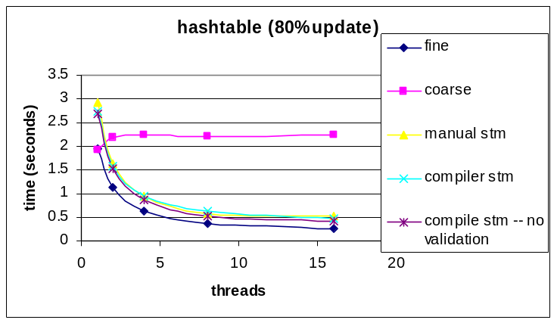
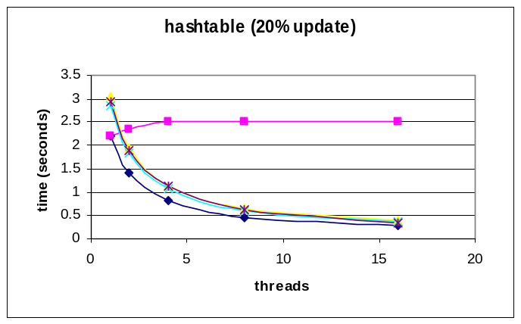
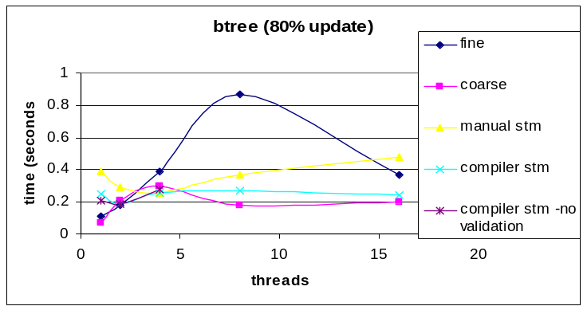
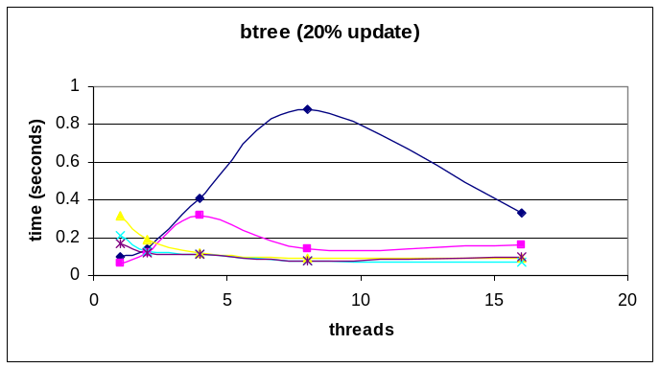
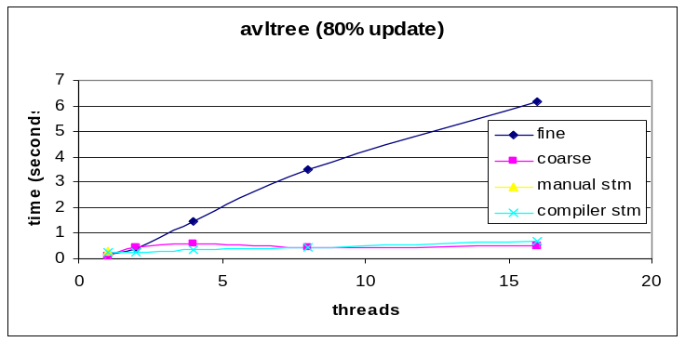
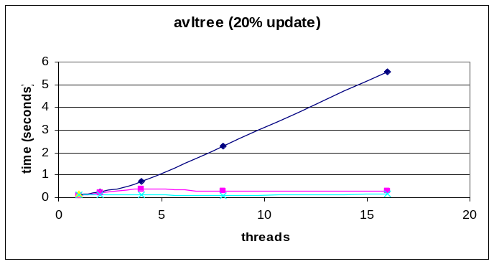
Data Structures
Notes:
Fine grain lock is better than coarse grain lock
STM scales similarly as fine grain lock
Manual and compiler STM comparable performance
Coarse-grained lock Performs better than fine-grained lock
STM can be faster than locks, if mostly reads
STM is similar to coarse-grain lock
TM frees programmers from the issue of lock granularity

Slide 21
Example 1
  #pragma tm_atomic
  {
  t = head;
  Head = t->next;
  }
  … = *t;
  #pragma tm_atomic
  {
  s = head;
  *s = …;
  }

Slide 22
Example 2
#pragma tm_atomic
  {
  t = head;
  head = t->next;
  }
  … = *t;
  #pragma tm_atomic
  {
  s = head;
  *s = …;
  head = s->next;
  }

Slide 23
Example 3
#pragma tm_atomic
  {
  t = head;
  head = t->next;
  }
  *t = …;
  #pragma tm_atomic
  {
  s = head;
  … = *s;
  head = s->next;
  }

Slide 24
Optimization Issues (Register Checkpointing)
  Source Code
  #pragma tm_atomic
  {
  t1 = 0;
  t2 = t1 + t2;
  …
  }
  t1 = t3;
  t3 = 1;
  Checkpointing Code
  t2_bkup = t2;
  while(setjmp(…)) {
  t2 = t2_bkup;
  }
  stmStart(…)
  t1 = 0;
  t2 = t1 + t2;
  …
  stmCommit(…);
  t1 = t3;
  t3 = 1;
  Optimized Code
  t2_backup = t2;
  t1 = 0;
  while(setjmp(…)) {
  t2 = t2_bkup;
  }
  stmStart(…);
  t2 = t1 + t2;
  t1 = t3;
  t3 = 1;
  …
  stmCommit(…);
can not
recover
Abort
  Checkpointing all the live-in local data does not work with compiler optimizations across transaction boundary
Notes:
For efficiency, we use checkpointing recover the registerizable data instead of STM runtime API.
We need consider the interaction between our register checkpointing and other compiler optimizations
Optimization across transaction entry: Explicitly represent transaction rollback in IR to let compiler optimization aware of it
Optimization across transaction exit: Checkpointing all the live in data instead of the live-in data used only in transaction

Slide 25
TimeStamp based Consistency Checking
Global Timestamp 1
Global Timestamp 0
Thread 1
Thread 2
  #pragma tm_atomic
  {
  if(tq->free) {
  for(temp1 = tq->free;
  temp1->next &&…,
  temp1 = temp1->next);
  task_struct[p_id].loc_free = tq->free;
  tq->free = temp1->next;
  temp1->next = NULL;
  …
  }
  }
#pragma tm_atomic
  {
  if(tq->free) {
  for(temp2 = tq->free;
  temp2->next &&…,
  temp2 = temp2->next);
  task_struct[p_id].loc_free = tq->free;
  tq->free = temp2->next;
  temp2->next = NULL;
  …
  }
  }
Version 0
Version 1
Version 1
Local Timestamp 0
Local Timestamp 0
Notes:
This example comes from real splash2 benchmark
It implements a task queue. Transverse the global task queue get a list of task from it. then put the list of tasks into local task queue. Then process task from local task queue one by one
Optimistic read do not immediately abort either of the transaction. The first transaction will abort only when it verify all its reads at transaction commit
This example shows inconsistency between two reads of the same memory. Inconsistency can also happen between two reads of different memory.
associate a timestamp with each committed transaction. This timestamp is used as version of its committed data
Each transaction keep track of the latest timestamp of all it read. If a data with newer timestamp is read, we know a transaction is committed in between. Then we verify all the memory reads.

Slide 26
Checkpointing Approach
normal entry
retry entry
normal entry
retry entry
  t2_bkup = t2
  t3_bkup = t3
  t2 = t2_bkup
  t3 = t3_bkup
  t2_bkup = t2
  t3_bkup = t3
  t1 = 0
  t2 = t2_bkup
  t3 = t3_bkup
  t1 = 0
  #pragma tm_atomic
  {
  t1 = 0
  t2 = t1 + t2;
  …
  }
  t1 = t3;
  t3 = 1;
  #pragma tm_atomic
  {
  t2 = t1 + t2;
  t1 = t3;
  t3 = 1;
  …
  }
Optimization
Notes:
This may cause unnecessary checkpointing. A post process at the end of all optimization to delete unnecessary checkpointing

Slide 27
Function Clone
  Source Code
  #pragma tm_function
  void foo(…) {
  …
  }
  #pragma tm_atomic
  {
  foo();
  (*fp)();
  }
  STM Code
  <foo-4>:
  &foo_tm
  <foo>: // normal version
  no-op maker
  … // normal code
  <foo_tm>: // transactional version
  … // code for transaction
  foo_tm();
  if(*fp == “no-op marker”)
  (**(fp-4))(); // call foo_tm
  else
  handle non-TM binary
Point to
transactional version
Unique Marker
Notes:
Since we need insert STM Runtime calls to the code for transaction, our compiler need generate different code for function called within transaction and out of transaction.
For function called both within transaction and out of transaction, we need function clone.

Slide 28
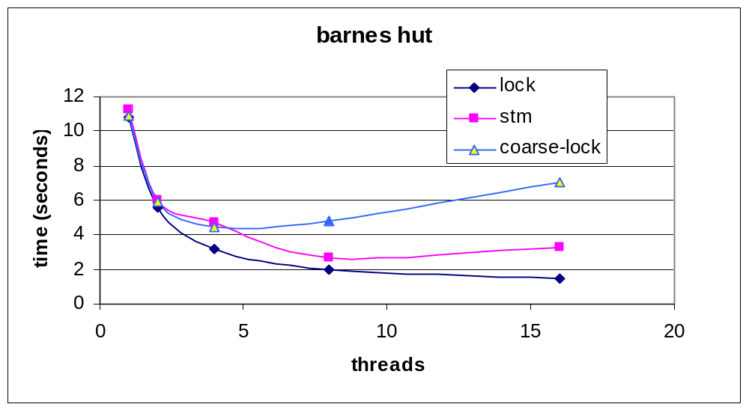
  STM is much better than coarse-grain lock (fine lock ???)

