Slide 1


Evaluating Indirect Branch Handling Mechanisms in Software Dynamic Translation Systems
Bruce Childers
Jason D. Hiser, Daniel Williams, Wei Hu, Jack W. Davidson, Jason Mars
Department of Computer Science, University of Virginia
Department of Computer Science, University of Pittsburgh

Slide 2
What is SDT?
The programmatic modification of a running program’s binary instructions
Software layer mediates program execution by modifying (translating) instructions before they execute on host CPU
Application Binary
Dynamic Translator
Uses include
Dynamic optimization (e.g., Dynamo, JITs)
Code security (e.g., diversity, shepherding)
Software migration (e.g., Apple Rosetta)
Dynamic instrumentation (e.g., Insop)
Dynamic patching & debugging (bug fixes)
And many more!
Operating System
CPU

Slide 3
SDT Overhead
More pervasive use desirable
High overhead can limit pervasive use
  Execution time, memory, disk size, network traffic
Many techniques to minimize overhead
  Traces, large code regions, branch linking, etc.
How branches are handled especially important
  Indirect branches problematic
Several IB schemes in different translators, architectures
Goal: Understand how translation mechanisms for indirect branches impact overhead, given architecture capabilities.

Slide 4
Overview
Introduction
SDT and branch handling
Indirect branch mechanisms
Evaluation
Summary

Slide 5
Software Dynamic Translation
Fragment Cache
Application Binary
Context
Capture
Dynamic Translator
Cached?
New
PC
New
Fragment
Fetch
Finished?
Decode
Context
Switch
Translate
Next PC
Direct branch
Indirect branch

Slide 6
Handling Direct Branches
Fragment Cache
Application Binary
Context
Capture
Dynamic Translator
Cached?
New
PC
New
Fragment
Fetch
Finished?
Decode
Context
Switch
Translate
Next PC
Direct branch
Fragment linking – change branch
to jump to already translated target
fragment
Indirect branch

Slide 7
Handling Indirect Branches
Fragment Cache
Application Binary
Context
Capture
Dynamic Translator
Cached?
New
PC
New
Fragment
Fetch
Finished?
Decode
Context
Switch
Translate
Next PC
Direct branch
Fragment ending with an indirect
branch that can transfer to one of
several target addresses – can’t
link the branch to the targets
Indirect branch

Slide 8
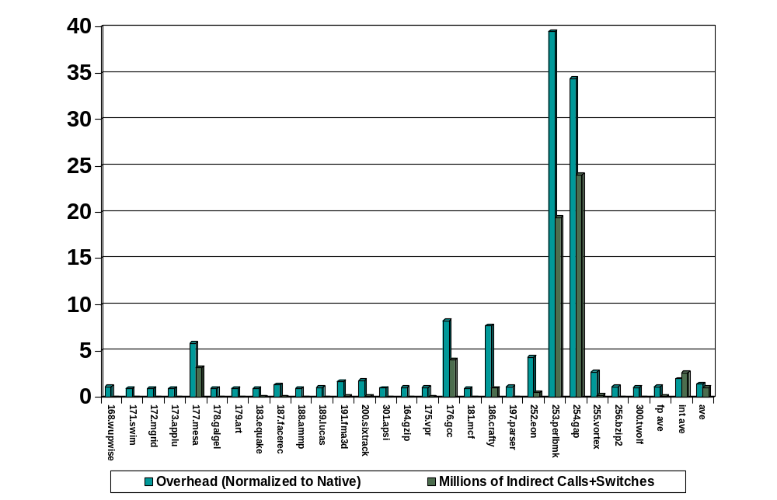
Indirect branches are rare, right?

Slide 9
Reduce Overhead due to IBs
Fragment Cache
Application Binary
Map app. address to frag. address
  Typically use a hash table
  Implemented as data or instruction sequence
  Interacts with the target machine
IB mapping implementations
  Data cache hashing: IBTC [Strata, Bruening Kim & Smith]
  Instruction cache hashing: Sieve [HDTrans]
  Combined: Inline entries [Dynamo, DAISY, Pin, Strata]
Context
Capture
Dynamic Translator
Cached?
New
PC
New
Fragment
Fetch
Finished?
Decode
Context
Switch
Translate
Next PC
Embed lookup and mapping of application address into fragment cache
Minimize amount of context to save & restore
Can be specialized to each indirect branch
Direct branch
Fragment ends with an indirect
branch that can transfer to one of
several target addresses
Indirect branch

Slide 10
Indirect Branch Translation Cache
Mapping done with table in memory (memory accesses)
  Table entry: <AppAddr, FragAddr>
Table indexed by application address
Application Binary
Fragment Cache
. . .
r1 = …
. . .
jmp r1
. . .
L0:
. . .
. . .
r1 = …
. . .
save t0, t1
t0 = hash(r1)
if (IBTC[t0].AppAddr == r1)
t1 = IBTC[t0].FragAddr
jmp t1
restore t0, t1
else
jmp translator

Slide 11
Indirect Branch Translation Cache
Table in memory
  Advantage: Small code footprint & minimal branches
  Disadvantage: Memory accesses & D-cache pressure
  Other considerations
    Uses two temporary registers & comparison
Many options
  Sharing (one for all branches or one per branch)
  Appropriate size (number of entries)
  Resizing (dynamically adjust size)
  Reprobing (where to look on collision)
  Lookup code placement
    Inline in fragment or a separate “function”

Slide 12
Sieve
Mapping done by executing instruction sequence
Sieve Table
Fragment Cache
Addr16
Addr10
Bucket2
Addr8
Frag10
Dispatch
Jmp Bucket1
Bucket1
Addr4
Frag99
Jmp Bucket4
Bucket4
Addr10
Return To
Translator
Frag111
Bucket3
Addr12
Bucket5
Addr16
Frag204
Frag16

Slide 13
Sieve
Table as an instruction sequence
  Advantage: Fewer memory accesses
  Disadvantage: More branches and possibly pressure on I-cache
  Other considerations
    Uses one temporary register
    Uses an address-sized constant compared to register
Options
  Table size
  Others possible, but seem to not matter

Slide 14
Combined: Inline Mapping
Instructions emitted at each branch to perform translation
No hashing – compare app. address against inlined addresses
Application Binary
Fragment Cache
. . .
r1 = …
. . .
jmp r1
. . .
L0:
. . .
. . .
r1 = …
. . .
save t0
t0 = APPADDR_1
if (r1 == t0)
jmp FRAGADDR_100
restore t0
t0 = APPADDR_2
if (r1 == t0)
jmp FRAGADDR_120
restore t0
<backing mechanism>

Slide 15
Combined: Inline Mapping
Inlining mappings at indirect
  Advantage: Avoids hashing, no mem. accesses, min. branches
  Disadvantage: Code growth & hit cost depends on hit entry
  Other considerations
    Possibly one register and constant address comparison to register
Options
  Number of inline entries
    Should the translator decide the amount of inlining?
  Target to inline
  Execution point when that target be selected
  Backing mechanism to use (what to do on a miss)

Slide 16
Evaluation
Common SDT platform to study indirect branch translation implementations across architectures
Strata: Retargetable framework [CGO’03, IJPP’05, VEE’06]
Three machines/OS/compiler
  UltraSparc-IIi/Solaris/SunSWPRO
  Pentium IV Xeon/Linux/gcc 3.4
  Opteron 244/Linux/gcc 4.0
SPEC 2000: mesa, gcc, crafty, eon, perlbmk, gap, and vortex
Returns are handled separately (predictable)
Slowdown compared to native execution (no translation)

Slide 17
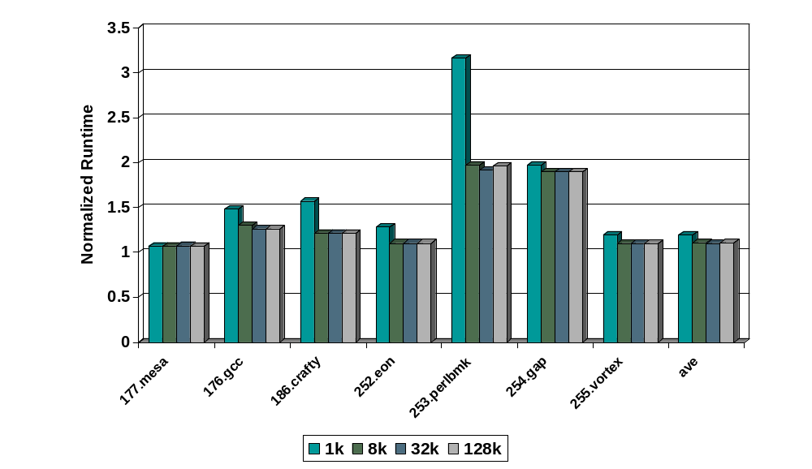
IBTC Size (P4)
Conflicts reduced by larger table size; levels off and more cost at >32K
Opteron and SPARC had similar results.

Slide 18
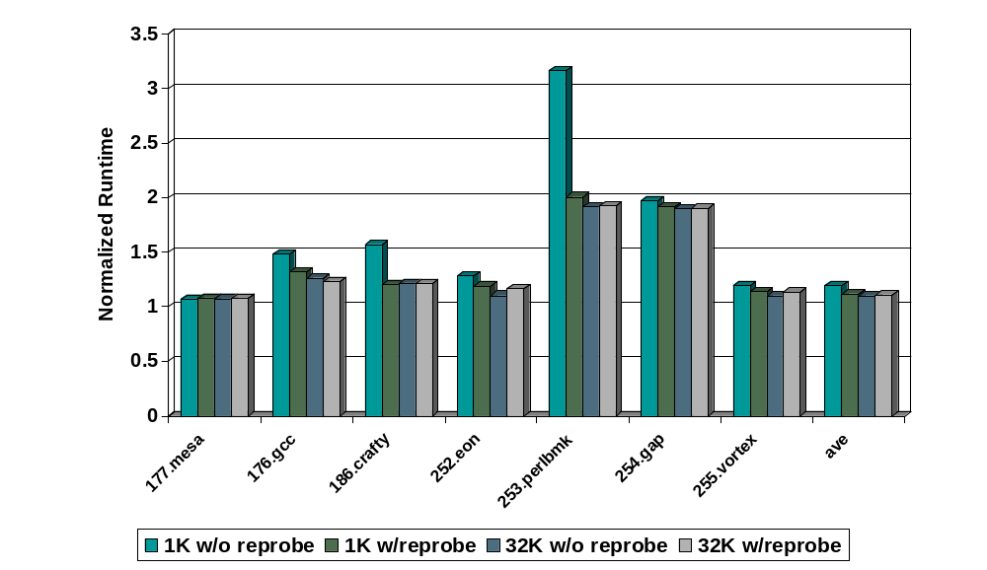
IBTC Reprobing (P4)
Conflicts reduced for 1K but increased cost not worthwhile on 32K
Opteron and SPARC had similar results.

Slide 19
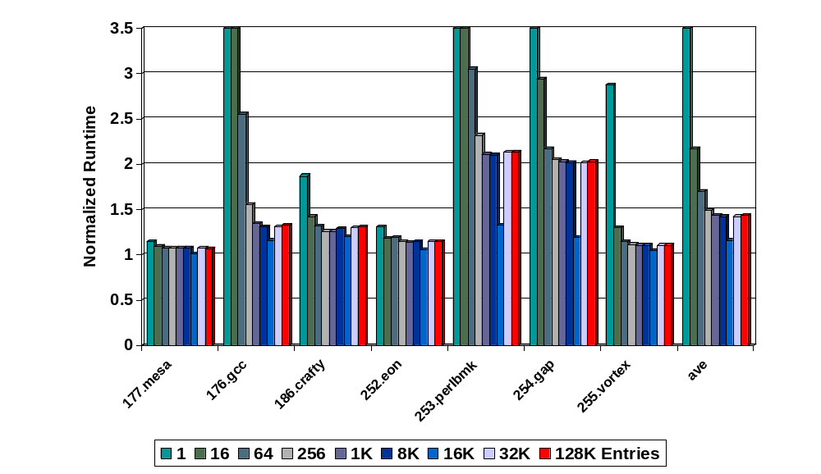
Sieve Size (P4)
Conflicts by larger table, but ISA effects restrict benefit beyond 16K
Opteron had similar results; SPARC levels off at 1K entries

Slide 20
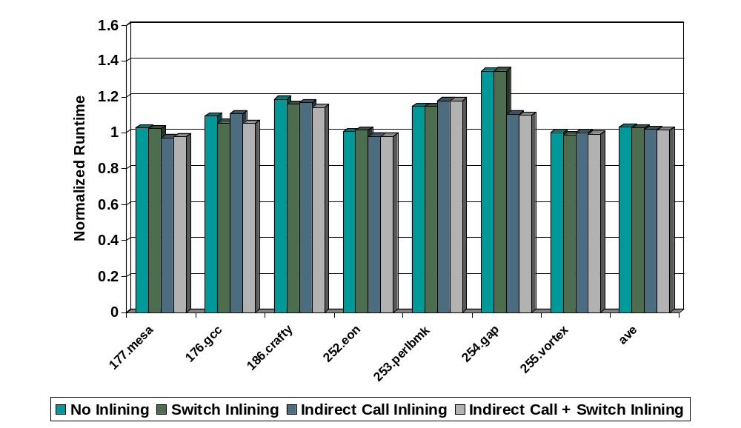
Inlining (Opteron)
Inlining helps branch predictor in some cases
P4 and SPARC have worse performance (complexity & I-cache pressure)

Slide 21
Summary
SDT is widely used and performance is important
  Good performance requires good IB handling
Evaluated IB handling techniques in an apples-to-apples comparison across three architectures
Details of the hardware dictate best method
  IBTC on SPARC’s due to limited constant size (3.5% avg SPEC)
  16K Sieve on Intel P4 to avoid eflag save (4.5% avg SPEC)
  Inlining on Opteron to help branch predictor (2.2% avg SPEC)

Slide 22
Evaluating Indirect Branch Handling Mechanisms in Software Dynamic Translation Systems
Questions?
Contact us: childers@cs.pitt.edu

