Slide 1



Persistent Code Caching
Exploiting Code Reuse
Across Executions
& Applications
Vijay Janapa Reddi†
Dan Connors‡, Robert Cohn§, Michael D. Smith†
†Harvard University | ‡University of Colorado at Boulder | §Intel Corporation

Slide 2
Runtime Compilation System
Execution environments
that provide an interface
to the dynamic instruction
stream of an application
Process
Managers
Overheads
  Runtime compilation
  Performance of the
  compiled code
Runtime
Compilation
Systems
Program
Introspection
Resource
Management
Notes:
Execution operators – change instruction stream (binary translators: pin/dynamo/daisy)
Process managers – fault tolerance/redundancy
Resource controllers – power/thermal control
Dynamic binary instrumentation can help developers fix/find bugs by providing services such as code characterization or memory error detection.

Slide 3
Managing compilation overhead via software code caching
Original dynamic
instruction stream
A
B
C
C
A
Reuse of cached code
Runtime Sys. (RS)
Code caching
RS
A’
RS
B’
RS
C’
C’
A’
Execution time
Basis: 90% execution time in 10% (hot) code
Notes:
Explain in real basic terms what the execution stream is under every execution. Use the example of open Emacs repeatedly everyday and using it the same way.
Explain the ABCCA as “code units”.

Slide 4
Problem statement
There exist execution domains where
code caching is ineffective, which limits the
deployment of runtime compilation systems
Highlight of this talk:
Challenges in deploying dynamic
binary instrumentation into production
regression testing environments
Case study of the Oracle database

Slide 5
Caching performance varies based on program behavior
Loop intensive application
181.mcf
Runtime Compilation
Code Cache
176.gcc
Large code footprint &
infrequent code re-use
Notes:
Explain what the x-axis and y-axis are, and that the black lines mean compilation requests.
Startup of the graph always has bars because that is when compilation is occurring, otherwise it is mostly empty (good).
MCF is easy because of its small footprint.
Gcc is large footprint, and despite long execution time the overhead is not easily amortized.
(Increase the vertical size of the two mcf, and cc1)

Slide 6
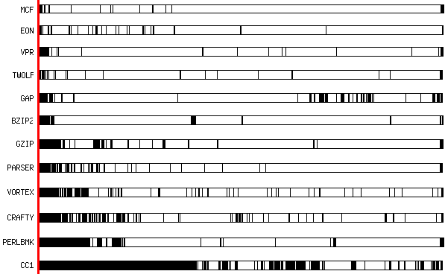
Caching performance varies based on program behavior
Loop intensive
(frequent reuse)
Mcf
Eon
Vpr
Twolf
Gap
Bzip2
Runtime Compilation
Gzip
Code Cache
Parser
Vortex
Crafty
Perl
Gcc
Large footprint
(infrequent reuse)
Normalized execution time
Notes:
Normalize the execution time.

Slide 7
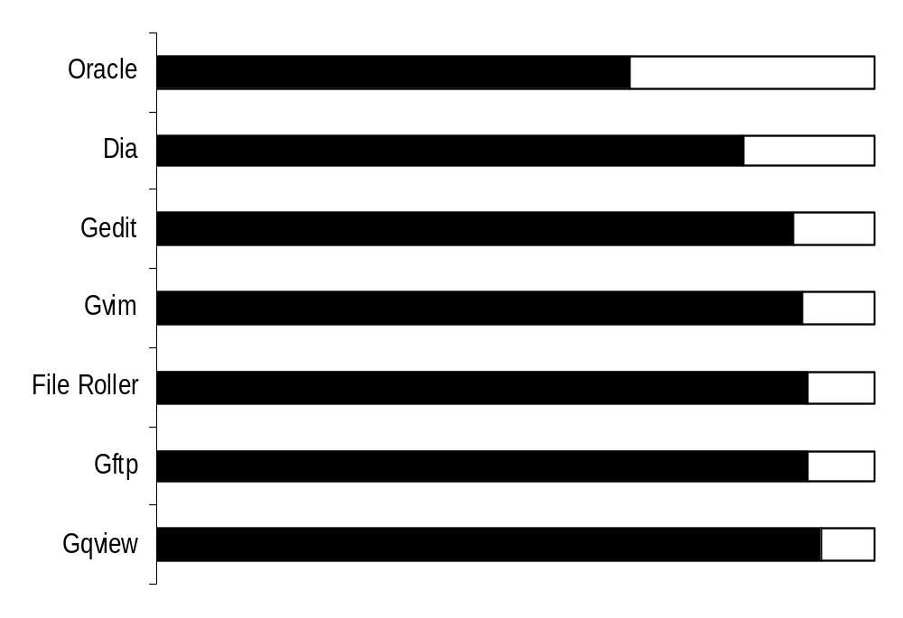
Benchmark 176.gcc is not an outlier
Oracle
Gedit
Dia
Runtime Compilation
Gvim
Code Cache
File Roller
GUI applications
- Large startup cost
- Library initialization
executed < 10 times
Gftp
Gqview
Normalized execution time
Notes:
Explain the applications as linux gui programs, and that this is only the startup phase of the programs.
Highlight that these programs are worse than Gcc in terms of the runtime system overhead.
Explain why the startup phase of these programs is so slow (make clear that there aren’t any deficiencies in Pin).
Show oracle database graph here, so that it makes it easier to justify the GUI apps showing up out of the blue.

Slide 8
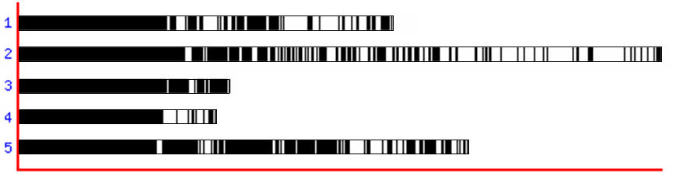
Code caching suffers under certain execution behaviors
Less code reuse
Large code footprint
Short run times
Not uncommon!
Regression testing
  Oracle (100,000 tests)
  Gcc (4000+ tests)
Cold code is hot code
across executions!!!
176.gcc
(5 SPEC reference inputs)
Execution time
Notes:
Identify when the code caches are not effective. Explain that it is not a rare case.
But when you combine cold code and reuse of persistent caches, you get hot code!
Explain how interpretation, and 2-pass compilers won’t necessarily help when they are really meant for just cold code being the rare case scenario.

Slide 9
Caching code across executions improves caching performance
Original dynamic
instruction stream
A
B
C
C
A
Caching (Run 1)
RS
A’
RS
B’
RS
C’
C’
A’
Caching (Run 2)
RS
A’
RS
B’
RS
C’
C’
A’
Persistent caching
(Run 2)
A’
B’
C’
C’
A’
Reduce overhead by
storing & reusing caches
Execution time
Notes:
Explain in real basic terms what the execution stream is under every execution. Use the example of open Emacs repeatedly everyday and using it the same way.
Should I have text on the slide for related work?

Slide 10
Implementation Framework: Pin
(Dynamic binary instrumentation)
Address Space
Client
Appropriate system for
evaluating persistence
  General model
  Robust design
  Enterprise-scale usage
Interface
Runtime System
Components
Application
Code Cache
Operating System
Hardware
Notes:
Allude to other papers for details on system components, but focus on “Pin VM” and the “Code Cache”
Explain why this system is effective to explore this idea:
General model: (Name a few systems), and state how this infrastructure is similar to DynamoRIO, Strata, HDTrans etc.
Robust: Very fine level of transparency to the application
Enterprise-scale usage: Capable of supporting large applications because of its robustness, and we can do case studies
Customizable execution: You can use the API to adapt the instrumentation, which requires fine-grained support implementation. Hence the large overheads.

Slide 11
Persistent Pin
Address Space
Client
Persistent
Cache DB
Interface
Persistence Mgr.
Pin
Components
Application
Code Cache
Persistent Cache
  Translated code
  Translation data structures
  Correctness metadata
Operating System
Hardware
Notes:
Explain the minimal extensions required to support persistence.
Highlights: Deployed on an existing system,
Capable of supporting multi- threaded and process applications
Supports w/ and w/o instrumentation.
In application by Oracle
Explain briefly what is stored offline, and how the reuse relies on metadata to verify execution.
Slide 10 -- do not have "data structures" as it is unclear whether it is program's data or pin's data.

Slide 12
Experimental setup
Input X
IA32 Linux implementation
Bounded cache (320MB)
  Applications ran unmodified
  No cache flushes occurred
Pin
Empty
Cache
Persistent
Cache X
Input ?
Pin
Persistent
Cache X
Measure
improvement
Notes:
Describe why this experiment is important, and what it proves/shows.
Explain the illustration.
- sanity checking on whether code can be successfully be reused or not.

Slide 13
Exploiting code reuse across executions and applications
Same-input
Cross-input
Cross-application
Code coverage: Bull's eye (100% reuse)
Notes:
Describe the classifications. And explain it with relation to the bullseye (100% coverage is at the middle)

Slide 14
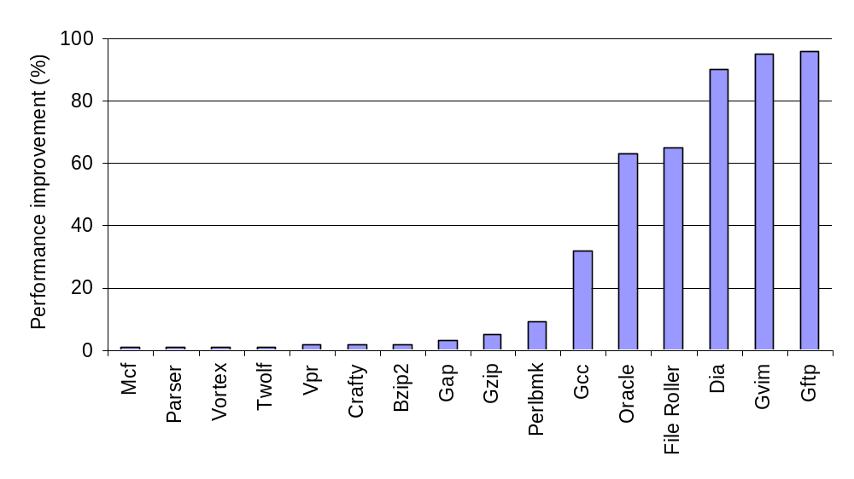
Persistent caching works across program classes
Benefits large code footprint
applications
Persistent caching is complementary
to the current code caching model
SPEC 2000 INT (Reference inputs)
Notes:
Explain that there are different types of applications, and refer to the motivation.
Describe that other than Gcc no one else incurs substantial overhead in the SPEC domain.
Focus on the fact that the large benefits is what we are shooting for, and persistence achieves the improvements.

Slide 15
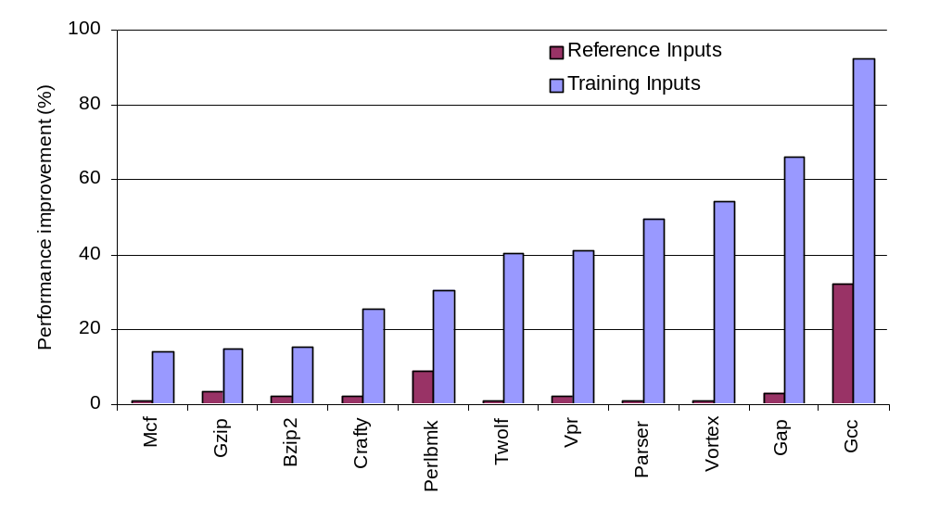
Persistent caching is effective for short-running applications
Input data set alters
program behavior
Small improvements gets bigger (Gap) and
large improvements get even larger (Gcc)
Notes:
Describe that training inputs are 6 times shorter than reference inputs, which leads to less VM overhead amortization.
Explain that by changing the input data set, we have altered the program characteristics for the same application.
Contrast Vpr, Parser, Vortex, Gap and highlight the contrasting behavior.
(circle the bars to get their attention) Shove the legend to the left, and box gap and gcc.

Slide 16
Evaluating persistent caching across program inputs
253.perlbmk
175.vpr
176.gcc
164.gzip
Oracle
256.bzip2
50%
60%
70%
80%
90%
100%
Code coverage between inputs
Notes:
Oracle
Helps illustrate production environment challenges
Large code footprint
Low coverage → Good for cross-input evaluation

Slide 17
Production environments require runtime systems improvements
Case study: Regression testing of Oracle XE
  Oracle: 80s
  Oracle +
  Pin (translation): 2000s
  Oracle +
  Pin (translation) +
  Instrumentation (memory tracing): 3000s
One unit-test!
Notes:
We have talked about fundamentals, now let us get to real production environments.
Explain what Pin and PinTool are doing.
Mention the version of the Oracle database.
Make it clear that despite the large slowdowns, oracle chooses to use pin because of the immense value it adds to their regression setup. Further more, the dynamic footprint of a runtime system is only about 300MB otherwise the static pre-translation size goes into GBs!!!

Slide 18
Oracle is a multi-process programming environment
Challenges
Oracle’s execution phases
Start
Mount
Open
Work
Close
1
Large number of
process compilations
Notes:
Explain the different phases.
State why they are all colored according to phases.
3) Explain that each circle is a process, and that they are created via fork() which is nice because they inherit their parents copy.
4) The number of processes can be very large, so it is challenging to compile them all at once.

Slide 19
Processes exhibit code sharing
Challenges
Oracle’s execution phases
Start
Mount
Open
Work
Close
1
Large number of
process compilations
2
Redundant translations
across processes
A
C
C
B
Z
A
C
C
B
Z
Notes:
1) Explain the different phases.
2) Explain every line on the figure.
2.1) Explain why the lines are colored identically.

Slide 20
Every Oracle unit-test starts a new instance of the database
Challenges
Oracle’s execution phases
Start
Mount
Open
Unit-test 1
Close
1
Large number of
process compilations
2
Every unit-test
executes all phases
Redundant translations
across processes
Start
Mount
Open
Unit-test 2
Close
3
Redundant translations
across unit-tests
Only phase changing
across all unit-tests
Notes:
1) Explain the different phases.
2) Explain every line on the figure.
2.1) Explain why the lines are colored identically.

Slide 21
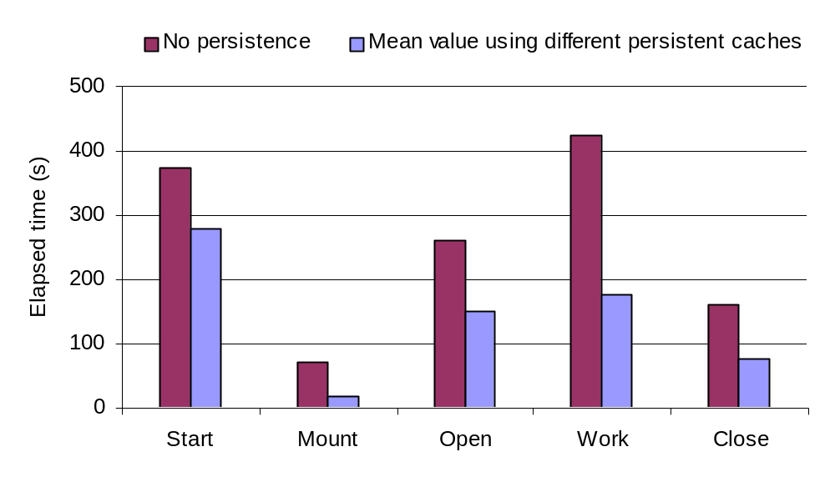
Leveraging persistence across processes
Persistent Cache (Start)
Low code coverage (15%)
Persistent Cache (Open)
High code coverage (77%)
Notes:
Add a marker at the bottom to explain the single unit test data.
Explain the bars, and the error markers.
State again, we are doing much better than running without persistence.
But then highlight the contrasting difference in performance based on the cache you choose to use.

Slide 22

Persistent Cache Accumulation (PCA) addresses limited code coverage
Input X
Input Y
Accumulate code
across executions
Pin
Empty
Cache
Pin
Persistent
Cache X
Persistent
Cache X
Persistent
Cache X+Y
Input Z
Persistent
Cache X+Y
Pin
Timed Run
Notes:
Explain how it is better to do online caching cause performance improves over time.
Why do online accumulation versus offline accumulation?
- Optimizations cannot be ported via offline mechanisms (e.g. chaining optimization relies on runtime data)

Slide 23
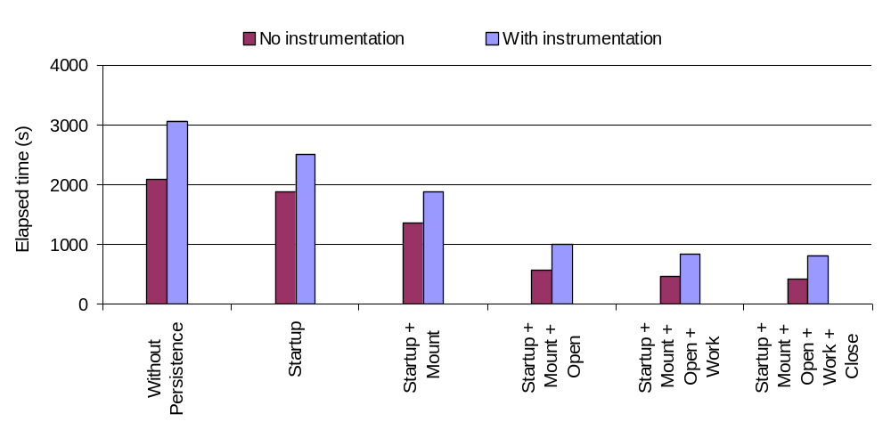
Persistent Cache Accumulation (PCA) improves unit-test performance
Performance improves with
more accumulation of code
Accumulated persistent caches
Notes:
Explain how this flow fits into the regression run.
Point specifically to the Start+Mount+Open and say how that fits in a regression model.
Explain that we have improved execution time to a point where we are able to run our tests effectively, but there is still scope for improvement.

Slide 24
Contributions:
Improved code caching
  Cold code is hot code!
  Persistence is effective
    Less code reuse
    Short run times
    Large code footprint
  Robust and performance
  efficient implementation
  Production environment regression testing study
Intra-
Execution
Inter-
Execution
Reuse
Inter-
Application
Notes:
“Now I am sure this has got people thinking, so why don’t we open the floor for questions?!”

Slide 25
Backup Slides

Slide 26
Future Research Questions
Selective persistent caching
  Cache only cold/hot code
Effectiveness of optimizations across
  Inputs
  Applications
Impact of excessive cache accumulation

Slide 27
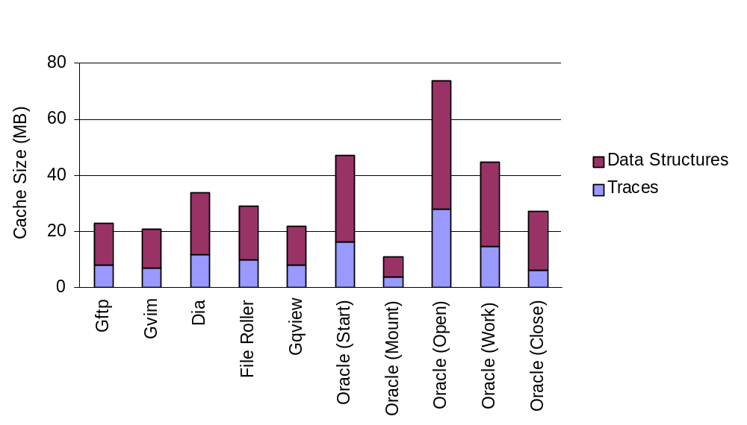
Persistent Cache Sizes:
DS is larger than CC!

Slide 28
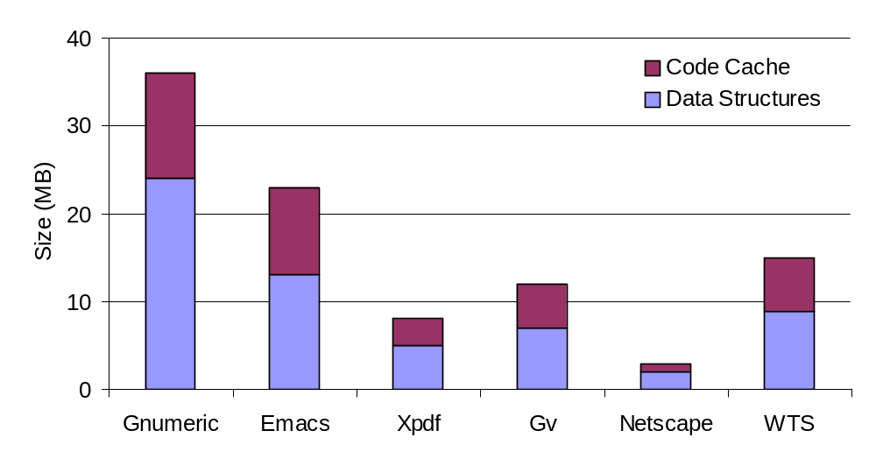
Persistent Cache Sizes:
DS is larger than CC!

Slide 29
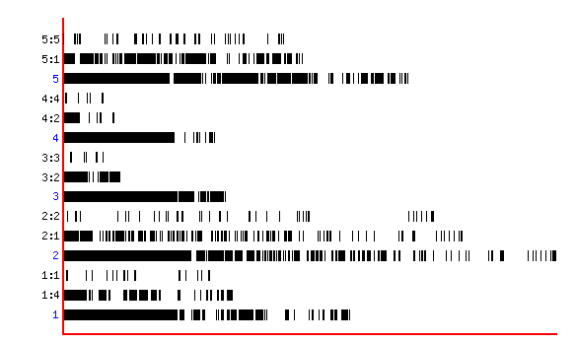
Cross-input Persistence reduces re-translation across inputs
Persistence is effective even
across changing input data sets
time
~30% improvement via Cross-input Persistence
Re-invocation w/ Persistence using a cache
from a different input for a previously unseen input
Without Persistence
Re-invocation w/ Persistence using
a previously cached execution
Notes:
What this graph is attempting to show?! Why use this graph over the raw bar graphs?

Slide 30
Persistent instrumentation issues
Dynamically allocated memory
Called upon every instruction execution
VOID Analysis(COUNTER * counter) {
(*counter) ++;
}
VOID Instrumentation(INS ins, VOID *v) {
STATS * stats = new STATS( INS_Address(ins));
INS_InsertCall(ins, IPOINT_BEFORE, AFUNPTR (Analysis), IARG_PTR, &stats->counter, …);
…
}
VOID main(INT32 argc, CHAR *argv[]) {
…
INS_AddInstrumentFunction(Instrumentation, 0);
…
PIN_StartProgram();
}
Invalid pointer during
cache reuse
Memory allocation during cache generation
Called once per instruction compilation
Solution: Allocate memory using
the Persistent Memory Allocator
Notes:
Go over how the instrumentation mechanism works.
Explain how control flow varies from regular runs to a persistent run.

Slide 31
Inter-Application exploits redundancy of library translations
Application A
Application B
Libraries (DSO)
  Initialization
  Toolkits/Pkgs
    X11
    GTK+
    FLTK
Input X
Input Y
Pin
Empty
Cache
Pin
Empty
Cache
Persistent
Cache X
Persistent
Cache Y
Input X
Input Y
Pin
Persistent
Cache Y
Pin
Persistent
Cache X
Timed Run
Notes:
Talk about how libraries are generally shipped in packages.

Slide 32
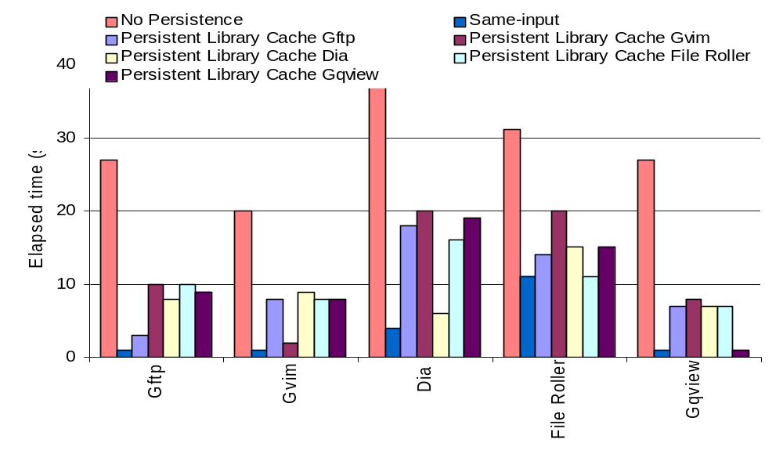
Inter-Application Persistence
~60% improvement
Verifies that large amount of time
is spent initializing library routines
Notes:
Explain the legend (persistent library cache).
Confirm how a persistent library cache alone can come really close to same-input persistence.

Slide 33
Processes exhibit code sharing
Challenges
Oracle’s execution phases
Start
Mount
Open
Work
Close
1
Large number of
process compilations
2
Redundant translations
across processes
fork()
exec()
exec() loses parent cache:
May re-translate parent code!
Notes:
1) Explain the different phases.
2) Explain every line on the figure.
2.1) Explain why the lines are colored identically.

