Slide 1
Virtual Cluster Scheduling Through the Scheduling Graph
CGO’07, San Jose, California - March 2007
Josep M. Codina
Jesús Sánchez
Antonio González
Intel Barcelona Research Center, Intel Labs - UPC

Slide 2
Clustered Architectures
Semiconductor technology is continuously improving
  New technologies pack more logic in a single chip
  Exploit more ILP → More functional units, registers, etc.
  Faster clock cycles
Current/future challenges in processor design
  Delay in the transmission of signals
  Power consumption
Clustering: divide the system in semi-independent units
  Each unit ⇒ Cluster
    Fast interconnects intra-cluster
    Slow interconnects inter-clusters
Common trend in commercial VLIW processors
    Equator’s MAP1000, TI TMS320C6x, ADI TigerSharc, HP/ST’s Lx, …

Slide 3
Overview of the Architecture
Clustered VLIW processor
Register buses
REGISTER FILE
CLUSTER
1
CLUSTER
2
CLUSTER
N
INT
INT
FP
FP
MEM
MEM
DATA CACHE
DATA CACHE
MAIN MEMORY

Slide 4
Clustered VLIW Processors
Performance relies on the Compiler
Code generation:
  Instruction Scheduling
  Register Allocation
  Cluster Assignment
    Hide delay due to inter-cluster communications
Phase-ordering problem
  Decisions made for one task constraint possible decisions on the others
    Single-Phase approach

Slide 5
Phase-Ordering Alternatives
Previous Work
  First Assign then schedule
    Accurate information of the assignment when scheduling
    However, schedule is constrained for the assignment
  Instructions scheduled and assigned at the same time
    Partially alleviates the ordering constraints
    However, no information from one task when performing the other
Our Approach
  Perform both tasks at the same time but decisions aimed at assignment are delayed
    Accurate scheduling information when performing final assignment
  First instructions scheduled
    Partial assignment is built with the consequences of the scheduling decisions
      If a scheduling decision is not appropriate for assignment can be discarded
  Then, final assignment is performed

Slide 6
Talk Outline
Proposed algorithm
  Overview
  Scheduling Graph
  Virtual Clusters
  Deduction Process
Performance evaluation
Conclusions

Slide 7
Proposal Overview
Superblock Scheduling
  Single entry multiple exits
  GOAL: Minimize Average Weighted Completion Time (AWCT)
    Cycles between the entry and each exit weighted by the exit probability
    Our scheme enumerates AWCT
Data Dependence Graph
Estart(B0) = 3 Estart(B1) = 6 Estart(B2) = 8
MinAWCT = 0.1 * 3 + 0.2 * 6 + 0.7 * 8 = 7.1
I0
I1
I2
Estart(B0) = 3 Estart(B1) = 7 Estart(B2) = 8
AWCT = 0.1 * 3 + 0.2 * 6 + 0.7 * 8 = 7.3
B0
I3
0.1
I4
B1
Estart(B0) = 3 Estart(B1) = 7 Estart(B2) = 9
AWCT = 0.1 * 3 + 0.2 * 7 + 0.7 * 9 = 8
0.2
Inst B and I fully pipelined
  Latency(B) = 3
  Latency(I) = 2
Issue-with: 2 I, 1 B
B2
0.7

Slide 8
Proposal Overview
Superblock Scheduling
  Single entry multiple exits
  GOAL: Minimize Average Weighted Completion Time (AWCT)
    Cycles between the entry and each exit weighted by the exit probability
    Our scheme enumerates AWCT
Single-phase approach scheduling and cluster assignment
  Delaying the cluster assignment decisions
    More information of the scheduling when making assignment decisions
    Impact of scheduling over assignment discovered and managed
Main ingredients
  Scheduling Graph
    Describes all possible schedules
  Virtual Clusters
    Enable delaying the cluster assignment by keeping partial assignment
  Deduction Process
    Discovers most of the consequences of any decisions made

Slide 9
Ingredient 1: Scheduling Graph
Describes all possible schedules
  Contains all feasible combinations between inst pairs that may overlap
Combinations are feasible depending on
  Dependences
  Resources
  For a particular AWCT, estart and lstart
Undirected Graph
  Same nodes as DDG
  An edge (v, w) means execution of v and w can be overlapped
    Labels at every edge are the set of combinations
0
I
-1
B
-2
B
I
B
B
I
I
1
Assume B < I
Notes:
Que quedi clar Overlapping

Slide 10
Scheduling Based on SG
Choose some combinations while discard others
  Chosen combinations create complex instructions
Schedule each complex instruction in a cycle
Data Dependence Graph
Scheduling Graph
I0
Cyc | FU1 | FU2 | Br
0 | I0
1
2 | I1 | I2
3
4 | I3 |  | B0
5
6 |  |  | B1
7 | I4
8
9 |  |  | B2
10
11
I0
I0
I1
1
0
I2
I1
I2
I1
I2
3
2
4
B0
0
I3
B0
I3
-2
B0
I3
6
5
I4
-1
B1
I4
B1
B2
7
B1
I4
B2
Edges | Comb
1,2 | -1, 0, 1
3,4,6 | -2, -1, 0, 1
5,7 | -2, -1
Instructions B and I fully pipelined
  Latency(B) = 3
  Latency(I) = 2
Issue-with: 2 I, 1 B
B2
Notes:
Combinacions seleccionades
Borrar la taula

Slide 11
Ingredient 2: Virtual Clusters
Virtual Cluster
  Set of instructions to be mapped into the same physical cluster
  Multiple virtual clusters can be mapped into the same physical cluster
  However, not all virtual clusters can be mapped into the same phsical cluster
    Not enough resources to accommodate both VCs in the same physical cluster
VCG: Undirected Graph
  Each node is a virtual cluster
  When an edge (VC1,VC2) exists, VC1 and VC2 are incompatible
    VC1 and VC2 must be mapped into different physical clusters
VCG managed by the deduction process
  Clusters are fused
  Clusters become incompatible
  Communications are added
    When a pair producer-consumer belong to incompatible clusters

Slide 12
Ingredient 3: Deduction Process
Every decision considered is submitted to the deduction process
  Discovers most of the consequences of any decisions
    Improves the knowledge to make appropriate decisions
  Anticipate invalid decisions
    Avoid non-valid schedules in advance
Process based on rules
  Interaction between resources and dependences
  Cluster assignment
A rule
  Takes a decision or a change on the state as a input
  Examines the current state
  Concludes mandatory changes to apply over the state
Decision
Scheduling
State
Deduction
Process
VC1
VC2
I1
I2
A communication
is required
either I1→I0 or I2→I0
Scheduling
State’
Rule
Concludes
I0

Slide 13
Ingredient 3: Deduction Process
Every decision considered is submitted to the deduction process
  Discovers most of the consequences of any decisions
    Improves the knowledge to make appropriate decisions
  Anticipate invalid decisions
    Avoid non-valid schedules in advance
Process based on rules
  Interaction between resources and dependences
  Cluster assignment
A rule
  Takes a decision or a change on the state as a input
  Examines the current state
  Concludes mandatory changes to apply over the state
Changes feed back to the process
  Consequences of consequences discovered
  Process finishes when no change to be treated
Decision
Scheduling
State
Deduction
Process
Scheduling
State’

Slide 14
Algorithm Overview
DDG
Compute SG
  Dependences
  Resources
Compute
Scheduling Graph
Compute Virtual
Clusters Graph
Deduction
Process
Compute
minAWCT
Set
AWCT = minAWCT
Set Scheduling
State for AWCT
Find a Schedule
For AWCT
NO
Valid
Schedule
YES
Increase
AWCT

Slide 15
Algorithm Overview
DDG
Compute VCG
  Each instruction has its own VC
Compute
Scheduling Graph
Compute Virtual
Clusters Graph
Deduction
Process
Compute
minAWCT
Set
AWCT = minAWCT
Set Scheduling
State for AWCT
Find a Schedule
For AWCT
NO
Valid
Schedule
YES
Increase
AWCT

Slide 16
Algorithm Overview
Set Scheduling State
  AWCT constraints the cycles where instructions can be scheduled and so the SG
  DP used to obtain accurate initial state
DDG
minAWCT
  Enhanced through DP
Compute
Scheduling Graph
Compute Virtual
Clusters Graph
Deduction
Process
Compute
minAWCT
Set
AWCT = minAWCT
Enumerate AWCT
Set Scheduling
State for AWCT
Find a Schedule
For AWCT
NO
Valid
Schedule
YES
Increase
AWCT

Slide 17
Algorithm Overview
Find a Schedule
  DP provides knowledge on the consequences of a candidate
  Simple widely used heuristics to select among the candidates based on the outcome of the DP
    Num of communications
    Compact code
  The success of the decision making relies on the DP
DDG
Combination
Complex instruction
Pair of virtual clusters
Select
Candidates
Compute
Scheduling Graph
Compute Virtual
Clusters Graph
Study each
Candidate
Deduction
Process
Compute
minAWCT
Take a decision
over a Candidate
Set
AWCT = minAWCT
Set Scheduling
State for AWCT
Find a Schedule
For AWCT
NO
Valid
Schedule
YES
Increase
AWCT

Slide 18
Algorithm Overview
A schedule is valid if:
  All virtual clusters have been mapped
  All combinations have been chosen or discarded
  All instructions have been scheduled in one cycle
  A combination has been chosen for all pairs of overlapping instructions
DDG
Compute
Scheduling Graph
Compute Virtual
Clusters Graph
Deduction
Process
Compute
minAWCT
Set
AWCT = minAWCT
Set Scheduling
State for AWCT
Find a Schedule
For AWCT
NO
Valid
Schedule
YES
Increase
AWCT

Slide 19
Algorithm Overview
DDG
Increase AWCT
  The next valid AWCT value is considered
Compute
Scheduling Graph
Compute Virtual
Clusters Graph
Deduction
Process
Compute
minAWCT
Set
AWCT = minAWCT
Enumerate AWCT
Set Scheduling
State for AWCT
Find a Schedule
For AWCT
NO
Valid
Schedule
YES
Increase
AWCT

Slide 20
Experimental Environment
CARS
  Single-Phase approach
    List-schedule giving priority to instructions in the critical path of the DG
    Schedules and Assigns instructions at the same time
    For each instruction,
      the scheduling cycle for each cluster is computed
      the cluster that allows for the schedule of the instruction in the earliest cycle is selected
      instruction becomes assigned and scheduled in the selected cluster
  In contrast to our approach
    It does not study the consequences before making a decision
    It simply updates the estart of all successors as a consequence of a decision to the scheduling state

Slide 21
Experimental Environment
Impact compiler
Profiling information
  on the superblock exit probabilities
  execution frequency of each superblock
Configurations
  Three different ones
    2-clusters 1 Interconnect Bus with 1 cycle latency
    4-clusters 1 Interconnect Bus with 1 cycle latency
    4-clusters 1 Interconnect Bus with 2 cycle latency
  Each cluster able to execute 1 Int, 1 FP, 1 Mem, 1 Branch
  Perfect Memory
  Non-constrained number of registers
Benchmarks 7 SpecInt95 and 7 MediaBench

Slide 22
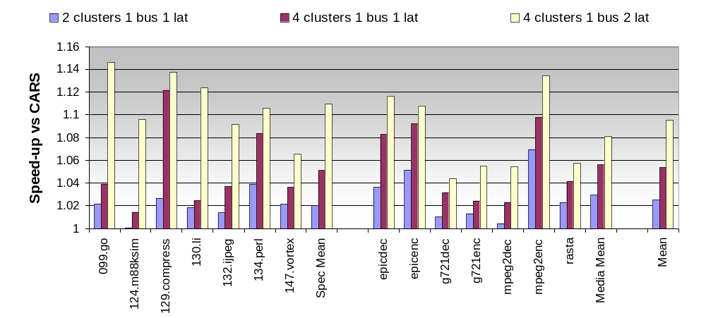
Performance Results
We perform better than CARS for all benchmarks and configurations
Similar trends when comparing speedups obtained with SpecInt and MediaBench
The more aggressive the architecture is the higher the benefits of our approach
  Specially when extra complexity on exploiting the resources (e.g. bus latency 2)
Notes:
No hi ha slowdown

Slide 23
Conclusions
Single-phase scheduling and cluster assignment
  Delaying the cluster assignment
Key features
  Scheduling Graphs
  Virtual Clusters
  Deduction Process
Our approach applied to superblocks performs better than CARS
  Avg speedup close 10% for 4 clusters 1 bus latency 2
  Up to 14% for some programs
Improvements come from
  More information of the effects of all decisions made
    Reducing the probabilities to made erroneous decisions
  Allowing for a better interaction between scheduling and assignment

Slide 24
Virtual Cluster Scheduling Through the Scheduling Graph
CGO’07, San Jose, California - March 2007
Josep M. Codina
Jesús Sánchez
Antonio González
Intel Barcelona Research Center, Intel Labs - UPC

