Slide 1
Performance Overheads In Real-Time Java Programs
Mark Stoodley and Mike Fulton
Compilation Technology
IBM Toronto Lab

Slide 2
Outline
What is Real Time?
Java and Real-Time Systems
IBM WebSphere Real Time
Overheads
Some Preliminary Results
Summary

Slide 3
What is a “Real Time” Application
Characterized by activities that have deadlines
  Often involve interactions with physical world
Several facets to real-time requirements
  Fault tolerance: what happens when deadline missed?
  Level of determinism: allowable variance?
  Response time: how long do we have?
Maxim: real-time is not just real-fast
Not just embedded systems
  Transaction processing, complex middleware systems

Slide 4
Traditional Java and Real Time Systems
Real-Time systems need deterministic behaviour
  Predictable performance enables robust design
Determinism not one of Java’s strengths
  Class loading, garbage collection, JIT compilation
Traditional performance focus on average case
  Worst case performance matters more for real-time apps
Must balance determinism and raw performance
  Customers say “real-slow is not real-good”
Notes:
Determinism needed to varying degrees, but all real-time systems need some degree of determinism to support robust design
Many dynamic activities not under programmer control in traditional Java systems (listed on slide)
Last decade has seen tremendous improvement in Java programs by targeting average case performance, often sacrificing worst-case performance, but real-time systems care more about worst-case performance
Engineering deterministic performance is critically important for Java to become a realistic option in RT space, but it brings with it a throughput hit (though we’re working to reduce that hit)
As compiler engineers, we often tell the story that “real-time is not real-fast”, but we need to recognize that customers say “real-slow is not real good”
need

Slide 5
The Real Time Specification for Java (RTSJ)
JSR #1
Augments Java with tools to engineer RT systems
  Threading, scheduling, memory management, event handling, asynchrony, time, physical memory access
Large and complex specification
  470 pages! (JVM spec is 472 pages)
No syntax changes to the language
  Substantial new class library support
  JVM implementation and OS implications
Notes:
Some might argue that no syntax changes is bad and makes programming model more cumbersome to use, but it also means that the huge body of JCL and third class library code can (largely) be reused.

Slide 6
Example: Realtime and NoHeapRealtime Threads
RTSJ introduces new RealtimeThread class
  Extends java/lang/Thread
  Can specify scheduling policies, release parameters
Also NoHeapRealtimeThread
  Extends RealtimeThread
  Created for tasks that cannot tolerate GC interruptions
  NHRTs not allowed to observe heap references
  New programmer-managed memory areas introduced
    Immortal, scopes
Notes:
Because NHRTs cannot tolerate GC interruptions, they are not allowed to access the heap (so no need to synchronize with GC)
New memory areas needed so that NHRTs can allocate objects and do work.

Slide 7
IBM WebSphere Real Time
Released end of August 2006
Fully compliant RTSJ implementation
  Built on IBM’s J9 virtual machine technology
Engineered to meet customer requirements over and above what’s required by the RTSJ
Significant new features:
  Real-time Linux kernel patches (open source model)
  Metronome deterministic GC
  Ahead-Of-Time (AOT) native code compilation
Notes:
JCK1.0

Slide 8
Overheads in Real-Time Native Code
Overheads for RTSJ
  NoHeapRealtimeThread memory checks
  Scope memory checks
  Asynchronous Transfer of Control support
Overheads for Metronome GC
  GC is incremental so need write barriers
  Arraylets object model
  If defragmentation supported, need read barriers
Not strictly “overheads”, but:
  Many optimizations also disabled to promote determinism
  Ahead-Of-Time compiled code typically slower than JITed code
Notes:
Sorry, only time to look at one type of overhead…the paper discusses more of these plus some that aren’t mentioned here.

Slide 9
NoHeapRealtimeThread (NHRT) Memory Checks
NHRTs cannot load heap references
  Exception must be thrown if heap reference found
NHRT checks inserted all over the place, ahead of
  Parameter loads
  Instance and static field loads
  Call returns
  Reference array element loads
  Exception object load
  (New object allocations)

Slide 10
Generated Code for NHRTCheck operation
NHRTCheck: test [ebp+#flags], #bitmask ; thread is NHRT?
jz CheckDone
cmp eax, <heap base>
jb CheckDone
cmp eax, <heap top>
ja CheckDone
push ebp ; found heap ref, need to throw
push eax ; MemoryAccessError exception
call jitThrowMemoryAccessError
CheckDone:
Notes:
We generate only one version of a method; we do not generate a NHRT version of foo() and a non-NHRT version of foo()
Therefore, must check if current thread is NHRT before executing the check (flags field stored in thread structure pointed to by EBP)
EAX is the register holding the reference just materialized…it could be any register, really, except ebp
<heap base> and <heap top> are constants since Metronome GC does not currently support movable or noncontiguous heap
The actual exception is thrown via the jitThrowMemoryAccessError runtime function since allocating and initializing an exception object would require too much code to be inserted at each check.
Talk about the red branch on the next slide (notice it’s a forward taken branch for non-NHRTs)

Slide 11
Why not put reference check into a snippet?
Motivation: most threads are not NHRTs
  We discourage this thread type unless truly needed
NHRTChecks are plentiful
  number of branches overloads processor’s BHT
  Processor resorts to default forward branch prediction: fall-through
  Only gets it right for NHRTs ☹
Natural candidate for snippet generation

Slide 12
NHRTCheck operation with heap ref snippet
NHRTCheck: test [ebp+#flags], #bitmask ; thread is NHRT?
jnz Snippet
CheckDone: …
Snippet: cmp eax, <heap base>
jb CheckDone
cmp eax, <heap top>
ja CheckDone
push ebp ; found heap ref, need to throw
push eax ; MemoryAccessError exception
call jitThrowMemoryAccessError
Notes:
Isn’t this non-deterministic? Probably no worse than before. programmers don’t expect non-NHRTs to be affected by NHRT check
NHRTs are the threads that expect best determinism: making them pay for the memory check is reasonable (even if it includes a mispredict penalty).
Trade-off here: throughput performance for non-NHRTs versus a size penalty. All branches before were < 128 bytes away so could use 2-byte instructions. Now all three branches are likely > 128 bytes so need 4-byte instructions (remember, there are a lot of these checks, so the different adds up pretty quickly).

Slide 13
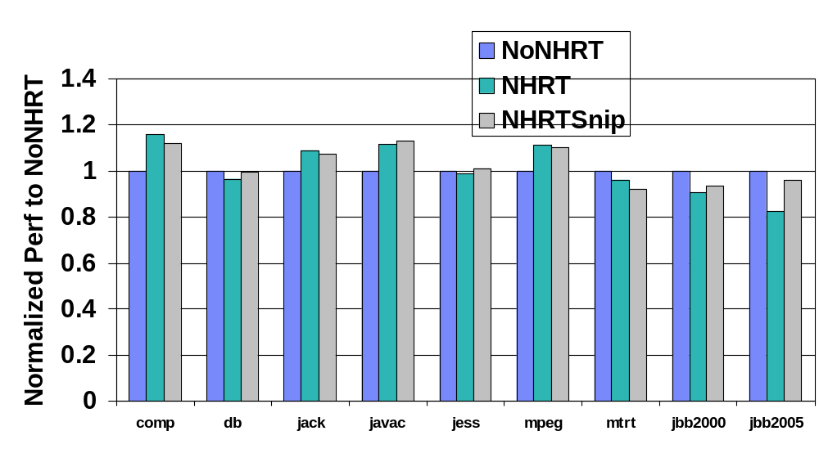
Performance Results
Lower is better
Higher is better
Notes:
Normalized performance means ratio of best times for jvm98 benchmarks (lower is better), ratio of total throughput scores for jbb2000 and jbb2005 (higher is better)
Trend mostly shows the presence of NHRT checks makes performance worse. Putting the reference check into a snippet mostly helps.
Notable outliers: db,mtrt
On average across jvm98 benchmarks: 5.5% worse when NHRT checks introduced, snippets save roughly 1.5% of that.
For jbb2000,jbb2005 benchmarks: 9.5% and 18% overhead due to NHRT checks, with 3.5% and 14% recovery by using snippets.
Of these benchmarks, jbb2005 is probably the most important result since it is closest to modern application design.

Slide 14
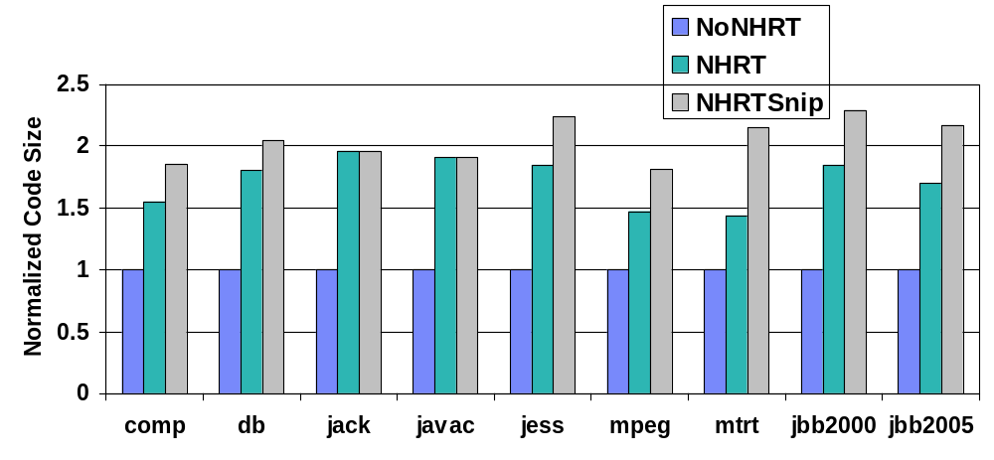
Code Size Results
Lower is better
Notes:
This may not seem like an impressive story: in many cases, the code size more than doubles when NHRT checks are placed into snippets due to the high frequency of these checks in the code. Nonetheless, it’s still much better than the alternative of generating two copies of the method since that solution includes both the blue and most of a yellow or grey bar!
There are cases where snippets don’t hurt, though snippets never result in lower code size. There is a counter-balancing effect where some branches that cross over a lot of NHRTchecks can fit into 127 bytes once the reference check is moved out-of-line. There are further improvements possible here: testing the NHRT flag bit could be done better (flag bits could be moved closer to start of thread structure and the NHRT bit could be moved into the first 8 bits).

Slide 15
Summary
Real-time applications need determinism
Java not traditionally suitable for RT systems
  RTSJ plus new technologies like Metronome GC and Ahead-Of-Time compilation making it possible
Deterministic performance has overheads
  Many sources (RTSJ, Metronome, disabled opts)
NHRT checks should be implemented in snippets
  Recovers some perf overhead without growing code size astronomically

Slide 16
Got Questions?
Mark Stoodley
IBM Toronto Lab
mstoodle@ca.ibm.com

Slide 17
Backup slides

Slide 18
Grand Challenge: Transparent Real-time Java
C++ Application
Java Application
Java Application
Garbage
Collection
Java Runtime System
(JVM)
Metronome
Java Runtime System
C++ Runtime System
Manual, Unsafe
Predictable
Automatic, Safe
Unpredictable
Automatic, Safe
Predictable
Notes:
Traditional real-time development occurs in something like the C++ picture on the left, where application are built on top of a thin runtime layer that provides little in the way of support for building real-time systems, other than by being thin and, to some extent, predictable. The blue bars here represent memory allocation activities, which must be completely managed by the programmer inside the big green box. This arrangement allows predictable systems to be engineered, but primarily in a manual way that can be very difficult to get right because there are few safety features.
The middle diagram shows the traditional Java runtime environment, with a much fatter runtime layer that includes substantial class librariers that enables applications to be developed with much less work from the programmer (green box). The runtime system manages memory which frees the Java programmer from worrying about when memory should be freed. This runtime system provides a higher level of safety and support for memory management, but dynamic elements such as the garbage collector and JIT compiler contribute substantially to unpredictability.
The diagram on the right shows the ultimate goal for real-time development: a fat run-time with support for memory management and extensive Java class libraries that enables the real-time application writer to focus more on the particular activities of the application rather than memory management. A deterministic garbage collector, such as Metronome, provides predictable performance that the application designer can rely on to build a robust system. Native code compilation, through an adapted JIT compiler or AOT compilation, does not impact program behaviour while still providing native code performance.

Slide 19
WRT Architecture
Java SE 5.0 Libraries
Java
jar
Real-time
library
Bind
Compile
J9 VM
Real-time GC
Metronome
Real-time
JIT
Bound
jar
Real-time Linux (Based on RedHat 4.2)
X86-32 Opteron (4-way SMP)
Real-time feature (“-Xrealtime”)
Standard J9 component

Slide 20
The Easy Stuff
Disable speculative optimizations
Lower priority of JIT compiler
  Below priority of any real-time activity
  But higher than any non-real-time activity
Sampling thread still has very high priority
  Does very little work so impact is not high
Suitable for “softer” real-time environments with “looser” timing requirements

Slide 21
When JIT effects cannot be tolerated
Ahead-Of-Time compilation technology
Generate native code statically
  Throw away platform neutrality
  No compilation or sampling thread active at runtime
Java conformance has a performance cost
  All references unresolved
  Optimizer largely hamstrung (but not always)

Slide 22
Real-Time Linux
Customized kernel, fully open-source
Fully preemptible kernel
Threaded interrupt handlers for reduced latency
SMP real-time scheduling
High resolution timers
Priority inheritance support to avoid inversion
Robust and fast user-space mutex support

