Slide 1
Compiler-Directed Variable Latency Aware SPM Management To Cope With Timing Problems
O. Ozturk, G. Chen, M. Kandemir
Pennsylvania State University, USA
M. Karakoy
Imperial College, UK

Slide 2
Outline
Motivation
Background
Block-Level Reuse Vectors
SPM Management Schemes
Experimental Evaluation
Summary and Ongoing Work

Slide 3
Motivation (1/3)
Nanometer scale CMOS circuits work under tight operating margins
  Sensitivity to minor changes during fabrication
  Highly susceptible to any process and environmental variability
Disparity between design goals and manufacturing results
  Called process variations
  Impacts on both timing and power characteristics

Slide 4
Motivation (2/3)
Execution/access latencies of the identically-designed components can be different
More severe in memory components
  Built using minimum sized transistors for density concerns
Number of Occurrences
Δ - δ₁
targeted
latency
(Δ)
Δ + δ₂
Latency

Slide 5
Motivation (3/3)
Conservative or worst-case design option
  Increase the number of clock cycles required to access memory components, or
  Increase the clock cycle time of the CPU
  Easy to implement
  Results in performance loss
Performance loss caused by the worst-case design option is continuously increasing [Borkar ‘05]
Alternate solutions?
  Drop the worst case design paradigm
  We study this option in the context of SPMs

Slide 6
Background on SPMs
Software managed on-chip memory with fast access latency and low power consumption
Frequently used in embedded computing
  Allows accurate latency prediction
  Can be more power efficient than conventional caches
Can be used along with caches
Prior work
  Management dimension
    Static [Panda et al ‘97] vs. dynamic [Kandemir et al ‘01]
  Architecture dimension
    Pure [Benini et al ’00] vs. hybrid [Verma et al ‘04]
  Access type dimension
    Instruction [Steinke et al ’00], data [Wang et al ’00], or both [Steinke et al ’02]

Slide 7
SPM Based Architecture
Instruction Cache
Memory
Processor
Address Space
Data Cache
SPM

Slide 8
Background on Variations
Process vs. environmental
Process variations
  Die-to-die vs. within-die
  Systematic vs. random
Prior work
  [Nassif ’98], [Agarwal et al ’05], [Borkar et al’06], [Choi et al ’04], [Unsal et al ’06]
  Corner analysis
  Statistical timing analysis
  Improved circuit layouts
  Variation aware modeling and design

Slide 9
Our Goal
Improve SPM performance as much as possible without causing any access timing failures
Use circuit level techniques [Gregg 2004, Tschanz 2002] that can be used to change the latency of individual SPM lines
Key Factor: Power consumption
line 1
high
latency
line 2
line 3
line 4
low
latency
line 5
line 6
line 7
SPM

Slide 10
How to Capture Access Latencies?
An open problem in terms of both mechanisms and granularity
One option is to extend conventional March Test to encode the latency of SPM lines (blocks) [Chen ’05]
  Latency value would probably be binary (low latency vs. high latency)
  Space overhead involved in storing such table in memory (or in hardware) is minimal
  March test is performed only once per SPM
Can be done dynamically as well [work at IMEC]

Slide 11
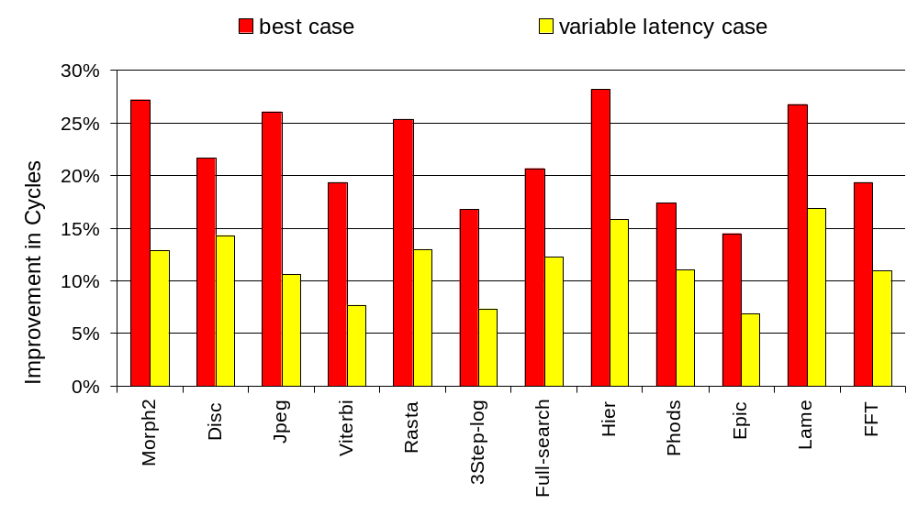
Performance Results (with 50%-50% Latency Map)
Average Values:
Best Case:21.9%
Variable Latency Case:11.6%

Slide 12
Reuse and Locality
Element-wise reuse
  Self temporal reuse: an array reference in a loop nest accesses the same data in different loop iterations
  Self spatial reuse: an array reference accesses nearby
  data in different iterations
Block-level reuse
  Each block (tile) of data is considered as if it is a single element
SPM locality problem
  Accessing most of the blocks from low latency SPM
  Problem: Convert block-level reuse into SPM locality

Slide 13
Block-Level Reuse Vectors
Block iteration vector (BIV)
  Each entry has a value from the block iterator
Block-level reuse vector (BRV)
  Difference between two BIVs that access the same data block
  Captures block reuse distance
Next reuse vector (NRV)
  Difference between the next use of the block and the current execution point

Slide 14
Data Block Ranking Based on NRVs (1/2)
Use NRVs to rank different data blocks
To create space in an SPM line, block(s) with largest NRV is (are) selected as victim for replacement [DAC 2003]
Schedule for block transfers
  Schedules built at compile-time
  Executed at run-time
  Conservative when conditional flow concerned

Slide 15
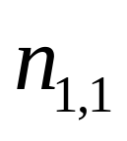
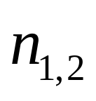
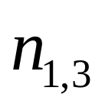
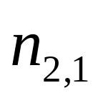
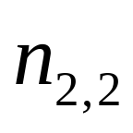
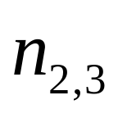
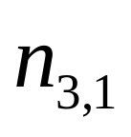
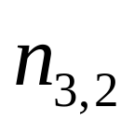
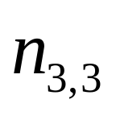
Data Block Ranking Based on NRVs (2/2)
Sorting NRVs:
L1
L2
L3

Slide 16
SPM Management Schemes (1/2)
Scheme-0: Data blocks are loaded into the SPM as long as there is available space
  State-of-the-art SPM management strategy (worst-case design option)
  Victim to be evicted → Largest NRV
  Does not consider the latency variance across different locations
Scheme-I: Latency of each SPM line (the physical location) is available to the compiler
  Select the SPM line with the smallest latency that contains a data block whose NRV is larger
  Send the victim off-chip memory
  Considers the delay of the SPM lines
Off-Chip
SPM
1
2
Off-Chip
SPM
L₁
1
L₂
L₃
2
L₄

Slide 17
SPM Management Schemes (2/2)
Scheme-II: Do not send the victim block to off-chip memory
  Find another SPM-line with a larger latency than the victim
Off-Chip
SPM
L₁
1
L₂
L₃
2
3
L₄
4

Slide 18
Experimental Setup
SPM
  Capacity: 16KB
  Access time:
    Low latency → 2 cycles
    High latency → 3 cycles
  Line size: 256B
  Energy: 0.259nJ/access
Main memory (off-chip)
  Capacity: 128MB
  Access time: 100 cycles
  Energy: 293.3nJ/access
Block distribution
  50% - 50%
Tools
  SimpleScalar, SUIF
Benchmark | Description
Morph2 | Morphological operations and edge enhancement
Disc | Speech/music discriminator
Viterbi | A graphical Viterbi decoder
Jpeg | Compression for still images
3step-log | Logarithmic search motion estimation
Rasta | Speech recognition
Full-search | DES crypto algorithm
Phods | Parallel hierarchical motion estimation
Hier | Motion estimation algorithm
Epic | Image data compression
Lame | MP3 encoder
FFT | Fast Fourier transform

Slide 19
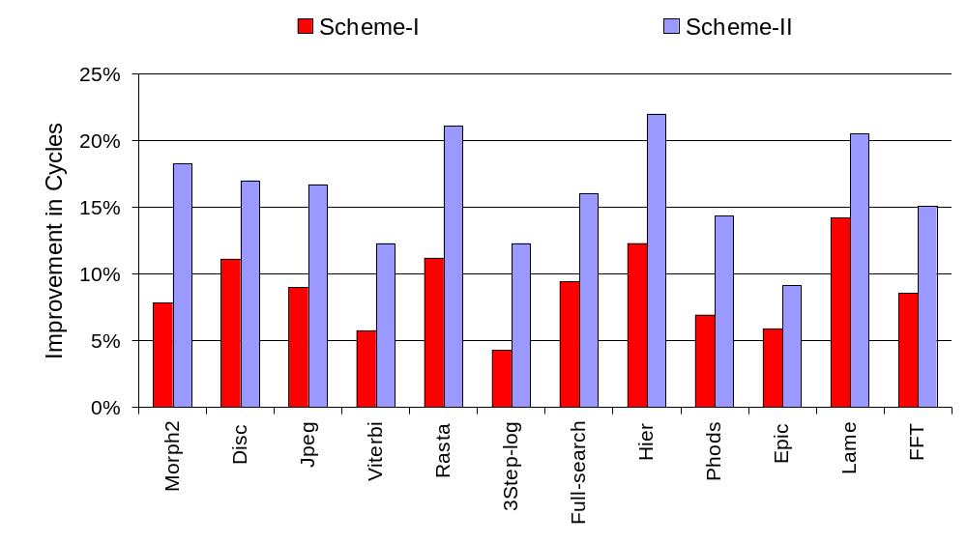
Evaluation of Different Schemes

Slide 20
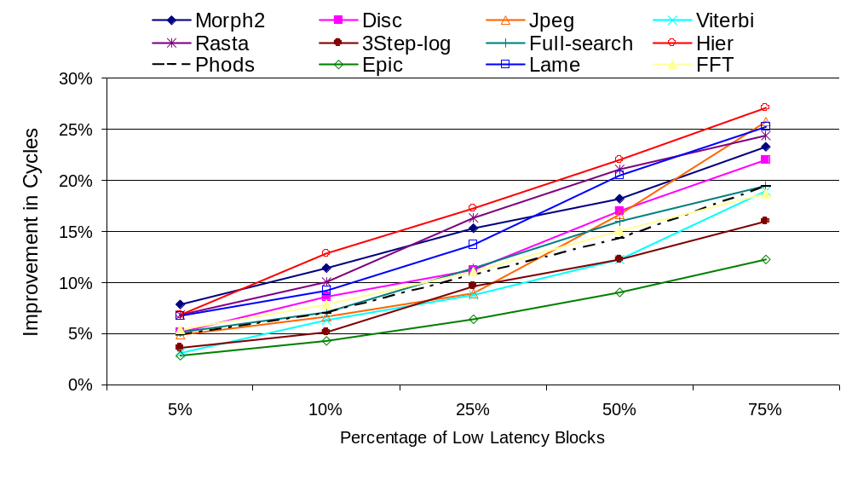
Impact of Latency Distribution (1/2)

Slide 21
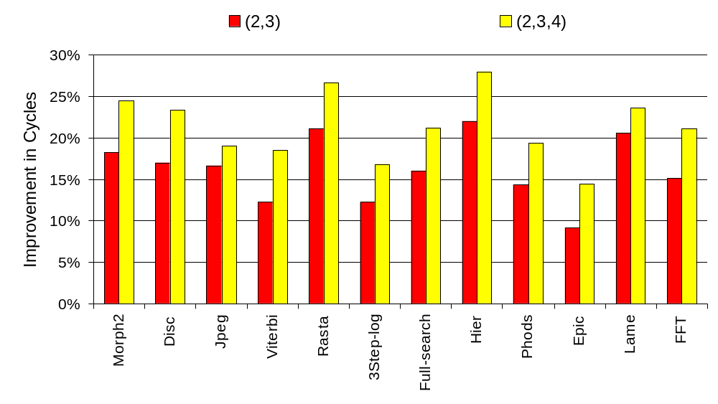
Impact of Latency Distribution (2/2)

Slide 22
Scheme-II+
Hardware-based accelerator
Several techniques in the circuit related literature reduces access latency
  E.g., forward body biasing, wordline boosting
Forward body biasing [Agarwal et al ‘05], [Chen et al ’03], [Papanikolaou et al ‘05]
  Reduces threshold voltage
  Improves performance
  Increases leakage energy consumption
Each SPM line is attached a forward body biasing circuit which can be controlled using a control bit set/reset by the compiler
  Uses these bits to activate body biasing for the select SPM lines
  Mechanism can be turned off when not used
Use optimizing compiler
  To control the accelerator using reuse vectors
Change latency from L₂ to L₁
Off-Chip
2
SPM
L₁
1
L₂
L₃
L₄

Slide 23
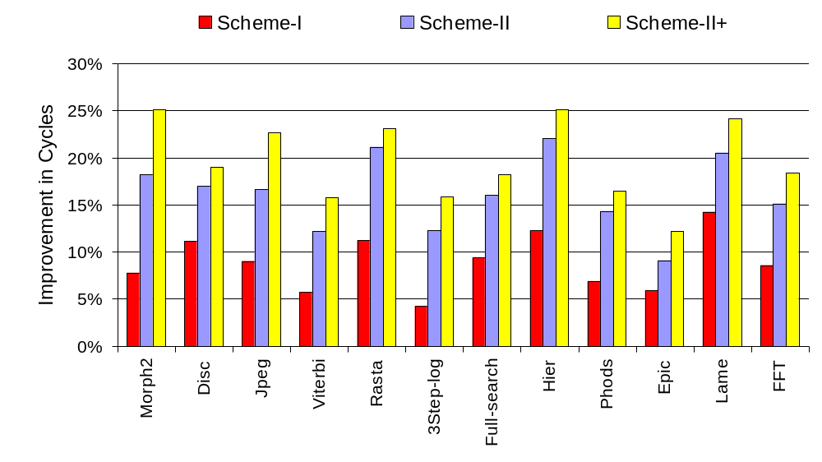
Evaluation of Scheme-II+

Slide 24
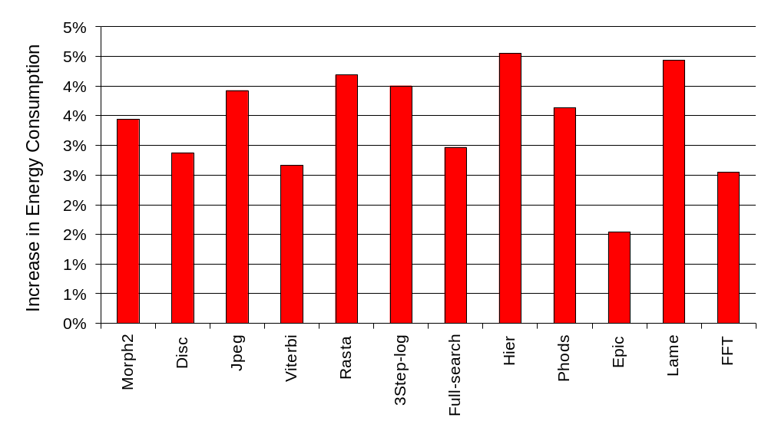
Energy Consumption of Scheme-II+

Slide 25
Summary and Ongoing Work
Goal: Manage SPM space in a latency-conscious manner using compiler’s help
  Instead of worst case design option
Approach: Place data into the SPM considering the latency variations across the different SPM lines
  Migrate data within SPM based on reuse distances
  Tradeoffs between power and performance
Promising results with different values of major simulation parameters
Ongoing Work: Applying this idea to other components

Slide 26
Thank You!
For more information:
WEB: www.cse.psu.edu/~mdl
Email: kandemir@cse.psu.edu

