Slide 1
Compiler-Managed Redundant Multi-Threading for Transient Fault Detection
Cheng Wang, Ho-seop Kim, Youfeng Wu, Victor Ying
Programming Systems Lab
Microprocessor Technology Labs
Intel Corporation
Notes:
1. This talk is about our compiler work for TM in unmanaged environment

Slide 2
Motivation
  Modern processors are becoming increasingly more susceptible to transient hardware faults
  Hardware-based Redundant Multi-Threading (HRMT)
    Hardware replication for redundant thread execution
    Hardware complexity and cost
  Software-based Redundant Multi-Threading (SRMT)
    Cost effective
      No special hardware for reasonably high error coverage
    Flexible
      Different reliability for different applications and different codes
    Compiler analysis and optimization
      Competitive performance to HRMT

Slide 3
Contributions
  First software-based redundant multi-threading
    Handle non-determinism caused by data racing on shared memory access
  Novel code generation techniques for SRMT
    Integrate redundant code and non-redundant code in the same application
  Novel compiler analysis and optimizations for SRMT
    Fail-stop memory access and non fail-stop memory access

Slide 4
Outline
  Software Redundant Multi-Threading
  Compiler Analysis, Code Generation and Optimizations
  Experimental Results
  Related Work
  Conclusion

Slide 5
Software-based Redundant Multi-Threading
Leading Thread
Trailing Thread
Sphere of Replication
Replication 1
Replication 2
Replicate
Repeatable Operations
Repeatable Operations
Compare
Non-Repeatable Operations

Slide 6
Redundancy Model
  Non Repeatable Operations
    Shared memory access
    System calls
    Legacy binary functions
  Replication
    loaded values of shared memory load
    Return values of legacy binary functions and system calls
  Comparison
    Values to be stored into shared memory
    Addresses of shared memory load and store
    Parameters passed to legacy binary functions and system calls

Slide 7
Replication Example
// original code … ld r1, [mem1] // use r1 | // leading thread … ld r1, [mem1] send r1 // use r1 | // trailing thread … // skip memory load receive r1 // use r1

Slide 8
Non-shared memory access
// original code foo() { int x; // shared int *p; // non-shared use x; use p; … = &x; } | // Leading Thread leading_foo() { int x; int *p; send x; use x; use p; send &x; … = &x; } | // Trailing thread trailing_foo() { // no replicate x int *p // replicate p receive x; use x; use p; // directly use p receive &x; … = &x; }

Slide 9
Comparison Example
// original code .. // compute mem1 ld r1, [mem1] … // compute r2 and mem2 st r2, [mem2] | // leading thread … // compute mem1 send mem1 wait (ack) ld r1, [mem1] send r1 … // compute r2 and mem2 send mem2 and r2 wait (ack) st r2, [mem2] | // trailing thread … // compute mem1 receive mem1’ check mem1’ with mem1 signal (ack) receive r1 … // compute r2 and mem2 receive mem2’ with r2’ check mem2 with mem2’ check r2 and r2’ signal (ack)

Slide 10
Compiler Analysis and Optimizations
  Shared memory access and non-shared memory access
    No communication and comparison overhead for non-shared memory access
  Fail-stop memory access and non fail-stop memory access
    No round-trip communication overhead for non fail-stop memory accesses

Slide 11
Legacy Binary Functions (System Calls)
// Source Program main() { … ret = foo(&bar); … } bar() { … } | // Legacy Binary Function foo(fp) { … ret = (*fp)(); … }
Leading thread
trailing thread
main
main
foo
bar
bar
foo
main
main

Slide 12
Experiments Setup
  SRMT Compiler
    Intel Compiler v9.0, -O3
  Target System
    An internal CMP simulator with on-chip communication queue
    8-way IBM eServer xSeries 445, 2.2GHz Xeon, Linux 2.4.20
  SPEC CPU2000
    All library are treated as legacy binary function
    MinneSPEC input for simulator run
    MinneSPEC input for error coverage statistic
    Reference input for communication bandwidth
    Reference input for real machine run

Slide 13
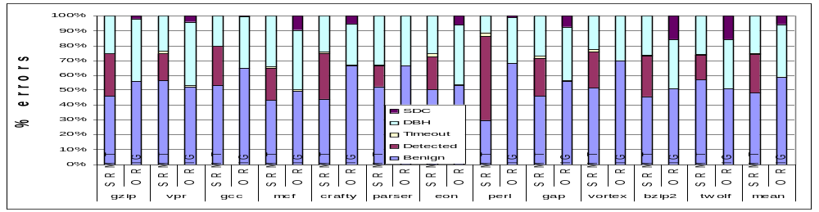
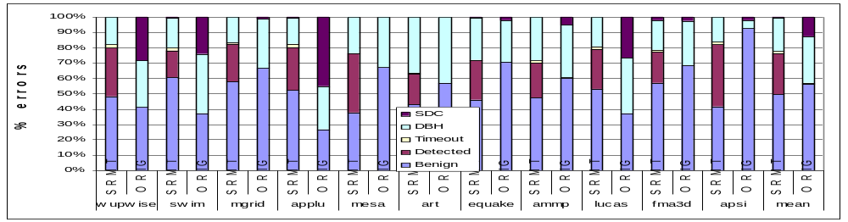
Error Coverage with Instrumented Error
  Without SRMT: SDC 5.8%(INT), 12.6%(FP)
  With SRMT: SDC 0.02%(INT), 0.4%(FP)

Slide 14
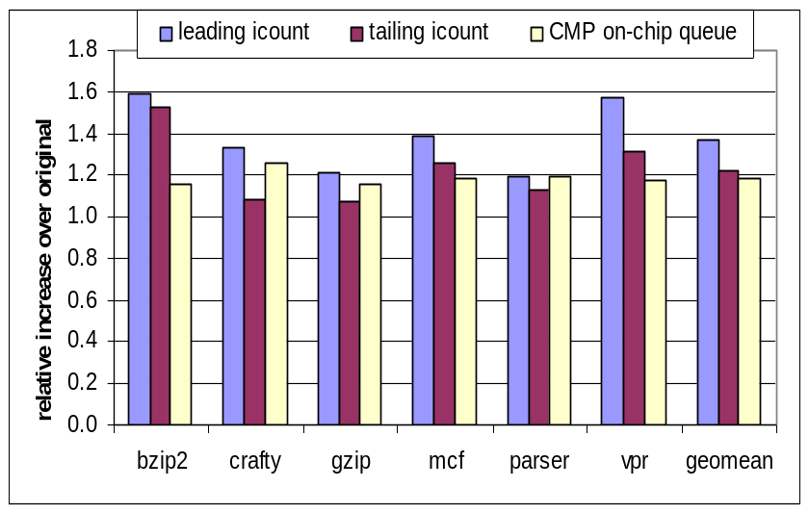
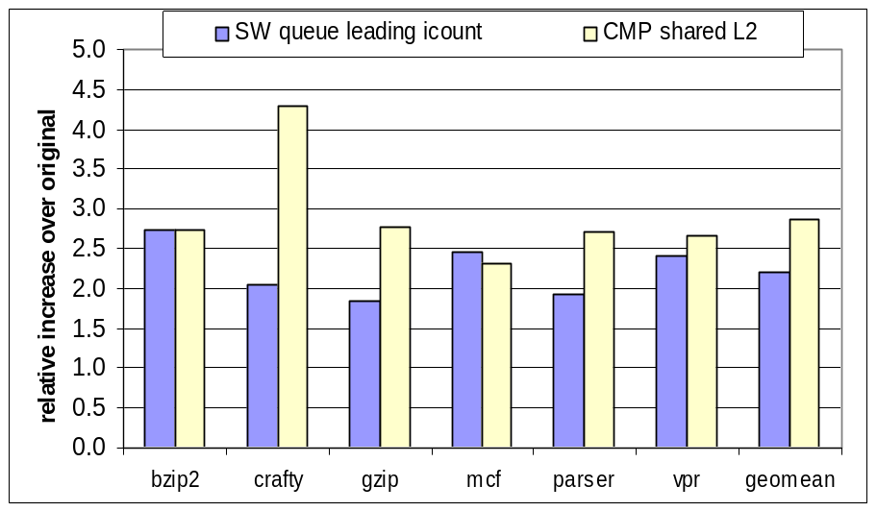
Performance on CMP Simulator
  With on-chip communication queue: 19% slow down
  With shared L2 cache: 2.86X slow down

Slide 15
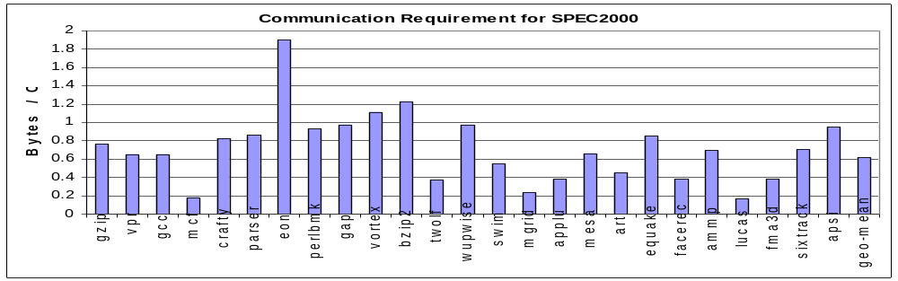
Communication Bandwidth
Average bandwidth demand: 0.6 Bytes/Cycle
    88% reduction compared to Hardware RMT (5.2 Bytes/cycle)

Slide 16
Related Works
  Hardware-based Redundant Multi-Threading
    [Reinhardt, ISCA’00], [Vijaykumar, ISCA’02], [Mukherjee, ISCA’02], [Gomaa, ISCA’03]
  Lightweight Redundant Multi-Threading
    [Gomma,ISCA’05], [Wang, DSN’05], [Reddy, ASPLOS’06], [Parashar, ASPLOS’06]
  Instruction Level Software-based Transient Fault Detection
    [Reis, CGO’05], [Reis, ISCA’05], [Borin, CGO’06]
  Process Level Fault Tolerance
    [Murray, HPL’98]
  Fast Inter-Core (Inter-Thread) Communication
    [Tasi, PACT’96], [Ottoni, ISCA’05], [Shetty, IBM RD’06], [Rangan, MICRO’06]

Slide 17
Conclusion and Future Work
  We developed a compiler-managed software-based redundant multi-threading for transient fault detection
    SRMT reduce design and validation complexity in Hardware-based RMT.
    We allow flexible reliability by linking code with SRMT and binary code without SRMT.
    Compiler analysis and optimization reduce 88% communication bandwidth demands. Performance slow down is only 19%.
    We achieve error coverage rate of 99.98% for INT and 99.6% for FP
  Future work
    Error recovery
    Binary translation for SRMT
    Neutron-induced soft-error measurement

Slide 18
Questions ?

Slide 19
Code Generation for Binary Function
// Leading Thread leading_main() { … // call binary function foo ret = foo(&bar); // notify binary function end send END_CALL; // pass return value send ret; … } leading_bar() {…} | // Trailing Thread trailing_main() { … // skip binary function foo do { // get notification receive func; // check binary function end if(func == END_CALL) break; call *func; } while(1); // get function return receive ret; … } trailing_bar() {…} | // For call back from binary function bar() { // notify trailing thread with // function pointer send trailing_bar; leading_bar(); } // binary function foo foo(fp) { … (*fp)(); … }

Slide 20
Thread Communication
  Shared Software Queue
    Delayed Buffering (DB)
    Lazy Synchronization (LS)
enqueue(data) { buffer[tail_DB] = data; tail_DB = (tail_DB + 1) % QUEUE_SIZE; if ( tail_DB % UNIT == 0 ) while ( tail_DB == head_LS ) head_LS == head; tail = tail_DB; } } | dequeue(data) { if ( head_DB % UNIT == 0 ) { head = head_DB; while ( head_DB == tail_LS) tail_LS = tail; } data = buffer[head_DB]; head_DB = (head_DB + 1) % QUEUE_SIZE; return data; }

Slide 21
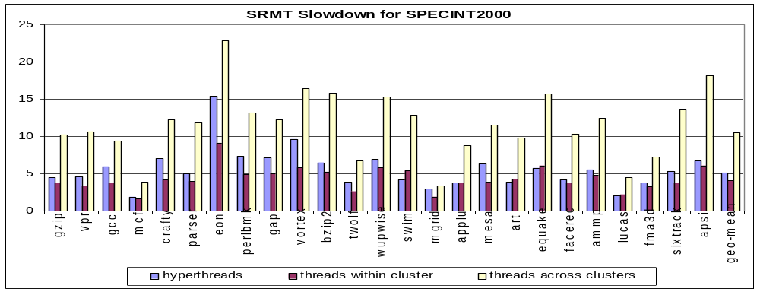
Performance on SMT and SMP
  Slow down due to producer-consumer cache thrashing
    5X on SMT
    4X on SMP with shared off-chip L4 cache
    11X on SMP without shared off-chip L4 cache

