Slide 1
Graph-Based
Procedural Abstraction
A. Dreweke, M. Wörlein, D. Schell,
T. Meinl, I. Fischer, M. Philippsen

Slide 2
embedded systems
cost and energy consumption depend on the size of the built-in memory
  limited amount of memory
more and more functionality is packed on embedded systems
  memory must be used more efficiently
procedural abstraction reduces code size by extracting duplicate code segments

Slide 3
procedural abstraction
post link-time optimization of static binaries:
  whole program code, including all libraries
  function prolog and epilog
  constant address calculations
  precise control flow must be reconstructed
  offset tables
  register indirect jumps
preprocessor
binary
duplicate search
duplicate search
candidate selection
candidate selection
extraction
postprocessor
optimized binary

Slide 4
procedural abstraction (suffix tree)
textual matching of instruction sequences
frequent instruction sequences are taken from the suffix tree
various optimizations:
  special treatment for labels, jumps, …
  fingerprinting
  canonic register mapping
  …
but fundamental suffix tree matching problem persists

Slide 5
duplicate search (suffix tree)
...
2000: add r2, r1, 0x42
2004: sub r2, r2, r3
2008: add r4, r2, 0x4
200c: load r3, 0x10710
2010: sub r2, r2, r3
2014: load r3, 0x1071c
2018: add r4, r2, 0x4
...
2504: mul r2, r1, 0x5
2508: sub r2, r2, r3
250c: add r4, r2, 0x4
2510: load r3, 0x10710
2514: sub r2, r2, r3
2518: load r3, 0x1071c
251c: add r4, r2, 0x4
...
...
3118: div r3, r2, r1
311c: sub r2, r2, r3
3120: add r4, r2, 0x4
3124: load r3, 0x10710
3128: sub r2, r2, r3
312c: load r3, 0x1071c
3130: add r4, r2, 0x4
...
400c: sub r3, r2, 0x42
4010: sub r2, r2, r3
4014: load r3, 0x10710
4018: add r4, r2, 0x4
401c: sub r2, r2, r3
4020: add r4, r2, 0x4
4024: load r3, 0x1071c
...
preprocessor
duplicate search
candidate selection
extraction
postprocessor

Slide 6
extraction (suffix tree)
...
2000: add r2, r1, 0x42
2004: call 0x5070
...
2504: mul r2, r1, 0x5
2508: call 0x5070
...
3118: div r3, r2, r1
311c: call 0x5070
...
400c: sub r3, r2, 0x42
4010: sub r2, r2, r3
4014: load r3, 0x10710
4018: add r4, r2, 0x4
401c: sub r2, r2, r3
4020: add r4, r2, 0x4
4024: load r3, 0x1071c
...
5070: sub r2, r2, r3
5074: load r3, 0x10710
5078: add r4, r2, 0x4
507c: sub r2, r2, r3
5080: add r4, r2, 0x4
5084: load r3, 0x1071c
5088: return
preprocessor
duplicate search
candidate selection
extraction
postprocessor

Slide 7
candidates selection (iterative greedy)
3
3
3 instructions
3
extraction benefit:
(L · (N – 1) – (N + 1) > 0
L: code length
N: # of occurrences
extraction benefit:
(3 · (2 – 1) – (2 + 1) = 0
L: code length
N: # of occurrences
extraction benefit:
(7 · (2 – 1) – (2 + 1) = 4 > 0
L: code length
N: # of occurrences
extraction benefit:
(4 · (2 – 1) – (2 + 1) = 1 > 0
L: code length
N: # of occurrences
3
call
call
4
call
call
ret
ret
ret
call
ret
call
call
4
3
call
7 instructions
call
3
call
preprocessor
4
ret
duplicate search
4
4
candidate selection
3
4 instructions
extraction
ret
ret
postprocessor
4
∑=21
∑=17
∑=16

Slide 8
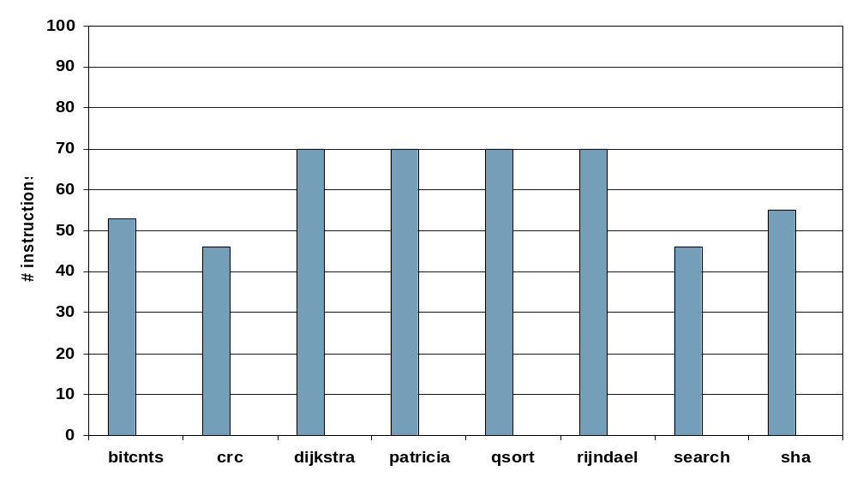
saved instructions (absolute values)
really small input binaries: gcc -Os, dietlibc linked
MiBench programs on ARM

Slide 9
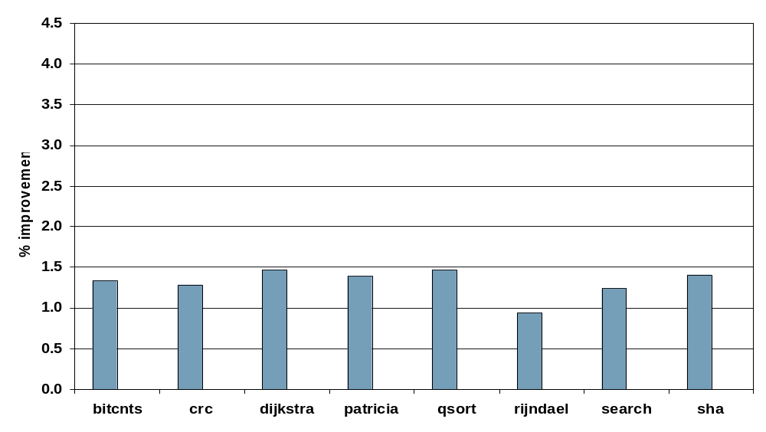
saved instructions (relative values)
really small input binaries: gcc -Os, dietlibc linked
good savings,
still not optimal
MiBench programs on ARM

Slide 10
procedural abstraction (graph-based)
transform instruction sequences into minimal data flow graphs (DFG)
search for frequent subgraphs in DFGs
sub r2, r2, r3
add r4, r2, 0x4
load r3, 0x10710
sub r2, r2, r3
load r3, 0x1071c
add r4, r2, 0x4
sub
load
add
load
add
sub
add
load

Slide 11
duplicate search (graph-based)
...
2000: add r2, r1, 0x42
2004: sub r2, r2, r3
2008: add r4, r2, 0x4
200c: load r3, 0x10710
2010: sub r2, r2, r3
2014: load r3, 0x1071c
2018: add r4, r2, 0x4
...
2504: mul r2, r1, 0x5
2508: sub r2, r2, r3
250c: add r4, r2, 0x4
2510: load r3, 0x10710
2514: sub r2, r2, r3
2518: load r3, 0x1071c
251c: add r4, r2, 0x4
...
...
3118: div r3, r2, r1
311c: sub r2, r2, r3
3120: add r4, r2, 0x4
3124: load r3, 0x10710
3128: sub r2, r2, r3
312c: load r3, 0x1071c
3130: add r4, r2, 0x4
...
400c: sub r3, r2, 0x42
4010: sub r2, r2, r3
4014: load r3, 0x10710
4018: add r4, r2, 0x4
401c: sub r2, r2, r3
4020: add r4, r2, 0x4
4024: load r3, 0x1071c
...
preprocessor
duplicate search
candidate selection
extraction
postprocessor

Slide 12
extraction (graph-based)
...
2000: add r2, r1, 0x42
2004: call 0x5070
...
2504: mul r2, r1, 0x5
2508: call 0x5070
...
3118: div r3, r2, r1
311c: call 0x5070
...
400c: sub r3, r2, 0x42
4010: call 0x5070
...
...
5070: sub r2, r2, r3
5074: load r3, 0x10710
5078: add r4, r2, 0x4
507c: sub r2, r2, r3
5080: add r4, r2, 0x4
5084: load r3, 0x1071c
5088: return
preprocessor
duplicate search
candidate selection
extraction
postprocessor

Slide 13
search lattice
*
sub
load
add
sub
sub
load
add
add
load
sub
sub
sub
load
load
sub
preprocessor
add
load
sub
sub
add
duplicate search
candidate selection
add
load
sub
extraction
sub
postprocessor
add
load
sub
sub
add
load
sub
load
add
load
sub
add
add
sub
add
load

Slide 14
graph miner (procedural abstraction extensions)
pruning necessary because of the size of the search lattice
number of occurrences must decrease with growing subgraph size
calculate the maximal-independent set (MIS) of subgraphs to make pruning possible again
preprocessor
load
#occurrences: 1
#occurrences: 2
#occurrences: 1
duplicate search
candidate selection
sub
extraction
postprocessor
add
add

Slide 15
graph miner (procedural abstraction extensions)
invalid subgraph pruning during candidate selection
sub
preprocessor
load
add
load
add
call
load
duplicate search
sub
candidate selection
extraction
add
load
add
load
postprocessor

Slide 16
candidates selection (optimal)
collisions:
3
3
call
call
3
call
call
call
call
call
call
4
3
call
3
call
preprocessor
4
ret
ret
4
duplicate search
4
candidate selection
3
ret
extraction
ret
postprocessor
4
∑=21
∑=16
∑=15
greedy iterative
optimum

Slide 17
procedural abstraction (graph-based)
Pro
no special treatment of branches and labels
resistant to instruction reordering
can be used to extract general code fragments, not limited to basic blocks or single-entry single-exit regions
Con
subgraph-isomorphism test is NP-complete
extremely huge search lattice (exponential in time and memory usage)

Slide 18
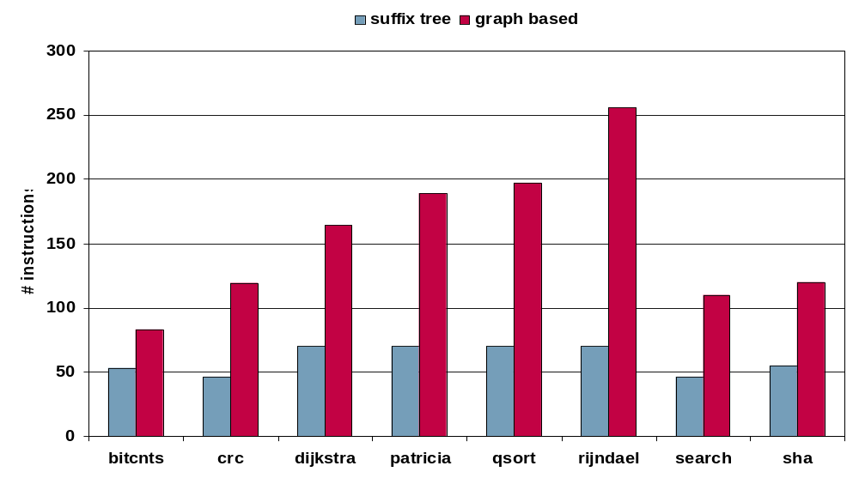
saved instructions (absolute values)
really small input binaries: gcc -Os, dietlibc linked
MiBench programs on ARM

Slide 19
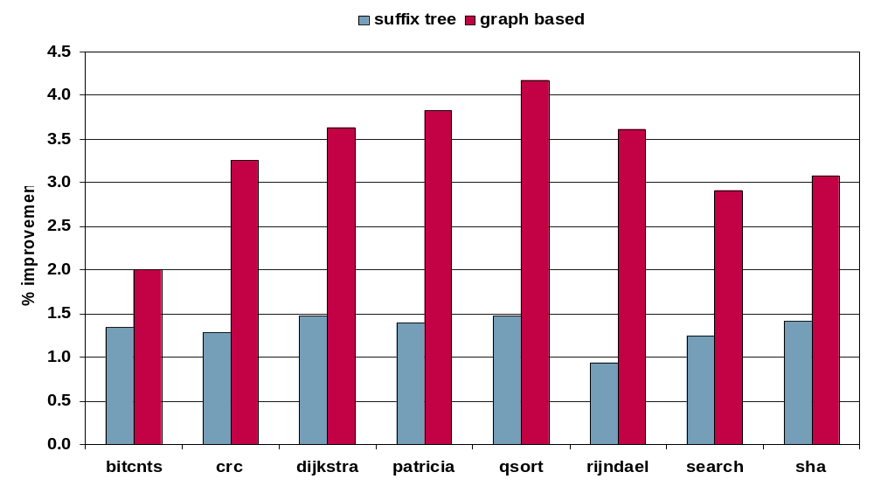
saved instructions (relative values)
really small input binaries: gcc -Os, dietlibc linked
MiBench programs on ARM

Slide 20
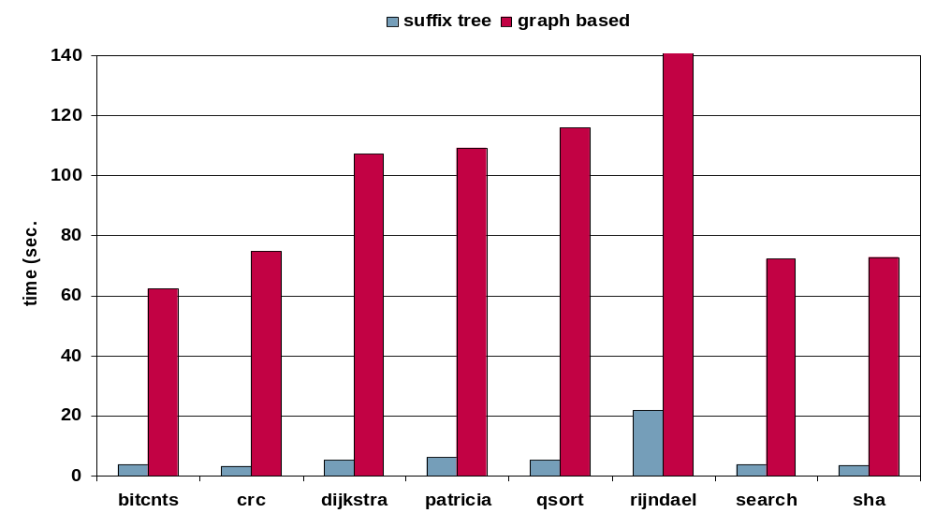
optimization time (sec.)
really small input binaries: gcc -Os, dietlibc linked
4h 20m
MiBench programs on ARM

Slide 21
future work
increase number of identified duplicate candidates
  extend search areas from basic blocks to function and whole program
  canonic register mapping
speedup duplicate search
  further parallelize graph search
  more procedural abstraction specific pruning rules to limit search lattice

Slide 22
summary
procedural abstraction with DFGs result in more compact code:
  graph-based mining saves up to 2.6 times more instructions than the traditional approaches
interesting for embedded systems (huge volumes)
  long optimization times affordable because of price per piece
  overnight or over the weekend optimization of code during the development process
  every saved bit counts

Slide 23
Graph-Based
Procedural Abstraction
A. Dreweke, M. Wörlein, D. Schell,
T. Meinl, I. Fischer, M. Philippsen

