Slide 1
A Structure Layout Optimization for Multithreaded Programs
Easwaran Raman, Princeton
Robert Hundt, Google
Sandya S. Mannarswamy, HP

Slide 2
Outline
Background
Solution Outline
Algorithm and Implementation
Results
Conclusion
3/13/2007
CGO 2007

Slide 3




Structure layout
cache
struct S{
int a;
char X[1024];
int b;
}
ld s.a
ld s.b
st s.a
s.a
M
M
H
M
M
H
s.b
cache
struct S{
int a;
int b;
char X[1024];
}
ld s.a
ld s.b
st s.a
M
H
H
M
H
H
s.a s.b
3/13/2007
CGO 2007

Slide 4
Multiprocessors: False Sharing
Data kept coherent across processor-local caches
Cache coherence protocols
  shared, exclusive, invalid, …
  operate at cache line granularity
False Sharing: Unnecessary coherence costs incurred because data migrates at cache line granularity
  Fields f1 and f2 are in cache line L. When f1 is written by P1, P1 invalidates f2 in other Ps even if f2 is not shared.
3/13/2007
CGO 2007

Slide 5




Structure layout
cache
cache
struct S{
int a;
char X[1024];
int b;
}
ld s.a
st s.b
s.a
M
M
H
H
H
H
s.b
cache
cache
struct S{
int a;
int b;
char X[1024];
}
ld s.a
st s.b
s.a s.b
s.a s.b
M
M
M’
H
M’
H
3/13/2007
CGO 2007

Slide 6
Locality vs False Sharing
Tightly packed layouts
  Goodlocality, more false sharing
Loosely packed layouts
  Less false sharing, poor locality
Goal : Increase locality and reduce false sharing simultaneously
3/13/2007
CGO 2007

Slide 7
Solution Outline
f1
f2
struct S {
int f1, f2;
int f3, f4, f5;
}
+20
+100
+50
for(…){
…
access f1
…
access f3
…
}
f3
+100
f4
f5
3/13/2007
CGO 2007

Slide 8
Solution Outline
-100
f1
f2
struct S {
int f1, f2;
int f3, f4, f5;
}
+20
+100
-100
-200
+50
T1
barrier
write f1
T2
barrier
read f3
f3
+100
f4
f5
f1
f4
f2
f3
f5
3/13/2007
CGO 2007

Slide 9
CycleGain
For all dynamic pairs of instructions (i1, i2)
  If i1 accesses f1 and i2 accesses f2 (or vice versa)
    If MemDistance(i1,i2) < T
      CycleGain(f1, f2) += 1
MemDistance(i1, i2) - # distinct memory addresses touched between i1 and i2
3/13/2007
CGO 2007

Slide 10
CycleGain – In practice
Approximations
  Use static instruction pairs
  Consider only intra-procedural paths
  Find paths within the same loop level
If i1 and i2 belong to loop L,
  CycleGain(f1, i1, f2, i2) = Min(Freq(i1), Freq(i2))
3/13/2007
CGO 2007

Slide 11
CycleLoss
Estimating cycles lost due to false sharing for a given layout is difficult
… and insufficient
Solution : Compute concurrent execution profile and estimate FS
  Relies on performance counters in Itanium
3/13/2007
CGO 2007

Slide 12
Concurrency Profile
P1
P2
P3
B1
B2
B3
B4
(1,B1)
(1,B3)
B1
1
2
1
(2,B3)
B2
1
2
(5,B3)
B3
1
(7,B4)
(7,B2)
B4
(10,B4)
(12,B1)
(12,B2)
(15,B4)
(16,B1)
Use Itanium’s performance monitoring unit (PMU)
Collect PC and ITC values
3/13/2007
CGO 2007

Slide 13
CycleLoss
For every pair of fields f1 accessed in B1 and f2 in B2
  If one of them is a write
    CycleLoss(f1,f2) = k*Concurrency(f1, f2)
B1
B2
B3
B4
B1
1
2
1
B2
1
2
B3
1
B4
3/13/2007
CGO 2007

Slide 14
Clustering Algorithm
Separate RO fields and RW fields
while RWF is not empty
  seed = Hottest field in RWF
  current_cluster = {seed}
  unassigned = RWF – {seed}
  while true:
    f = find_best_match()
    If f is NULL exit loop
    add f to current_cluster
    remove f from unassigned
  add current_cluster to clusters
Assign each cluster to a cache line, adding pad as needed
f1
f2
50
150
10
5
-250
f6
100
f3
200
10
150
500
5
5
f4
f5
f5
f1
f2
f3
f4
f6
3/13/2007
CGO 2007

Slide 15
Clustering Algorithm
f1
f2
find_best_match()
  best_match = NULL
  best_weight = MIN
  for every f1 from unassigned
    weight = 0
    For every f2 from current_cluster
      weight += w(f1, f2)
    If weight > best_weight
      best_weight = weight
      best_match = f1
  return best_match
50
150
10
5
-250
f6
100
f3
200
10
150
500
5
5
f4
f5
3/13/2007
CGO 2007

Slide 16
Clustering Algorithm
while RWF is not empty
  seed = Hottest field in RWF
  current_cluster = {seed}
  unassigned = RWF – {seed}
  while true:
    f = find_best_match()
    If f is NULL exit loop
    add f to current_cluster
    remove f from unassigned
  add current_cluster to clusters
Assign each cluster to a cache line, adding pad as needed
f1
f2
50
150
10
5
-250
f6
100
f3
200
10
150
500
5
5
f4
f5
f5
f1
f6
f2
f1
f3
f4
f6
3/13/2007
CGO 2007

Slide 17
Implementation
Analysis
BB to field
map
Source
Files
Layout
tool
Layout
Layout rationale
Hotness
Conc.
Profile
build
Executable
Process
trace
caliper
PMU Trace
3/13/2007
CGO 2007

Slide 18
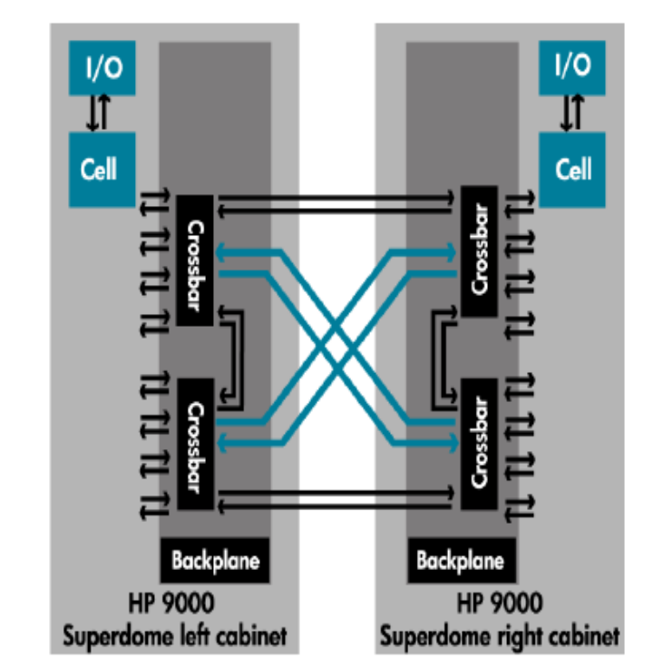
Experimental setup
Target application : HP-UX kernel
  Key structures heavily hand optimized by kernel performance engineers
Profile runs
  16 CPU Itanium2® machine
Measurement runs
  HP Superdome® with 128 Itanium2® CPUs
    8 CPUS per Cell
    4 Cells per Crossbar
    2 Crossbars per backplane
  Access latencies increase from cell-local to cross-bar local to inter-crossbar
3/13/2007
CGO 2007

Slide 19
Experimental setup
SPEC Software Development Environment Throughput (SDET) benchmark
  Runs multiple small processes and provides a throughput measure
1 warmup run, 10 actual runs
Only a single structure’s layout modified on each run
Arithmetic mean computed on throughput after removing outliers
3/13/2007
CGO 2007

Slide 20
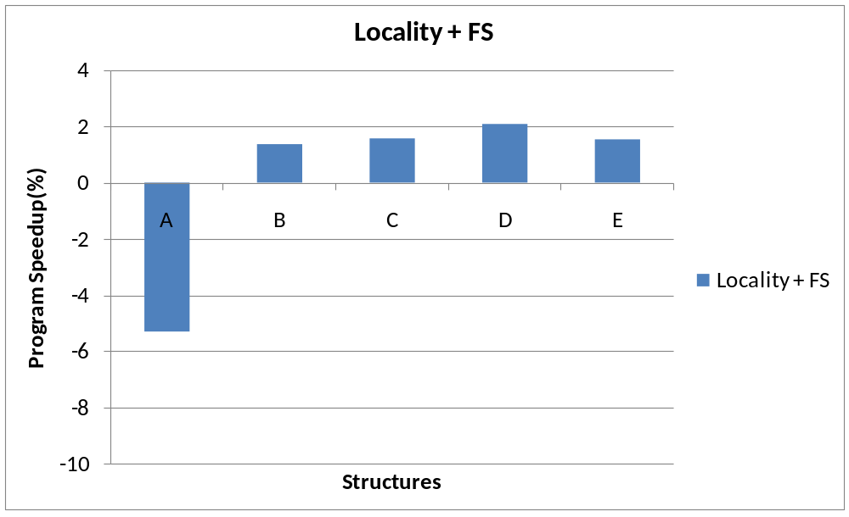
Results
3/13/2007
CGO 2007

Slide 21
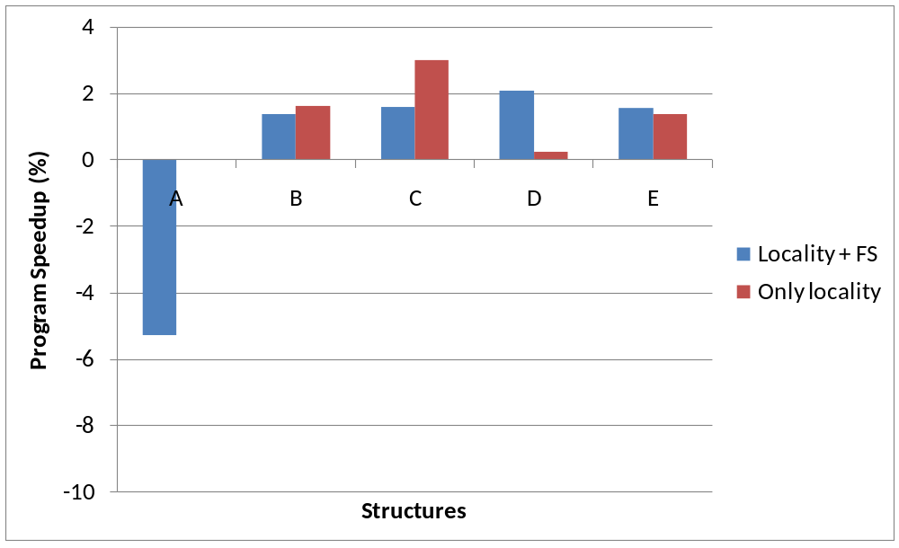
Results
3/13/2007
CGO 2007

Slide 22
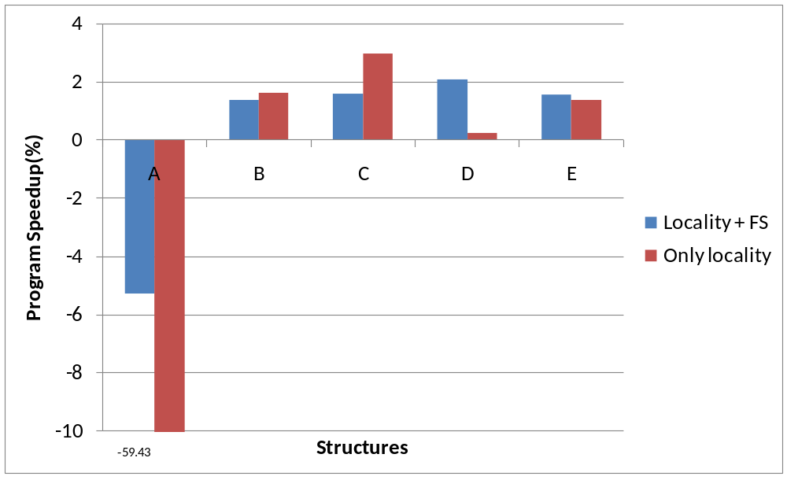
Results
3/13/2007
CGO 2007

Slide 23
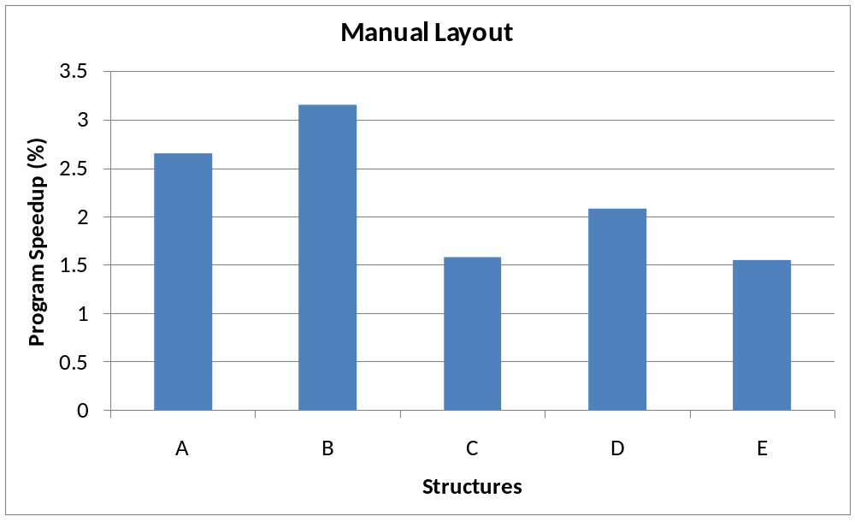
Results
3/13/2007
CGO 2007

Slide 24
Conclusion
Unified approach to locality and false sharing between structure fields
A new sampling technique roughly estimate false sharing
Positive initial performance results on an important real-world application
3/13/2007
CGO 2007

Slide 25
Thanks!
Questions?
3/13/2007
CGO 2007

