Slide 1
Code Compaction of an Operating System Kernel
Haifeng He, John Trimble, Somu Perianayagam,
Saumya Debray, Gregory Andrews
Computer Science Department
Notes:
[!] Remember to introduce authors
1. Me, John, undergrad, Somu, Ph.D, And Two advisors.

Slide 2
The Problem
Reduce the memory footprint of Linux kernel on embedded platform
Why is this important?
  Use general-purpose OS in embedded systems
  Limited amount of memory in embedded systems
Goal:
  Automatically reduce the size of Linux kernel
Notes:
[!!] Less word on this !
EB devices (cellphone, media players, consumer elecs) usually have short life cycles.
Very uneconomical to develop custom Oss for each device (re-implement)
Increasing use of General-purpose Oss, such as Linux deployed in embedded system,
Limited resource in Embedded systems (cpu, memory)
Linux image always kept in the memory so that amount of memory occupied by linux is static.
Virtual memory is also common in ES (add cost to devices, add energy cost)
Compaction not compression (overhead at runtime and space-code buffer)

Slide 3
The Opportunities
 | General-Purpose OS | Embedded Systems
Hardware | Many devices | Small, fixed set of devices
Software | Many applications | Small, fixed set of applications
System calls | Large number | Small subset
How to utilize these opportunities?
Notes:
Small set of syscalls: around 30
Design difference between Linux and ES. Gives opportunities.
Linux designed without making assumptions about their deployment environment and what applications will run on it.
Each new version of linux, no. of syscalls increasing
Small devices, simple Filesystem (cellphone does not have a mouse device)
Most common syscalls in ES are read write,

Slide 4
The Options
Hardware configuration
  Carefully configure the kernel
  Still not the smallest kernel
Program analysis for code compaction
  Find unreachable code
  Find duplications (functions, instructions)
Orthogonal to hardware assisted compression (e.g., ARM/Thumb)
Notes:
(e.g. ARM/Thumb)
ARM/Thumb
Tweaking configure file can remove code not required by user applications, can’t remove used system calls

Slide 5
The Challenges of Kernel Code Compaction
Does not follow conventions of compiler-generated code
  How to handle kernel code
Large amount indirect control flow
  How to find targets of indirect calls
Multiple entry points in the kernel
Implicit control flow paths
  Interrupts
Notes:
How to find syscalls required by user apps??
Difficult to use standard compiler-based techs. To do whole-system analysis and optimization.
Indirect calls through function pointers. Modulize Linux code and make it maintainable. Add abstraction in the code.
Need pointer analysis

Slide 6
Our Approach
Use binary rewriting
  A uniform way to handle C and assembly code
  Whole program optimizations
  Handling kernel binary is not trivial
  Less information available (types, pointer aliasing)
Combine source-level analysis
  A hybrid technique
Notes:
A binary rewriting system transforms a binary program into a different but functionally equivalent program. Potential can
Handle program written in any languages.
Even in binary level, there are data stay in executable section. How to identify them is a problem (we will come to this later)
At source-level, we do pointer analysis, actual compaction work is done at binary level

Slide 7
A Big Picture
Source Code
of Kernel
Pointer
Analysis
Syscalls
required by
User Apps
Source-Level
Analysis
Program Call Graph
Compact
Kernel
Executable
Compile
Binary
Rewriting
Binary Code
Of Kernel
Disassemble
Kernel
Compaction
Control Flow Graph

Slide 8
Source-Level Analysis
A significant amount of hand-written assembly code in the kernel
  Can’t ignore it
  Interacts with C code
Requires pointer analysis for both C code and assembly code
  “Lift” the assembly code to source level
Notes:
How to interact between C and Assembly is a problem
Cant ignore ass: 1. ass contains indirect call; 2. we have to perform a safe analysis
Unlike other analysis, for example finding bugs, they can afford no safe analysis

Slide 9
Approximate Decompilation
Idea
  Reverse engineer hand-written assembly code back to C
The benefit
  Reuse source-level analysis for C
The translation can be approximate
  Can disregard aspects of assembly code that are irrelevant to the analysis
Notes:
Difficulties of decompile ass to C (tlb eg.)

Slide 10
Approximate Decompilation
Source Code of Kernel
*.c
*.c
Pointer
analysis X
Appr. decomp.
for analysis X
*.S
*.c^{X}
Program Call Graph
If pointer analysis is flow-insensitive, then instructions like cmp, condition jmp can be ignored

Slide 11
Pointer Analysis
Tradeoff: precision vs. efficiency
Our choice: FA analysis by Zhang et al.
  Flow-insensitive and context-insensitive
  Field sensitive
Why?
  Efficiency: almost linear
  Quite precise for identifying the targets of indirect function calls
Notes:
Large volume of work on pointer aliasing analysis. The greater the precision is, the great the analysis cost.
FA stands for flow-insensitive aliasing
Distinguish between different fields of a structure
UNION-Find algorithm. Complexity is almost linear with respect to code size.
Wouldn’t be too conservative

Slide 12
Identify Reachable Code
Compute program call graph of Linux kernel based on FA analysis
Identify entry points of Linux kernel
  startup_32
  System calls invoked during kernel boot process
  System calls required by user applications
  Interrupt handlers
Traverse the program call graph to identify all reachable functions
Notes:
How to find syscalls by user apps:
Address-taken because source code of library are not available.

Slide 13
Improve the Analysis
Observation: During kernel initialization, execution is deterministic
  Only one active thread
  Only depends on hardware configuration and command line options
Initialization code of kernel is “static”
  If configuration is same, we can safely remove unexecuted initialization code
  Use .text.init section to identify initialization code
  Use profiling to identify unexecuted code
Notes:
What initialization code does. Init hardware driver code, enable paging..

Slide 14
Kernel Compaction
Unreachable code elimination
  Based on reachable code analysis
Whole function abstraction
  Find identical functions and leave only one instance
Duplicate code elimination
  Find identical instruction sequences

Slide 15
Experimental Setup
Start with a minimally configured kernel
Compile the kernel with optimization for code size (gcc –Os)
Compile kernel with and without networking
  Linux 2.4.25 and 2.4.31
Benchmarks:
  MiBench suite
  Busybox toolkit (used by Chanet et al.)
Implemented using PLTO
Notes:
Remove unnecessary modules such as sound cards and video support
Remove unnecessary modules such as sound cards and video support
Remove sound card & video card
MiBench a widely used and free collection of benchmarks for embedded system
Busybox. BusyBox is a software application which provides many standard Unix tools. BusyBox is designed to be a small executable for use with Linux, which makes it ideal for special purpose Linux distributions and embedded devices. It has been called "The Swiss Army Knife of Embedded Linux".
Also used by Chanet et al.

Slide 16
Results: Code Size Reduction
 | Linux 2.4.25
Apps. Set | All Sys. Calls | Busybox | MiBench
With Networking | 12.2% | 18.0% | 19.3%
Without | 14.5% | 22.1% | 23.8%
Notes:
?? Why all.sys are able to get 15 – 16 % reduction rate? What to get rid of ?!!!
.text.init are consistent
All systems. Make no assumptions of applications.
Without, the total size of kernel is small (denominator smaller)

Slide 17
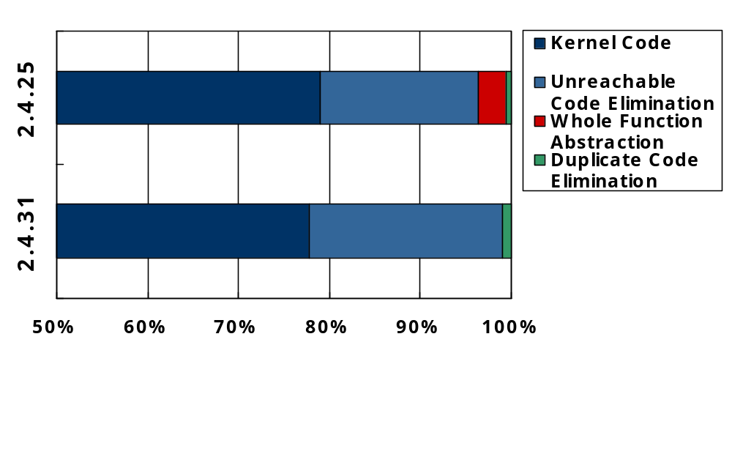
Effects of Different Optimizations
Reduction

Slide 18
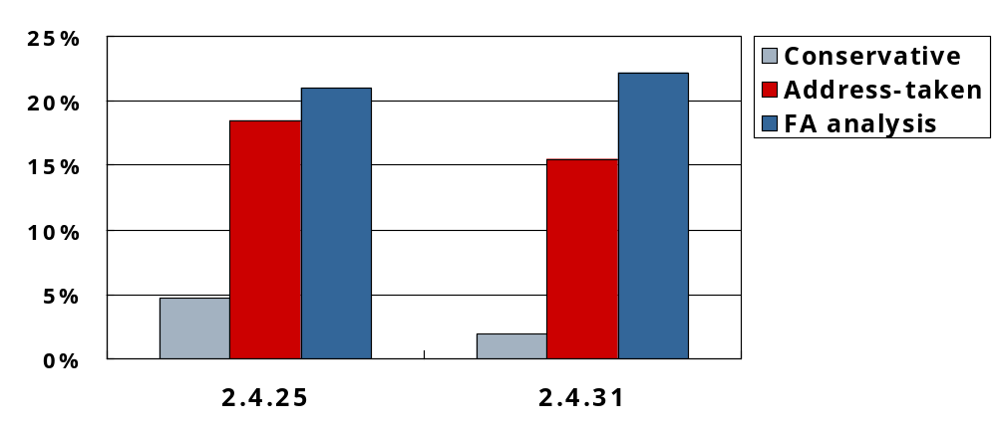
Effects of Different Call Targets Analysis
Reduction
Kernels

Slide 19
Related Work
“System-wide compaction and specialization of the Linux Kernel” (LCTES’05)
  by Chanet et al.
“Kernel optimizations and prefetch with the Spike executable optimizer” (FDDO-4)
  by Flower et al.
“Survey of code-size reduction methods”
  by Beszédes et al.

Slide 20
Conclusions
Embedded systems typically run a small fixed set of applications
General-purpose OSs contain features that are not needed in every application
An automated technique to safely discard unnecessary code
  Source-level analysis + binary rewriting
  Approximate decompilation

Slide 21
Questions?
Project website:
http://www.cs.arizona.edu/solar/

Slide 22
Binary Rewriting of Linux Kernel
PLTO: a binary rewriting system for Intel x86 architecture
Disassemble kernel code
  Data embedded within executable section
  Implicit addressing constraints
  Unusual instruction sequences
  Applied a type-based recursive disassemble algorithm
  Able to disassemble 94% code
Notes:
Bootup code execute prior to page table init reuiqred to be at specific address

