Slide 1
Pipelined Execution of Critical
Sections Using Software-Controlled
Caching in Network Processors
Jinquan Dai, Long Li, Bo Huang
Intel China Software Center
Shanghai, China

Slide 2
Agenda
Network processors
Auto-Partitioning programming model
Pipelined execution of critical sections
The automatic transformation
Experimental Evaluations
Conclusions

Slide 3
Network Processors
A processor optimized for high-performance packet processing
  Common applications of a network processor
    Network infrastructure and enterprise applications (e.g., routers, VPN firewall)
  Guarantee and sustain throughput for the worst-case traffic
    Scalable throughput from 100 Mbps to 10 Gbps
Highly parallel multi-core, multi-threaded architecture
  Multiple hardware-threaded processing element (cores) on a single chip
  Rich set of inter-thread/inter-processor communication and synchronization mechanisms

Slide 4
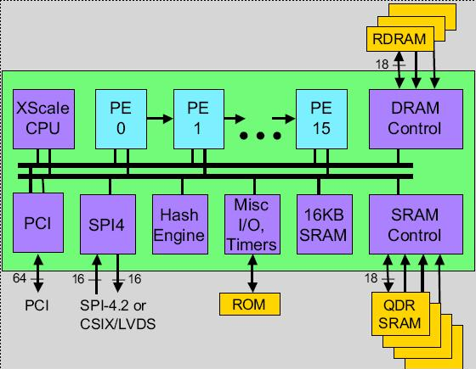
IXP2800
All the processing elements (PEs) share the external memory (e.g., SRAM and DRAM)
  Long memory access latency – hundreds of compute cycle for one memory access
The performance of an IXP application depends heavily on whether memory latency can be effectively hidden
  Overlap memory latency with the latency of other memory accesses and the computations in different threads

Slide 5
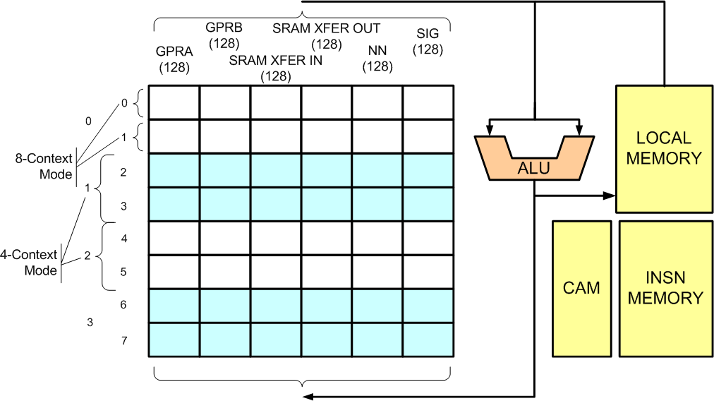
IXP Processing Element
Each processing element has eight hardware thread
  Each thread has its own register set, program counter, and thread-specific local registers
  Zero-overhead context switching between threads
Latency hiding through multi-threading/multi-processing
  The threads of one or more PEs are treated as a thread pool and perform the same processing tasks on different packets.

Slide 6
Memory Latency Hiding through Multi-Threading

Slide 7
Agenda
Network processors
Auto-Partitioning programming model
Pipelined execution of critical sections
The automatic transformation
Experimental Evaluations
Conclusions

Slide 8
Challenges
Traditional network applications, e.g., the networking stacks in the OSes, are usually implemented using sequential semantics.
Effective utilization of the concurrency available on the IXP is required for the performance of IXP applications
The parallel programming paradigm on IXP is too complex
  Manual partitioning and mapping of the network application onto multiple threads and multiple cores
  Performance obtained by fine-grained packet level parallelism and inter-processor, inter-thread communication
    E.g., multi-processing/multi-threading, synchronization minimization, memory latency hiding

Slide 9
Auto-Partitioning Programming Model
Packet
Processing
Application
PPS0
PPS1
PPSm
Perf.
Spec.
Auto-Partitioning
C Compiler
XScale
XScale
XScale
XScale
PE
PE
ME
PE
PE
PE
PE
PE
PE
PE
PE
PE
PE
PE
PE
PE
PE
PE
PE
PE
PE
PE
PE
PE
PE
PE
PE
PE
PE
PE
IXP2325
IXP2350
IXP2400
IXP28x0
Application expressed as a set of communicating packet processing stages (PPS) – CSP model
  Each PPS is coded using sequential C semantics
  Multiple PPSes run concurrently and communicate though pipes
Compiler handles the mapping of PPSes to threads / processing elements
  The compiler manages multi-threading, synchronizations and communications

Slide 10


10GbE Core/Metro Router
IPv4
MPLS
FTN
WRED
Rx
Sch
QM
Tx
IPv6
MPLS
FTN
srTCM
Meter

Slide 11
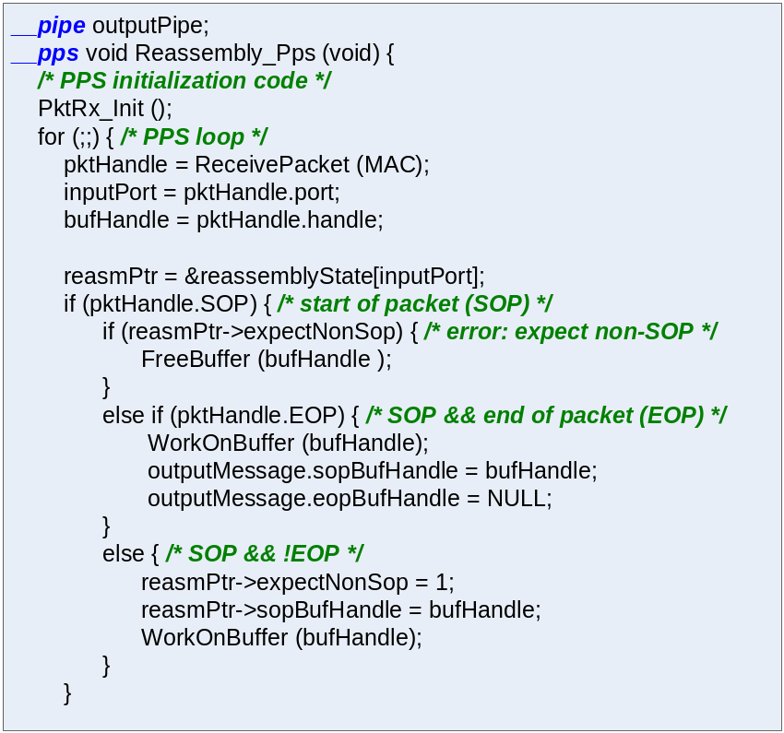
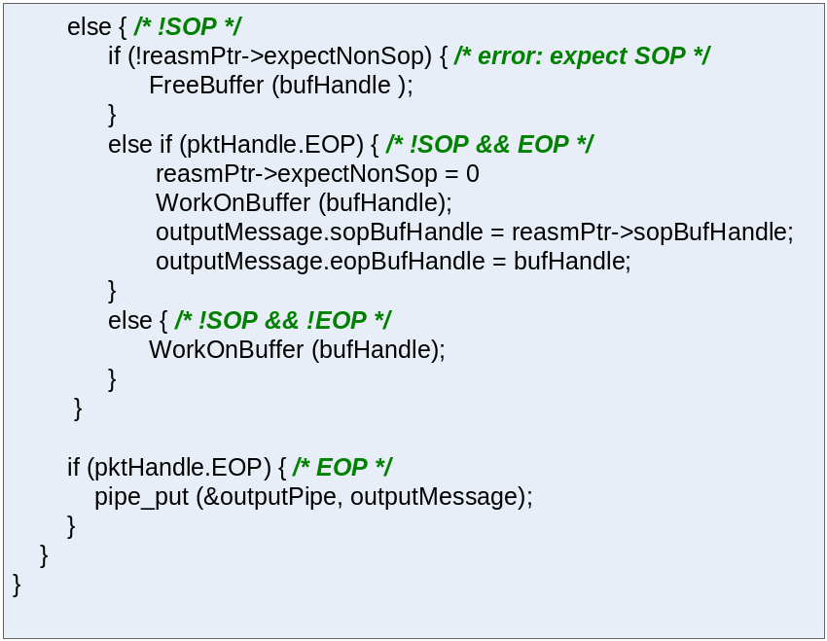
Rx PPS

Slide 12
Multi-Threading/Multi-Processing
Conceptually, each iteration of the PPS loop will run on a separate thread
The sequential semantics of the original PPS is preserved
  A critical section is introduced for all the accesses to each shared variable (one of the accesses is a WRITE)
  A distinct hardware signal s is associated with the critical section
  An AWAIT(s) operation is introduced before entering the critical section
  An ADVANCE(s) operation is introduced after leaving the critical section

Slide 13
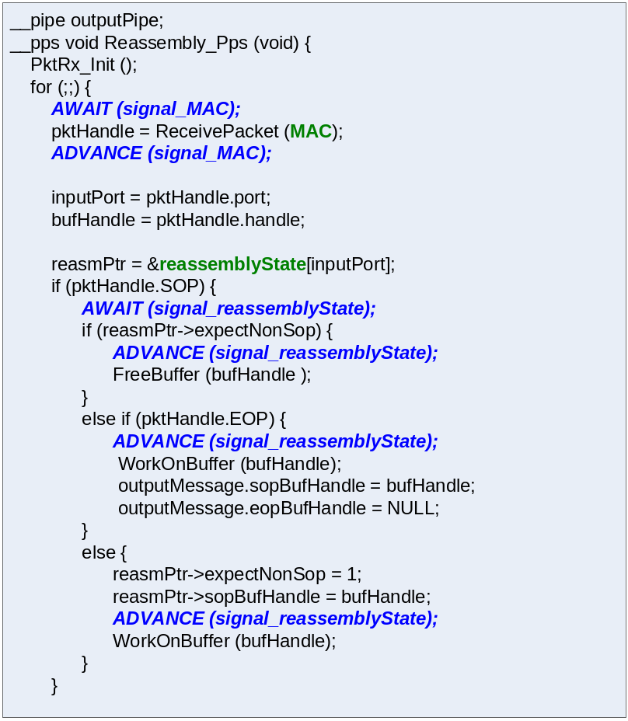
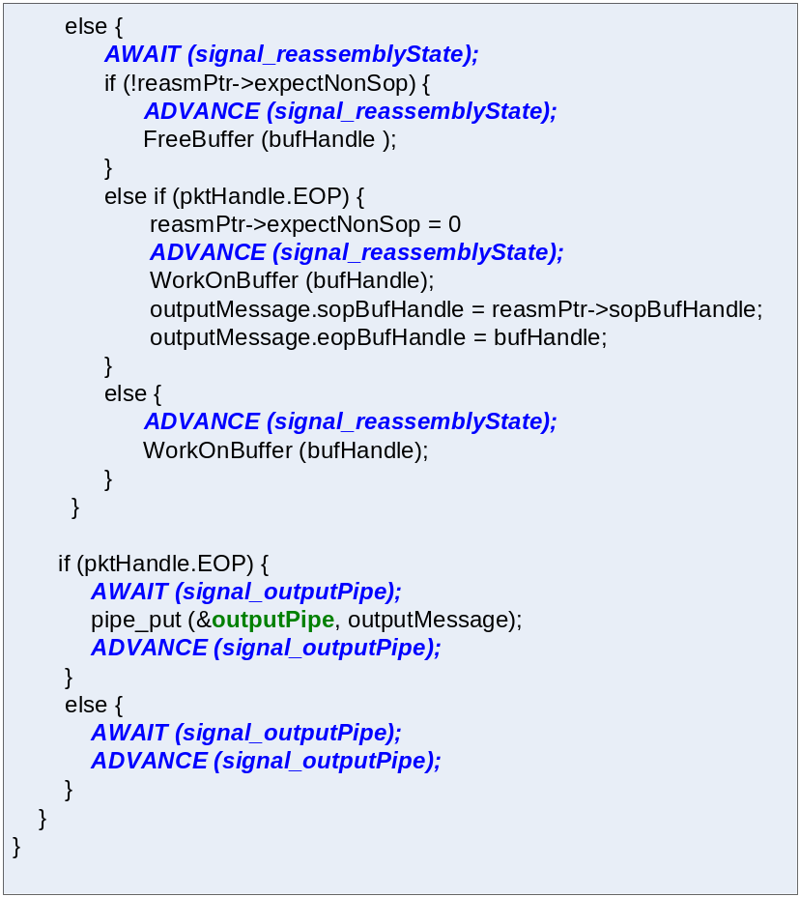
Multi-Threaded Rx PPS

Slide 14
Agenda
Network processors
Auto-Partitioning programming model
Pipelined execution of critical sections
The automatic transformation
Experimental Evaluations
Conclusions

Slide 15
Memory Latency Hiding through Multi-Threading

Slide 16
Multi-Threaded Rx PPS

Slide 17
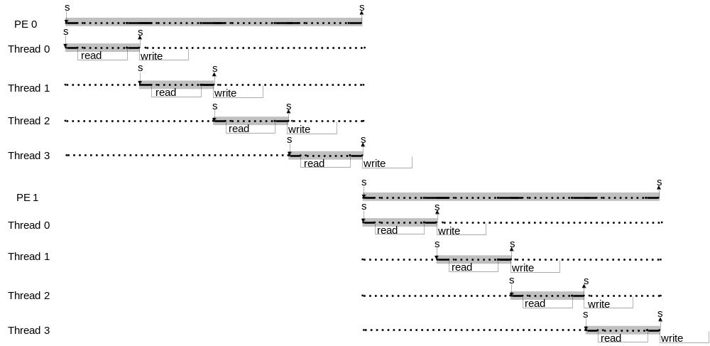
RMW Critical Sections

Slide 18
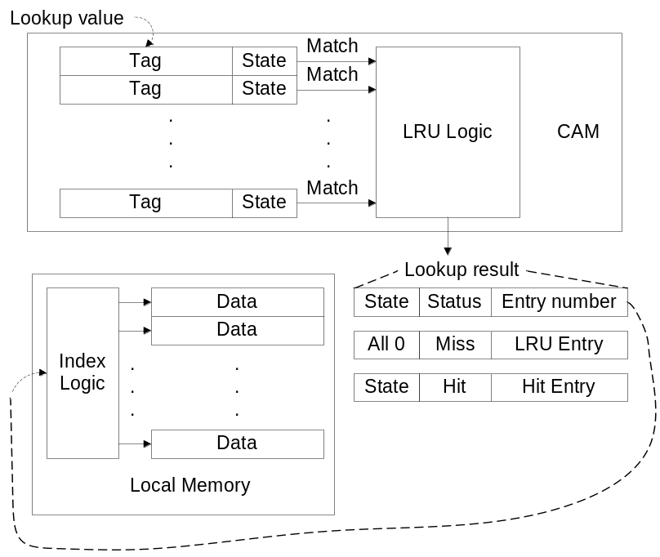
Software controlled caching
Hardware-based caching mechanisms are ineffective for network applications
  Packet data structures (e.g., packet header/payload and packet-specific meta-data) have little locality
  Network application data structures (e.g., flow- and application-specific data) exhibit considerable locality of accesses
Software-controlled caching mechanisms are more appropriate for network processors
  Data structures can be cached explicitly and selectively according to the application behavior.

Slide 19
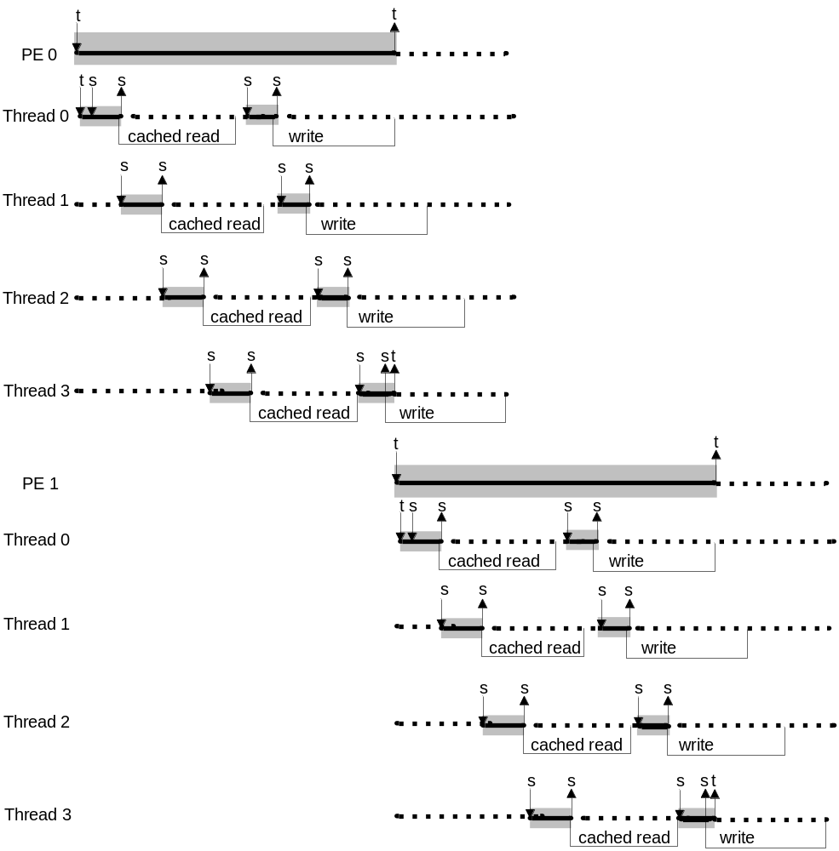
Pipelined Execution of RMW Critical Sections

Slide 20
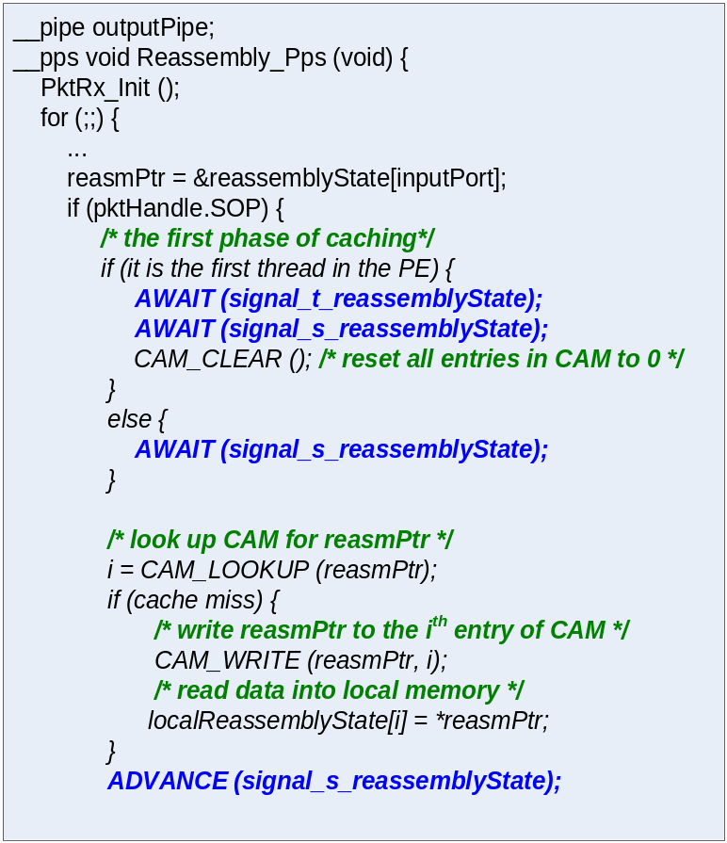
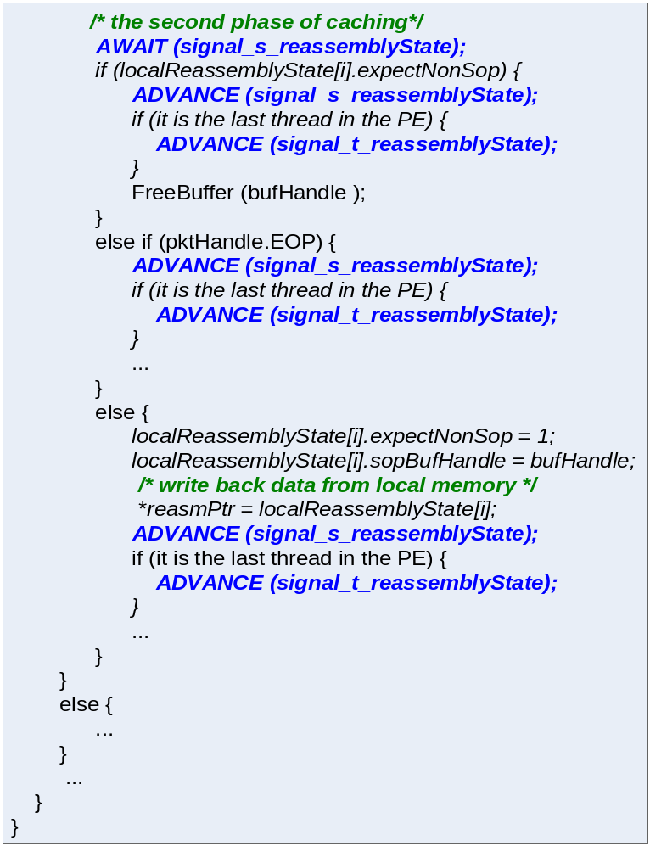
Software-Caching for Rx PPS

Slide 21
Caching multiple RMW Critical Sections
The network application may modify multiple, independently-accessed shared variables
The CAM can be divided into multiple logical CAMs
  Different logical CAM can be used to cached different RMW critical sections in an un-coordinated fashion
  Different RMW critical sections cached using the same logical CAM should be executed in strict order

Slide 22
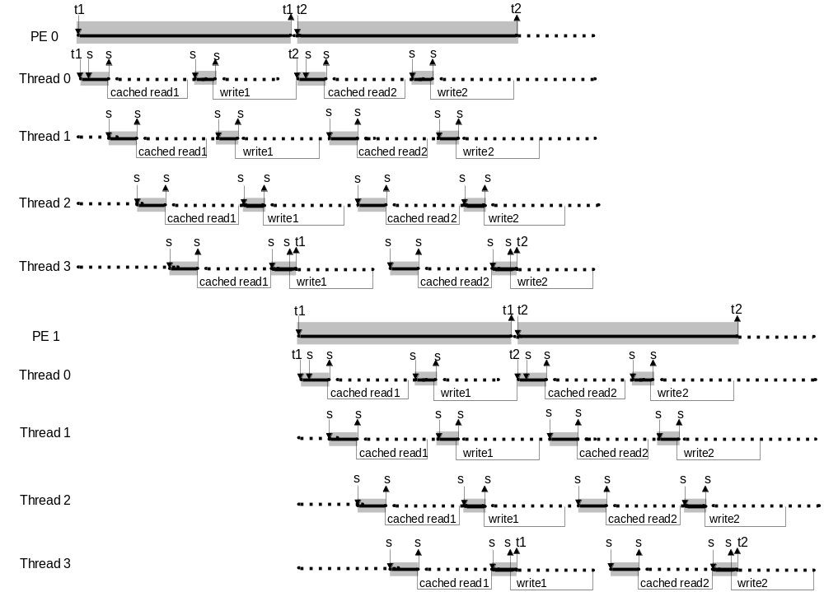
Ordered Software-Controlled Caching

Slide 23
Agenda
Network processors
Auto-Partitioning programming model
Pipelined execution of critical sections
The automatic transformation
Experimental Evaluations
Conclusions

Slide 24
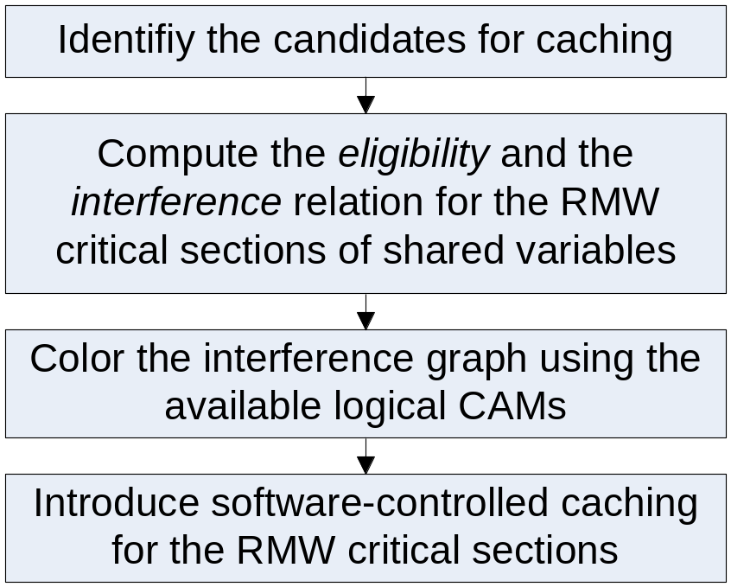
Framework of the Transformation

Slide 25
Selection of candidates
Candidates for caching
  A closed set of memory operations (with at least one WRITE) that access the shared variable
    It contains all the accesses that are in a dependence relationship with each other
  The addresses of those memory accesses must be in the syntactic form of base + offset
    base is common to all the memory accesses in the set (the cache look-up key )
    offset is an integer constant.

Slide 26
Candidates for Caching

Slide 27
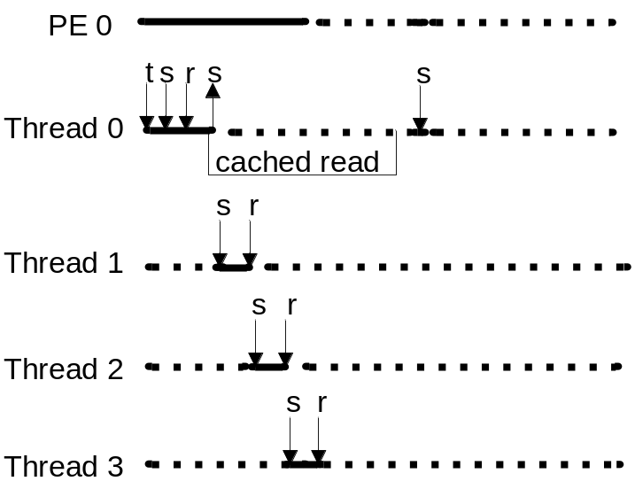
Free of Deadlock
There are no deadlocks when caching is not introduced
  No circular wait
With software-controlled caching, deadlock is possible

Slide 28
Pipelined Execution of RMW Critical Sections

Slide 29
Eligibility
In software-control caching, the first thread waits for a signal from the last thread in the PE before entering the second phase
  If this may cause deadlocks in the program, the associated RMW critical section is not eligible for caching
The candidate is eligible for caching iff
  If there is a path from an AWAIT(r) operation to an ADVANCE operation of the first phase, there is an ADVANCE(r) in every path from the source to an AWAIT operation of the second phase

Slide 30
Ordered Software-Controlled Caching

Slide 31
Interference
When two caching schemas use the same logical CAM, the first thread waits for a signal from the last thread in the PE before executing the second caching schema
  If this may cause deadlocks in the program, those two associated RMW critical sections interfere with each other
Two caching schemas does not interfere iff
  If there is a path from an AWAIT(t) operation to an ADVANCE operation of the second phase of the first caching schema, there is an ADVANCE(t) operation in every path from the source to an AWAIT operation of the first phase of the second caching schema

Slide 32
Assigning Logical CAMs
Coloring eligible candidates
  Based on the interference relation
  Using available logical CAMs as color

Slide 33
Agenda
Network processors
Auto-Partitioning programming model
Pipelined execution of critical sections
The automatic transformation
Experimental Evaluations
Conclusions

Slide 34
Experiments
The transformation: implemented in the Inter® Auto-partitioning C Compiler for IXP
Benchmark: 10GbE Core/Metro Router
Three versions studied
  Un-cached
  Cached sequential (caching introduced, and critical section not split and sequentially executed)
  Cached pipelined (caching introduce, and critical section split and executed in a pipelined fashion)
Speedup over baseline
  The baseline is the un-cached version running on a single PE using 8 threads

Slide 35
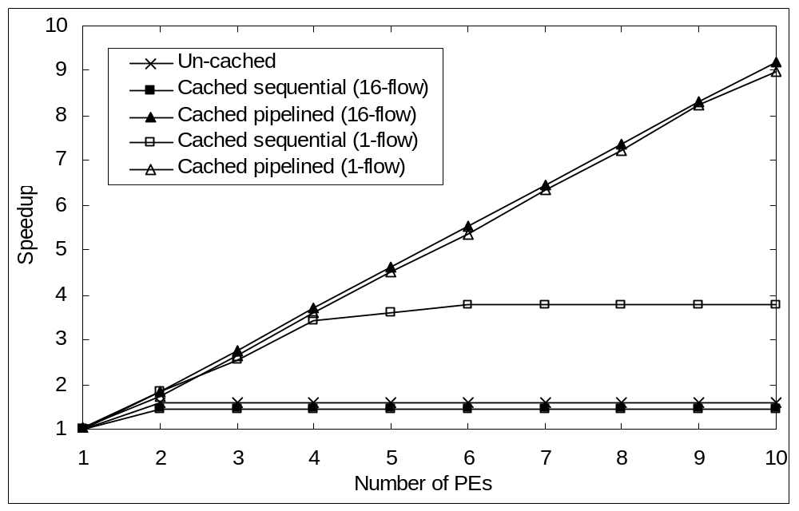
The Speedup of the Main Processing PPS (IPv4 Traffic)
The cache lookup key is (derived from) the packet flow id
  16-flow traffic – always miss (i.e., no locality)
  1-flow traffic – always hit (i.e., most data conflicts)

Slide 36
Conclusions
The transformation exploits the inherent finer-grain parallelism of the RMW critical sections using the software-controlled caching mechanisms
The experiments show that the transformation is both effective and critical in improving the performance and scalability of the real-world network applications.

Slide 37


