Slide 1
Data-centric Subgraph Mapping for Narrow Computation Accelerators
Amir Hormati, Nathan Clark,
and Scott Mahlke
Advanced Computer Architecture Lab.
University of Michigan

Slide 2






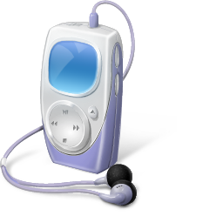

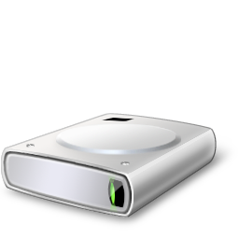



Introduction
Migration of applications
Programmability and cost issues in ASIC
More functionality in the embedded processor
Notes:
In today’s embedded systems, you can see a wide variety of applications such as image processing video processing security and encryption all running on a simple processor. Most of these application have high performance demands and they will change very often, for example encryption and encoding applications change almost every year because of the new standard coming out. The other property in this domain is that more applications are coming to the embedded domain every day. ASIC are traditional solution in this area but they simply can not keep up because the lack of programmability and high cost issues. So, the embedded system designers are trying to move from ASICs toward general purpose computing as much as possible. One of the solutions to this problem is using general purpose computation accelerators. With the general purpose accelerators you can efficiently accelerate a wide range of applicatoins without adding dedicated ASICs for each of them. Remember that our goal is not to eliminate ASICs all together but to mitigate the problems associated with ASICs to some extent.

Slide 3
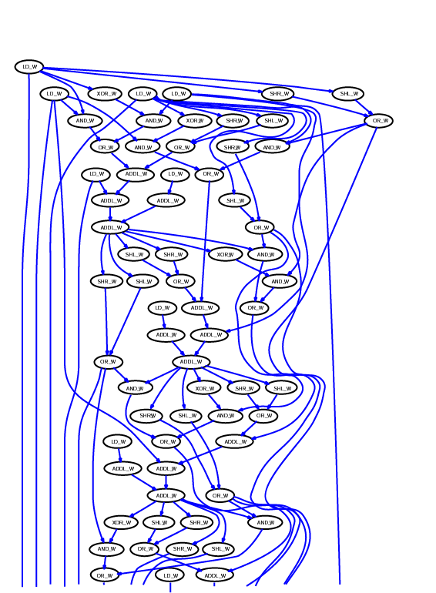
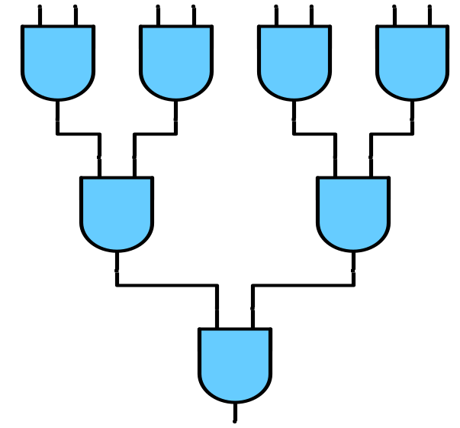


What Are the Challenges
Accelerator Hardware: Compiler Algorithm:
Notes:
Now let’s look at the problem in more detail. The first challenge that we are facing here is to find a general purpose accelerator that can accelerate a wide range of applications. Clearly this piece of hardware has to fall in the embedded system hardware specification. For example in terms of area and power it should be in a reasonable envelope. The other part of this challenge is the compilation algorithm. We need to find efficient compilation strategies for our targeted hardware. In other words, based on the program data flow graph and the accelerator hardware we want to efficiently find portions of this graph that can be executed on the accelerator, and replace them with atomic instructions.

Slide 4
Configurable Compute Array (CCA)
Input1
Input2
Input3
Input4
Array of FUs
Arithmetic/logic
32-bit functional units
Full interconnect between
rows
Supports 95% of all
computation patterns
(Nathan Clark, ISCA 2005)
Output1
Output2
Notes:
Now, let’s see what is inside the accelerator. Our universal general purpose accelerator, we call CCA from now on, is an array of functional units arranged in rows. It has 4 inputs, and 2 outputs. The light blue FUs can do both arithmetic and logic operations. The orange Fus can perform logic operations. There is full interconnect between rows and all of the FUs are 32-bit.

Slide 5
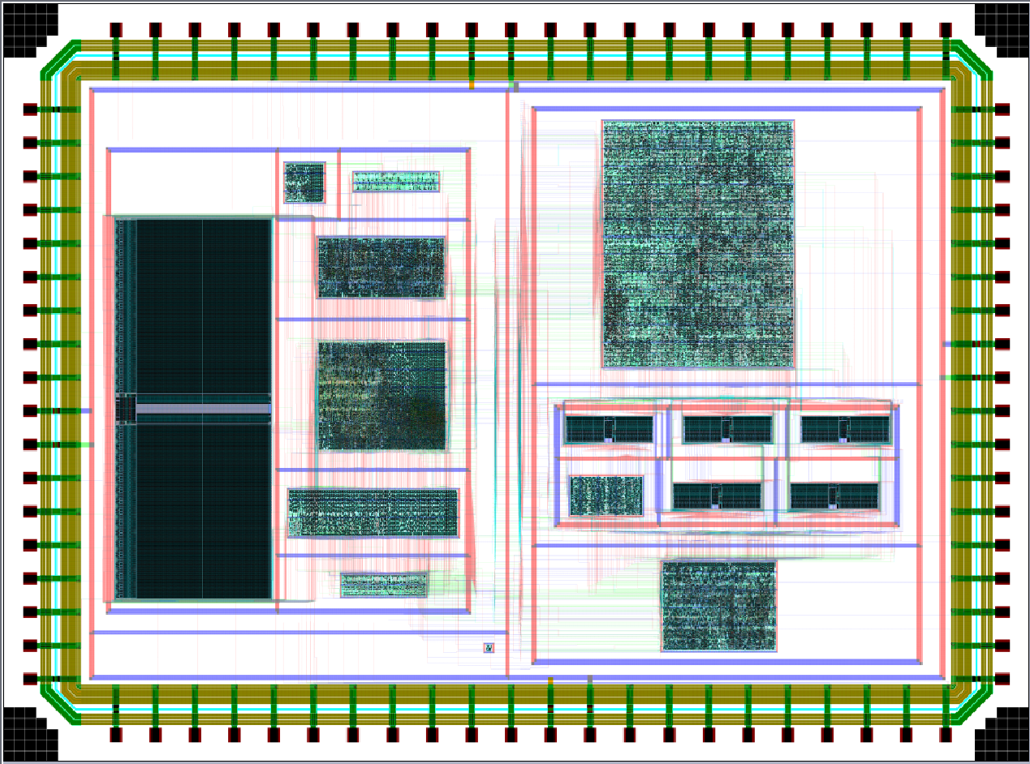
Report Card on the Original CCA
Easy to integrate to current embedded systems
High performance gain
however...
32-bit general purpose CCA:
  130nm standard cell library
  Area requirement: 0.3mm²
  Latency: 3.3ns
die photo of a processor with CCA
Notes:
ARM 9 (130nm) → 2.4mm^2 and Latency 250MHZ
ARM 11 (90nm) → > 500MHZ
Talk about pipelining

Slide 6
Objectives of this Work
Redesign of the CCA hardware
  Area
  Latency
Compilation strategy
  Code quality
  Runtime

Slide 7
Width Utilization
Full width of the FUs is not always needed.
Narrower FUs is not the solution.
Benchmark | Less than 16-bit | Less than 8-bit
Rawcaudio | 94% | 52%
Rawdaudio | 91% | 60%
Epic | 80% | 45%
Unepic | 74% | 40%
Cjpeg | 76% | 49%
Djpeg | 70% | 53%
 | Larger than 16-bit | Larger than 8-bit
3des | 86% | 90%
bitcount | 80% | 85%
rijndael | 50% | 64%

Slide 8
Width-Aware Narrow CCA
Input Registers
[8-31]
[8-31]
[8-31]
[8-31]
[
0
-
7
]
[
0
-
7
]
[
0
-
7
]
Width Checker
[
0
-
7
]
-
[8-31]
[8-31]
[8-31]
Carry bits
[8-31]
Iteration
Controller
CCA
Iterate
Carry Bits
Output Registers
Iterate
Output 1
Output 2
Notes:
`

Slide 9
Sparse Interconnect
Rank wires based on utilization.
>50% wires removed.
91% of all patterns are supported.
Input1
Input2
Input3
Input4
Input1
Input2
Input3
Input4
Output1
Output1
Output2
Output2

Slide 10
Synthesis Results
Synthesized using Synopsys and Encounter in 130nm library.
Accelerator Configuration | Latency (ns) | Area(mm²)
32-bit with full interconnect | 3.30 | 0.301
32-bit with sparse interconnect | 2.95 | 0.270
16-bit with full interconnect | 2.88 | 0.168
16-bit with sparse interconnect | 2.55 | 0.140
8-bit with full interconnect | 2.56 | 0.080
8-bit with sparse interconnect | 2.00 | 0.070
Width Checker | 0.39 | 0.002

Slide 11
Compilation Challenges
Best portions of the code
Non-uniform latency
What are the current solutions:
  Hand coding
  Function intrinsics
  Greedy solution
Notes:
The simplest solution to this problem is the greedy algorithm. In the greedy algorithm, you just look at the DFG and pick up a random seed. Instead of random you can also pick the seed topologically. After picking the seed, the algorithm tries to expands the seed in both directions as much as possible.
The greedy algorithm has its own advantages and disadvantages. Obviously it is a very easy algorithm to implement and it is fairly fast. The problem of this algorithm is the optimality of the results. It could actually end up finding suboptimal solutions. On top of these problems, non of these techniques can deal with non-uniform latency.

Slide 12
Step 1: Enumeration
Live In
Live In
ADD
3
3
3
ADD
6
ADD
ADD
5
AND
Live In
4
AND
4
OR
AND
7
1
6
ADD
ADD
XOR
8
Live Out
7
2
3
OR
ADD
CMP
8
XOR
AND
5
Live Out
ADD
6
Live Out
Notes:
The primary reason for enumerating subgraphs and then later pruning them is that it is much faster than performing both steps at once.

Slide 13
Step 2: Subgraph Isomorphism Pruning
Ensure subgraphs can run on accelerator
<<
<<
<<
<<
<<
<<
8
*
*
*
*
*
*
*
3
Logic
3
3
3
3
AND
SHL
3
A
A
A
A
A
A
A
B
B
B
B
B
B
B
C
C
C
C
C
C
3
8
C
SUB
SHRA
>>
>>
>>
>>
>>
10
10
>>
>>
>>
>>
10
>>
>>
6
+/-
+/-
6
6
6
6
10
D
6
D
D
D
D
D
D
E
E
E
E
E
E
E
F
F
F
F
F
F
F
ADD
11
+/-
+/-
+/-
+/-
+/-
+/-
+/-
+/-
+/-
+/-
11
11
11
11
G
G
G
G
G
G
G
H
H
H
H
H
H
H
Notes:
It is hard to do heavy constraint checks during the enumeration. In the pruning phase we use subgraph isomorphism techniques to ensure that a subgraph can actually get executed on the accelerator. This phase takes into account the functionality and connectivity issues that were ignored during the enumeration.

Slide 14
Step 3: Grouping
Live In
Live In
Live In
Live In
3
3
E
ADD
E
ADD
5
C
5
B
Live In
C
4
B
Live In
4
AND
AND
AND
1
AND
6
1
6
ADD
A
ADD
ADD
A
ADD
Live Out
7
2
Live Out
7
2
F
OR
AC
F
OR
CMP
D
CMP
D
8
8
Live Out
XOR
Live Out
XOR
Live Out
Live Out
Assuming A and C are the only possibilities for grouping.

Slide 15
Dealing with Non-uniform Latency
 | W^{[0,8]} | W^{[9,16]} | W^{[17,24]} | W^{[25,32]} | Average Latency
ADD | 100% | 0% | 0% | 0% | 1
OR | 0% | 50% | 0% | 50% | 3
AND | 0% | 50% | 50% | 0% | 2.5
Subgraph Cost:3 Benefit: 0
ADD
OR
AND
A
B
C
24 bit
8 bit
Average Latency =2
Average Latency =2
Average Latency =2
8 bit
24 bit
8 bit
24 bit
Time
>94% do not change width
Notes:
The cost function does not take time into account.

Slide 16

Step 4: Unate Covering
Width
Op ID
AC
D
G
H
…
N
Width | Op ID | A | B | C | AC | D | E | F | G | H | … | N
24 | 1 | 1 |  |  | 1 |  |  |  | 1 |  | …
8 | 2 | 1 |  |  | 1 |  |  |  |  | 1 | …
24 | 3 |  | 1 | 1 | 1 |  | 1 |  |  |  | …
8 | 4 |  |  | 1 | 1 |  | 1 |  |  |  | …
32 | 5 |  | 1 |  |  |  | 1 |  |  |  | …
32 | 6 |  | 1 |  |  |  |  | 1 |  |  | …
8 | 7 |  |  |  |  | 1 |  | 1 |  |  | …
8 | 8 |  |  |  |  | 1 |  | 1 |  |  | … | 1
Cost |  | 3 | 4 | 3 | 3 | 1 | 4 | 4 | 1 | 1 | … | 1
Benefit |  | -1 | -1 | -1 | 1 | 1 | -1 | -1 | 0 | 0 | … | 0
24
1
1
1
…
8
2
1
1
…
24
3
1
…
8
4
1
…
32
5
…
32
6
…
8
7
1
…
8
8
1
…
1
Cost
3
1
1
1
…
1
Benefit
1
1
0
0
…
0

Slide 17
Experimental Evaluation
ARM port of Trimaran compiler system
Processor model
  ARM-926EJS
  Single issue, in-order execution, 5 stage pipeline
  I/D caches : 16k, 64-way
Hardware simulation: SimpleScalar 4.0
Notes:
_{<number>}
_{<footer>}
_{<header>}
_{<date/time>}
untill now, we explained the way we utilize the CCA.
There were two steps for utilization of the CCA and two approaches were proposed for each of the steps.
And, I will introduce the experimental result of the use of CCA.
experiment was performed under simplescalar toolset, and following is the processor model used in these experiments.

Slide 18
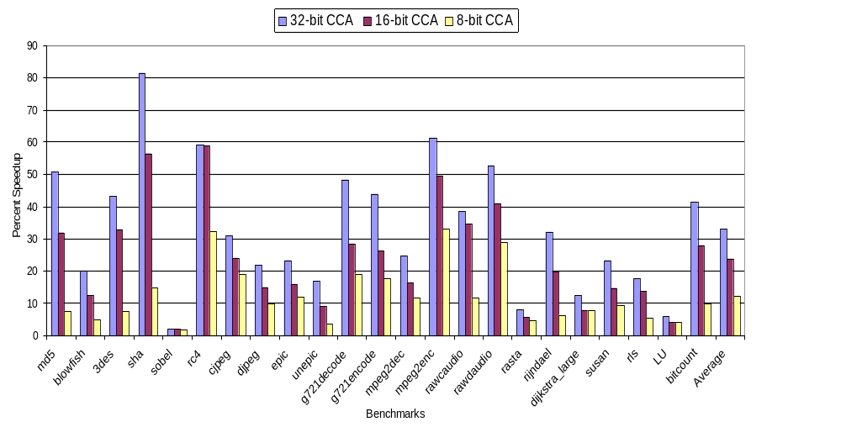
Comparison of Different CCAs
16-bit and 8-bit CCAs are 7% and 9% better than 32-bit CCA.
Assuming clock speed(1/(3.3ns) = 300 MHZ)

Slide 19
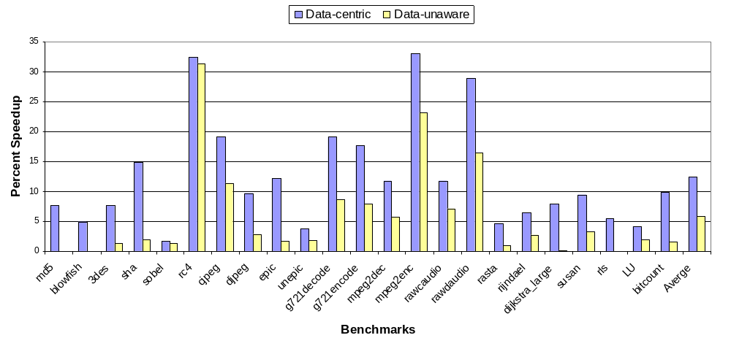
Comparison of Different Algorithms
Previous work: Greedy 10% worse than data-unaware

Slide 20
Conclusion
Programmable hardware accelerator
Width-aware CCA: Optimizes for common case.
  64% faster clock
  4.2x smaller
Data-centric compilation: Deals with non-uniform latency of CCA.
  Average 6.5%,
  Max 12% better than data-unaware algorithm.

Slide 21
?
For more information: http://cccp.eecs.umich.edu/

Slide 22
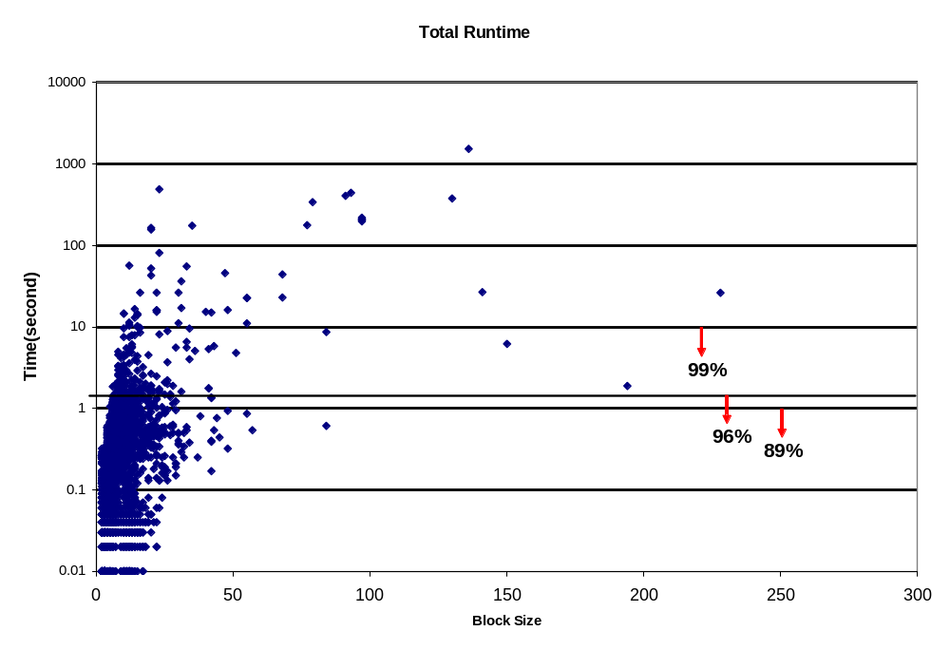
Data-Centric FEU

Slide 23
Operation of Narrow CCA
[(0x1D + 0x0C) + (0x20 OR 0x08)]
1
D
0
C
2
0
0
8
1
D
0
C
2
0
0
8
A
B
C
D
A
B
C
D
0
0
1
ADD
0
OR
FU
FU
ADD
OR
ADD
OR
1
0
0
0
0
0
9
8
2
2
0
1
ADD
FU
ADD
ADD
1
0
0
5
1
1

Slide 24
Data-Centric Subgraph Mapping
Enumerate
  All subgraphs
Pruning
  Subgraph isomorphism
Grouping
  Iteratively group
  disconnected subgraphs
Selection
  Unate covering
Shrink search space to control runtime
Enumeration
Pruning
Grouping
Selection

Slide 25
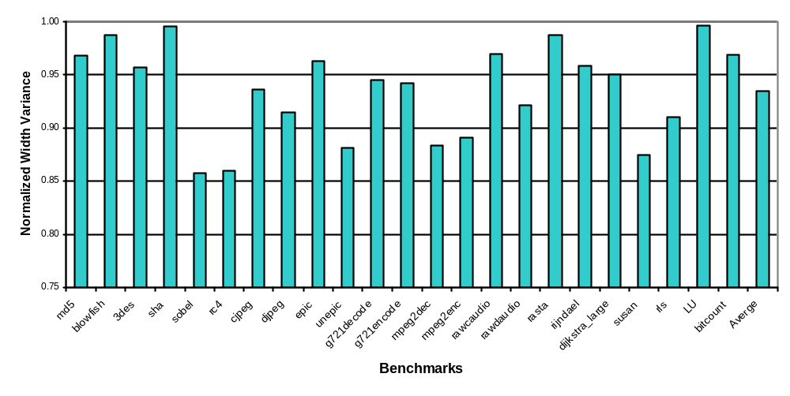
How Good is the Cost Function
Almost all of the operands have the same width range through out the execution.

Slide 26
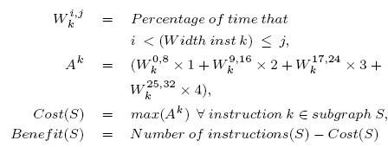

Slide 27
Width Utilization
Full width of the FUs is not always needed.
Replacing FUs with narrower FUs is not a good idea by itself.
Benchmark | Less than 16-bit | Less than 8-bit
Rawcaudio | 94% | 52%
Rawdaudio | 91% | 60%
Epic | 80% | 45%
Unepic | 74% | 40%
Cjpeg | 76% | 49%
Djpeg | 70% | 53%
 | Larger than 16-bit | Larger than 8-bit
3des | 86% | 90%
bitcount | 80% | 85%
rijndael | 50% | 64%

Slide 28

Introduction
Migration of applications
Programmability and cost issues in ASIC
More functionality in the embedded processor
Notes:
In today’s embedded systems, you can see a wide variety of applications such as image processing video processing security and encryption all running on a simple processor. Most of these application have high performance demands and they will change very often, for example encryption and encoding applications change almost every year because of the new standard coming out. The other property in this domain is that more applications are coming to the embedded domain every day. ASIC are traditional solution in this area but they simply can not keep up because the lack of programmability and high cost issues. So, the embedded system designers are trying to move from ASICs toward general purpose computing as much as possible. One of the solutions to this problem is using general purpose computation accelerators. With the general purpose accelerators you can efficiently accelerate a wide range of applicatoins without adding dedicated ASICs for each of them. Remember that our goal is not to eliminate ASICs all together but to mitigate the problems associated with ASICs to some extent.

Slide 29
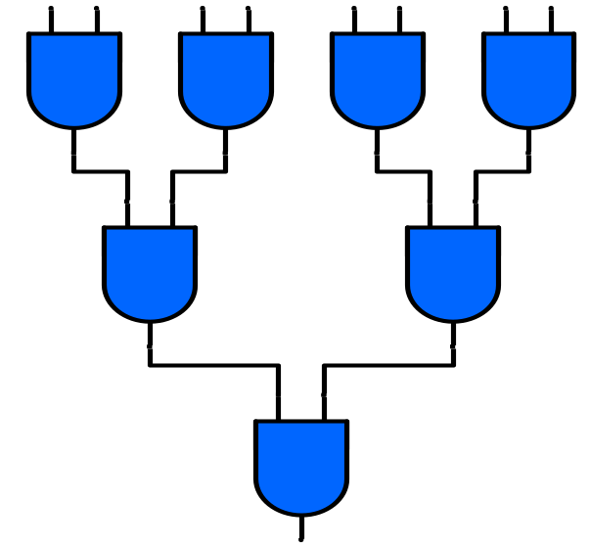
What Are the Challenges
Accelerator Hardware: Compiler Algorithm:
Notes:
Now let’s look at the problem in more detail. The first challenge that we are facing here is to find a general purpose accelerator that can accelerate a wide range of applications. Clearly this piece of hardware has to fall in the embedded system hardware specification. For example in terms of area and power it should be in a reasonable envelope. The other part of this challenge is the compilation algorithm. We need to find efficient compilation strategies for our targeted hardware. In other words, based on the program data flow graph and the accelerator hardware we want to efficiently find portions of this graph that can be executed on the accelerator, and replace them with atomic instructions.

