Slide 1


Heterogeneous Clustered VLIW Microarchitectures
Northeastern University
CGO’07, San Jose, California - March 2007
Alex Aletà, Josep M. Codina, Antonio González and David Kaeli

Slide 2
Clustered Microarchitectures
Challenges in processor design
  Wire delays
  Power consumption
Clustering: divide the system into semi-independent units
  Each unit ⇒ Cluster
    Fast interconnects intra-cluster
    Slow interconnects inter-clusters
  Common trend in commercial VLIW processors
    DSP/embedded domain
Notes:
So let’s go...
Development of technology allows us to
Put more logic in a chip
Use faster clocks
However, this development generates new challenges. May be the 3 main issues that the researchers have to face up are…
the delay of the wires relative to the delay of the gates
One promising technique to deal with these difficulties is the design of the microprocessor with clusters.
In this way, the system is divided in computational units that can work almost independently.
Each one of these units is called cluster and is typically composed of some functional units and a local register file.
The rest of resources are centralized.
Then, some inter-cluster network is required to communicate values among clusters. !!!! no dir busos pq hi ha altres maneres d’interconnexio!!!!
In fact, clustering is already a common trend in commercial VLIW processors.
VLIW processors are very popular in the DSP and the embedded domain

Slide 3
Clustered VLIW Architecture
Clustered VLIW processor
I-CACHE
Register buses
REGISTER FILE
CLUSTER
1
CLUSTER
2
CLUSTER
N
INT
INT
FP
FP
MEM
MEM
DATA CACHE
DATA CACHE
MAIN MEMORY
Notes:
Here we can see a picture of a clustered architecture
N clusters
an interconnection network (we have assumed buses)
centralized data cache
The figure on the right is a cluster
It’s own register file
Can access the bus
Functional units and memory ports
Memory ports access the centralized cache
Instruction cache

Slide 4
Motivation
Not all instructions have the same impact on execution time
A
I
B
L
Divide resources
  Performance oriented clusters
    Higher voltages
    Faster
    Place critical instructions
  Power oriented clusters
    Lower voltages
    Consume less power
    Place non-critical instructions
J
C
M
K
D
N
E
F
G
Heterogeneous Microarchitecture
H
Notes:
So let’s go...
Development of technology allows us to
Put more logic in a chip
Use faster clocks
However, this development generates new challenges. May be the 3 main issues that the researchers have to face up are…
the delay of the wires relative to the delay of the gates
One promising technique to deal with these difficulties is the design of the microprocessor with clusters.
In this way, the system is divided in computational units that can work almost independently.
Each one of these units is called cluster and is typically composed of some functional units and a local register file.
The rest of resources are centralized.
Then, some inter-cluster network is required to communicate values among clusters. !!!! no dir busos pq hi ha altres maneres d’interconnexio!!!!
In fact, clustering is already a common trend in commercial VLIW processors.
VLIW processors are very popular in the DSP and the embedded domain

Slide 5
Motivation
 | C0 | C1 | C2 | ICN
Cycle time | 1 | 1 | 1 | 1
A
Homogeneous
I
B
L
J
C
M
Cycle | C0 | C1 | C2 | Bus
0 | A
1 | B |  |  | Com A
2 | C | I | L
3 | D | J | M
4 | E | K | N
5 | F
6 | G
7 | H
K
D
N
Scheduling
E
F
G
H
Notes:
So let’s go...
Development of technology allows us to
Put more logic in a chip
Use faster clocks
However, this development generates new challenges. May be the 3 main issues that the researchers have to face up are…
the delay of the wires relative to the delay of the gates
One promising technique to deal with these difficulties is the design of the microprocessor with clusters.
In this way, the system is divided in computational units that can work almost independently.
Each one of these units is called cluster and is typically composed of some functional units and a local register file.
The rest of resources are centralized.
Then, some inter-cluster network is required to communicate values among clusters. !!!! no dir busos pq hi ha altres maneres d’interconnexio!!!!
In fact, clustering is already a common trend in commercial VLIW processors.
VLIW processors are very popular in the DSP and the embedded domain

Slide 6
Motivation
 | C0 | C1 | C2 | ICN
Cycle time | 1 | 2 | 2 | 1
A
Heterogeneous
I
B
L
J
C
M
Cycle | C0 | C1 | C2 | Bus
0 | A
1 | B |  |  | Com A
2 | C | I | L
3 | D
4 | E | J | M
5 | F
6 | G | K | N
7 | H
K
D
N
Scheduling
E
F
G
H
Notes:
So let’s go...
Development of technology allows us to
Put more logic in a chip
Use faster clocks
However, this development generates new challenges. May be the 3 main issues that the researchers have to face up are…
the delay of the wires relative to the delay of the gates
One promising technique to deal with these difficulties is the design of the microprocessor with clusters.
In this way, the system is divided in computational units that can work almost independently.
Each one of these units is called cluster and is typically composed of some functional units and a local register file.
The rest of resources are centralized.
Then, some inter-cluster network is required to communicate values among clusters. !!!! no dir busos pq hi ha altres maneres d’interconnexio!!!!
In fact, clustering is already a common trend in commercial VLIW processors.
VLIW processors are very popular in the DSP and the embedded domain

Slide 7
Talk Outline
Heterogeneous Clustered Architecture
Proposed Compiler Techniques
Experimental Evaluation
Conclusions

Slide 8
Heterogeneous Architecture
Configured similar to a multiple clock domain design
  Domain boundaries:
    Each cluster
    Inter-connection Network
    Memory hierarchy
Each domain can use a different voltage / frequency
  Performance oriented: higher voltage/frequency
  Power oriented: lower voltage/frequency
Communication between domains: synchronization queues
Notes:
So let’s go...
Development of technology allows us to
Put more logic in a chip
Use faster clocks
However, this development generates new challenges. May be the 3 main issues that the researchers have to face up are…
the delay of the wires relative to the delay of the gates
One promising technique to deal with these difficulties is the design of the microprocessor with clusters.
In this way, the system is divided in computational units that can work almost independently.
Each one of these units is called cluster and is typically composed of some functional units and a local register file.
The rest of resources are centralized.
Then, some inter-cluster network is required to communicate values among clusters. !!!! no dir busos pq hi ha altres maneres d’interconnexio!!!!
In fact, clustering is already a common trend in commercial VLIW processors.
VLIW processors are very popular in the DSP and the embedded domain

Slide 9
Heterogeneous Architecture
Clustered VLIW processor
synchronization
queues
Register buses
I-CACHE
REGISTER FILE
CLUSTER
1
CLUSTER
2
CLUSTER
N
INT
INT
FP
FP
MEM
MEM
DATA CACHE
MAIN MEMORY
DATA CACHE
Notes:
Here we can see a picture of a clustered architecture
N clusters
an interconnection network (we have assumed buses)
centralized data cache
The figure on the right is a cluster
It’s own register file
Can access the bus
Functional units and memory ports
Memory ports access the centralized cache
Instruction cache

Slide 10
Distributed Control Path
Fetch and decode units distributed among clusters
  Instruction lay-out
    Grouped by cluster
Centralized Control Path
I¹_{C1}
I¹_{C2}
I¹_{C3}
I¹_{C4}
I²_{C1}
I²_{C2}
I²_{C3}
I²_{C4}
I³_{C1}
I³_{C2}
I³_{C3}
I³_{C4}
PC
PC₁
PC₂
...
...
I¹_{C1}
I²_{C1}
I³_{C1}
I¹_{C2}
I²_{C2}
I³_{C2}
Distributed
Control Path
...
...
I¹_{C3}
I²_{C3}
I³_{C3}
I¹_{C4}
I²_{C4}
I³_{C4}
[Zhong et al. PACT’05]
PC₃
PC₄
Notes:
So let’s go...
Development of technology allows us to
Put more logic in a chip
Use faster clocks
However, this development generates new challenges. May be the 3 main issues that the researchers have to face up are…
the delay of the wires relative to the delay of the gates
One promising technique to deal with these difficulties is the design of the microprocessor with clusters.
In this way, the system is divided in computational units that can work almost independently.
Each one of these units is called cluster and is typically composed of some functional units and a local register file.
The rest of resources are centralized.
Then, some inter-cluster network is required to communicate values among clusters. !!!! no dir busos pq hi ha altres maneres d’interconnexio!!!!
In fact, clustering is already a common trend in commercial VLIW processors.
VLIW processors are very popular in the DSP and the embedded domain

Slide 11
Talk Outline
Heterogeneous Clustered Architecture
Proposed Compiler Techniques
Experimental Evaluation
Conclusions

Slide 12
Statically Scheduled Processors
Performance relies on the compiler
  Instruction scheduling
  Register allocation
  Clustered microarchitectures
    Cluster assignment
    Communications
Multimedia and numeric code
  Majority of the execution in loop bodies
  Modulo scheduling
Notes:
Then, for statically scheduled processors (such as VLIW) performance relies very much on the compiler
For such architectures, it is very important to make a good instruction scheduling. This is a complex task because:
resource constraints
dependences among instructions
Besides, if we are targeting a clustered architecture, there is an additional problem
communications …
In this work we focus on instruction scheduling for loops. in particular, we use MS
MS is a technique that overlaps the execution of different iterations of loop
Very effective for multimedia and numeric code
Therefore, MS puts additional pressure on resources
In particular, on the register buses

Slide 13
Modulo Scheduling
Iteration space
Effective technique for scheduling loops
  Overlaps loop iterations
  Increases parallelism
cycle 1
1st It
A
cycle 2
B
3rd It
cycle 3
C
A
2nd It
4th It
Time
cycle 4
A
B
A
Kernel: pattern repeated every II cycles
cycle 5
B
C
B
II ≥MII (Minimum Initiation Interval)
Constrained by resources and recurrences
MII = max {resMII, recMII}
cycle 6
C
C
Notes:
To schedule the loops we use MS…
…which is an effective software pipelining technique that overlaps the execution of different iterations of a loop
A new iteration can be started before the previous one has finished
Hence, it increases parallelism
But at the expense of putting additional pressure on resources
In particular, on registers
After a certain number of cycles we reach a stable state: kernel
We iterate the kernel every II cycles
The instructions launched in each kernel iteration belong to different original iterations

Slide 14
MS for Heterogeneous
Iteration space
cycle 1
1st It
A
cycle 2
B
Each cluster has its own II
Constant Iteration Time (IT)
cycle 3
D
2nd It
Kernel
C
cycle 4
A
E
A
E
Time
cycle 5
B
B
MIT = max {resMIT, recMIT}
cycle 6
D
3rd It
C
D
C
E
A
B
C
D
E
Notes:
Then, for statically scheduled processors (such as VLIW) performance relies very much on the compiler
For such architectures, it is very important to make a good instruction scheduling. This is a complex task because:
resource constraints
dependences among instructions
Besides, if we are targeting a clustered architecture, there is an additional problem
communications …
In this work we focus on instruction scheduling for loops. in particular, we use MS
MS is a technique that overlaps the execution of different iterations of loop
Very effective for multimedia and numeric code
Therefore, MS puts additional pressure on resources
In particular, on the register buses

Slide 15
Proposed Technique
Profile homogenous
architecture
Select frequencies
and voltages
Modulo Scheduling

Slide 16
Select Voltages and Frequencies
For each domain
At program level
Consider different delays between fast and slow domains
  Estimate execution time
  Estimate energy consumption
  Select minimum ED²

Slide 17
Estimate Execution Time
Use profiling
  T_{exec}= n_{iters} · (II + SC - 1) · T_{cycle}
Estimated IT
  Enough to accommodate
    All instructions
    All recurrences
    Value lifetimes of the profiled homogeneous
    Communications required by the profiled homogeneous
Notes:
The IT has to be big enough to accommodate the
Instructions
The register requirements
The communications
Of the profiled homogeneous

Slide 18
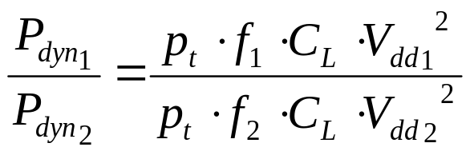
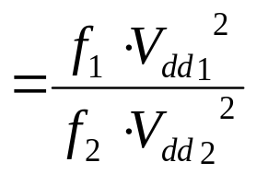
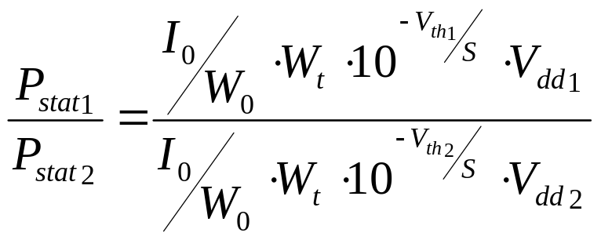
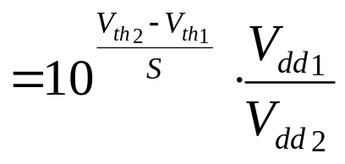
Estimate Energy Consumption
Same microarchitecture, different voltages
  Relative dynamic power
  Relative static power
Notes:
Use the profiled homogeneous architecture as baseline
Compute relative power with respect to this baseline

Slide 19
MS Algorithm
Compute
MIT
IT:=MIT
Select IIs
& freqs
OK?
NO
Increase
IT
Cluster | Supported cycle times
C0 | 1ns
C1 | 5/4 ns ; 4/3 ns ; 3/2 ns
IT= 7ns
II(C0)= 7 /1 = 7 cycles
II(C1)= 7 / 1.25 = 5.6
II(C1)= 7 / 1.3333 = 5.25
II(C1)= 7 / 1.5 = 4.667
IT= 8ns
II(C0)= 8 / 1= 8 cycles
II(C1)= 8 / 1.25 = 6.4
II(C1)= 8 / 1.3333 = 6

Slide 20
MS Algorithm
Compute
MIT
IT:=MIT
Select IIs
& freqs
OK?
NO
Increase
IT
YES
Partition
DDG
Schedule
Done
YES
OK?
NO

Slide 21
MS for Heterogeneous
Multilevel graph partitioning algorithm
  Coarsening
    Place critical recurrences in fast clusters
  Refinement
    Estimate execution time and energy consumption
    Optimize for ED²
Scheduling
  Instructions delayed due to synchronization hazards

Slide 22
Recurrence Constrained Loops
Large benefits expected
  A small number of instructions are critical for execution time
A
2-cycle latency instructions
4 clusters, 1 FU per cluster
B
Homogeneous
  Recurrence: 6 cycles
  II= 6 cycles (all clusters!) lots of unused slots
C
D
H
Heterogeneous
  1 fast cluster, cycle time= 1ns
  3 slow clusters, cycle time= 2ns
E
I
IT= 6ns
II(fast cluster)= 6
II(slow clusters)= 3
F
J
G
K

Slide 23
Talk Outline
Heterogeneous Clustered Architecture
Proposed Compiler Techniques
Experimental Evaluation
Conclusions

Slide 24
Experimental Environment
Microarchitecture
  Clusters
    4 clusters
    1 FP-unit, 1 INT-unit, 1 memory port, 16 registers per cluster
  Inter-connection Network
    1-cycle latency broadcast buses
  Heterogeneity
    Clusters: 1 performance oriented / 3 power oriented
Benchmarks:
  SpecFP2k Fortran programs
  Loops obtained with ORC
Baseline: homogeneous architecture

Slide 25
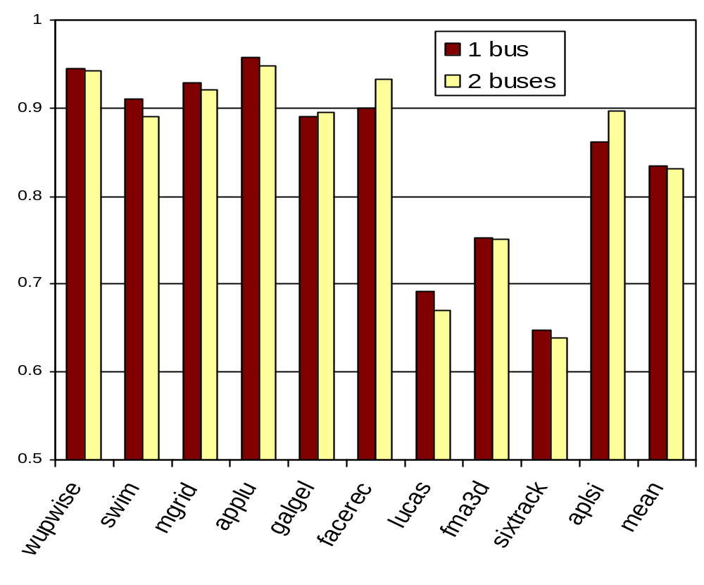
Results
ED²
17%
30%
35%

Slide 26
High ILP Programs
A
B
D
F
H
C
E
G
I
All instructions have a similar impact on execution time
  No benefit using different frequencies
  Higher IPC
    Dynamic energy accounts for a majority of the total energy consumption
    Use lower V_{dd} and lower frequencies
  Memory hierarchy and inter-connection network can use different voltages

Slide 27
Talk Outline
Heterogeneous Clustered Architecture
Proposed Compiler Techniques
Experimental Evaluation
Conclusions

Slide 28
Conclusions
Heterogeneous clustered architectures
  Clusters run at different voltages / frequencies
    Instructions that impact execution time scheduled in fast clusters
    Remaining instructions in power-oriented clusters
Proposed compiler techniques
  Algorithm to select the voltages / frequencies
  MS for heterogeneous configurations
ED² : 15% improvement on average
  Up to 35% for selected programs

Slide 29

Heterogeneous Clustered VLIW Microarchitectures
CGO’07, San Jose, California - March 2007
Alex Aletà, Josep M. Codina, Antonio González and David Kaeli

Slide 30
Motivating Example
 | C1 | Bus | C2
0 | A
1 | B | Comm A
2 | C |  | E
3 | D
A
B
E
 | C1 | C2
Cycle time | 1 ns | 1 ns
C
2 ns
 | C1 | Bus | C2
0 | A
1 | B | Comm A
2 | C |  | E
3 | D
D
Notes:
In this work we focus on VLIW architecutres
Require less power
Because they execute in order
So the compiler plays a critical role
In particular we study spill code generation
When register requirements are too high we can introduce store a value to memory to free up a register
Dir de paraula que ho farem per loops modulo scheduled q suporten molta pressio sobre registres pq se solapen instruccions

Slide 31
Heterogeneous Architecture
Signals
C₁
bus
enable_C₁
clock
Freq.
Multiplier
Divider
On Chip
Memory
sync
queues
enable_all
enable_mem
C_{N}
enable_C_{N}
Notes:
So let’s go...
Development of technology allows us to
Put more logic in a chip
Use faster clocks
However, this development generates new challenges. May be the 3 main issues that the researchers have to face up are…
the delay of the wires relative to the delay of the gates
One promising technique to deal with these difficulties is the design of the microprocessor with clusters.
In this way, the system is divided in computational units that can work almost independently.
Each one of these units is called cluster and is typically composed of some functional units and a local register file.
The rest of resources are centralized.
Then, some inter-cluster network is required to communicate values among clusters. !!!! no dir busos pq hi ha altres maneres d’interconnexio!!!!
In fact, clustering is already a common trend in commercial VLIW processors.
VLIW processors are very popular in the DSP and the embedded domain

Slide 32
Branch Instructions
Branches decoupled in several instructions (Unbundled Branch Architecture)
  Branch target computation
    Independent in each cluster
  Branch condition evaluation
    Computed in one cluster
    Broadcasted to the rest
  Control transfer
    Different in each cluster
Notes:
So let’s go...
Development of technology allows us to
Put more logic in a chip
Use faster clocks
However, this development generates new challenges. May be the 3 main issues that the researchers have to face up are…
the delay of the wires relative to the delay of the gates
One promising technique to deal with these difficulties is the design of the microprocessor with clusters.
In this way, the system is divided in computational units that can work almost independently.
Each one of these units is called cluster and is typically composed of some functional units and a local register file.
The rest of resources are centralized.
Then, some inter-cluster network is required to communicate values among clusters. !!!! no dir busos pq hi ha altres maneres d’interconnexio!!!!
In fact, clustering is already a common trend in commercial VLIW processors.
VLIW processors are very popular in the DSP and the embedded domain

Slide 33
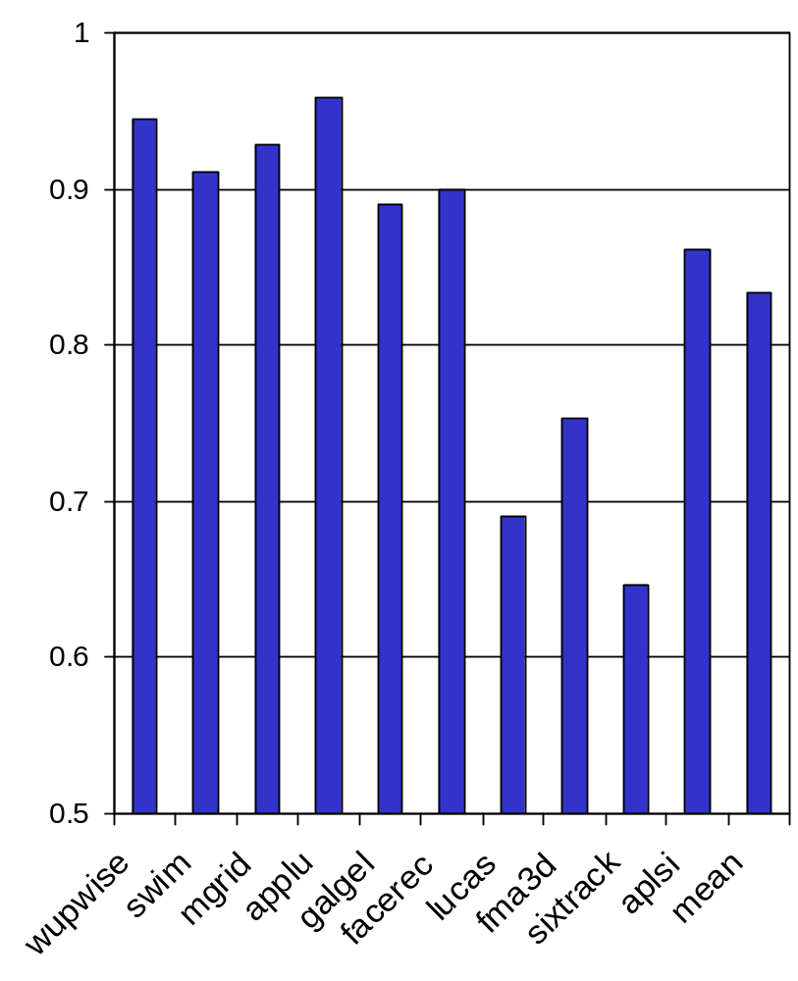
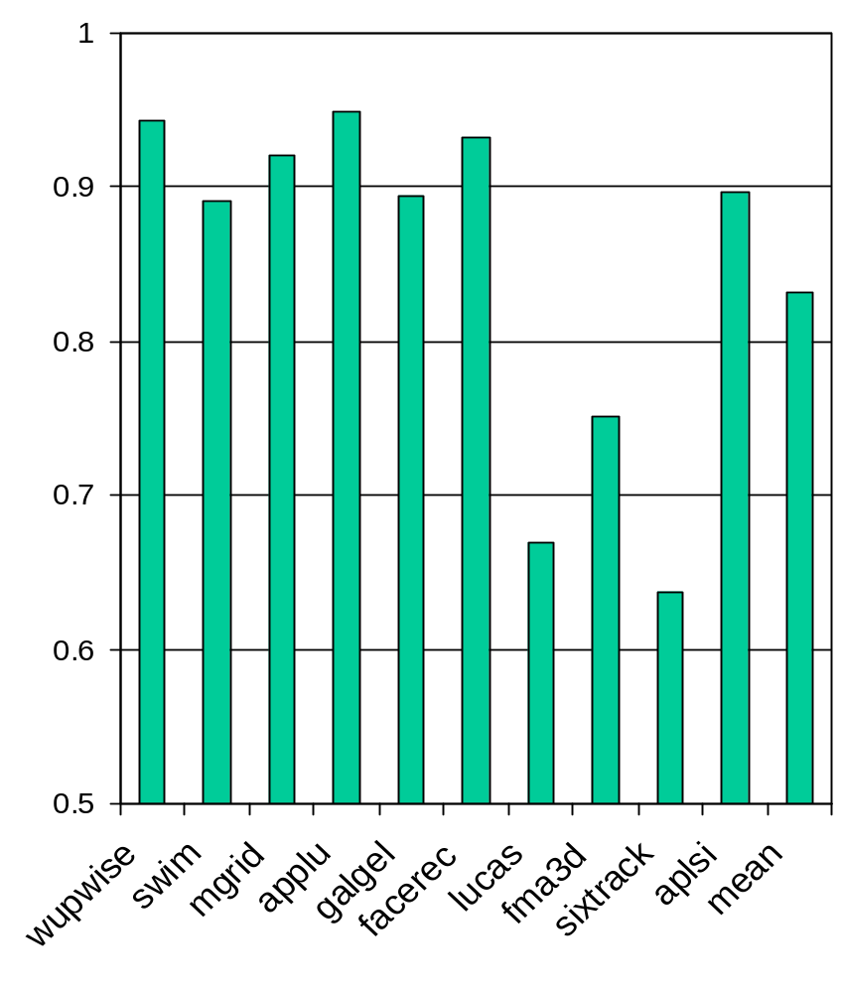
Results
ED²
1 bus
ED²
2 buses

Slide 34
Recurrence Constrained Loops
Largest benefits obtained
  A small number of instructions are critical for execution time
  Improvement: 30% - 35% for 189.lucas and 200.sixtrack
A
2-cycle latency instructions
4 clusters, 1 FU per cluster
B
Homogeneous
  Recurrence: 6 cycles
  II= 6 cycles (all clusters!) lots of unused slots
C
D
H
Heterogeneous
  1 fast cluster, cycle time= 1ns
  3 slow clusters, cycle time= 2ns
E
I
IT= 6ns
II(fast cluster)= 6
II(slow clusters)= 3
F
J
G
K

Slide 35
Smallest Benefits
Around 5%
  168.wupwise
    Loops have different characteristics
  173.applu
    Low number of iterations
    Schedule length has a big impact

