Slide 1

Performance is Dead,
Long Live Performance
Ben Zorn
Microsoft Research

Slide 2





Outline
Good news
Bad news
Good news again!
Mystery…
Ben Zorn CGO 2010 Keynote

Slide 3
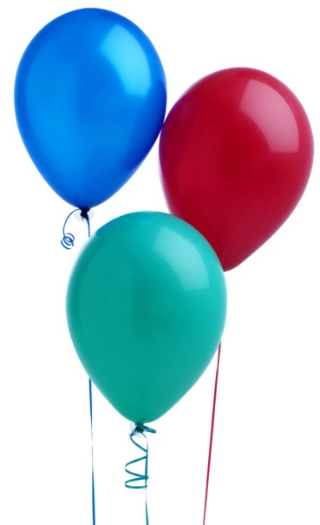
1990s
A Great Decade for Performance!
Stock market booming
Itanium processor shipping
Processor performance growing
exponentially (Moore’s Law)
Compiler research booming
Ben Zorn CGO 2010 Keynote

Slide 4
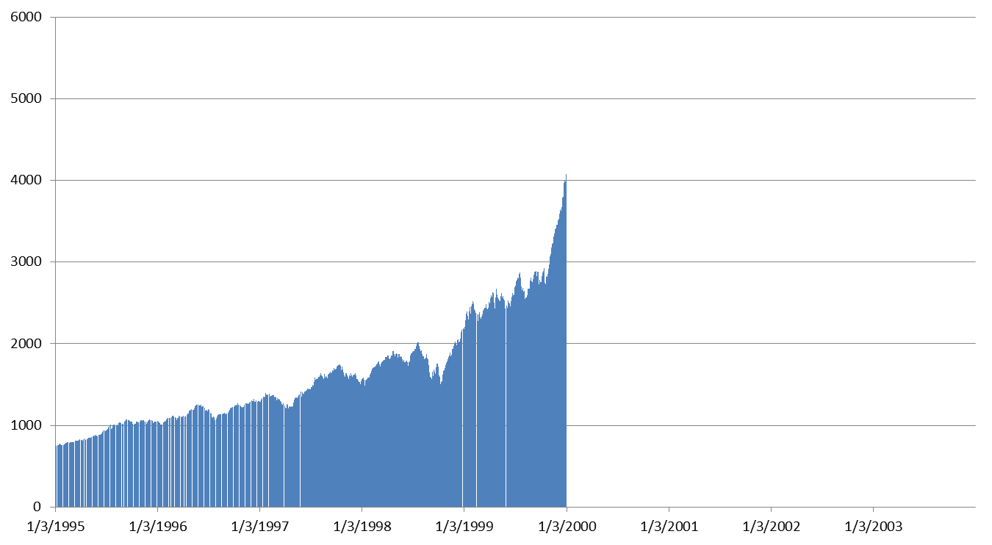

NASDAQ Booming
Ben Zorn CGO 2010 Keynote

Slide 5
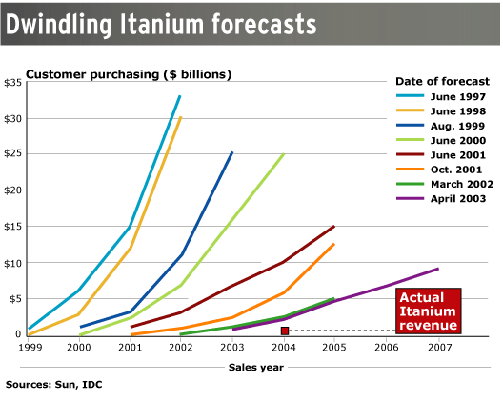

New Processors Had High Expectations
Itanium Sales Forecasts
Source: CNET Networks from data provided by Sun and IDC (12/7/2005)
Ben Zorn CGO 2010 Keynote

Slide 6
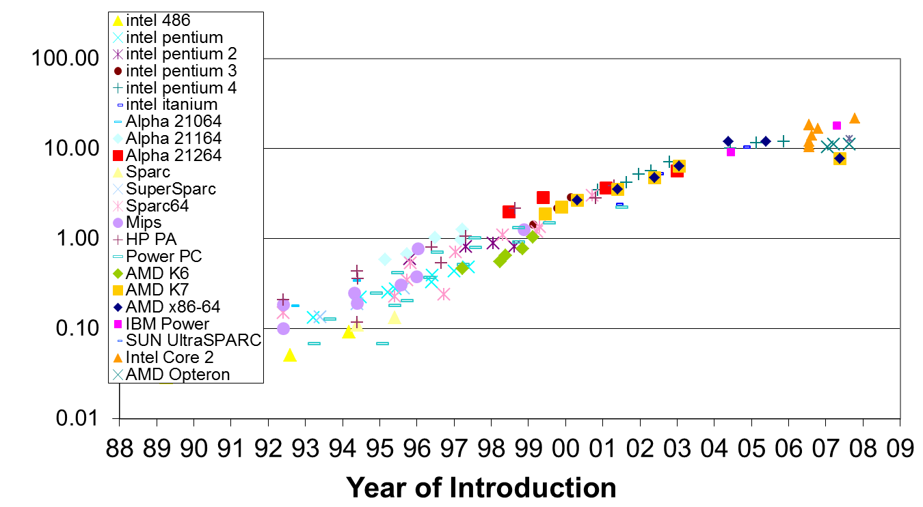

SPECint2006 CPU Performance
Numbers courtesy of Mark Horowitz, Ofer Shacham
Ben Zorn CGO 2010 Keynote

Slide 7

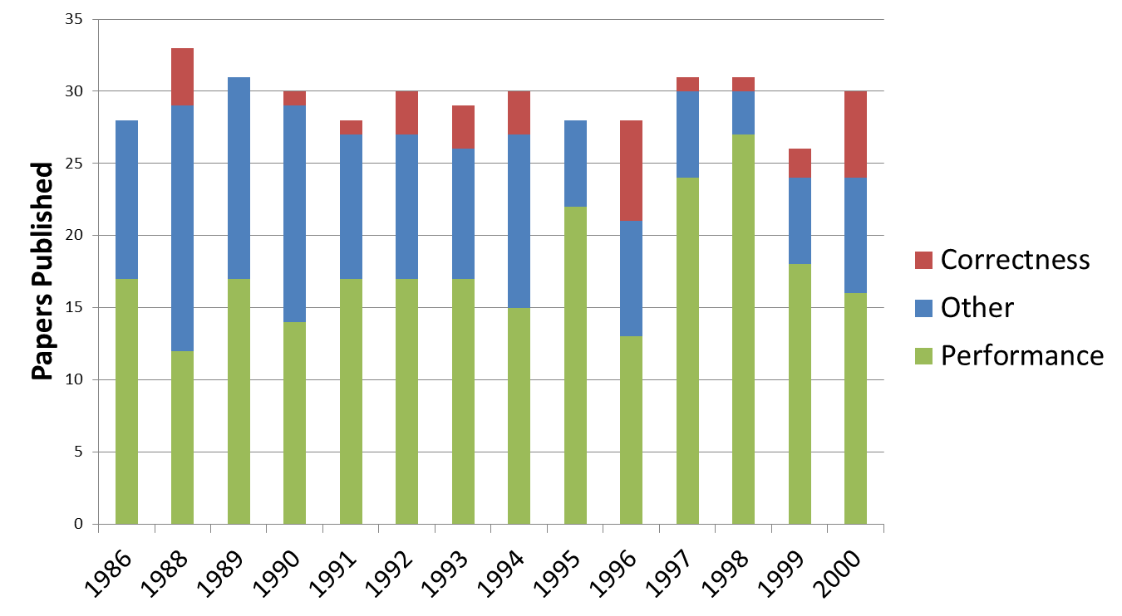
Performance Papers Dominate PLDI
Ben Zorn CGO 2010 Keynote

Slide 8

Some Cynics: Proebsting’s Law
Proebsting's Law: Compiler Advances Double Computing Power Every 18 Years
“…This means that while hardware computing horsepower increases at roughly 60%/year, compiler optimizations contribute only 4%. Basically, compiler optimization work makes only marginal contributions.”
http://research.microsoft.com/en-us/um/people/toddpro/papers/law.htm
Ben Zorn CGO 2010 Keynote

Slide 9
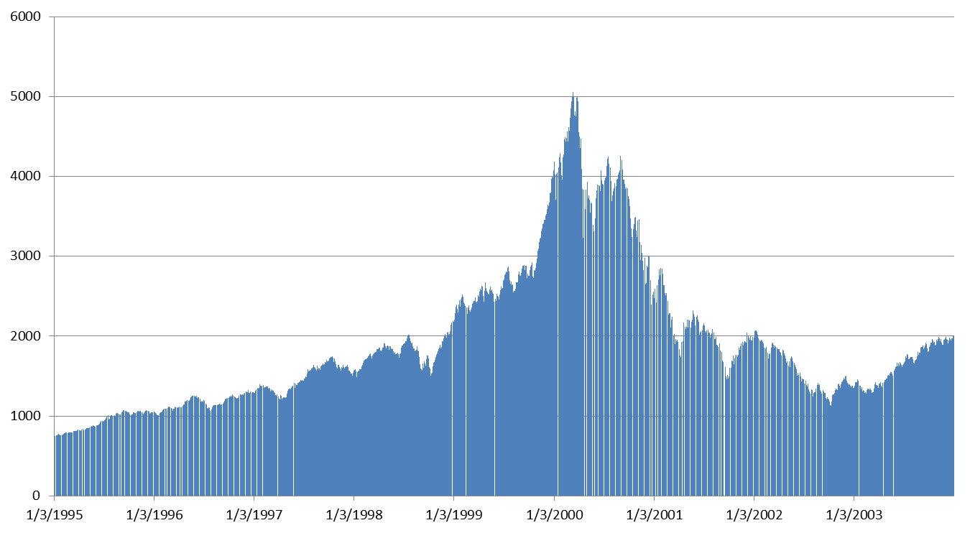

The Bubble Bursts
Ben Zorn CGO 2010 Keynote

Slide 10

Itanium Sales Lag
Source: CNET Networks from data provided by Sun and IDC (12/7/2005)
Ben Zorn CGO 2010 Keynote
http://news.cnet.com/2300-1006_3-5873647.html

Slide 11
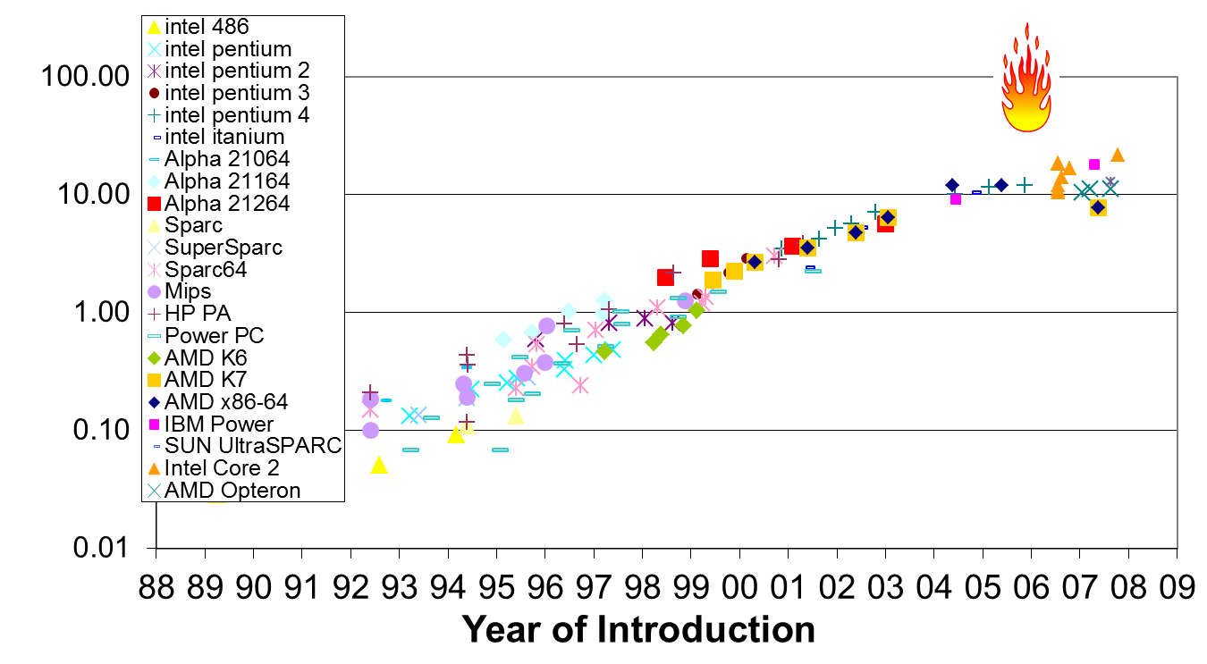
Uniprocessor Performance Flattens
4%/year sounding pretty good
Numbers courtesy of Mark Horowitz, Ofer Shacham
Ben Zorn CGO 2010 Keynote

Slide 12
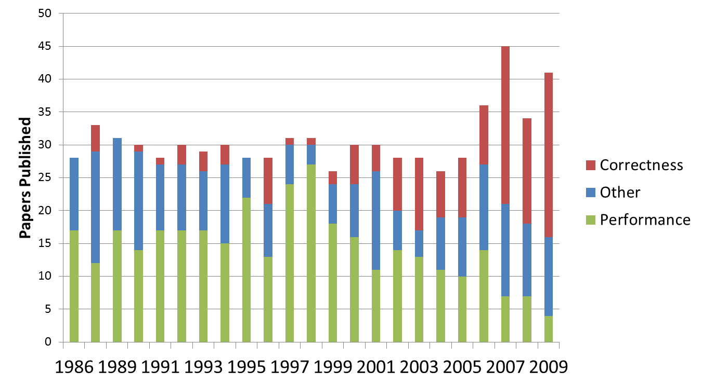
PLDI Performance Paper Decline
What
Happened?
Ben Zorn CGO 2010 Keynote

Slide 13
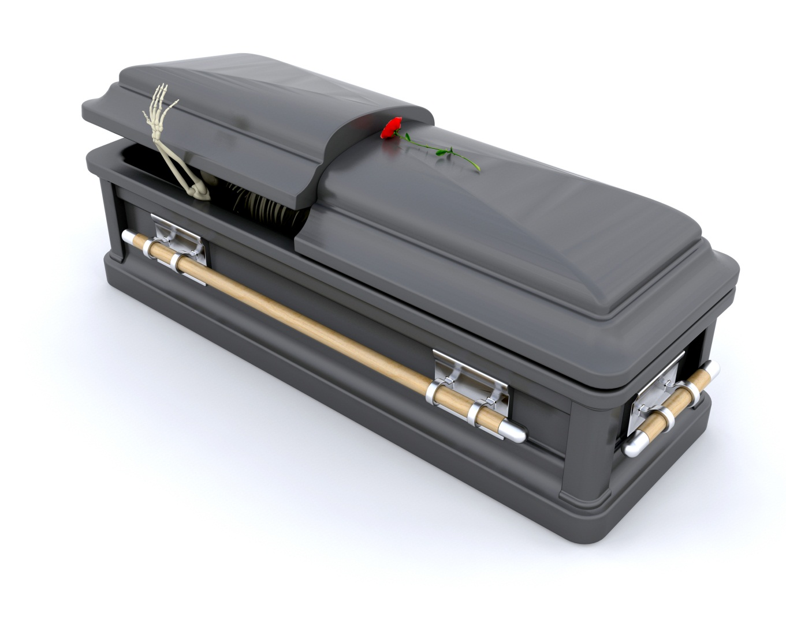
Performance is Dead
Ben Zorn CGO 2010 Keynote

Slide 14
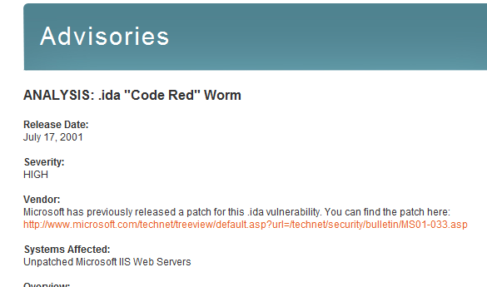
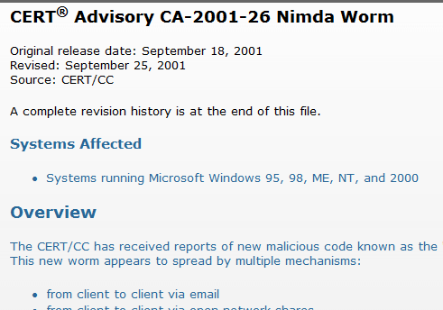
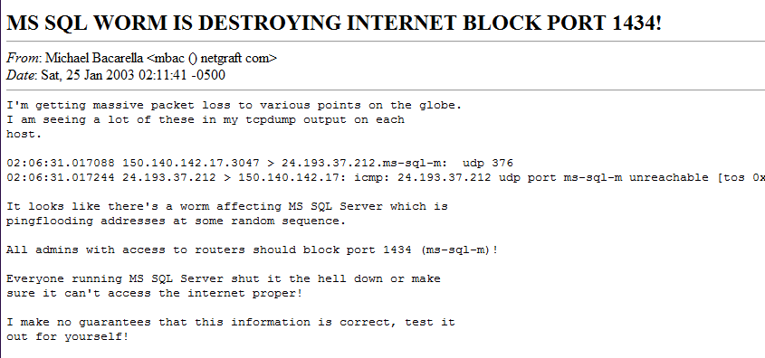
What Killed Performance?
Nimda
September 2001
Became largest worm
in 22 minutes
Code Red
July 2001
359k hosts, 1 day
Slammer
January 2003
Infected 90% of vulnerable
hosts in < 10 minutes
Ben Zorn CGO 2010 Keynote

Slide 15

Companies Shift Gears
Correctness and security a major new focus
Microsoft investments:
  PREfix, PREfast, SDV (Slam), ESP
  Large code bases automatically checked for correctness errors (10+ million LOC)
“Combined, the tools [PREfix and PREfast] found 12.5% of the bugs fixed in Windows Server 2003”
  “Righting Software”, Larus et al., IEEE Software, 2004
Ben Zorn CGO 2010 Keynote

Slide 16
Researchers Shift Gears
Ben’s research agenda changes
1990s
  Predicting object lifetime and locality
  (with David Barrett and Matt Seidl)
  Branch Prediction (with Brad Calder et al.)
  Value Prediction (with Martin Burtscher)
2000s –tough sounding project names
  DieHard – with Emery Berger, Gene Novark
  Samurai – with Karthik Pattabiraman
  Nozzle – with Ben Livshits
Ben Zorn CGO 2010 Keynote
Notes:
Working with Emery helped me learn to name my projects

Slide 17
The New Threat:
Exploitable Memory Corruptions
Buffer overflow
char *c = malloc(100);
c[101] = ‘a’;
Use after free
char *p1 = malloc(100);
char *p2 = p1;
free(p1);
p2[0] = ‘x’;
c
a
0
99
p1
p2
x
0
99
Ben Zorn CGO 2010 Keynote

Slide 18
Strategies for Avoiding Memory Corruptions
Rewrite in a safe language (Java, C#, JavaScript)
Static analysis / safe subset of C or C++
  SAFECode [Adve], etc.
Runtime detection, fail fast
  Jones & Lin, CRED [Lam], CCured [Necula], others…
A New Approach: Tolerate Corruption and Continue
  Failure oblivious computing [Rinard] (unsound)
  Rx, Boundless Memory Blocks, ECC memory
  DieHard / Exterminator, Samurai
Ben Zorn CGO 2010 Keynote

Slide 19
Correctness at What Cost?
Heap implementations are/were maximally brittle for performance
Space: packed as tightly as possible
Time: reuse freed objects as soon as possible
  free = push malloc = pop
freelist
freelist
Ben Zorn CGO 2010 Keynote

Slide 20
DieHard Allocator in a Nutshell
With Emery Berger (PLDI 2006)
Existing heaps are brittle, predictable
  Predictable layout is easier for attacker to exploit
Randomize and overprovision the heap
  Expansion factor determines how much empty space
  Semantics are identical
  Allocator is easy to replace
Replication increases benefits
Exterminator extended ideas
(PLDI 2007, Novark et al.)
Normal Heap
DieHard Heap
Ben Zorn CGO 2010 Keynote
Notes:
Empty space can be filled with canaries, allows detection of corruption in non-objects
We define “infinite heap semantics”
Programs execute as if each object allocated with unbounded memory
All frees ignored

Slide 21
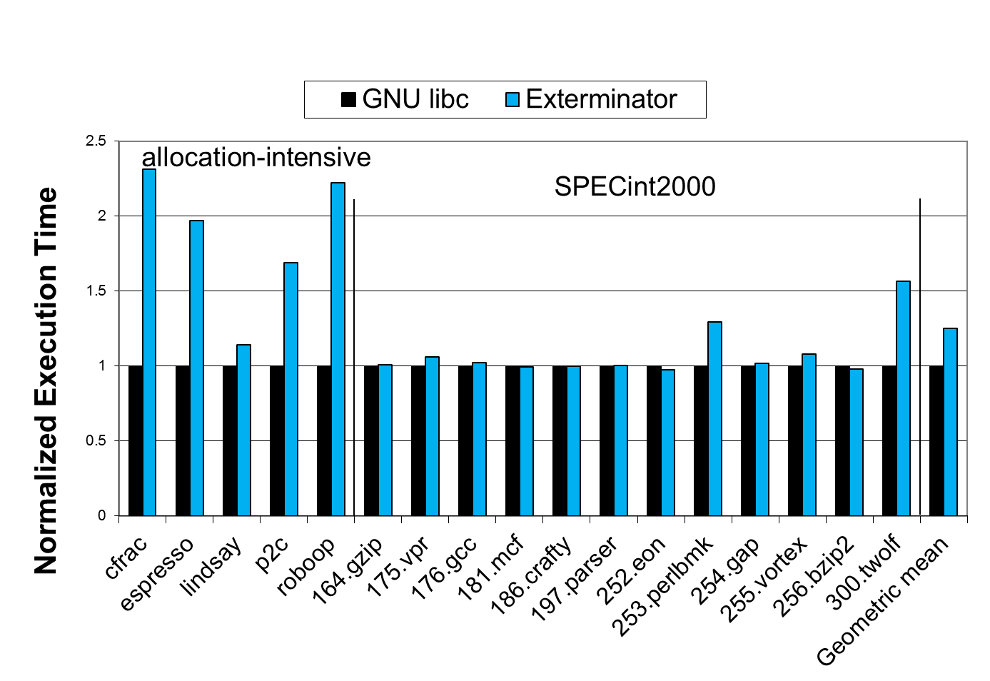
Of Course, Performance Matters
Ben Zorn CGO 2010 Keynote

Slide 22
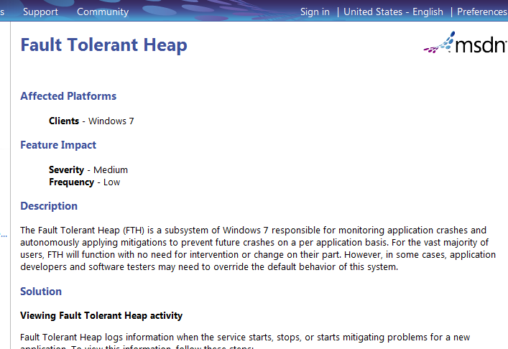
DieHard Impact
DieHard (non-replicated)
  Windows, Linux version implemented by Emery Berger
  Works in FireFox distribution without any changes
  Try it right now! (http://www.diehard-software.org/)
RobustHeap
  Microsoft internal version implemented by Ted Hart
  Prototyped in Microsoft products
  Demonstrated to tolerate faults and detect errors
Windows 7 Fault Tolerant Heap (FTH)
  Inspired by ideas from DieHard/Robustheap
  Turns on when application crashes
Ben Zorn CGO 2010 Keynote

Slide 23

A Benefit of Working at Microsoft…
One day I was trying to convince a security team that DieHard would improve security…
They said “What about heap spraying?”
And I said “What’s that?” (long pause)
And they said “Look it up…”
Ben Zorn CGO 2010 Keynote

Slide 24
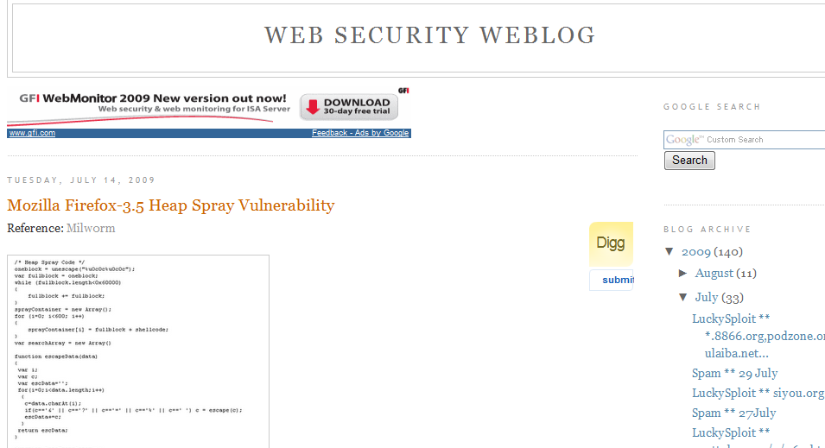
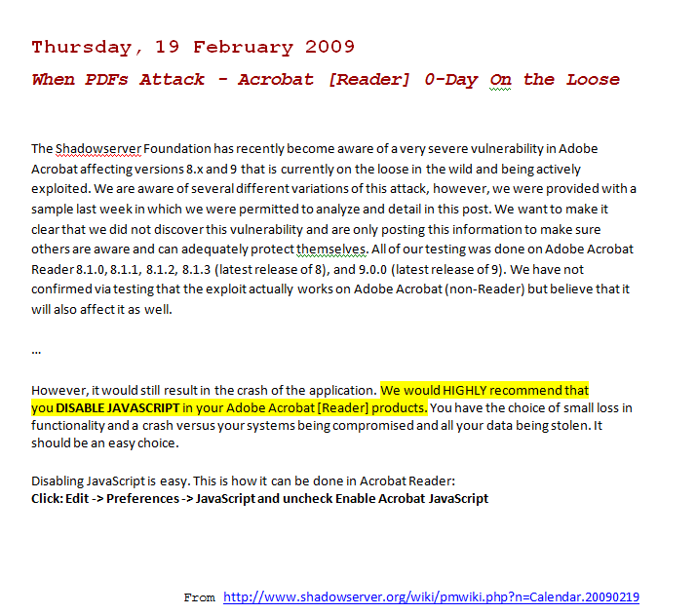
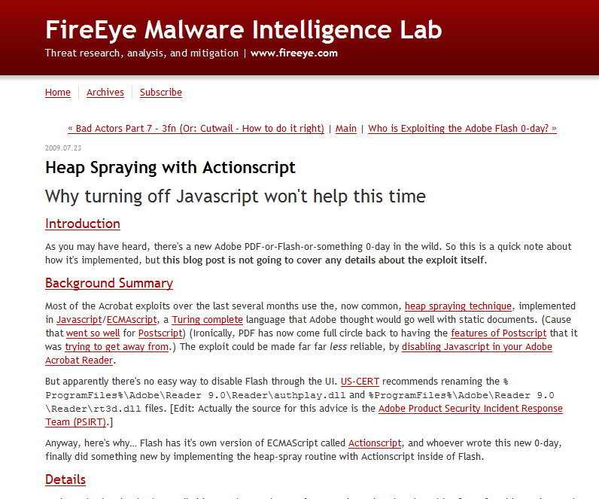
Here’s What I Found…
http://www.web2secure.com/2009/07/mozilla-firefox-35-heap-spray.html
Common Element:
All vulnerable applications support
embedded scripting languages
(JavaScript, ActionScript, etc.)
Flash
July 23, 2009
Firefox 3.5
July 14, 2009
Adobe Acrobat / Reader
February 19, 2009
Ben Zorn CGO 2010 Keynote
http://blog.fireeye.com/research/2009/07/actionscript_heap_spray.html
Adobe Acrobat/Reader
July 23, 2009

Slide 25



Drive-By Heap Spraying
Owned!
Ben Zorn CGO 2010 Keynote

Slide 26
Drive-By Heap Spraying (2)
ASLR prevents the attack
Program Heap
ok
bad
PC
Creates the malicious object
ok
<HTML>
<SCRIPT language="text/javascript">
shellcode = unescape("%u4343%u4343%...'');
</SCRIPT>
<IFRAME SRC=file://BBBBBBBBBBBBBBBBBBBBBBBBBBBBBBBBBB … NAME="CCCCCCCCCCCCCCCCCCCCCCCCCCCCCCCCCCCCCCCC …
&#3341;&#3341;">
</IFRAME>
</HTML>
Triggers the jump
Ben Zorn CGO 2010 Keynote

Slide 27
Drive-By Heap Spraying (3)
Program Heap
ok
bad
bad
bad
bad
bad
ok
bad
<SCRIPT language="text/javascript">
shellcode = unescape("%u4343%u4343%...'');
oneblock = unescape("%u0C0C%u0C0C");
var fullblock = oneblock;
while (fullblock.length<0x40000) {
fullblock += fullblock;
}
sprayContainer = new Array();
for (i=0; i<1000; i++) {
sprayContainer[i] = fullblock + shellcode;
}
</SCRIPT>
Allocate 1000s of malicious objects
Ben Zorn CGO 2010 Keynote

Slide 28
Nozzle – Detecting Heap Spraying
Joint work with Paruj Ratanaworabhan (Kasetsart University) and Ben Livshits (Microsoft Research)
Insight:
  Spraying creates many objects with malicious content
  That gives the heap unique, recognizable characteristics
Approach:
  Dynamically scan objects to estimate overall malicious content
Ben Zorn CGO 2010 Keynote

Slide 29
Nozzle: Classifying Malicious Objects
Application Threads
Nozzle Threads
Repeat
scan object and classify
create
object
benign
object
new object
suspect
object
suspect
object
suspect
object
benign
object
benign
object
benign
object
Application Heap
Ben Zorn CGO 2010 Keynote
Notes:
Runtime monitor
Assumes objects are code
and classifies
- Tracks current state of heap

Slide 30
Local Malicious Object Detection
Is this object dangerous?
Code or Data?
NOP sled
000000000000000000000000000000000000000000000000000000000000000000000000
000000000000
add [eax], al
add [eax], al
add [eax], al
add [eax], al
add [eax], al
add [eax], al
add [eax], al
Is this object code?
  Code and data look the same on x86
Focus on sled detection
  Majority of object is sled
  Spraying scripts build simple sleds
Is this code a NOP sled?
  Previous techniques do not look at heap
  Many heap objects look like NOP sleds
  80% false positive rates using previous techniques
Need stronger local techniques
0101010101
0101010101
0101010101
0101010101
0101010101
0101010101
0101010101
and ah, [edx]
and ah, [edx]
and ah, [edx]
and ah, [edx]
and ah, [edx]
and ah, [edx]
and ah, [edx]
shellcode
Ben Zorn CGO 2010 Keynote

Slide 31
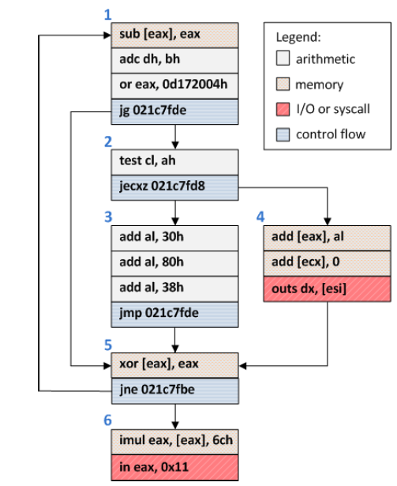
Object Surface Area Calculation
Assume: attacker wants to reach shell code from jump to any point in object
Goal: find blocks that are likely to be reached via control flow
Strategy: use dataflow analysis to compute “surface area” of each block
An example object from visiting google.com
Ben Zorn CGO 2010 Keynote

Slide 32
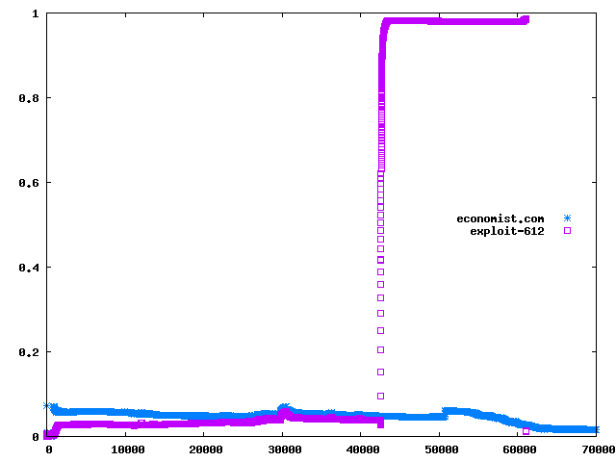
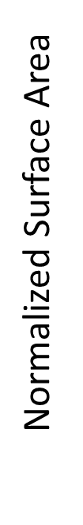
Nozzle Effectiveness
Application: Web Browser
Malicious Page
Normal Page
Logical time (number of allocations/frees)
Ben Zorn CGO 2010 Keynote

Slide 33
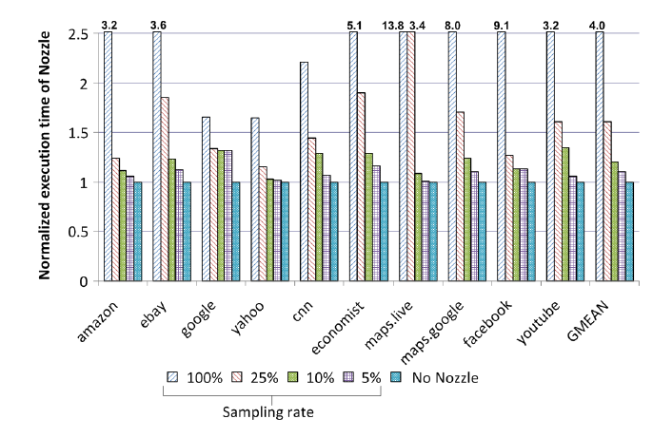
Nozzle Performance
Ben Zorn CGO 2010 Keynote

Slide 34
So, Performance is Dead…
How far can defect detection and runtime toleration go?
How much
headroom is left
for improvement?
100
Static analysis,
verification
DART, safe languages,
etc.
% All “Critical” Defects Detected
50
Testing automation,
fuzzing, extreme
programming…
Future challenges:
Diminishing returns
Scaling verification
3rd-party library code
Performance implications
Testing, code reviews
0
1970
1980
1990
2000
2010
Ben Zorn CGO 2010 Keynote

Slide 35
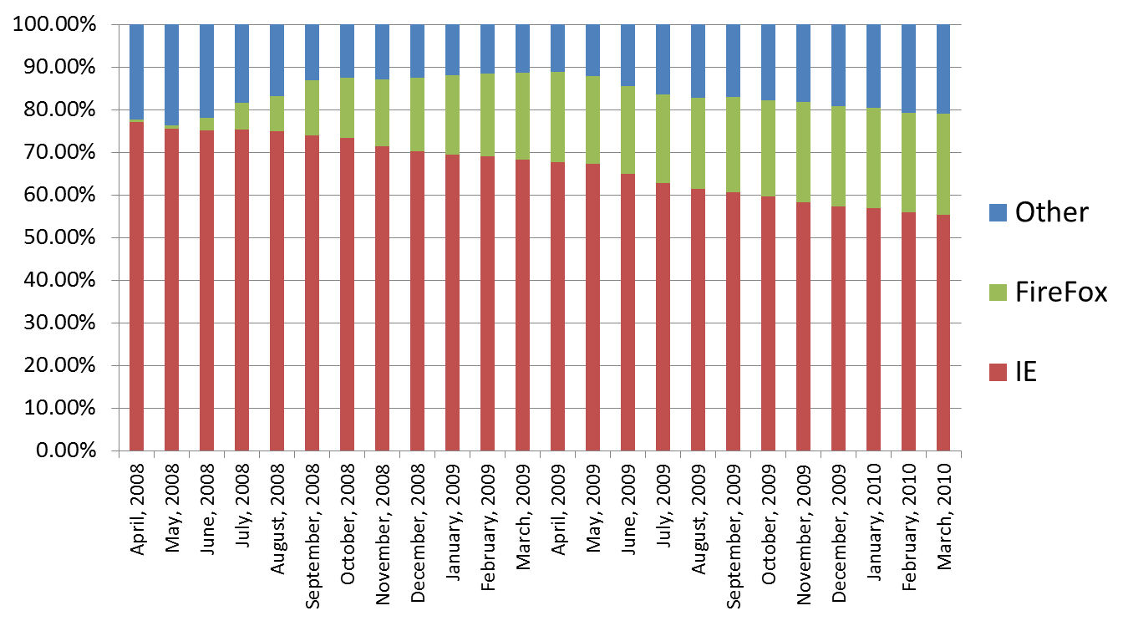
What’s Happening Here?
Browser Market Share Trends
Can we explain this?
Security?
Reliability?
Features?
Performance!
Source: http://marketshare.hitslink.com/
Ben Zorn CGO 2010 Keynote

Slide 36
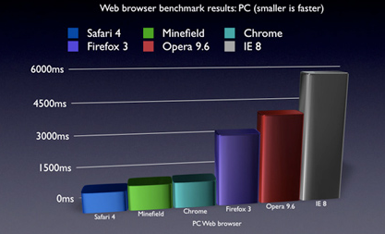
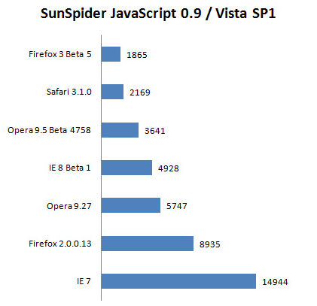
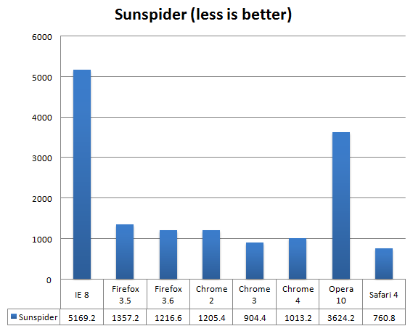
Long Live Performance!
“Safari dominates browser benchmarks”
“Browser faceoff: IE vs Firefox vs Opera vs Safari”
“Browser Wars: Ultimate Browser Benchmark…”
Performance can make or break a platform
http://news.zdnet.com/2100-9595_22-272792.html
Kai Schmerer, ZDNet Germany on May 29th, 2008
http://www.favbrowser.com/chrome-vs-opera-vs-firefox-vs-internet-explorer-vs-safari/
Ben Zorn CGO 2010 Keynote

Slide 37
One Word:
Standard for scripting web applications
Fast JITs widely available
JavaScript
Lots of code present
in all major web sites
Support in every browser
Ben Zorn CGO 2010 Keynote

Slide 38


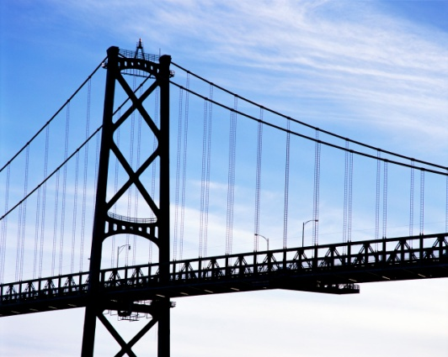







Understanding JavaScript Behavior
With Paruj Ratanaworabhan and Ben Livshits
Benchmarks
Real apps
JSMeter
7 V8 programs:
richards
deltablue
crypto
raytrace
earley-boyer
regexp
splay
8 SunSpider programs:
3-draytrace
access-nbody
bitops-nsieve
controlflow
crypto-aes
date-xparb
math-cordic
string-tagcloud
Maps
Maps
Goal: Measure JavaScript in real web applications
Approach: Instrument IE runtime
Ben Zorn CGO 2010 Keynote

Slide 39
JSMeter Project
Joint work with Paruj Ratanaworabhan (Kasetsart University) and Ben Livshits (Microsoft Research)
Goal: Measure the behavior of JavaScript in real web applications
  Determine if benchmarks are representatative
  Understand the behavior we are optimizing for
Approach: instrument IE runtime
Ben Zorn CGO 2010 Keynote

Slide 40
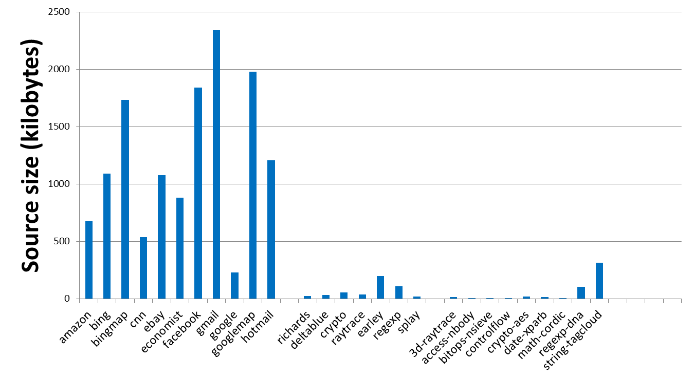
Real Apps are Much Bigger
Gmail delivers more than 2 megabytes of source code to your browser
Real apps
Benchmarks
Ben Zorn CGO 2010 Keynote

Slide 41
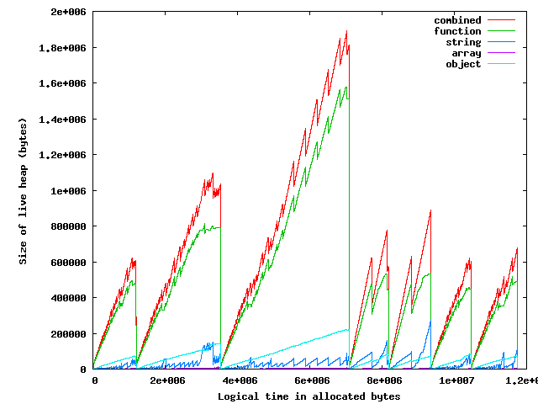
Real Apps have Interesting Behavior:
Live Heap over Time (eBay)
Heap contains
mostly functions
Heaps
repeatedly
created, then
discarded
Ben Zorn CGO 2010 Keynote

Slide 42
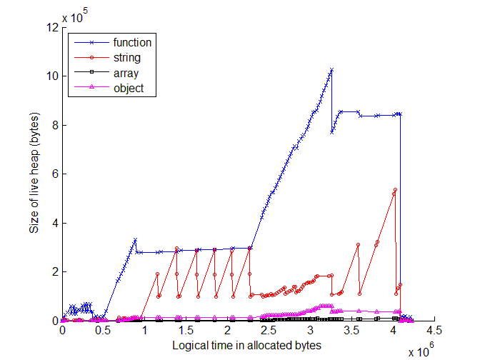
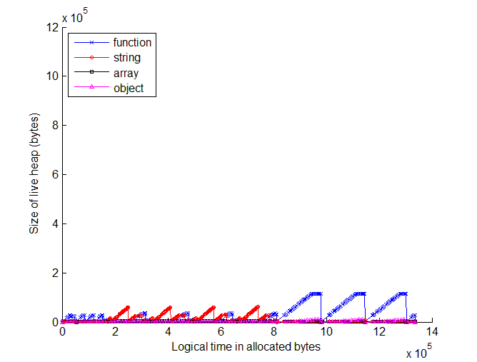
Real Apps have Different Architectures
Code|Objects|Events
You stay on the same page
during your entire visit
Code loaded once
Heap is bigger
Every transition loads a
new page
Code loaded repeatedly
Heap is smaller
Bing
(Web 2.0)
Google
(Web 1.0)
Ben Zorn CGO 2010 Keynote

Slide 43
The Next 10 Years
Reliability
“Good enough” = cheap
Energy
Concurrency
Ben Zorn CGO 2010 Keynote

Slide 44
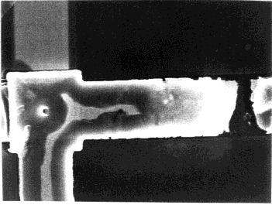
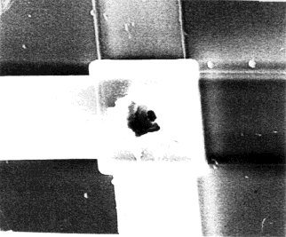

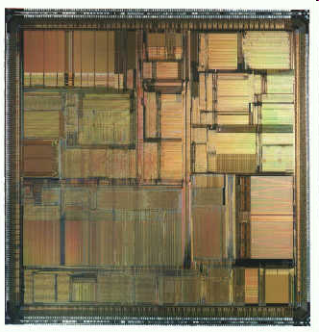
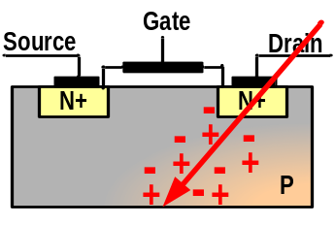
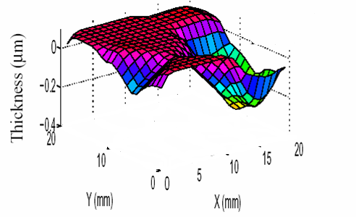
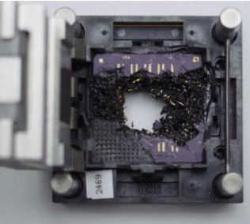
Reliability Threats
H/W and S/W
Design Errors
(Bugs are expensive and
expose security holes)
Transient Faults due to
Cosmic Rays & Alpha Particles
(Increase exponentially with
number of devices on chip)
Silicon Defects
(Manufacturing defects and
device wear-out)
Parametric Variability
(Uncertainty in device and environment)
Manufacturing Defects
That Escape Testing
(Inefficient Burn-in Testing)
Intra-die variations in ILD thickness
Increased Heating
Thermal
Runaway
Higher
Power
Dissipation
Higher
Transistor
Leakage
Ben Zorn CGO 2010 Keynote
Slide courtesy of Todd Austin “Reliable Processor Research @ Umich”

Slide 45




The “Good Enough” Revolution
Source: WIRED Magazine (Sep 2009) – Robert Kapps
Observation: People prefer “cheap and good enough” over “costly and near-perfect”
Examples: Flip video cameras, Skype, etc.
Conclusion:
  Engineer for imperfect result at low cost
Projects: Green (Chilimbi, MSR), Perforation (Rindard, MIT), Flicker (Pattabiraman, UBC)
Ben Zorn CGO 2010 Keynote

Slide 46
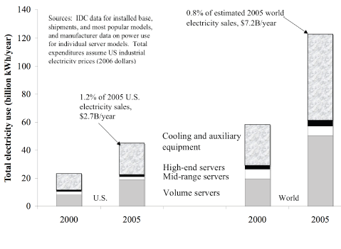
Energy
0.8% of 2005 world
electricity sales
Coo
Total Electricity Use (billions kWh/year)
1.2% of 2005 US
electricity sales
Cooling and auxiliary
equipment
High-end servers
Mid-range servers
Volume servers
US
World
“Estimating Total Power Consumption by Servers in the U.S. and the World”, Jonathan G. Koomey, LBL Report, Feb. 2007
Ben Zorn CGO 2010 Keynote

Slide 47
Conclusions
Performance was and continues to be critical
  Correctness and security neglected until 2000s
What is being optimized changes
  Energy usage
  Concurrency
  Cost effectiveness
  Constrained devices
Improvements in next 10 years harder
  Proebsting’s Law: Accurate? Acceptable?
Ben Zorn CGO 2010 Keynote

Slide 48
Acknowledgements
CGO Organizers (especially Kim Hazelwood and David Kaeli)
Todd Austin, U. Michigan
Alex David, Deborah Robinson – Microsoft
Mark Horowitz, Ofer Shacham – Stanford
CJ Newburn, Shubu Mukherjee – Intel
Karthik Pattabiraman – UBC
DBLP Computer Science Bibliography – Universität Trier
Ben Zorn CGO 2010 Keynote

Slide 49
Questions?
Ben Zorn CGO 2010 Keynote

